Slide 1
Blue Waters Petascale Semester Curriculum v1.0 Unit 4: OpenMP Lesson 4: OpenMP Target Offload Developed by Maria Pantoja for the Shodor Education Foundation, Inc.

Slide 2
Except where otherwise noted, this work by The Shodor Education Foundation, Inc. is licensed under CC BY-SA 4.0. To view a copy of this license, visit https://creativecommons.org/licenses/by-sa/4.0 Browse and search the full curriculum at http://shodor.org/petascale/materials/semester-curriculum We welcome your improvements! You can submit your proposed changes to this material and the rest of the curriculum in our GitHub repository at https://github.com/shodor-education/petascale-semester-curriculum We want to hear from you! Please let us know your experiences using this material by sending email to petascale@shodor.org

Slide 3
OpenMP 4.5 Target Pragma

Slide 4
Learning Objectives
Explain OpenMP pragma target
IDENTIFY which loops are parallelizable with this pragma
COMPARE sequential to GPU accelerated execution times
Apply pragma target to accelerate scientific code example
Poisson Equation

Slide 5
Expected Time of the Activity:
Lesson Approximate Timing
Pragma Target Introduction clauses: 10 min
Example: 15 min
Total time for the lesson: 25 minutes

Slide 6
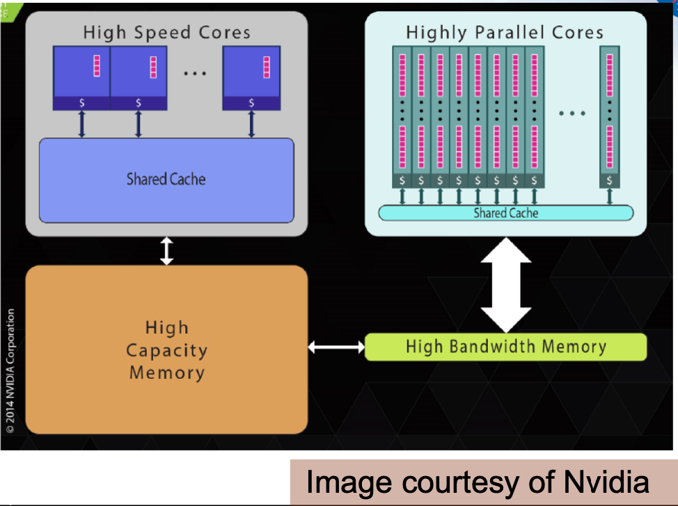
#pragma omp target
Introduced in OpenMP 4.5 Standard to Program Heterogeneous Systems
Heterogeneous System: A general purpose CPU connected to an accelerator device
Example: Intel CPU connected to a Nvidia GPU
Programming Steps:
Identify the device to offload the computations to
Copy Data from Host CPU to Device Memory
CPU initializes execution of the code (loop or task function) on the device
Device executes the function
Data is copy back from the device to the host CPU

Slide 7
#pragma omp target
Creates a device data environment for the code region
The marked code region is mapped to the device and executed
Host
(CPU)
Device
(GPU)
1. Map(to: a[0:N])
2. #pragma omp target
for(int i=0; i<N;i++)
y[i]=a*x[i];
3. Map(from: y[0:N])

Slide 8
#pragma omp target clauses:
#pragma omp target teams
A league of threads teams is created
The master thread of each team executes the code region
#pragma omp target teams distribute
Share work across the teams
#pragma omp target map(map-type:list)
Map a variable to/from the device data environment
to (list) allocates memory on the device and copies data in when entering the region, the values are not copied back
from(list) allocates memory on the device and copies the data to the host when exiting the region
alloc(list) allocates memory on the device. If the data is already present on the device a reference counter is incremented
Complete set of clauses and examples on OpenMP 4.5 samples

Slide 9
#pragma omp target teams distribute
#pragma omp target map(to:x[0:N]), map(y[0:N])
{
#pragma omp teams num_teams(N), thread_limit(M)
//some sequential CPU code
//pragma omp distribute parallel for
for(int i=0; i<N;i++)
y[i]=a*x[i];
//some more sequential CPU code
}
Host (CPU) 1 Thread per core
…
Device (GPU) CUDA Block 1 master Thread
…
…
…
Device (GPU) CUDA Block
Host (CPU) 1 Thread per core

Slide 10
Example: 2D Laplace Solver Sequential code
While(error > tol && iter <iter_max){
error=0.0;
for(int j=1; j<n-1;j++){
for(int i=1;i<m-1;i++){
Anew[j][i]=0.25(A[j][i+1]+A[j][i-1]+A[j-1][i]+A[j+1][i]);
error=fmax(error,fabs(Anew[j][i]-A[j]i]));
}
}
for(int j=1; j<n-1;j++){
for(int i=1;i<m-1;i++){
A[j][i]=Anew[j][i];
}
}
}
1. This loop controls the number of times we calculate the stencil code in the next loops.
To calculate stencil at Anew at iteration t1 we need the values at iteration t0; so there is a clear loop dependency here.
2. Loop calculates for each element of array[row][col] a weighted average with the neighbors to north, south, east, and west
Then calculates the error
3. Copy Anew into A

Slide 11
Example: 2D Laplace Solver
#pragma omp target data map(to:Anew) map(A)
While(error > tol && iter <iter_max){
error=0.0;
#pragma omp target teams distribute parallel for reduction(max:error) map(error) collapse(2)
for(int j=1; j<n-1;j++){
for(int i=1;i<m-1;i++){
Anew[j][i]=0.25(A[j][i+1]+A[j][i-1]+A[j-1][i]+A[j+1][i]);
error=fmax(error,fabs(Anew[j][i]-A[j]i]));
}
}
#pragma omp target teams distribute parallel for collapse(2)
for(int j=1; j<n-1;j++){
for(int i=1;i<m-1;i++){
A[j][i]=Anew[j][i];
}
}
}

Slide 12
Compiling Code
Need compiler version that supports OpenMP 4.5 pragma target
OpenMP:
gcc-5 supports offload to MIC (Xeon Phi)
gcc-7 supports offload to NVIDIA-PTX and AMD HSAIL
gcc-above adds more platforms to be offload
Configure the host compiler and device compiler to support offload pragma. Follow instructions from either of the following if compiler is gcc/g++:
1 OpenMP offload
2 Building GCC with support for Nvidia ptx
3 First Steps with OpenMP 4.5 on Ubuntu and Nvidia GPUs

Slide 13
Compiling Code
Compile as:
gcc –O3 –fopenmp –foffload=nvptx-none –foffload=“-lm” –Wall
–o solver solver.c
Execution time:
~4x sequential code

Slide 14
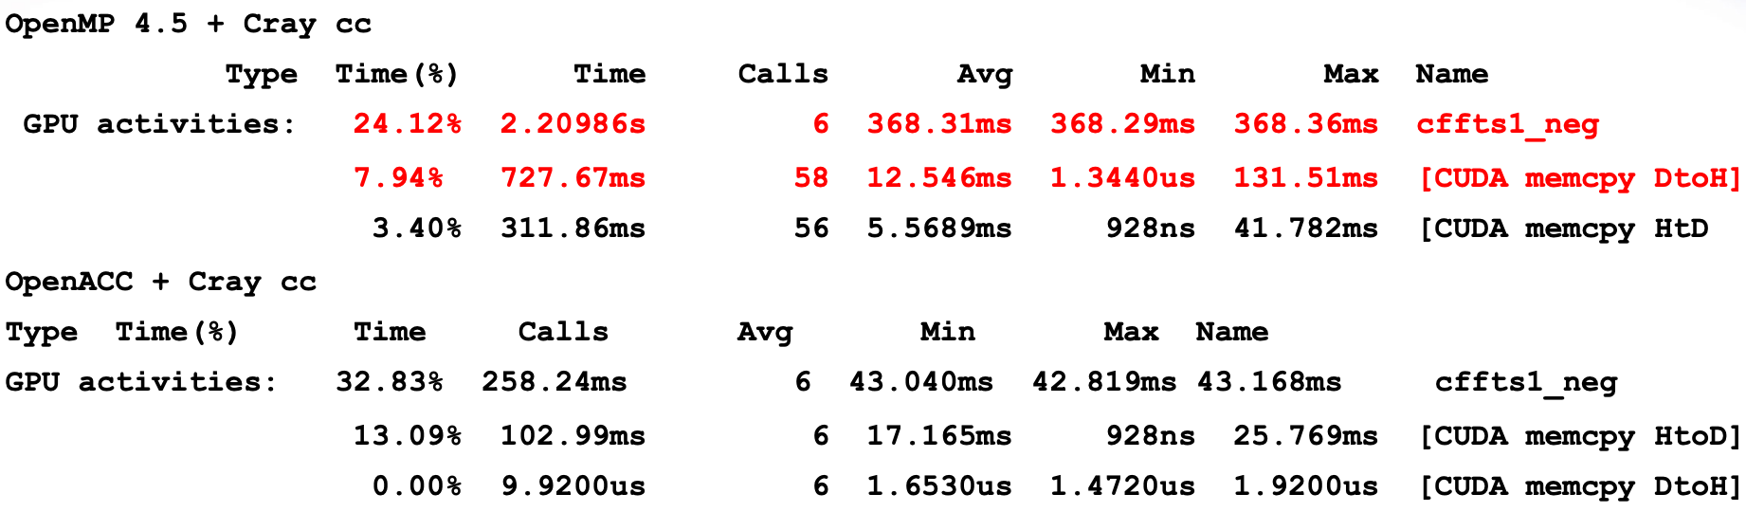
OpenMP Target offload vs OpenACC
Both directive based methods for programming “accelerators”
Performance differences due to compiler support, not to a lack of functionality in OpenMP 4.5
Full data Link (courtesy NASA): OpenMP 4.5

Slide 15
Conclusion
OpenMP 4.5 target offload did not lack a feature/functionality when compared with OpenACC
OpenMP 4.5 employs existing functionality for accelerator execution, if possible, e. g. “parallel for”, and “simd”
Compiler support for OpenMP would definitely benefit from further improvement
OpenMP offload support is getting increasingly stable

Slide 16
Student Activity
Ask Students to implement the complete Laplace Solver
Using OpenMP parallel for pragma
Using OpenMP target teams distribute for pragma
Compare the results

