Slide 1
Blue Waters Petascale Semester Curriculum v1.0 Unit 5: MPI Lesson 8: N-Body Mechanics in MPI Developed by Justin Oelgoetz for the Shodor Education Foundation, Inc.

Slide 2
Except where otherwise noted, this work by The Shodor Education Foundation, Inc. is licensed under CC BY-SA 4.0. To view a copy of this license, visit https://creativecommons.org/licenses/by-sa/4.0 Browse and search the full curriculum at http://shodor.org/petascale/materials/semester-curriculum We welcome your improvements! You can submit your proposed changes to this material and the rest of the curriculum in our GitHub repository at https://github.com/shodor-education/petascale-semester-curriculum We want to hear from you! Please let us know your experiences using this material by sending email to petascale@shodor.org

Slide 3
A simple N-Body Problem Parallelized with MPI

Slide 4
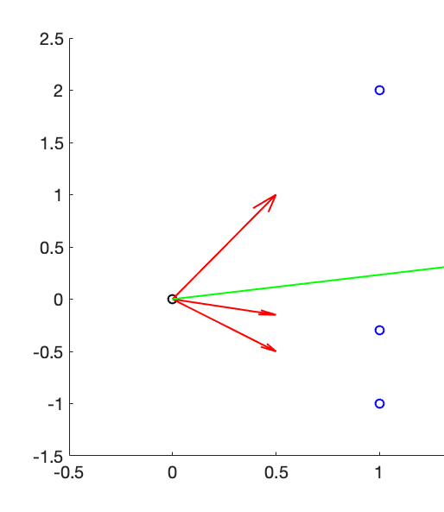

What is the N-body problem

Slide 5

Newtonian Mechanics
.

Slide 6

Newtonian Gravity

Slide 7

Deriving Verlet’s Method (1/2)

Slide 8

Deriving Verlet’s Method (2/2)

Slide 9

Writing the vectors using components

Slide 10

There is a problem however

Slide 11
The Algorithm
Load initial conditions
(Calculate Accelerations) Loop i over the body index form 1 to Nbodies
Loop j over the body index from 1 to Nbodies
Calculate force between object i and j
Add force into the sum of the force on object i
(Calculate Next Position - Taylor) Loop over the body index from 1 to Nbodies
Calculate a second set of x, y, & z coorindates Δt in the future (the next time step) using the previous Taylor series expansion
Loop from time step 2 until the final time index (Ntimes)
(Calculate Accelerations) Loop i over the body index form 1 to Nbodies
Loop j over the body index from 1 to Nbodies
Calculate force between object i and j
Add force into the sum of the force on object i
(Calculate Next Position - Verlet) Loop over the body index from 1 to Nbodies
Calculate the next set of x, y, & z coordinates using Verlet’s method

Slide 12
How to Parallelize?

Slide 13
Strengths of MPI
MPI works by passing messages back and forth between executables
The various instances do not need to share the same physical memory
MPI can allow us to expand our problem beyond the capabilities (physical memory) of one node

Slide 14
MPI at the beginning
int numprocs, rank;
// For storing x, y, & z positions of all
// the particles across all processor
// at a given time
double *gx,*gy,*gz;
gx=new double[GlobalNbodies];
gy=new double[GlobalNbodies];
gz=new double[GlobalNbodies];
MPI_Init(NULL, NULL);
// Get the number of processes/rank
MPI_Comm_size(MPI_COMM_WORLD,&numprocs);
MPI_Comm_rank(MPI_COMM_WORLD, &rank);
// Check to make sure GlobalNbodies is divisible by
// numprocs – loops will fail if not!
if (GlobalNbodies%numprocs){
cerr << "GlobalNbodies not divisible by num of processors!!!\n";
return(GlobalNbodies%numprocs);}
// Setting Nbodies like this allows us to use the serial main body largely intact
Need to set up the environment
Each processor determines how many processors there are and its individual rank
Also need to allocate gx, gy & gz as they will store all of the x, y & z coordinates at a given time index.
We want to allocate here, once in main()
We do not want to allocate with every call to accelerations()
We also need to check the total number of bodies is divisible by the number of processes – if not some bodies might be missed in loops due to integer rounding!

Slide 15
MPI in acceleration()
void acceleration(double x[], double y[],
double z[], int itime, int Nbodies,
double mass, double ax[],
double ay[],double az[], double gx[],
double gy[], double gz[],int numprocs,
int rank) {
// < . . . Snip . . .>
// MPI STUFF
// We need each processor to have a complete copy of all the positions these three lines will accomplish that
ibody1=0;
MPI_Allgather(&x[index(itime,ibody1,
Nbodies)], Nbodies, MPI_DOUBLE, gx,
Nbodies, MPI_DOUBLE,
MPI_COMM_WORLD );
MPI_Allgather(&y[index(itime,ibody1,
Nbodies)], Nbodies, MPI_DOUBLE, gy,
Nbodies, MPI_DOUBLE,
MPI_COMM_WORLD );
MPI_Allgather(&z[index(itime,ibody1,
Nbodies)], Nbodies, MPI_DOUBLE, gz,
Nbodies, MPI_DOUBLE,
MPI_COMM_WORLD );
As gx, gy, and gz (our arrays to hold all the x, y, and z coordinates at a particular time step) are allocated outside this function in the main code they need passed
Collective communication (MPI_Allgather) is used to communicate the positions stored on each node, to every other node

Slide 16
MPI in acceleration()
for(ibody1=0;ibody1<Nbodies;ibody1++) {
dx=x[index(itime,ibody1,Nbodies)];
dy=y[index(itime,ibody1,Nbodies)];
dz=z[index(itime,ibody1,Nbodies)];
r=sqrt(dx*dx+dy*dy+dz*dz)+1.0e8;
// 1.0e8 is to soften the potential, prevent
// "explosions"
F=(G*10*mass*Nbodies*numprocs/(r*r*r));
// a central mass/star/something with the
// 10x mass as the system
ax[ibody1]=-F*dx;
ay[ibody1]=-F*dy;
az[ibody1]=-F*dz;
for (ibody2=0;ibody2<Nbodies*rank+ibody1-1;
ibody2++) {
dx=x[index(itime,ibody1,Nbodies)]-gx[ibody2];
dy=y[index(itime,ibody1,Nbodies)]-gy[ibody2];
dz=z[index(itime,ibody1,Nbodies)]-gz[ibody2];
r=sqrt(dx*dx+dy*dy+dz*dz)+1.0e8;
// 1.0e8 is to soften the potential, prevent
// "explosions"
F=(G*mass/(r*r*r));
ax[ibody1]-=F*dx;
ay[ibody1]-=F*dy;
az[ibody1]-=F*dz;}
for (ibody2=Nbodies*rank+ibody1+1;
ibody2<Nbodies*numprocs;ibody2++) {
< . . . Snip . . .>
Instead of looping over just the Nbodies stored on the system, we need one of the loops to loop over all the bodes, stored on all the systems.
The inner loops were chosen as that results in the fewest code changes
gx, gy, and gz need to be substituted for x, y, and z in the corresponding particle
Additionally the equation for the force due to the center mass need to change slightly as well.

Slide 17
MPI IO
MPI_File mpifilex, mpifiley, mpifilez;
MPI_Status status;
MPI_Offset offset;
MPI_File_open(MPI_COMM_WORLD,"x.bin", MPI_MODE_CREATE | MPI_MODE_WRONLY,
MPI_INFO_NULL,&mpifilex);
MPI_File_open(MPI_COMM_WORLD,"y.bin",
MPI_MODE_CREATE | MPI_MODE_WRONLY,
MPI_INFO_NULL,&mpifiley);
MPI_File_open(MPI_COMM_WORLD,"z.bin",
MPI_MODE_CREATE | MPI_MODE_WRONLY,
MPI_INFO_NULL,&mpifilez);
for (itime=0; itime<Ntime;itime++){
offset=sizeof(tempr)*
(itime*GlobalNbodies+rank*Nbodies);
MPI_File_write_at_all(mpifilex,offset,&x[itime*Nbodies],
Nbodies,MPI_DOUBLE,&status);
MPI_File_write_at_all(mpifiley,offset,&y[itime*Nbodies],
Nbodies,MPI_DOUBLE,&status);
MPI_File_write_at_all(mpifilez,offset,&z[itime*Nbodies],
Nbodies,MPI_DOUBLE,&status); }
MPI_File_close(&mpifilex);
MPI_File_close(&mpifiley);
MPI_File_close(&mpifilez);
First we need to open the files.
We are instructing the call to MPI_File_open to create the file if needed, and to open it write only.
Note the or “|” between the status variables
The serial code writes the arrays out to binary files
In order to maintain compatibility, we are using the collective call MPI_File_write_at_all to write to the file
Not it needs not only what is to be written, but also an offset in bytes so it knows where each process should write to.
MPI collective IO routines avoid unnecessary communication to a central process which then does the write.

Slide 18
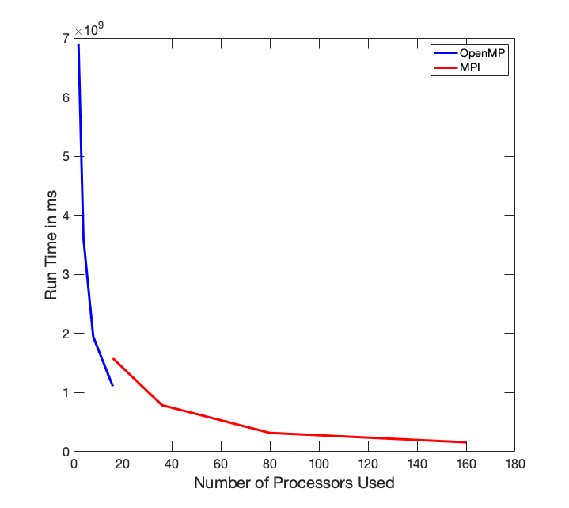
Runtime as a function of the number of processors
We have included an OpenMP version (same as in the N-body OpenMP lesson) for comparison.
Note that at 16 processors, the OpenMP code is about 30% faster! Communication takes time – shared memory is faster (this is why people write MPI/OpenMP Hybrid codes, to get the best of both!)
MPI does allows us to expand significantly beyond the limitations of a single node – large SMP nodes get very expensive, quickly, thus most machines only have limited SMP ability

Slide 19
Can we do more?
Yes, but we’d need to move away from the way we are storing positions and calculating accelerations.
One of the options is the Barnes-Hut algorithm which stores the positions in an octree which allows one to easily treat collections of distant objects as a single object with their combined mass at their center of mass.
Another is solving for the gravitational potential (using for instance a spectral method) at each time step and calculating the forces based on that potential.
Both approaches are beyond the scope of this lesson
If you’d like to know more, check out the GalaxSee HPC modules at
http://shodor.org/petascale/materials/UPModules/NBody/
http://shodor.org/petascale/materials/UPModules/NBodyScaling/

Slide 20
Additional Suggested Exercises
If a problem gets too small, it will stop scaling earlier. Take the existing MPI code, how does it scale for a problem that is only 1/10th the size (total number of bodies)
How does the code scale for a problem 10 times larger?
Rewrite the IO section such that all the data for a particular time is gathered to process 0 and then written with the usual C++ fwrite command. Is the IO faster or slower than MPI collective routines? By how much?

