Slide 1
Blue Waters Petascale Semester Curriculum v1.0 Unit 7: CUDA Lesson 3: Graphics Interop with OpenGL Developed by Michael D. Shah for the Shodor Education Foundation, Inc.

Slide 2
Except where otherwise noted, this work by The Shodor Education Foundation, Inc. is licensed under CC BY-SA 4.0. To view a copy of this license, visit https://creativecommons.org/licenses/by-sa/4.0 Browse and search the full curriculum at http://shodor.org/petascale/materials/semester-curriculum We welcome your improvements! You can submit your proposed changes to this material and the rest of the curriculum in our GitHub repository at https://github.com/shodor-education/petascale-semester-curriculum We want to hear from you! Please let us know your experiences using this material by sending email to petascale@shodor.org

Slide 3
Graphics Interop with OpenGL

Slide 4
Interoperability on the GPU
Interoperability is the ability of a computer system to exchange and make use of information.
In this lesson we are going to look at interoperability on the GPU within a graphics application

Slide 5
GPU APIs
There are many ways to utilize our GPU
This series is about using CUDA for general purpose computation on the GPU
However, another popular API is in the domain of Graphics: OpenGL
OpenGL is a graphics specific API implemented by companies like NVidia, AMD, and Intel to create graphics applications (e.g. games or visualizations)
So using the OpenGL API, this is another way to ‘ship’ data to the GPU.
Often times however, it can be nice to manipulate that data using CUDA as well.

Slide 6
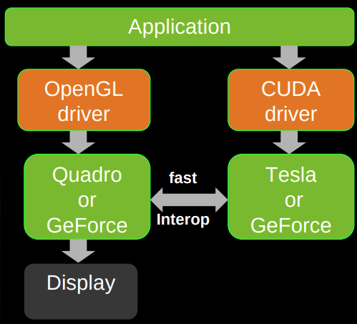
CUDA and OpenGL interop (1/2)
To the right is a diagram showing the basic idea
Our application can be using OpenGL and CUDA
And at some point the information that is transferred to our graphic card (or multiple graphic cards) can talk to each other and access information sent from each of the APIS
Then finally the display is sent to the user.
https://on-demand.gputechconf.com/gtc/2010/presentations/S12310-OpenGL-Pre-Conference-Tutorial.pdf

Slide 7
CUDA and OpenGL interop (2/2)
Our goal is going to be to build a graphics application that:
Uses OpenGL for rendering
Uses CUDA for general purpose calculations on the GPU
https://on-demand.gputechconf.com/gtc/2010/presentations/S12310-OpenGL-Pre-Conference-Tutorial.pdf

Slide 8
CUDA + OpenGL
Sometimes it’s a bit unclear why we cannot use either API to do both.
Remember however that each was designed for a specific purpose.
CUDA excels at performing calculations, generating data, and doing other image manipulation tasks (e.g. our gray_scale filter where we can actually change values and preserver those changes in memory)
OpenGL excels at drawing pixels and vertices, and rendering geometry (i.e. rasterizing) very fast

Slide 9
CUDA + OpenGL
CUDA uses the functions we have been learning to perform memory management (cudaMalloc)
OpenGL uses generic buffers (index buffer objects, vertex buffer objects, pixel buffer objects) to store data
CUDA + OpenGL talk using a few interop functions
Map and UnMap in order to move OpenGL buffers into CUDA’s memory space on the GPU

Slide 10
Our Application
Our Goal: To render a shape to the screen using OpenGL, and manipulate (i.e. do the computation) on CUDA.
Now this sounds like a BIG problem, so let’s break it into smaller pieces. There are a lot of moving parts

Slide 11
Breakdown
Let’s break our BIG problem down into some smaller steps:
We need to create a window and perform some general setup
For this we will use SDL2
You could use other tools like freeglut for instance.
We need to enable OpenGL and create an object
We need to create a CUDA kernel that does something interesting to that geometry

Slide 12
Windowing
SDL2

Slide 13
OpenGL Setup

Slide 14
CUDA Setup

Slide 15
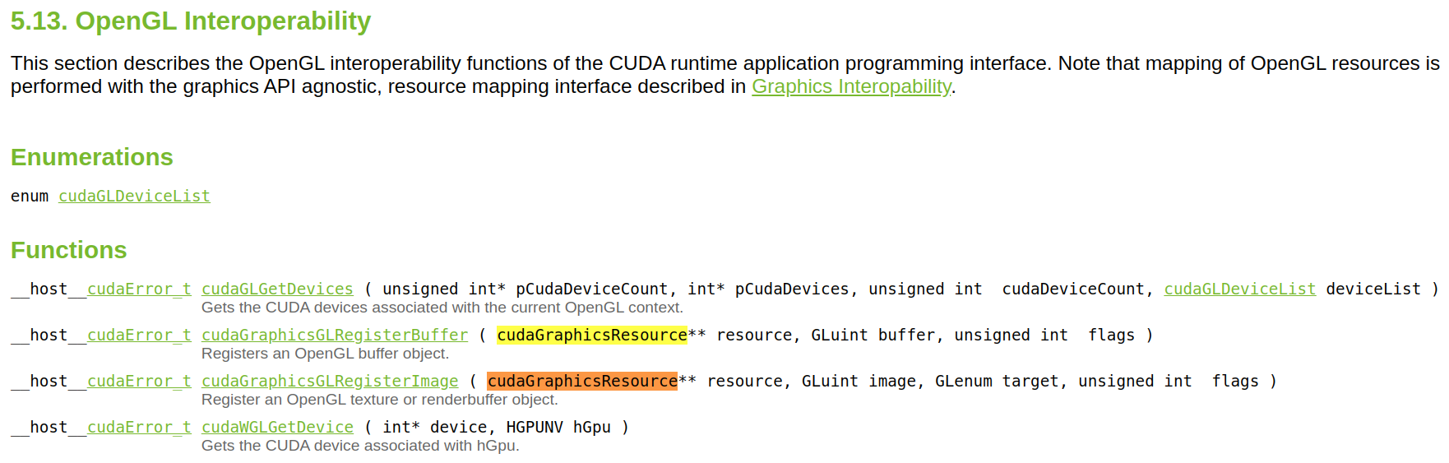
OpenGL Interoperability with CUDA
CUDA provides the following documentation for OpenGL Interoperability which we can refer to as a guide
https://docs.nvidia.com/cuda/cuda-runtime-api/group__CUDART__OPENGL.html

