Slide 1
Blue Waters Petascale Semester Curriculum v1.0
Unit 8: OpenACC
Lesson 1: Accelerating Scientific Applications
Developed by R. Phillip Bording for the Shodor Education Foundation, Inc.

Slide 2
Except where otherwise noted, this work by
The Shodor Education Foundation, Inc. is licensed under
CC BY-SA 4.0. To view a copy of this license, visit https://creativecommons.org/licenses/by-sa/4.0
Browse and search the full curriculum at http://shodor.org/petascale/materials/semester-curriculum
We welcome your improvements! You can submit your proposed changes to this material and the rest of the curriculum in our GitHub repository at https://github.com/shodor-education/petascale-semester-curriculum
We want to hear from you! Please let us know your experiences using this material by sending email to petascale@shodor.org

Slide 3

Blue Waters Project
Lesson on OpenACC - Pebbles
Other Lessons similar are:
  Lesson on MPI Waves
  Lesson on MPI and OpenMP – Pebbles
  Lesson on OpenACC – Pebbles
  Lesson on Visualization of Pebbles
    This lesson builds the vis tools
    used in those other lessons

Slide 4
Parallel Computing –
Geophysical Data Processing
Topics
Historical Survey of Parallel Computing
Geophysics – Acoustic Waves
High Performance Computing
Serial computers and how they work
Parallel computers and how they work
Pipelining and how it relates to serial and parallel computers
MPI for Parallel Computing
Visualization for Acoustic Waves

Slide 5
Parallel Computing
Topics
Programming Languages
Decomposition of a Problem Data Domain
Programming Constructs for Parallel Computing
Efficiency Modeling of Parallel Computing
Cost of Operations – Algorithm Complexity

Slide 6
Parallel Compute Examples
Fortran – C codes
OpenMPI
Linux Machines – Multi-Core Laptops with GPU’s
Network machines – Local, Remote, or Cloud
  Connect with User ID and Password
  SSH w/o passwords – best if inside a very tight firewall
Exa-Scale (10^18) machines with operations per second
Network Mounted File Systems – NFS

Slide 7
History of Machines
Illiac – University of Illinois
PEPE – DOD Radar Machine
FPS – Array Processors -1980’s
Cray X machines - 1980’s
IBM Multiprocessors
Hardware – CM 2
PC clusters
IBM Blue Gene – 128,000 cpu’s
Oak Ridge Summit – IBM Power 9 - 2019
Japan’s – Number 1 in the TOP 500 - 2020

Slide 8
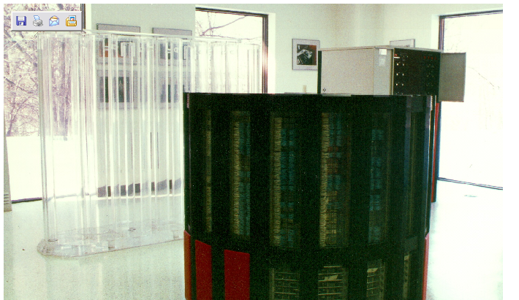
CRAY 2

Slide 9
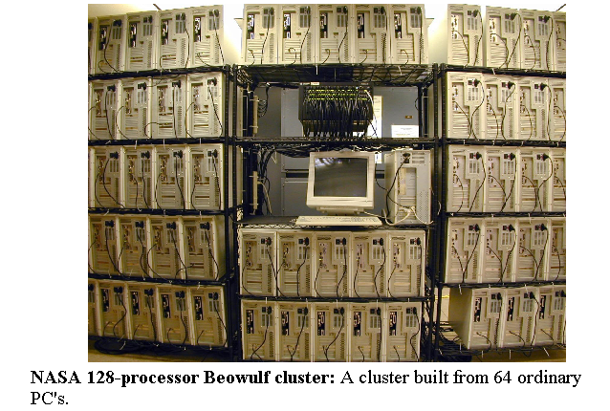
Beowulf Cluster

Slide 10

Gaming Laptop with a GPU

Slide 11
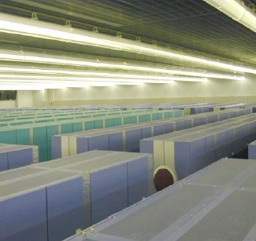
SIZE, COST, and HEAT
The EARTH Simulator
3 Megawatts
500 Million US $
It doesn’t simulate global warming, IT CAUSES IT!
Bednar, 2004

Slide 12
Chips have λ = Wire Sizes
Lambda Rules – now at 7 nanometers
½ = 4X
Transistors have wires at intersections

Slide 13
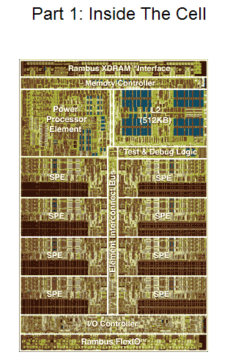
Lambda
Rules define
the wire sizes
on the chip
Here is the
IBM 8 Cell
Processor

Slide 14
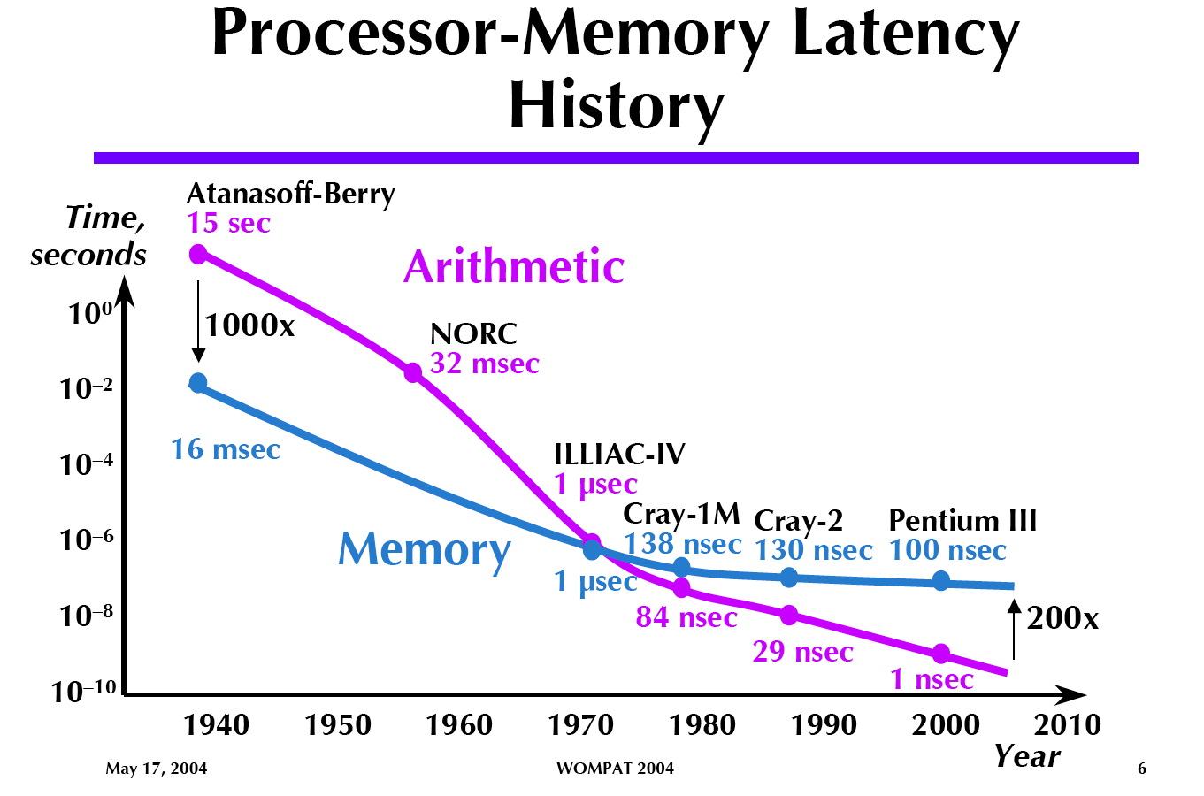
After Gustfason 2004
Arithmetic is getting faster
Memory has reached a
Limit…… around 100 nsec.
Bednar, 2004

Slide 15
Acoustic Waves – Pebble.f
Acoustic waves are used to demonstrate how parallel computing can work.
The domain is two dimensional and the waves propagate in time.
Domain decomposition is in one dimension.
Good accuracy requires a 9-point spatial derivative stencil.
Typical domain is 512 by 512 grid points.
This requires a ghost zone region of 4 memory locations.
Movie frames are written every few time steps to create an animation.
A post processing step creates a Graphics Magick animation.

Slide 16
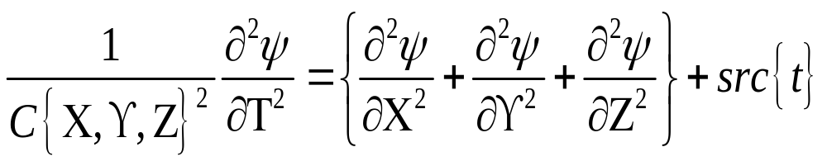

Acoustic, Constant Density
Density is so constant it does not appear in the equation.
C is the P Wave Velocity.
The source energy is in src.
Psi is the wave field.

Slide 17
Acoustic Waves in 2D
Wave Equation, Utt = (Uxx + Uzz)/c^2 where t is time and (x,z) are spatial.
Utt is the second partial derivative in time.
Uxx and Uzz are the spatial second derivatives.
Utt = (Un(new) – 2 Uc(current) + Uo(old))/2dt
Uxx = (Uc(i-1,j) – 2Uc(i,j) + Uc(i+1,j))/2dx
Uzz = (Uc(I,j-1) – 2Uc(i,j) + Uc(I,j+1))/2dz
Utt is accurate for acoustic waves.
Uxx and Uzz need more than a 3-point operator, we use a 9-point operator.

Slide 18
Time Marching
Waves work in time, so the outer compute loop is time, inner loops are spatial.
Do itime=1,ndtime
Do ix=1,ndx
Do kz=1,ndz
2D Array Time Step
End
End
End
Time
Steps
Of 2D
Arrays

Slide 19
Movie Time
Select every 4th time step result
Write to a file
Post process into a pixel map.
Movie Frames of
Floating Point Numbers
Time
Steps
Of 2D
Arrays

Slide 20
Algorithm Complexity
Count the operations for the work loop.
Do itime=1,ndtime
Do ix=1,ndx = Operations(ops,ndtime,ndx,ndz)
Do kz=1,ndz
O(nt x n^2 x 10) === > O(n^3)

Slide 22
Basic OpenACC Code
OpenACC has one version of code.
Program calls system routines for information.

Slide 23
Startup OpenACC Routines
How many processors are to be used - integer: size

Slide 24

Connecting CPU’s and GPU’s
GPU’s and Memory Memory and CPU
CPU
GPU’s
Read from the CPU – Write to the GPU
Read from the GPU – Write to the CPU
Separate memories and communicating programming models

Slide 25
Unified Shared Memory
GPU’s and Memory Memory and CPU
Common Address Space
CPU
GPU’s
Program Read/Writes are planned by the compiler
User write codes for common memory environment The GPU is used by the compiler
Single memory space and programming model that is aware of memory latency and bandwidth issues. A memory data centric solution

Slide 26
Serial Computer
-Linear Address Space
0 Max Address
Address Pointer
Latency is the time to access the first word
Bandwidth is the rate of accessing successive words

Slide 27
Unified Shared Memory Computer - Linear Address Space
CPU G P U ‘S
0 Max Address
Low Latency High Latency
Low Bandwidth High Bandwidth
CPU Address Pointers
Showing multi-thread CPU Address Pointers to all of Memory
Latency is the time to access the first word
Bandwidth is the rate of accessing successive words

Slide 28
Unified Shared Memory Computer - Linear Address Space
CPU G P U ‘S
0 Max Address
Low Latency High Latency
Low Bandwidth High Bandwidth
GPU Address Pointers
Showing GPU’s Address Pointers to all of Memory
Latency is the time to access the first word
Bandwidth is the rate of accessing successive words

Slide 29
Unified Shared Memory Computer - Linear Address Space
CPU G P U ‘S
0 Max Address
Low Latency High Latency
Low Bandwidth High Bandwidth
CPU and GPU Address Pointers
Showing CPU and GPU’s Address Pointers to all of Memory
Latency is the time to access the first word
Bandwidth is the rate of accessing successive words

Slide 31
Floating Point Operations per Second
Time entire run using LINUX
  Time run_pebble_mpi
Using work count of loops
Count floating point operations…
Divide flop count / run time == > FLOPS

Slide 32
Timing Code Methods
Time entire run using LINUX
  Time run_pebble_mpi
Internal call to timer routines…
  Call time(tstart)
  Do work
  Call time(tstop)
  Trun = tstop - tstart

Slide 33
Run Scripts
runclean ➔ clean up data directory.
  #!/bin/bash
  rm data/*
  rm temp_fort/*
run_pebble ➔ delete files, compile,
execute mpi program
#!/bin/bash
rm temp_fort/*
rm data/*
rm pebble
gfortran pebble.f -o pebble -O3
pebble_mpi

Slide 34
Serial Execution versus Multi-thread Processing
Run Time Serial Multi-Thread
< Main Thread >
Secondary Threads (3)
< Main Thread > Shared Variables
< Main Thread >
< Main Thread >
< Main Thread
< Main Thread
Organize data access
and execution between
threads
Run Time Savings

Slide 35
OpenACC Fortran Basics
PROGRAM BasicOpenACC
Integer*4 Icount
Real*4 Data(128,16)
Serial code
Beginning of parallel region. Fork a team of threads. Specify variable scoping
Master Thread
!$ACC Kernels Thread Team
Parallel region executed by all threads
Other OpenACC directives
Run-time Library calls
All threads join master thread and disband
!$ACC END Kernels
Resume serial code
END
Shared
Private

Slide 36
OpenACC Fortran in two MPI ranks and five ACC threads per MPI rank
Rank 0 Rank 1
Master Thread Master Thread
Thread Team Thread Team
Shared
Private
Shared
Private

Slide 37
Vis with Graphics Magick
Movie Frames Movie Frames
Of Floating Point of Integer
Numbers Pixels
Convert
32 float point number
to
32 integer ARGB
Pixel
Red, Green, and Blue with a transparency factor A.
Movie frames are made with gray scale pixels.

Slide 38
Discussion Time

Slide 39
Computing and Calculating Engines
Serial and Parallel Computers

Slide 40
Software Design Issues
Vector Programming
Cache Programming
Message Passing Programming
NUMA Programming
Grid Programming
ALL memory operations have a
Fixed Cost
Code Performance Improvements
are dominated by fixed costs

Slide 41
Hardware Design Issues
10 Years equals 100 Fold Speedup
Memory Latency – cost of getting the first word is a constant
Wires have failed to scale
Bigger cache memories are slower
Code Performance Improvements are
dominated by fixed costs

Slide 42
Serial Computer
-Linear Address Space
0 Max Address
Address Pointer
Latency is the time to access the first word
Bandwidth is the rate of accessing successive words

Slide 43
von Neumann
Architecture
Princeton
Memory
Address Pointer
Arithmetic
Logic
Unit
(ALU)
Data/Instructions
Pc = Pc + 1
Program Counter
Featuring Deterministic Execution

Slide 44
Cache Memory
Architecture
C
A
C
H
E
C
O
N
T
R
O
L
Memory
Main Memory is large and slow.
Cache is much smaller and much faster.
Control logic control keeps the main memory coherent.
Cache
Memory
Address Pointer
Featuring Non-Deterministic Execution

Slide 45
Cache Memory
- Three Levels
Architecture
Memory
Multi-
Gigabytes
Large
and
Slow
160 X
Cache
Control
Logic
2 Gigahertz Clock
2X
8X
16X
L3 Cache
Memory
L1 Cache
Memory
L2 Cache
Memory
32 Kilobytes
128 Kilobytes
16 Megabytes
Featuring Really Non-Deterministic Execution
Address Pointer

Slide 46
Pipeline Instructions
Pipeline Stages
Floating Point Add Operation
Reg 0
Reg 1
EXP 0
EXP 1
Mantissa
Alignment
Reg 0
Reg 1
Adder
Result

Slide 47
Discussion Time

Slide 48
#!/bin/bash
rm data/*
rm pebble
gfortran pebble.f -o pebble -O3 -fopenacc

Slide 49
#!/bin/bash
rm temp_fort/*
rm data/*
rm pebble
gfortran pebble.f -o pebble -O3
pebble

Slide 50
Discussion Time

Slide 51
GitHub Repository

Slide 52
References/Links
Pebble References:
https://en.wikipedia.org/wiki/Acoustic_wave
Seismic Modeling and Imaging with the Complete Wave Equation, SEG Course Notes Series, No. 8. by Ralph Phillip Bording and Larry R. Lines
https://en.wikipedia.org/wiki/Fortran
https://www.open-mpi.org/
https://computing.llnl.gov/tutorials/openMP/
https://www.openmp.org/resources/tutorials-articles/
https://www.openacc.org/
https://en.wikipedia.org/wiki/OpenACC
https://en.wikipedia.org/wiki/RGBA_color_model

