Slide 1
Blue Waters Petascale Semester Curriculum v1.0 Unit 9: Optimization Lesson 4: Multiprocessor Caching and False Sharing Developed by David P. Bunde for the Shodor Education Foundation, Inc.

Slide 2
Except where otherwise noted, this work by The Shodor Education Foundation, Inc. is licensed under CC BY-SA 4.0. To view a copy of this license, visit https://creativecommons.org/licenses/by-sa/4.0 Browse and search the full curriculum at http://shodor.org/petascale/materials/semester-curriculum We welcome your improvements! You can submit your proposed changes to this material and the rest of the curriculum in our GitHub repository at https://github.com/shodor-education/petascale-semester-curriculum We want to hear from you! Please let us know your experiences using this material by sending email to petascale@shodor.org

Slide 3
Multiprocessor caching and
false sharing

Slide 4
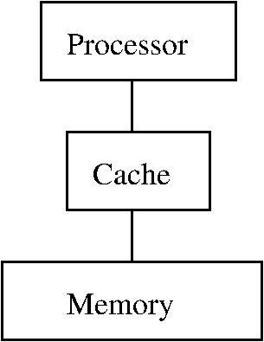
Recall: Caching
Cache(s) sit between processor and memory
Handle memory accesses w/o going all the way to memory
Exploit temporal locality and spatial locality
Notes:
Brief review of caching, with brief animation showing how it works

Slide 5
Recall: Caching
Cache(s) sit between processor and memory
Handle memory accesses w/o going all the way to memory
Exploit temporal locality and spatial locality
request
Notes:
On a memory request, if the data isn’t in the cache, the request is passed all the way to memory

Slide 6
Recall: Caching
Cache(s) sit between processor and memory
Handle memory accesses w/o going all the way to memory
Exploit temporal locality and spatial locality
request
response
Notes:
The response traces this path back to the processor, but also stores the desired data into the cache

Slide 7
Recall: Caching
Cache(s) sit between processor and memory
Handle memory accesses w/o going all the way to memory
Exploit temporal locality and spatial locality
request
response
Notes:
Subsequent requests don’t have to go to memory since the cache can satisfy the request

Slide 8
Recall: Caching
Cache(s) sit between processor and memory
Handle memory accesses w/o going all the way to memory
Exploit temporal locality and spatial locality
Store lines that with recently accessed memory locations and other locations nearby
request
response
Notes:
Key point of this slide is that a cache line also stores data near the accessed memory address. This is what makes caches useful for spatial locality

Slide 9
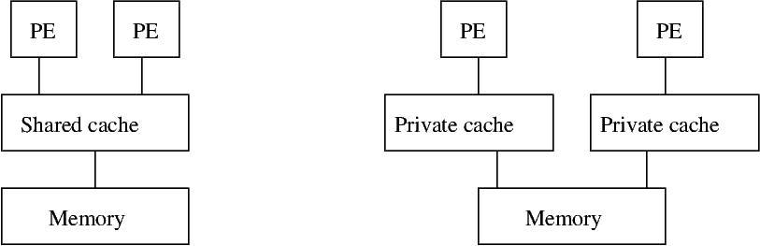
Caching for multiple processing elements (PEs)
Notes:
With multiple processors (or cores), caches can be shared or private. (In practice, a system can have multiple layers of caching so it may have both…)
We’re going to focus on private ones

Slide 10
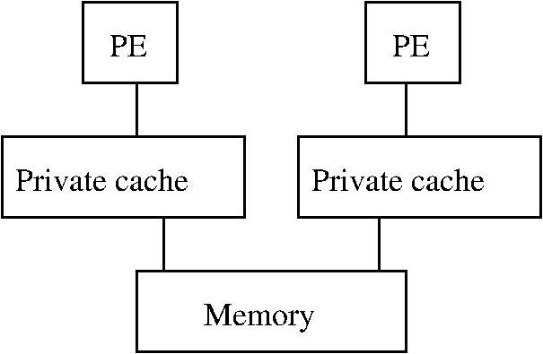
Cache coherence
Potential issue when cache line is in one cache and other PE requests it
request
Notes:
Private caches raise new challenge: If a cache line is stored on one of the private caches and the other processing element requests it, that PE’s cache won’t have the newest value and neither will the memory

Slide 11
Cache coherence
Potential issue when cache line is in one cache and other PE requests it
Cache of requesting PE needs way to steal that line
request

Slide 12
Cache coherence
Potential issue when cache line is in one cache and other PE requests it
Cache of requesting PE needs way to steal that line
Slower than normal cache hit because of need to steal
request
Notes:
This incurs a cost in complexity to know when a line needs to be stolen and in time for each steal operation

Slide 13
Cache coherence
Potential issue when cache line is in one cache and other PE requests it
Cache of requesting PE needs way to steal that line
Slower than normal cache hit because of need to steal
request
False sharing: When a memory access causes a cache line to be stolen even though no data is actually being shared
Notes:
Finally can introduce idea of false sharing. Follow up by going through the code (or having the students do so)
Key point is that because cache lines contain more than one data item, the two PEs might not share data, but might share cache lines. This can create significant unnecessary costs if they repeatedly steal the line from each other

