Slide 1
MPI (Message Passing Interface)

Slide 2
Outline
Definition and Use
Structure of MPI code
Hello_world_mpi
Area_curve_mpi
Load the module (software application)
Job Script Code
Run the job script
Screenshots of example of program codes run:
Hello_world_mpi
Area_curve code
BioFilm
More
Run job
Output

Slide 3
Structure of MPI code
#include <mpi.h>
...
ierr=MPI_Init(&argc, &argv);
ierr=MPI_Comm_size(MPI_COMM_WORLD,&npes);
ierr=MPI_Comm_rank(MPI_COMM_WORLD,&iam);
...
ierr=MPI_Finalize();

Slide 4
Structure of MPI Code
A parallel “Hello, World” program
– Initialize MPI
– Have each node print out its node number
– Quit MPI
#include <mpi.h>
...
ierr=MPI_Init(&argc, &argv);
ierr=MPI_Comm_size(MPI_COMM_WORLD,&npes);
ierr=MPI_Comm_rank(MPI_COMM_WORLD,&iam);
...
ierr=MPI_Finalize();

Slide 5
Load the module (software application)
module load OpenMPI
sbatch myJobScript
squeue –u haboudj

Slide 6
Job Script Code (SLURM)

Slide 7
Run the job script

Slide 8
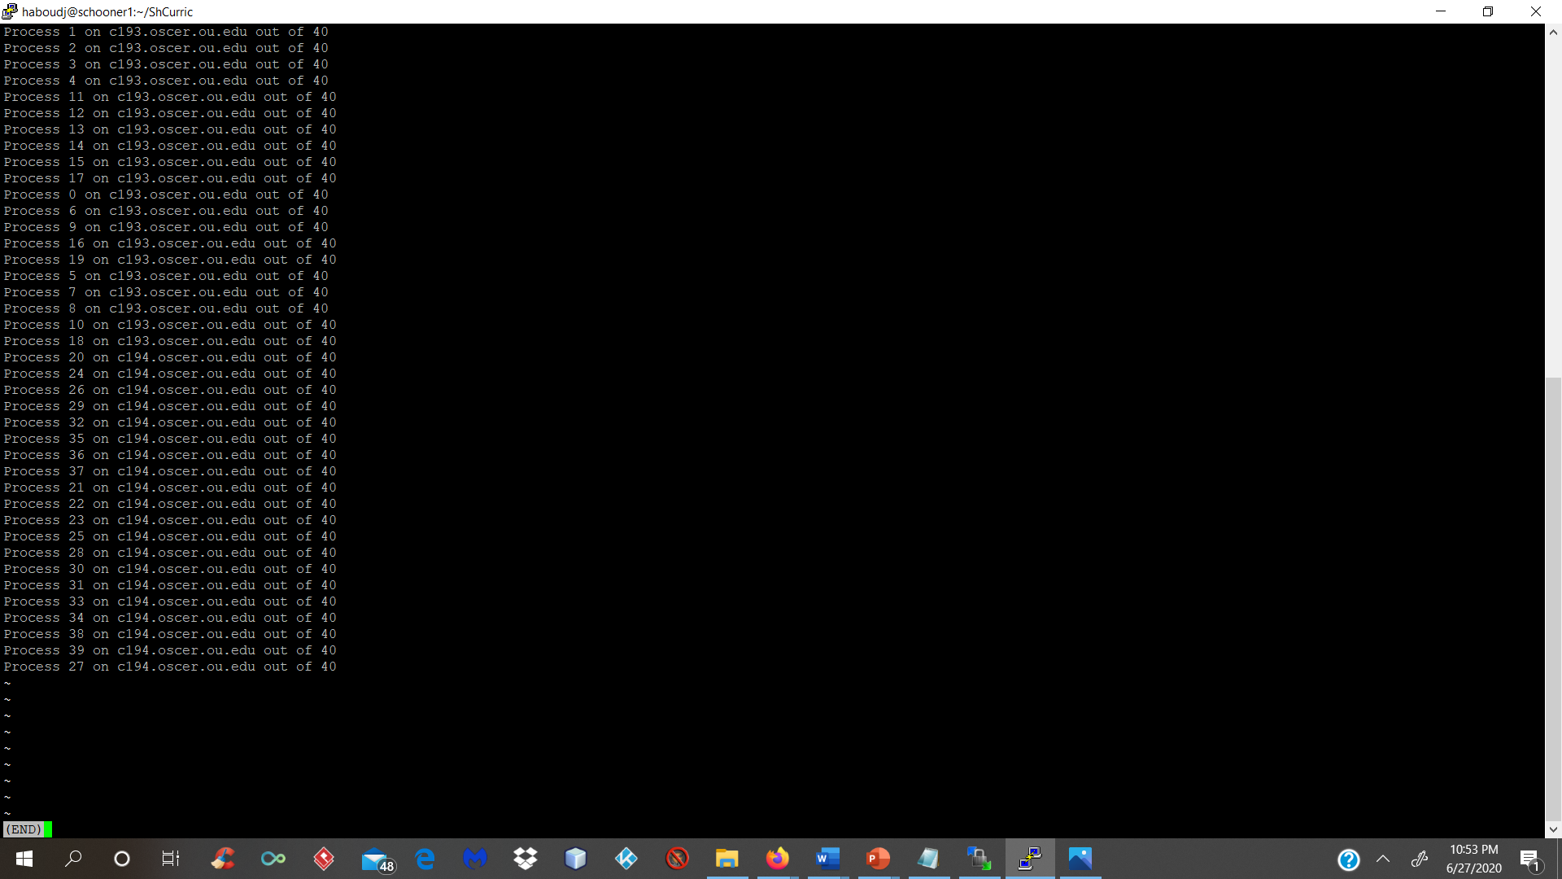
Screenshots of example of program codes run

Slide 9
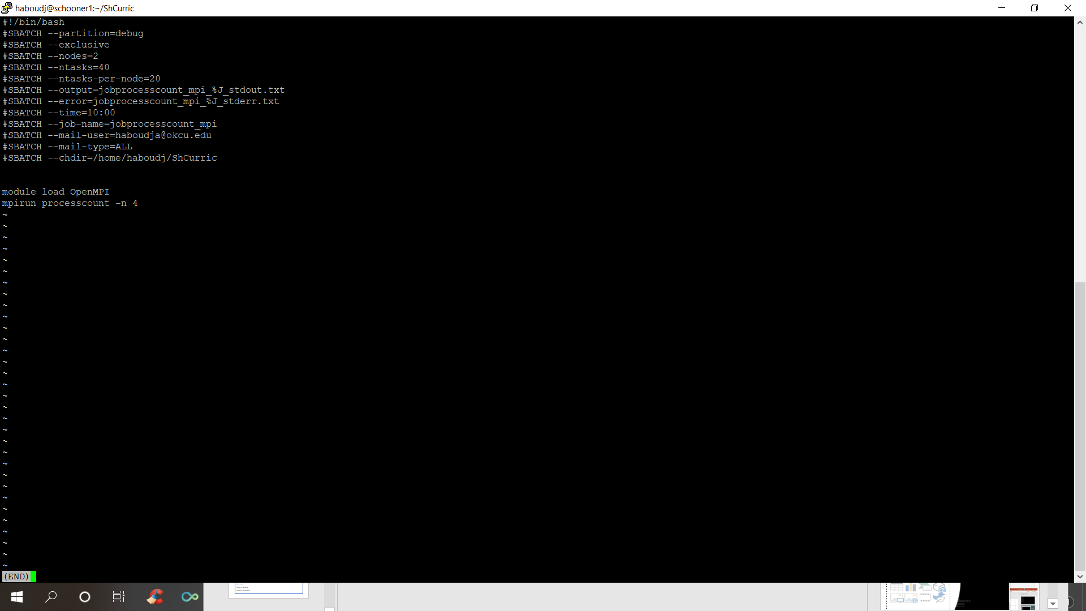

Slide 10
Steps to Use a Super Computer (Example Template)
ssh username@hostname.ncsa.illinois.edu<ENTER>
git clone \ https://github.com/aaronweeden/pi2018-submitting.git<ENTER>
cd pi2018-submitting<ENTER>
cc -o test.exe test.c<ENTER>
cat test.pbs<ENTER>
#!/bin/bash
#PBS -l nodes=2:ppn=32:xe
#PBS -l walltime=00:05:00
#PBS -N test
cd $PBS_O_WORKDIR
aprun -n 4 ./test.exe|sort

Slide 11
Running Job Script
cat test.pbs<ENTER>
#!/bin/bash
#PBS -l nodes=2:ppn=32:xe
#PBS -l walltime=00:05:00
#PBS -N test
cd $PBS_O_WORKDIR
aprun -n 4 ./test.exe|sort

Slide 12
Error and Output Files

Slide 13
References
1. https://people.sc.fsu.edu/~jburkardt/c_src/laplace_mpi/laplace_mpi.html
2. Please see the TACC_CS395_COURSE_MATERIALS s1.
3. https://www.mpi-forum.org/docs/mpi-1.1/mpi1-report.pdf

