Slide 1
Blue Waters Petascale Semester Curriculum v1.0 Unit 4: OpenMP Lesson 12: OpenMP Tasks Developed by Cameron Foss for the Shodor Education Foundation, Inc.

Slide 2
Except where otherwise noted, this work by The Shodor Education Foundation, Inc. is licensed under CC BY-SA 4.0. To view a copy of this license, visit https://creativecommons.org/licenses/by-sa/4.0 Browse and search the full curriculum at http://shodor.org/petascale/materials/semester-curriculum We welcome your improvements! You can submit your proposed changes to this material and the rest of the curriculum in our GitHub repository at https://github.com/shodor-education/petascale-semester-curriculum We want to hear from you! Please let us know your experiences using this material by sending email to petascale@shodor.org

Slide 3
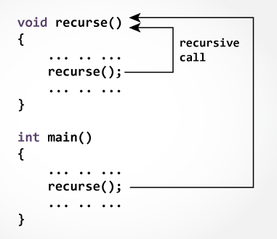
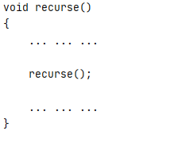
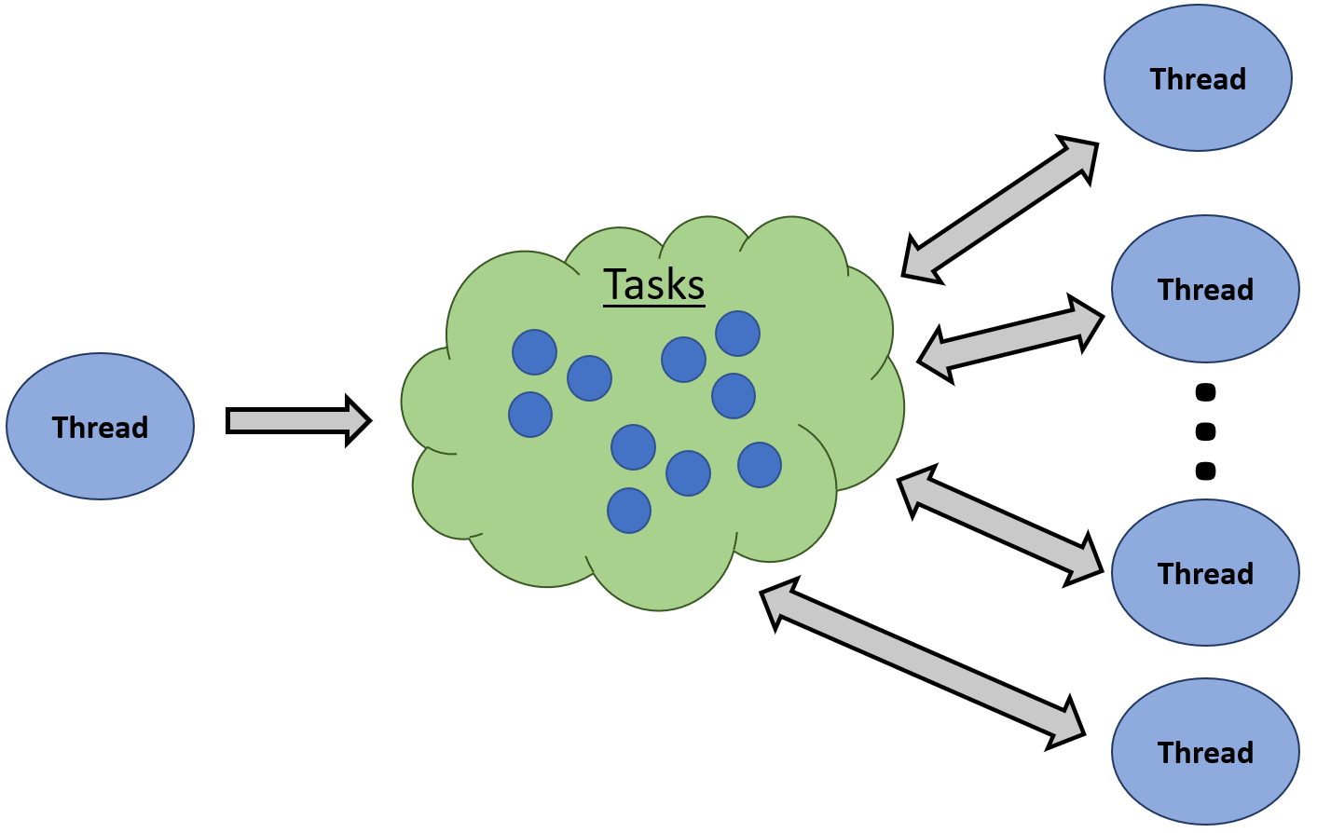

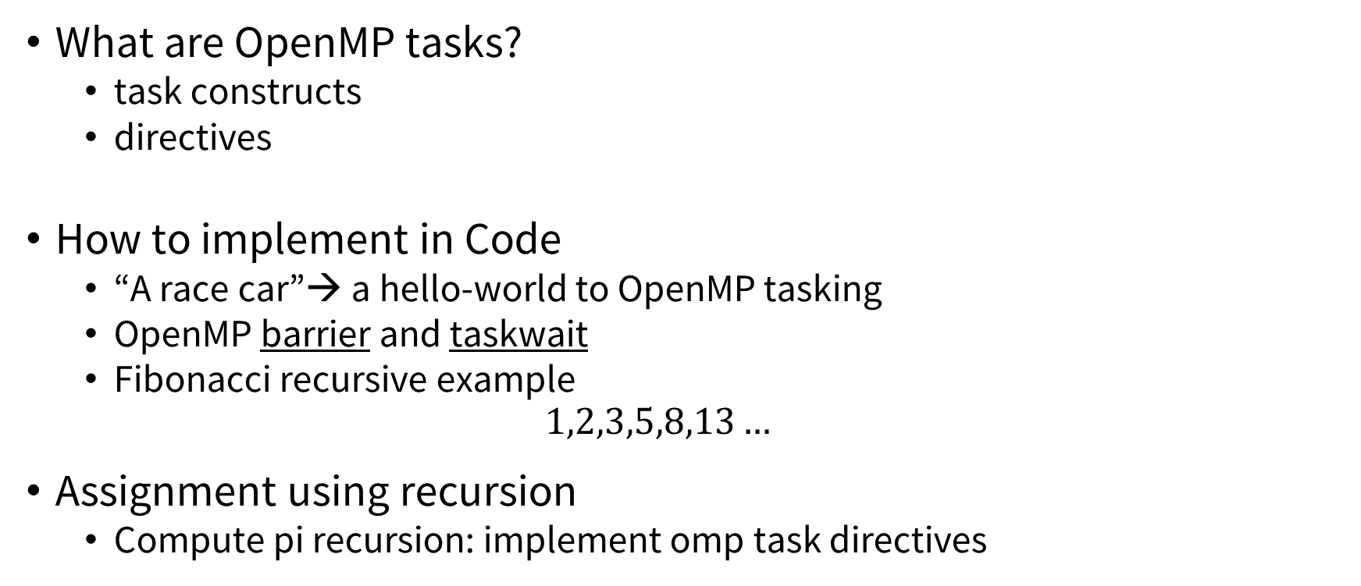



Outline
What are OpenMP tasks?
task constructs
directives
How to implement in Code
“A race car”→ a hello-world to OpenMP tasking
OpenMP barrier and taskwait
Fibonacci recursive example
$$1,2,3,5,8,13…$$
Assignment using recursion
Compute pi recursion: implement omp task directives
$$y$$
…
$$dx$$
$$x$$
$$r$$

Slide 4
OpenMP Tasking Model
Thread
Tasking facilitates the parallelization of applications where units of work are generated dynamically, as in recursive structures or while loops.
[API User’s Guide]
Tasks
Thread
…
Thread
Execute Tasks
Generate
Tasks
Thread
Task pool
Thread
Image source: “OpenMP Tasking Explained”, Ruud van der Pas, SC13

Slide 5
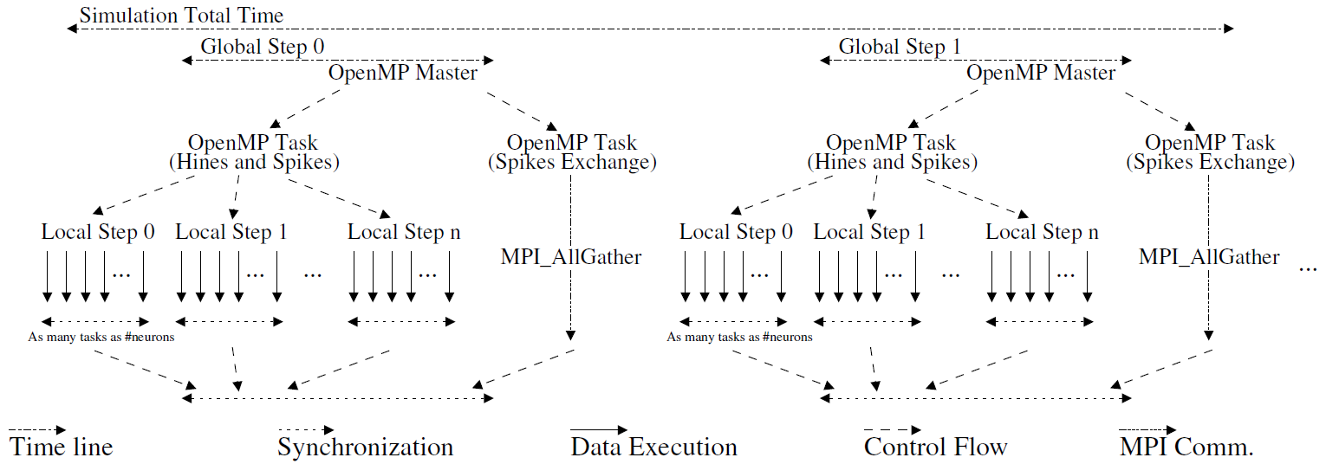
A more detailed example…
…revisit after MPI and Hybrid (MPI+OpenMP)
Parallel model implemented for the simulator based on MPI+OpenMP tasking.
Image source: “MPI+OpenMP tasking scalability for multi-morphology simulations of the human brain”, Parallel Computing, Volume 84, May 2019, Pages 50-61

Slide 6
Why use tasking…?
Up until OpenMP 3.0, certain types of parallelism was not feasible
This required messy workarounds at best
Threads all run the same code. Tasks allow us to assign different blocks of code that are independent to different threads.
enable irregular parallelism
Allowed specific code blocks to be run simultaneously and independently of other task blocks.
Notes:
Other motivating reasons…?

Slide 7
Task Execution
Tasks are generated by specifying the task construct.
Tasks can be generated anywhere in the code.
A task is composed of:
Code to be executed
Data environment (inputs to be used and outputs to be generated)
A location where the task will be executed (a thread)
http://icl.cs.utk.edu/classes/cosc462/2017/pdf/W43%20-%20OpenMP%20Tasking.pdf

Slide 8
Task Types
explicit tasks are generated using the task directive
implicit tasks are inherent to parallel constructs and function similarly to explicit tasks
# pragma omp task clause
{
block of code ...
}
Notes:
Implicit tasks are generated in all parallel constructs.
The key difference is that all implicit tasks are guaranteed to be complete when the master thread exits the implicit barrier at the end of the parallel region. Whereas, all explicit tasks generated within a parallel region are guaranteed to be complete on exit from the next implicit or explicit barrier within the parallel region.

Slide 9
Data environment
# pragma omp task clause
{
block of code ...
}
defines storage locations where task dependencies exist
clause can be:
depend (list)
if (expression)
final (expression)
untied
mergeable
default (shared | firstprivate | none)
private (list)
firstprivate (list)
shared (list)
priority (value)
Generate a task if a condition is met
Stop generating new tasks if a condition is met
Memory storage requirements on input output variables
inputs to be used and outputs to be generated
The task directive takes the following data-sharing attribute clauses that define the data environment of the task.
http://icl.cs.utk.edu/classes/cosc462/2017/pdf/W43%20-%20OpenMP%20Tasking.pdf

Slide 10

Tasking Explained…
Objective: Write a program that prints either “A race car” or “A car race” and maximize the parallelism.
Source: “OpenMP Tasking Explained”, Ruud van der Pas, SC13

Slide 11
A race car OR A car race…(1)
#include <stdlib.h>
#include <stdio.h>
int main(int argc, char *argv[])
{
printf(“A ”);
printf(“race ”);
printf(“car ”);
printf(“.\n”);
return(0);
}
Q: What will this program print?
$ gcc racecar.c
$ ./a.out
A race car .
$
Source: “OpenMP Tasking Explained”, Ruud van der Pas, SC13
Notes:
Trivial and skippable

Slide 12
A race car OR A car race…(2)
#include <stdlib.h>
#include <stdio.h>
int main(int argc, char *argv[])
{
#pragma omp parallel
{
printf(“A ”);
printf(“race ”);
printf(“car ”);
} // End of omp parallel region
printf(“.\n”);
return(0);
}
Q: What will this program print when we use 2 threads?
$ gcc –fopenmp racecar_omp.c
$ export OMP_NUM_THREADS=2
$ ./a.out
A race car A race car .
$
Source: “OpenMP Tasking Explained”, Ruud van der Pas, SC13
Notes:
Each OpenMP thread (in this case there are 2) execute the lines within the ‘omp parallel’ block. Therefore, we get permutations of {A, car, race} x N where N is the number of threads.
A ‘block’ of code refers to a chunk of code that is encased between { }’s.

Slide 13
A race car OR A car race…(3)
#include <stdlib.h>
#include <stdio.h>
int main(int argc, char *argv[])
{
#pragma omp parallel
{
#pragma omp single
{
printf(“A ”);
printf(“race ”);
printf(“car ”);
}
} // End of omp parallel region
printf(“.\n”);
return(0);
}
Q: What will this program print when we use 2 threads?
$ gcc –fopenmp racecar_omp.c
$ export OMP_NUM_THREADS=2
$ ./a.out
A race car .
$
It only prints it once now because the omp single block is run by only one (single) thread.
Source: “OpenMP Tasking Explained”, Ruud van der Pas, SC13
Notes:
‘omp single’ blocks out the print statements to be run by only one thread. The end result is indistinguishable from the serial case.

Slide 14
A race car OR A car race…(4)
#include <stdlib.h>
#include <stdio.h>
int main(int argc, char *argv[])
{
#pragma omp parallel
{
#pragma omp single
{
printf(“A ”);
#pragma omp task
{ printf(“race ”); }
#pragma omp task
{ printf(“car ”); }
}
} // End of omp parallel region
printf(“.\n”);
return(0);
}
Q: What will this program print when we use 2 threads?
$ gcc –fopenmp racecar_omp.c
$ export OMP_NUM_THREADS=2
$ ./a.out
A race car .
$ ./a.out
A car race .
Tasks are executed in arbitrary order!
Note: It may take many attempts before both “A race car” and “A car race” appear.
Source: “OpenMP Tasking Explained”, Ruud van der Pas, SC13
Notes:
The single thread executing the ‘omp single’ block now generates two tasks which are generated (?) and executed concurrently. The two tasks both print something, but in this case one prints ‘race’ and the other prints ‘car’. There is a race between which task finishes first. This race between the tasks is the feature that we’re taking advantage of here to get a desired output → (i.e. a code that sometimes prints “A race car” and “A car race”).

Slide 15
A race car OR A car race…(5)
Objective: Write a program that prints either “A race car” or “A car race” and maximize the parallelism.
Objective: Write a program that prints either “A race car” or “A car race” and maximize the parallelism.
COMPLETED
Objective 2: Add “is fun to watch.” to the end of the sentence…
Source: “OpenMP Tasking Explained”, Ruud van der Pas, SC13

Slide 16
A race car OR A car race…(6)
#include <stdlib.h>
#include <stdio.h>
int main(int argc, char *argv[])
{
#pragma omp parallel
{
#pragma omp single
{
printf(“A ”);
#pragma omp task
{ printf(“race ”); }
#pragma omp task
{ printf(“car ”); }
printf(“is fun to watch ”);
}
} // End of omp parallel region
printf(“.\n”);
return(0);
}
Q: What will this program print when we use 2 threads?
$ gcc –fopenmp racecar_omp.c
$ export OMP_NUM_THREADS=2
$ ./a.out
A is fun to watch race car .
$ ./a.out
A race is fun to watch car .
…
Source: “OpenMP Tasking Explained”, Ruud van der Pas, SC13
Notes:
The thread that generates the tasks seems to be faster than the tasks on average, as indicated by the output here. Although if you run the code enough times, you will find that some printouts can show a more coherent sentence like the second sentence above ‘A race is fun to watch car .’ Save for the last term ‘car’, the sentence is fine. Although keep in mind that it doesn’t satisfy our objective.

Slide 17
A race car OR A car race…(7)
#include <stdlib.h>
#include <stdio.h>
int main(int argc, char *argv[])
{
#pragma omp parallel
{
#pragma omp single
{
printf(“A ”);
#pragma omp task
{ printf(“race ”); }
#pragma omp task
{ printf(“car ”); }
#pragma omp taskwait
printf(“is fun to watch ”);
}
} // End of omp parallel region
printf(“.\n”);
return(0);
}
Task 1 is generated
Task 2 is generated
Synchronization point: “Wait here until all previous tasks have finished…”
Source: “OpenMP Tasking Explained”, Ruud van der Pas, SC13

Slide 18
A race car OR A car race…(8)
#include <stdlib.h>
#include <stdio.h>
int main(int argc, char *argv[])
{
#pragma omp parallel
{
#pragma omp single
{
printf(“A ”);
#pragma omp task
{ printf(“race ”); }
#pragma omp task
{ printf(“car ”); }
#pragma omp taskwait
printf(“is fun to watch ”);
}
} // End of omp parallel region
printf(“.\n”);
return(0);
}
Q: What will this program print when we use 2 threads?
$ gcc –fopenmp racecar_omp.c
$ export OMP_NUM_THREADS=2
$ ./a.out
A race car is fun to watch .
$ ./a.out
A car race is fun to watch .
…
Source: “OpenMP Tasking Explained”, Ruud van der Pas, SC13

Slide 19
A race car OR A car race…(9)
Objective: Write a program that prints either “A race car” or “A car race” and maximize the parallelism.
COMPLETED
Objective 2: Add “is fun to watch.” to the end of the sentence…
Objective: Write a program that prints either “A race car” or “A car race” and maximize the parallelism.
COMPLETED
Objective 2: Add “is fun to watch.” to the end of the sentence… COMPLETED
Source: “OpenMP Tasking Explained”, Ruud van der Pas, SC13

Slide 20
Recap so far…
When a thread encounters a #pragma omp task it generates a task
That is, the number of threads that encounter a #pragma omp task will generate that many number of tasks.
Can control with a directive #pragma omp single or more dynamically with the function omp_set_num_threads
Tasks are executed in parallel and in arbitrary order.
Implies a race occurs between tasks that are initiated by the same thread.
#pragma omp taskwait can be used to execute code by the main thread strictly after all tasks are completed.

Slide 21


Recursion
Recursion is defined as “relating to or involving a program or routine of which a part requires the application of the whole, so that its explicit interpretation requires in general many successive executions.”
Tasking is often used in codes that use recursion
Recursion, in simple terms, means defining a problem in terms of itself.
A recursive function is a function that calls itself iteratively until some condition is met.
int fib(int n) {
int i, j;
if (n<2) { return n; }
else {
i=fib(n-1);
j=fib(n-2);
return i+j;
}
}
Calculating the $n^{th}$ element in a Fibonacci sequence
$$fib\left(n=6\right)=\left[1, 2, 3, 5, 8, 13\right]$$
$$=13$$
https://www.cs.utah.edu/~germain/PPS/Topics/recursion.html

Slide 22
Recursion – Compute Pi
double pi_r (double h, unsigned depth, unsigned maxdepth, unsigned long long begin, unsigned long long niters)
{
if (depth < maxdepth)
{
double area1, area2;
// Process first half
area1 = pi_r (h, depth+1, maxdepth, begin, niters/2-1);
// Process second half
area2 = pi_r (h, depth+1, maxdepth, begin+niters/2, niters/2);
return area1+area2;
}
else
{
unsigned long long i;
double area = 0.0;
for (i = begin; i <= begin+niters; i++)
{
double x = h * (i - 0.5);
area += (4.0 / (1.0 + x*x));
}
return area;
}
}

Slide 23
Recursion – Compute Pi
double pi (unsigned long long niters)
{
double res;
double h = 1.0 / (double) niters;
#define MAX_PARALLEL_RECURSIVE_LEVEL 4
res = pi_r (h, 0, MAX_PARALLEL_RECURSIVE_LEVEL, 1, niters);
return res * h;
}
int main (int argc, char *argv[])
{
double tstart = omp_get_wtime();
int NITERS = atoi(argv[1]);
printf ("Number of rectangles: %d\n",NITERS);
double pi_approx = pi(NITERS);
printf ("PI (w/%d iters) is %15.13f\n", NITERS, pi_approx);
printf ("Accuracy for %d \titers is :: %10.7f % \n", NITERS, pi_approx/M_PI*100);
printf ("runtime is: %lf\n", omp_get_wtime()-tstart);
printf ("\n");
return 0;
}

Slide 24

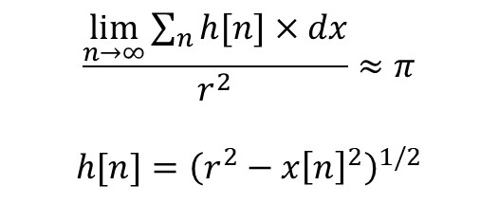



Assignment: Compute pi with OpenMP tasks
Parallelize the compute pi code with openMP
Use openMP tasks on the recursive function pi_r
Once the code has been parallelized, perform the following:
Compute pi with [100,500,1000,5000,10000,1000000,100000000] numbers of rectangles for both the serial and parallelized code with 2 and 4 threads. Note the runtime and accuracy of the approximation in each.
Comment on trends you see with the runtime when increasing the number of rectangles and the number of threads.
$$\frac{\lim_{n→∞}{\sum_{n}{h[n]×dx}}}{r^{2}}≈π$$
$$h[n]={\left(r^{2}−x{\left[n\right]}^{2}\right)}^{1/2}$$
$$y$$
…
$$x$$
$$dx$$
$$r$$

Slide 25
References and Additional resources:
OpenMP Tasking :
https://openmp.org/wp-content/uploads/sc13.tasking.ruud.pdf
http://icl.cs.utk.edu/classes/cosc462/2017/pdf/W43%20-%20OpenMP%20Tasking.pdf
https://en.wikibooks.org/wiki/OpenMP/Tasks
OpenMP tasking model (advanced):
https://www.slideshare.net/InformaticaUCM/openmp-tasking-model-from-the-standard-to-the-classroom?from_action=save
A nice book on OpenMP in general, many many examples:
https://www.openmp.org/wp-content/uploads/OpenMP4.0.0.Examples.pdf
OpenMP API User’s Guide:
https://docs.oracle.com/cd/E77782_01/html/E77801/gljyr.html#scrolltoc (2017 documentation)
https://docs.oracle.com/cd/E19205-01/820-7883/auto15/index.html (2010 documentation)
OpenMP directives:
https://docs.microsoft.com/en-us/cpp/parallel/openmp/reference/openmp-directives?view=vs-2019
Basics of recursion
https://www.programiz.com/c-programming/c-recursion
https://www.cs.utah.edu/~germain/PPS/Topics/recursion.html
Runtime Determinacy Race Detection for OpenMP Tasks:
https://link.springer.com/chapter/10.1007/978-3-319-96983-1_3

