Slide 1
Blue Waters Petascale Semester Curriculum v1.0 Unit 10: Productivity and Visualization Lesson 3: Visualization 1 Developed by R. Phillip Bording for the Shodor Education Foundation, Inc.

Slide 2
Except where otherwise noted, this work by The Shodor Education Foundation, Inc. is licensed under CC BY-SA 4.0. To view a copy of this license, visit https://creativecommons.org/licenses/by-sa/4.0 Browse and search the full curriculum at http://shodor.org/petascale/materials/semester-curriculum We welcome your improvements! You can submit your proposed changes to this material and the rest of the curriculum in our GitHub repository at https://github.com/shodor-education/petascale-semester-curriculum We want to hear from you! Please let us know your experiences using this material by sending email to petascale@shodor.org

Slide 3

Blue Waters Project
Lesson on Visualization of Pebbles
Other Lessons similar are:
Lesson on MPI - Waves
Lesson on MPI and OpenMP – Pebbles
Lesson on OpenACC – Pebbles
Lesson on Visualization of Pebbles
This lesson builds the vis tools
used in those other lessons

Slide 4
Parallel Computing – Geophysical Data Processing
Topics
Historical Survey of Parallel Computing
Geophysics – Acoustic Waves
High Performance Computing
Serial computers and how they work
Parallel computers and how they work
Pipelining and how it relates to serial and parallel computers
MPI for Parallel Computing
Visualization for Acoustic Waves

Slide 5
Parallel Computing
Topics
Programming Languages
Decomposition of a Problem Data Domain
Programming Constructs for Parallel Computing
Efficiency Modeling of Parallel Computing
Cost of Operations – Algorithm Complexity

Slide 6
Parallel Compute Examples
Fortran – C codes
OpenMPI
Linux Machines – Multi-Core Laptops with GPU’s
Network machines – Local, Remote, or Cloud
Connect with User ID and Password
SSH w/o passwords – best if inside a very tight firewall
Exa-Scale (10^18) machines with operations per second
Network Mounted File Systems – NFS

Slide 7
History of Machines
Illiac – University of Illinois
PEPE – DOD Radar Machine
FPS – Array Processors -1980’s
Cray X machines - 1980’s
IBM Multiprocessors
Hardware – CM 2
PC clusters
IBM Blue Gene – 128,000 cpu’s
Oak Ridge Summit – IBM Power 9 - 2019
Japan’s – Number 1 in the TOP 500 - 2020

Slide 8
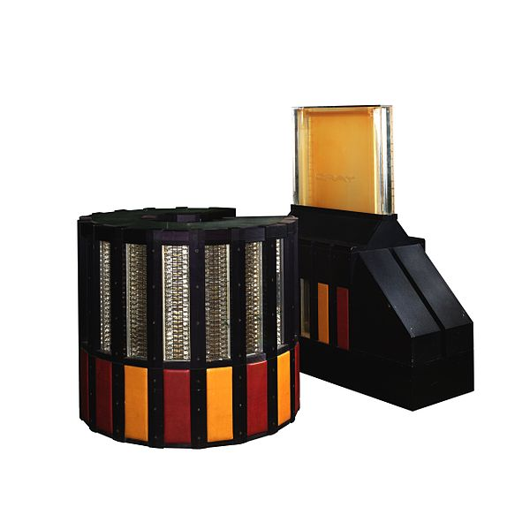
CRAY 2
Image: CRAY-2 IMG 8915-8913-8912a.jpg by Rama is licensed under Creative Commons Attribution-ShareAlike 3.0 France

Slide 9
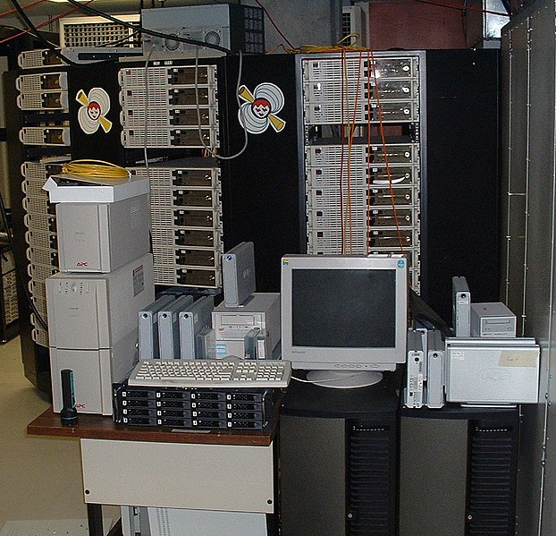
Beowulf Cluster
Image: Beowulf-cluster-the-borg.jpg is in the public domain.

Slide 10

Gaming Laptop with a GPU
Image: Falcon Northwest's TLX gaming laptop.png by Falcon Northwest is licensed under CC-BY-SA-4.0

Slide 11
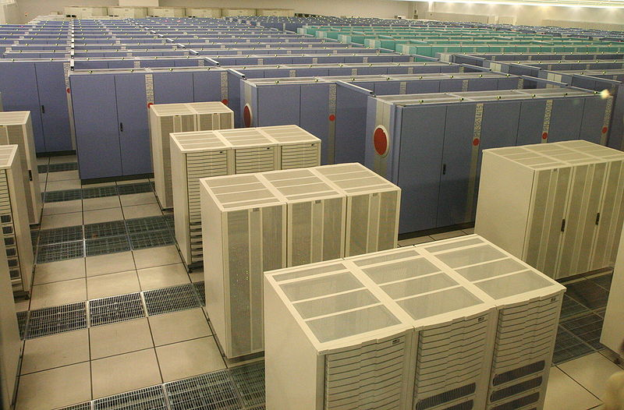
SIZE, COST, and HEAT
The EARTH Simulator
3 Megawatts
500 Million US $
It doesn’t simulate global warming, IT CAUSES IT!
Image: EarthSimulator.jpg by Manatee_tw is licensed under CC-BY-SA-4.0

Slide 12
Chips have λ = Wire Sizes Lambda Rules – now at 7 nanometers
½ = 4X
Transistors have wires at intersections

Slide 13
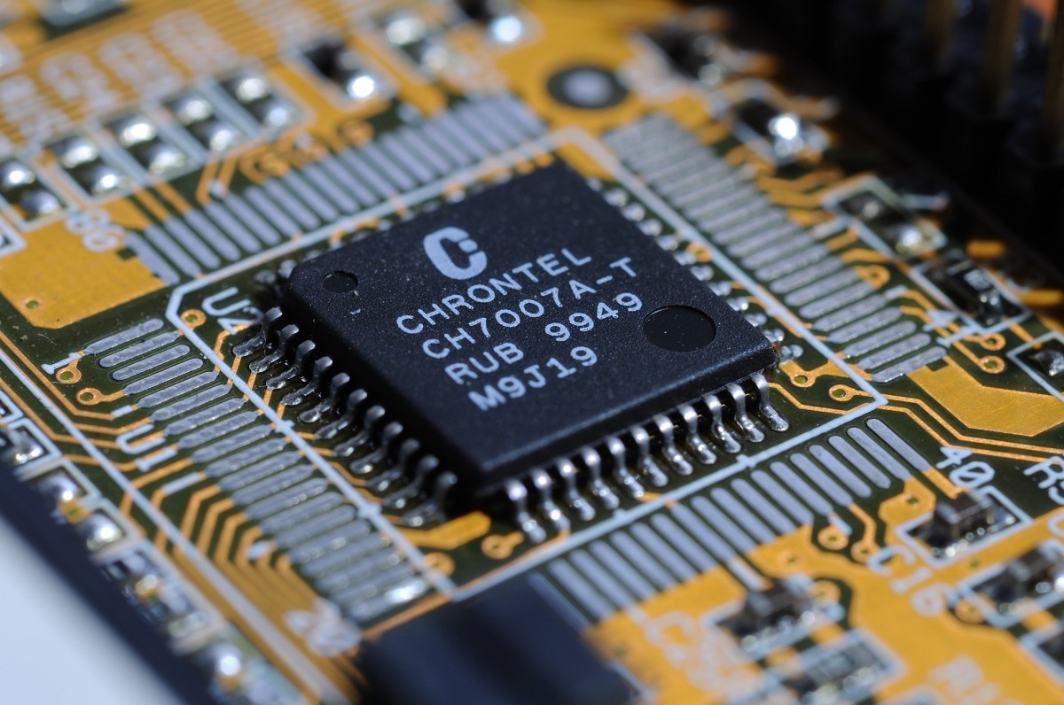
Lambda
Rules define
the wire sizes
on the chip
Image: circuit_board_high_tech.jpg is in the public domain.

Slide 14
Acoustic Waves – Pebble.f
Acoustic waves are used to demonstrate how parallel computing can work.
The domain is two dimensional and the waves propagate in time.
Domain decomposition is in one dimension.
Good accuracy requires a 9-point spatial derivative stencil.
Typical domain is 512 by 512 grid points.
This requires a ghost zone region of 4 memory locations.
Movie frames are written every few time steps to create an animation.
A post processing step creates a Graphics Magick animation.

Slide 15
Acoustic, Constant Density
Density is so constant it does not appear in the equation.
C is the P Wave Velocity.
The source energy is in src.
Psi is the wave field.

Slide 16
Acoustic Waves in 2D
Wave Equation, Utt = (Uxx + Uzz)/c^2 where t is time and (x,z) are spatial.
Utt is the second partial derivative in time.
Uxx and Uzz are the spatial second derivatives.
Utt = (Un(new) – 2 Uc(current) + Uo(old))/2dt
Uxx = (Uc(i-1,j) – 2Uc(i,j) + Uc(i+1,j))/2dx
Uzz = (Uc(I,j-1) – 2Uc(i,j) + Uc(I,j+1))/2dz
Utt is accurate for acoustic waves.
Uxx and Uzz need more than a 3-point operator, we use a 9-point operator.

Slide 17
Acoustic Waves in 2D
Utt is accurate for acoustic waves.
Uxx and Uzz need more than a 3-point operator, we use a 9-point operator in the x and z directions.

Slide 18
Acoustic Waves in 2D
Utt is accurate for acoustic waves.
Uxx and Uzz need more than a 3-point operator, we use a 9-point operator in the x and z directions.
Topside Ghost Region in memp+1
Memory Partitions
Memp
Memp+1

Slide 19
Acoustic Waves in 2D MPI Ghost Zones
4 memory cells deep
Ghost Zones
Internal cells
Ghost Zones
….
…………………………..…….…...
One Dimensional Decomposition in Pebble.f
….

Slide 20
Acoustic Waves in 2D MPI Ghost Zones
4 memory cells deep
Region 0 1 > 2
Ghost Zone 2 > 1
Ghost Zone
Region 1
Ghost Zone
Ghost Zone
Region 2
….
….
….
One Dimensional Decomposition in Pebble.f

Slide 21
Acoustic Waves in 2D MPI Parallel Compute Regions
Region 1 - CPU 0 Memory
Region 2 – CPU 1 Memory
Region 3 – CPU 2 Memory
CPU 0
CPU 1
CPU 2
One Dimensional Decomposition in Pebble.f

Slide 22
Time Marching
Waves work in time, so the outer compute loop is time, inner loops are spatial.
Do itime=1,ndtime
Do ix=1,ndx
Do kz=1,ndz
2D Array Time Step
End
End
End
Time
Steps
Of 2D
Arrays

Slide 23
Movie Time
Select every 4th time step result
Write to a file
Post process into a pixel map.
Movie Frames of
Floating Point Numbers
Time
Steps
Of 2D
Arrays

Slide 24
What is ARGB?
ARGB sets the pixel definitions for generating computer/digital visual screen images. A screen image has pixel patterns organized as objects, typically shown as rectangles. The ARGB encoding defines four 8 bit data sections of a 32 bit data, a “pixel”. See the cmap.f program for a detailed mapping run.
The RGB stands for the color pallet of Red, Green, and Blue colors. A is measure of image opacity.

Slide 25
What is ARGB?
The RGB stands for the color pallet of Red, Green, and Blue colors. Using the range of 0-255 for three integers creates the part of the color pallet which the human eye can discern. While we use the color attribute to describe these three 8 bit integers, they actually cover the gray scale pixels as well, from black, to gray shades, and white. The Alpha byte representing the data channel presenting a measure of image opacity.

Slide 26
Next we consider the only RGB map values…
Gray scales color map values, set the red, green, and blue values to the same value.
RED GREEN BLUE
White FFFFFF in octal 1111 1111 1111 1111 1111 1111 as binary
Light Gray c1c1c1 1100 0001 1100 0001 1100 0001
Gray 818181 1000 0001 1000 0001 1000 0001
Dark Gray 414141 0100 0001 0100 0001 0100 0001
Black 000000 0000 0000 0000 0000 0000 0000
Alpha values are not shown.

Slide 27
Opacity – Alpha Values
Alpha opacity values, when an image is displayed it can be constructed as linear combination of the background image and the current display image.
The values of alpha range from one to zero as an unsigned 8 bit integer. When alpha = 1, or FF the images are opaque. When alpha = 8000, the background image has an almost equal contribution to the final image. When alpha equals zero then the background image is in full display.
The pixels are selected from the Foreground – Background images, the pixel weight applied as:
Output = alpha*Foreground + (1-alpha) * Background
generating a final image.
For the .png file the 32 bit pixel format is: Alpha byte, Red byte, Green byte, and Blue byte.
If alpha is equal to one (1.0) then it has a binary/octal equivalent
of 1111 1111 or FF.

Slide 28
Using a two’s complement arithmetic for an integer the process of generating a 32 bit pixel follows.
Int pixel;
Int irint, igint, ibint;
pixel = -256*256*256 + 256*256*irint + 256*igint + ibint;
The 256 multiplies simply shift left the 8bits of the color value.
The -256*256*256 sets the FF for alpha.
If the image is in gray scale then irint = igint = ibint.
References: https://www.w3.org/TR/2003/REC-PNG-20031110/#13Alpha-channel-processing

Slide 29
Codes cmap.f and cfrgb.c
CMAP is a Fortran program that develops a color output table for gray scale images. It shows a sample for the gray scale from 0 to 255 using the ARGB pixel byte layout suitable for .png files.
Assuming an array of values has a maximum positive value of 2.6 and a minimum negative value of -2.2 and all values of the array are within these bounds, a mapping is made in cmap to show possible ARGB pixel values.
Cfrgb is a C program that develops a color output table for gray scale images. It shows a sample for the gray scale from 0 to 255 using the ARGB pixel byte layout suitable for .png files.
Assuming an array of values has a maximum positive value of 2.6 and a minimum negative value of -2.2 and all values of the array are within these bounds, a mapping is made in cfrgb to show possible ARGB pixel values.

Slide 30
Algorithm Complexity
Count the operations for the work loop.
Do itime=1,ndtime
Do ix=1,ndx = Operations(ops,ndtime,ndx,ndz)
Do kz=1,ndz
O(nt x n^2 x 10) === > O(n^3)

Slide 32
Basic MPI Code
MPI has one version of code.
Program calls system routines for information.
How many processors are to be used.
Who am I in the list of available processors.
Include file is needed: include “mpif.h”.
Startup calls are:
Call MPI_INIT(ierror)
Call MPI_COMM_SIZE(MPI_COMM_WORLD, size, ierror)
Call MPI_COMM_RANK(MPI_COMM_WORLD,rank,ierror)

Slide 33
Startup MPI Routines
How many processors are to be used - integer: size
Who am I in the list of available processors - integer: rank
A general world communicator is provided:
Error flag is an integer: ierror
MPI_COMM_WORLD
Startup calls are:
Call MPI_INIT(ierror)
Call MPI_COMM_SIZE(MPI_COMM_WORLD, size, ierror)
Call MPI_COMM_RANK(MPI_COMM_WORLD, rank, ierror)
End call is a good idea as you have distributed nodes computing and communicating. So shut down cleanly by doing a:
Call MPI_Finalize(ierror)

Slide 34
Pebble_mpi.f
MPI calls in Pebble_mpi.f are:
Call MPI_COMM_SIZE(MPI_COMM_WORLD, size, ierror)
Call MPI_COMM_RANK(MPI_COMM_WORLD, rank, ierror)
Call MPI_ALL_REDUCE(ucmax,ucmaxg,1,MPI_FLOAT,MPI_MAX,MPI_COMM_WORLD,ierror)
Call MPI_SEND(Ucur(i,j),lucur,MPI_Float,rankto,tag,MPI_COMM_WORLD,ierror)
Call MPI_RECV(Ucur(k,l),lucur,MPI_Float,rankfrom,tag,MPI_COMM_WORLD,ierror)
Call MPI_BARRIER(MPI_COMM_WORLD.ierror)

Slide 35
Pebble_mpi.f
MPI calls in Pebble_mpi.f are:
All_REDUCE the processors share ucmax, and what ever function MPI_MAX is applied, return that value to all processors.
Call MPI_ALL_REDUCE(ucmax,ucmaxg,1,MPI_FLOAT,MPI_MAX,MPI_COMM_WORLD,ierror)
SEND/RECV send a variable to rankto and receive from rankfrom.
Call MPI_SEND(Ucur(i,j),lucur,MPI_Float,rankto,tag,MPI_COMM_WORLD,ierror)
Call MPI_RECV(Ucur(k,l),lucur,MPI_Float,rankfrom,tag,MPI_COMM_WORLD,ierror)
Barrier causes a wait in the fast processors till the slow one's catchup, then moves on…..
Call MPI_BARRIER(MPI_COMM_WORLD.ierror)

Slide 36
Floating Point Operations per Second
Time entire run using LINUX
Time run_pebble_mpi
Using work count of loops
Count floating point operations…
Divide flop count / run time == > FLOPS

Slide 37
Timing Code Methods
Time entire run using LINUX
Time run_pebble_mpi
Internal call to timer routines…
Call time(tstart)
Do work
Call time(tstop)
Trun = tstop - tstart

Slide 38
Run Scripts
runclean ➔ clean up data directory.
#!/bin/bash
rm data/*
rm temp_fort/*
run_pebble_mpi ➔ delete files, compile,
execute mpi program
#!/bin/bash
rm temp_fort/*
rm data/*
rm pebble_mpi
mpif77 pebble_mpi.f -o pebble_mpi -O3
mpirun -np 8 pebble_mpi

Slide 39
Serial Execution versus Multi-thread Processing
Run Time Serial Multi-Thread
< Main Thread >
Secondary Threads (3)
< Main Thread > Shared Variables
< Main Thread >
< Main Thread >
< Main Thread
< Main Thread
Organize data access
and execution between
threads
Run Time Savings

Slide 40
OpenMP Fortran Basics
PROGRAM BasicOpenMP
Integer*4 Icount
Real*4 Data(128,16)
Serial code
Beginning of parallel region. Fork a team of threads. Specify variable scoping
Master Thread
!$OMP PARALLEL PRIVATE(VAR1, VAR2) SHARED(VAR3) Thread Team
Parallel region executed by all threads
Other OpenMP directives
Run-time Library calls
All threads join master thread and disband
!$OMP END PARALLEL
Resume serial code
END
Shared
Private

Slide 41
OpenMP Fortran in two MPI ranks and five MP threads per MPI rank
Rank 0 Rank 1
Master Thread Master Thread
Thread Team Thread Team
Shared
Private
Shared
Private

Slide 42
Vis with Graphics Magick
Movie Frames Movie Frames
Of Floating Point of Integer
Numbers Pixels
Convert
32 float point number
to
32 integer ARGB
Pixel
Red, Green, and Blue with a transparency factor A.
Movie frames are made with gray scale pixels.

Slide 43
Discussion Time

Slide 44
#!/bin/bash
rm data/*
rm pebble
gfortran pebble.f -o pebble -O3

Slide 45
#!/bin/bash
rm temp_fort/*
rm data/*
rm pebble_mpi
mpif77 pebble_mpi.f -o pebble_mpi -O3
mpirun -np 8 pebble_mpi

Slide 46
Discussion Time

Slide 47
GitHub Repository

Slide 48
References/Links
Pebble References:
https://en.wikipedia.org/wiki/Acoustic_wave
Seismic Modeling and Imaging with the Complete Wave Equation, SEG Course Notes Series, No. 8. by Ralph Phillip Bording and Larry R. Lines
https://en.wikipedia.org/wiki/Fortran
https://www.open-mpi.org/
https://computing.llnl.gov/tutorials/openMP/
https://www.openmp.org/resources/tutorials-articles/
https://www.openacc.org/
https://en.wikipedia.org/wiki/OpenACC
https://en.wikipedia.org/wiki/RGBA_color_model

