Slide 1
Blue Waters Petascale Semester Curriculum v1.0 Unit 3: Using a Cluster Lesson 4: Copying Code to a Cluster Developed by Roman Voronov for the Shodor Education Foundation, Inc.

Slide 2
Except where otherwise noted, this work by The Shodor Education Foundation, Inc. is licensed under CC BY-SA 4.0. To view a copy of this license, visit https://creativecommons.org/licenses/by-sa/4.0 Browse and search the full curriculum at http://shodor.org/petascale/materials/semester-curriculum We welcome your improvements! You can submit your proposed changes to this material and the rest of the curriculum in our GitHub repository at https://github.com/shodor-education/petascale-semester-curriculum We want to hear from you! Please let us know your experiences using this material by sending email to petascale@shodor.org

Slide 3
REVIEW: What is a File?
A file is basically a “container” that holds information, such as code.
Files can be of two types:
1) Human-readable (aka ASCII or “Formatted”) - these contain text that you and I can read and understand. They tend to be platform-independent, though there are some exceptions (see Slide #). Programming codes are generally stored as this type of file, since programmers are human and need to be able to edit the file frequently.
2) Machine-readable (aka Binary or “Unformatted”) - these are files in the binary language, which is NOT native to humans. It tends to be OS-dependent, and will look like a mess if you try to view it. Since machines do not speak human, programming code is typically “translated” (or “compiled”) into machine language.

Slide 4
Which type of Files is it Okay to Copy to a Cluster?
Supercomputer Clusters usually run some “flavor” of Linux
Human users like all kinds of OS: Windows, Mac, Linux, mobile...
→ Therefore, you should NOT copy compiled executables to Clusters. Note: Even if you are on identical Linux, the HPC compilers still optimize performance by tuning the code to the Cluster’s unique hardware. So, you should only compile code on the Cluster (and never copy exe’s to it).
The proper thing to do is to copy your code in an ASCI file from your machine to the cluster by transferring it via the internet (chances are you won’t have direct physical access to the cluster’s hardware,, so you won’t be able to insert a disk into it or use something like a memory stick).

Slide 5
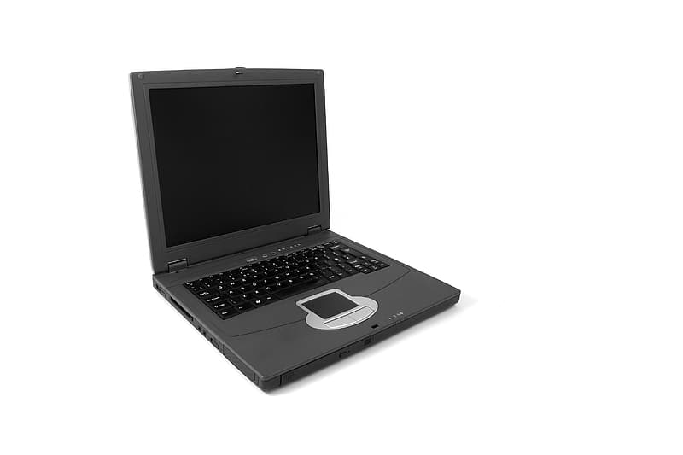
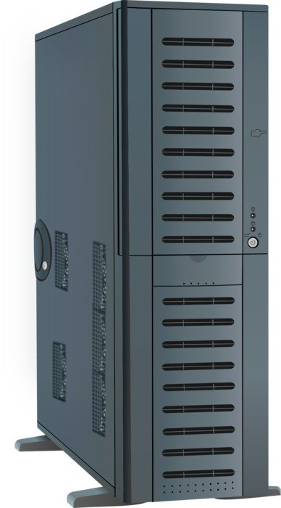
So how do we send an ASCI file to a Cluster?
Typically this is done via File Transfer Protocol (FTP)
Specifically, the Clusters like to be safe, so the Secure FTP is required.
A Cluster runs a SFTP server, while the User interacts with it using a SFTP client
The client can be either a graphical user interface (GUI) program on your PC or it can be a terminal-line program (e.g., the Linux ‘scp’ command)
SFTP
SFTP client
SFTP server
Images: White and black laptop computer and Server Case Computer Drawing are in the public domain.

Slide 6
Transfering Files to Cluster: From MS Windows
Download and Install any FTP Client that supports the SFTP Protocol
Many are available… Note: some of them may contain ad-ware.
Let’s try WinSCP: https://winscp.net/eng/download.php

Slide 7
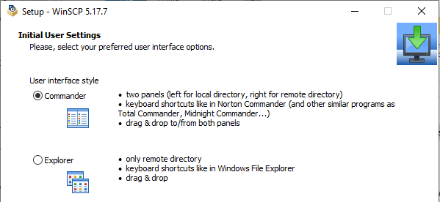
Transfering Files to Cluster: From MS Windows
I recommend the “Commander” option, where you can see both the local and the remote file directories on the same screen:

Slide 8
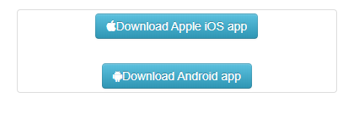

Transfering Files to a Cluster: Demonstration
Stampede2 is a Texas Advanced Computing Center (TACC) cluster.
Other clusters should be similar, but the additional layer of security below.
TACC requires Multi-Factor Authentication, which is like a 2nd password
You have a choice of 3 ways the password can be delivered to you: 1) A text message to your phone; 2) A physical dongle that you need to purchase for a small price; or 3) An app that you download on your phone or tablet device.
All three are equivalent, but let’s go with the app, because it is the easiest:
Download & Install the TACC app on your phone or tablet device from its app store.
Use the app to scan a personalized QR code generated within your TACC User Portal Account to pair it with your login credentials.

Slide 9
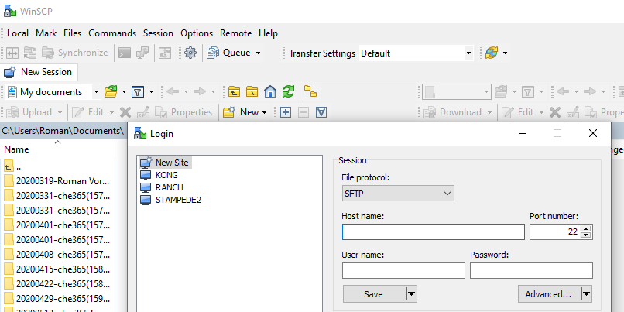
Transfering Files to Cluster: From MS Windows
Step 1: Click “New Session”
Step 2: leave as default
Step 3:
Enter the address of the cluster, and your login credentials
stampede2.tacc.utexas.edu

Slide 10
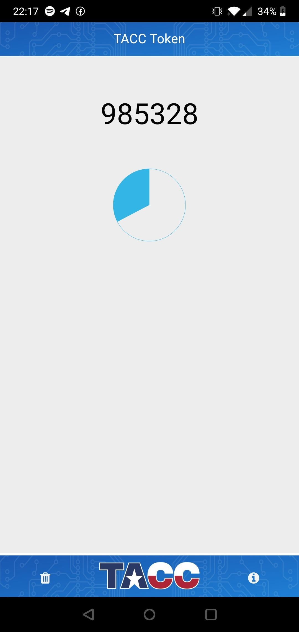
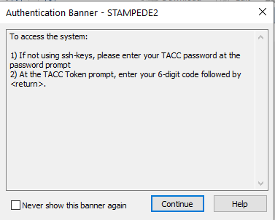
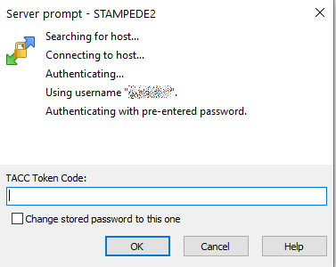
Transfering Files to a Cluster: Logging into Cluster
After you push the Login button, this prompt will show up
Next, enter the TACC Token Code from your App (before it expires!)
Expiration Clock

Slide 11
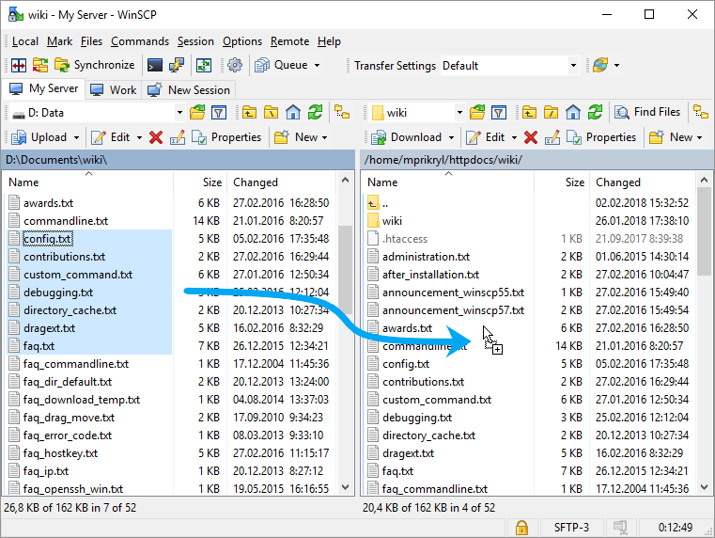
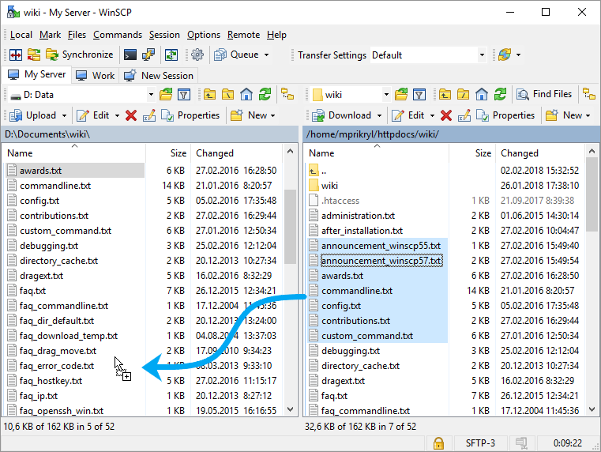
Transfering Files to a Cluster: Drag & Drop
Left Side is Local Files on your PC, While Right Side is the Remote Files on the Cluster
UPLOADING: LOCAL → REMOTE
DOWNLOADING: LOCAL ← REMOTE

Slide 12
A Little House-Keeping: The Dos2Unix Command
So you have transferred your code to a cluster, but you get weird errors when trying to compile it… What’s wrong?! Your code might actually be ok!
While editing files on Windows and uploading them to a Linux server is convenient, it can cause unforeseen complications: Windows-based text editors add special hidden characters at the end of lines to denote a line return or newline.
Dos2unix is a terminal tool that converts DOS format (carriage return + Line feed) to line breaks in a text file from Unix format (Line feed) to vice versa. (History Lesson: DOS is the non-graphical predecessor of Windows, and Unix is the predecessor of Linux→ Thus, the name of the command.)
So, if a file has ever “lived” on Windows, it is prudent to run the ‘dos2unix’ it immediately after transferring it to the cluster! Example, open a terminal and execute: dos2unix myfilename Or, you if you have many small files: dos2unix *

Slide 13
Terminal to Cluster: File Transfer
An alternative way to transfer files to a cluster is through the terminal.
As you have learned in a previous lesson, the terminal is the primary way to send commands to the cluster.
However, you can also use it to create new files and paste small content into them (do not do this to large files):
1. How to Create an Empty File
The following touch command creates an empty (zero byte) new file named myfile.f90:
# touch myfile.f90

Slide 14
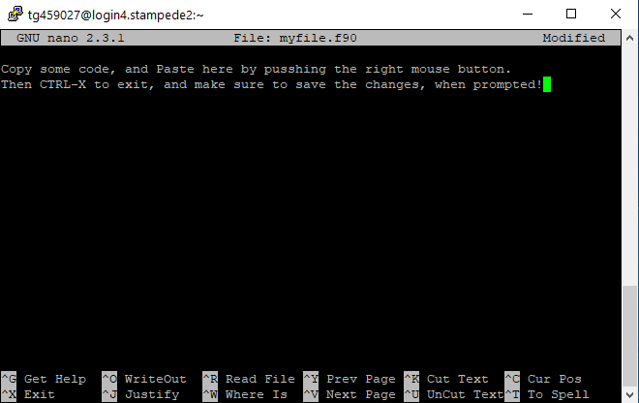
Terminal to Cluster: File Transfer
2. Paste Your Code Into the File:
Open myfile.f90 with a
text editor, such as ‘nano’:
# nano myfile.f90
And Copy/Paste code into it,
As explained on the right →
Finally, save changes.

Slide 15
Terminal to Cluster: File Transfer (Linux & MacOS)
Another way to transfer files via the terminal is the SCP (secure copy) is a command-line utility that allows you to securely copy files and directories between two locations. With ‘scp’, you can copy a file or directory:
From your local system to a remote system.
From a remote system to your local system.
Between two remote systems from your local system.
The scp command syntax take the following form:
scp [OPTION] [user@]SRC_HOST:]file1 [user@]DEST_HOST:]file2
For example, to copy a file from a local to a remote system (e.g., Stampede2) run the following command:
scp file.txt remote_username@stampede2.tacc.utexas.edu:/remote/directory
To copy a file named file.txt from a remote server (e.g., Stampede2) run the following command:
scp remote_username@stampede2.tacc.utexas.edu:/remote/file.txt /local/directory
The following command will copy the file /files/file.txt from the remote host 1 (e.g., Stampede2) to the directory /files on the remote host 2 (e.g., TACC’s storage facility Ranch).
scp username1@stampede2.tacc.utexas.edu:/files/file.txt username2@ranch.tacc.utexas.edu:/files
Note that the MS Windows terminal does not support ‘scp’ by default!

Slide 16
References / Further Reading:
Overview: How to Use an SFTP Client:
https://www.jscape.com/blog/bid/103831/How-to-Use-an-SFTP-Client
8 Practical Examples of Linux “Touch” Command:
https://www.tecmint.com/8-pratical-examples-of-linux-touch-command/
How to Use SCP Command to Securely Transfer Files:
https://linuxize.com/post/how-to-use-scp-command-to-securely-transfer-files/
Stampede2 User Guide:
https://portal.tacc.utexas.edu/user-guides/stampede2
Ranch User Guide:
https://portal.tacc.utexas.edu/user-guides/ranch

