Slide 1
BOUNCIE GPS
UX AUDIT
Identifying Experience Gaps
for TrackLynk Advantage
PHASE 1 · COMPETITIVE UX ANALYSIS · 2026
Competing on experience — not on features.

Slide 2
THE MANDATE
“We’re not trying to compete on a feature
or technical perspective. We are solely
competing on UX usability.”
— Lam Huynh, Project Lead
✦ Does it look good?
✦ Is it easy to use?
✦ Is it easy to buy?

Slide 3
SCOPE OF REVIEW
FLOWS REVIEWED
NOT YET COVERED
✓
Account Creation
Sign-up form, Face ID setup
✕
Home / dashboard screen
✓
Device Onboarding
VIN entry, IMEI scan, vehicle setup
✕
Multi-vehicle list view
✓
Subscription & Payment
Activation + billing flow
✕
Notification / alert inbox
✓
Live Tracking
Map view, speed band overlay
✕
Alert config detail screens
✓
Trip History & Detail
Drive stats, speed, fuel, habits
✕
Full trip list (history scroll)
✓
Geofence Creation
Geo-zone setup & alert config
✕
Fleet-specific management view
✓
Settings
Speed, impact, curfew controls

Slide 4
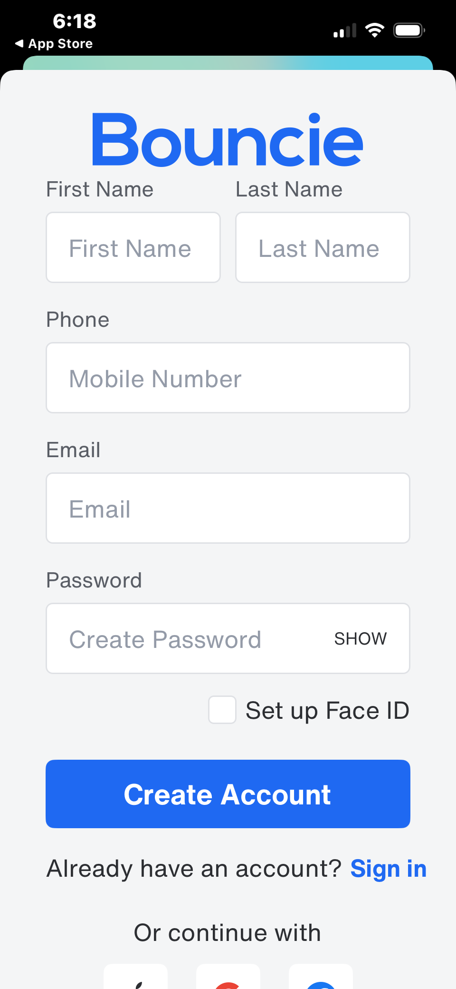
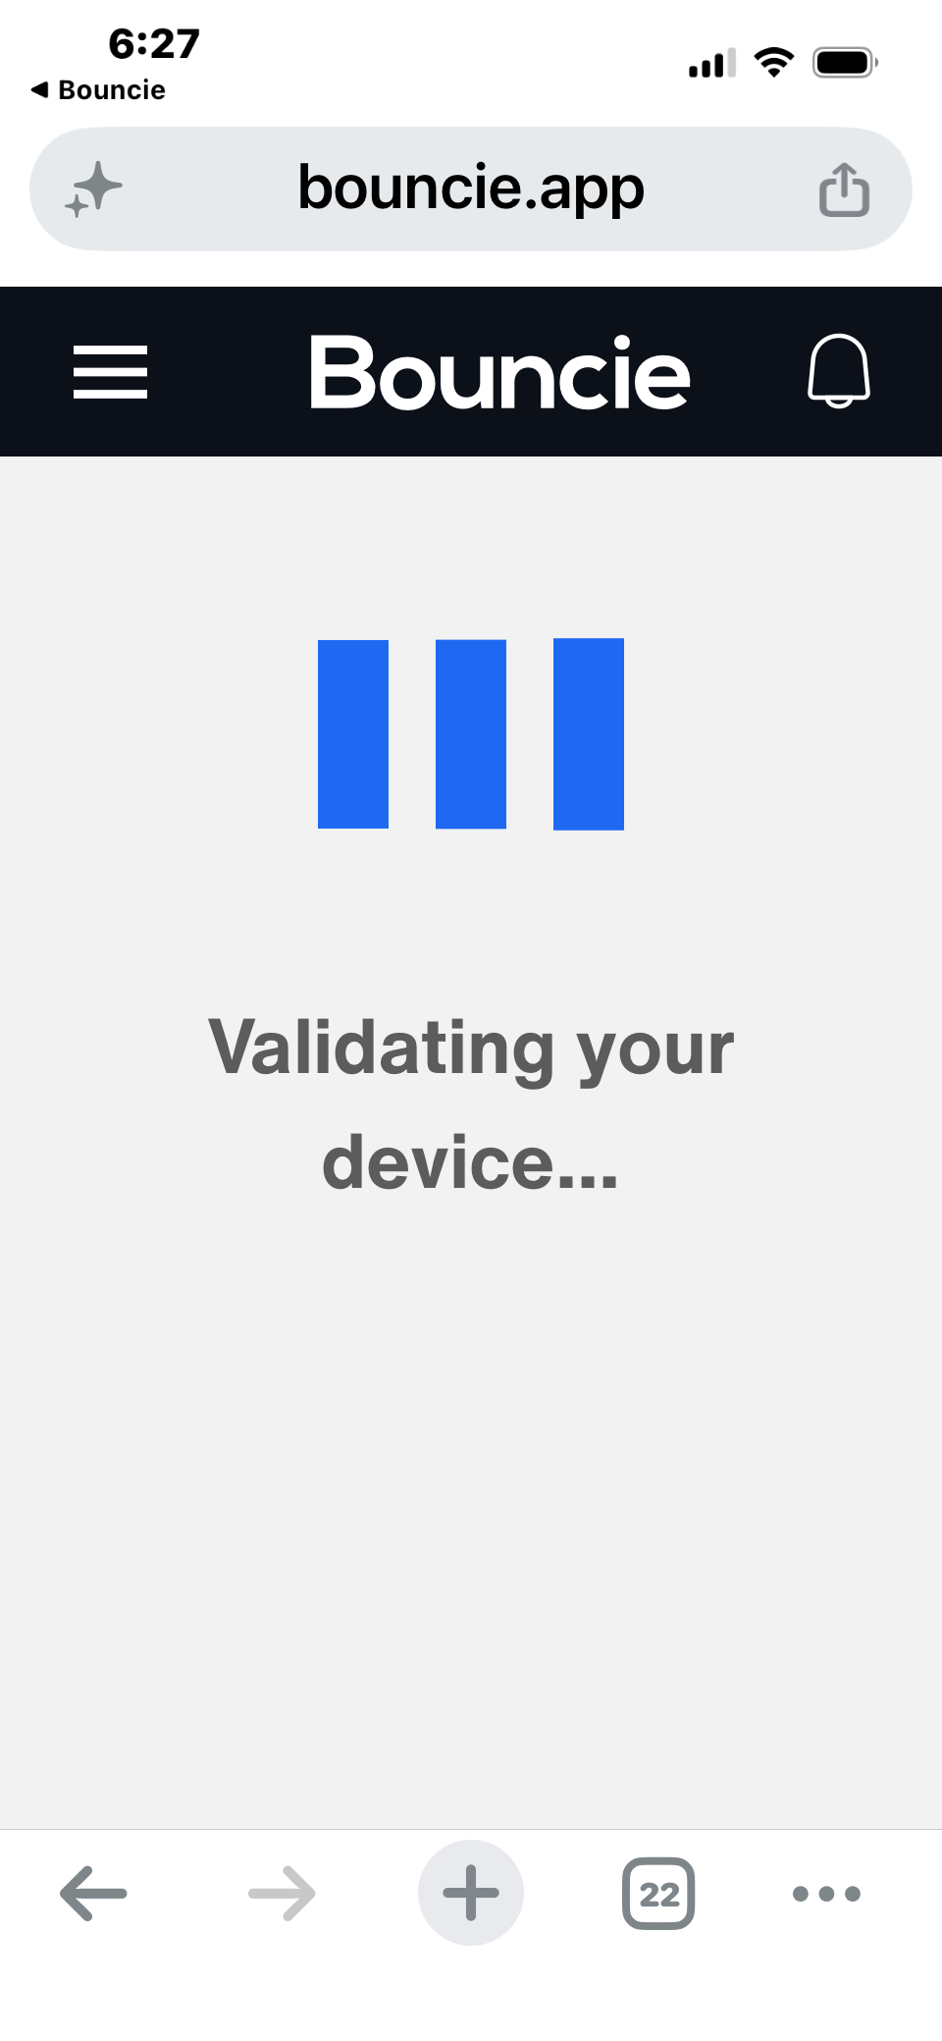
GAP 01
Onboarding Context Switch
THE PROBLEM
Bouncie drops users from the native app into a mobile browser at the most critical moment — device validation and payment — breaking trust and flow continuity.
▶
Mid-flow switch!
IMPACT
— Users lose the native navigation & back gestures
— Browser header + address bar erodes trust at payment
— No cohesive visual identity during checkout
SEVERITY: HIGH · Directly impacts conversion rate
NATIVE APP
MOBILE BROWSER

Slide 5
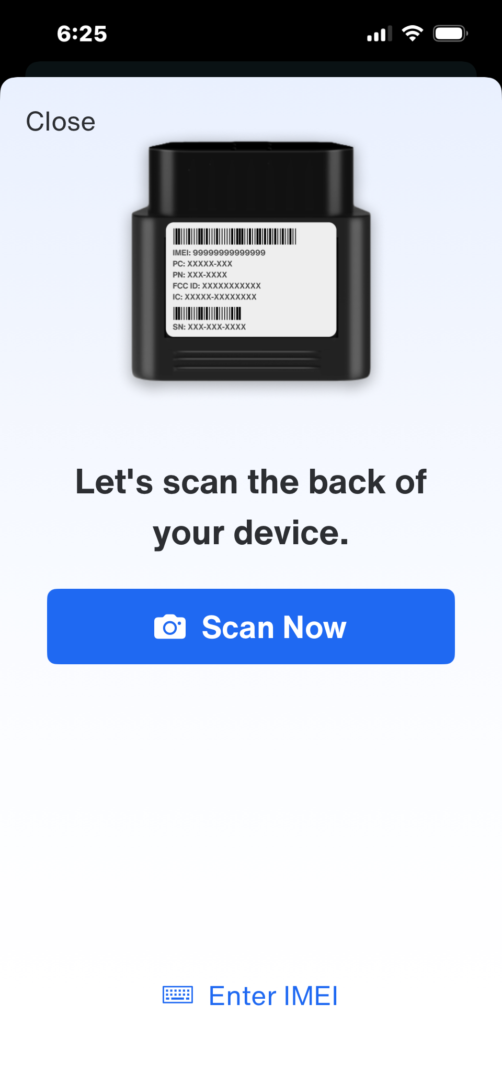
GAP 02
No Fleet Onboarding Wizard
BOUNCIE TODAY
TRACKLYNK OPPORTUNITY
✕
Single-device setup only
✓
Guided multi-vehicle setup wizard
✕
No bulk VIN / IMEI import
✓
Bulk IMEI/VIN import (CSV or scan)
✕
No role assignment (manager vs driver)
Role-based access: Manager, Driver, Viewer
✓
✕
No fleet profile or grouping
Automatic geofence templates on setup
✓
✕
No batch geofence creation
Fleet grouping with one-tap monitoring
✓
✕
Repeat setup for every device
One device at a time
SEVERITY: HIGH · Fleet persona is completely unserved

Slide 6
GAP 03
Circles-Only Geofencing
THE PROBLEM
UX IMPACT ANALYSIS
Bouncie only supports circular geofences. Real-world sites — warehouses, depots, parking lots, customer premises — are never circles. Circles leave dead zones or over-extend coverage in every direction.
Fleet operators
Can't accurately fence a depot or yard — circle always spills over
Parents
BOUNCIE
(circles only)
TRACKLYNK
(custom polygons)
School zone circles cover neighboring streets, triggering false alerts
Business owners
No way to define irregular customer site boundaries
Geofence setup UI also lacks polygon drawing tools, resize handles, or snap-to-road. Users have no precision controls.
SEVERITY: MEDIUM · Fleet persona, site-based businesses

Slide 7
GAP 04
Fragmented Trip Data Architecture
Details vs Events Tabs
No Hierarchy on Data
Buried Drive Filters
Trip data is split across 2 tabs with no explanation of what 'Events' means. Users must hunt for information rather than seeing the full picture at a glance.
Speed, fuel, drive distance, idle time and habits are presented with equal visual weight. There's no way to know what's most important or actionable.
The date-range filter panel is hidden with no clear affordance. New users won't discover 'Last 30 days' or custom date range without trial and error.
FIX →
FIX →
FIX →
Single scrollable trip view with contextual event markers on the map.
Prioritized summary card with drill-down for secondary metrics.
Persistent filter chips above the list — visible at all times.

Slide 8
GAP 05
Color-Only Speed Visualization
THE PROBLEM
TRACKLYNK OPPORTUNITY
Bouncie's speed bands use color as the only signal — green, yellow, orange, red, purple. No labels on the road, no speed numbers visible without opening the legend. This fails colorblind users and creates a steep learning curve for new users.
Inline speed labels on the road segments — no legend required. Users see actual numbers at a glance.
Also add:
✓
Speed vs limit indicator (e.g. +12 MPH over)
BOUNCIE'S LEGEND (floating, off-screen by default):
✓
Pattern + color dual encoding for accessibility
0–35 MPH
!
color only
35–45 MPH
!
color only
Persistent mini-legend anchored to map corner
✓
45–50 MPH
!
color only
50–65 MPH
!
color only
✓
Tap-to-see-speed on any road segment
65+ MPH
!
color only
SEVERITY: MEDIUM · Accessibility concern — fails WCAG 1.4.1 (Use of Color)

Slide 9
GAP 06
Flat Settings — No Progressive Disclosure
Settings
UX FAILURES IN SETTINGS
Speed
›
No descriptions
Geo-Zones
›
Each row is a bare label. Users have no idea what 'Impact Detection' does until they tap it.
!
Impact Detection
›
No grouping or hierarchy
Safety alerts, behavior tracking, and time rules are all one flat list. No mental model for the user.
Rapid Acceleration
›
Hard Braking
›
No inline previews
Current alert thresholds aren't visible without drilling in — users can't confirm their settings at a glance.
Curfews
›
No recommended defaults
Trip Start and End
›
First-time users have zero guidance on what to set. No tooltips, no setup prompts, no presets.
SEVERITY: MEDIUM · Raises support burden, lowers user confidence

Slide 10
UX Gap Summary
#
UX Gap
Personas Affected
Severity
Fix Effort
Onboarding Context Switch
All users
Medium
01
HIGH
No Fleet Onboarding Wizard
Fleet ops
High
02
HIGH
Circles-Only Geofencing
Fleet, Business
High
03
MEDIUM
Fragmented Trip Data Architecture
All users
Low
04
MEDIUM
Color-Only Speed Bands
All users
Low
05
MEDIUM
Flat Settings / No Disclosure
All users
Low
06
MEDIUM
2 HIGH severity gaps · 4 MEDIUM severity gaps · 3 low-effort quick wins available immediately

Slide 11
WHERE TRACKLYNK WINS
Our Competitive
Edge in UX
01
02
03
Unified native onboarding
Fleet-first experience
Polygon geofencing
Zero browser hand-offs. Setup — device, subscription, fleet — stays entirely inside the app.
Wizard-driven multi-vehicle setup, role-based views, and batch config from day one.
Draw any shape. Precision controls. Real-world site accuracy for every persona.
04
05
Intelligent trip view
Accessible speed viz
One screen, clear hierarchy, contextual insights — not a tab-hunting expedition.
Speed labels + color dual encoding. Every user — colorblind or not — reads the map instantly.
TRACKLYNK · Phase 1 UX Competitive Analysis · 2026

