Slide 1
COMPETITIVE UX RESEARCH
Bouncie
UX Gap Analysis
TrackLynk Lite · Competitive UX Research · 2025

Slide 2
THE FULL ONBOARDING FLOW
13 Steps Before You Can Track Your Vehicle
1
Create
Account
2
Face ID
Setup
3
Enter
VIN
4
VIN
Match
5
Vehicle
Details
6
Customize
Emblem
7
Scan
Device
8
Ready to
Activate
9
Validating
10
Device
Validated
11
Subscription
Setup
12
Billing
Address
13
Payment
UX Gap Identified
2.2 / 5
Trustpilot Score
4.8 / 5
App Store Rating
Acceptable Step
Score gap reveals real UX pain that polished app store screenshots hide
TrackLynk Lite · Bouncie UX Gap Analysis · Competitive Research 2025

Slide 3
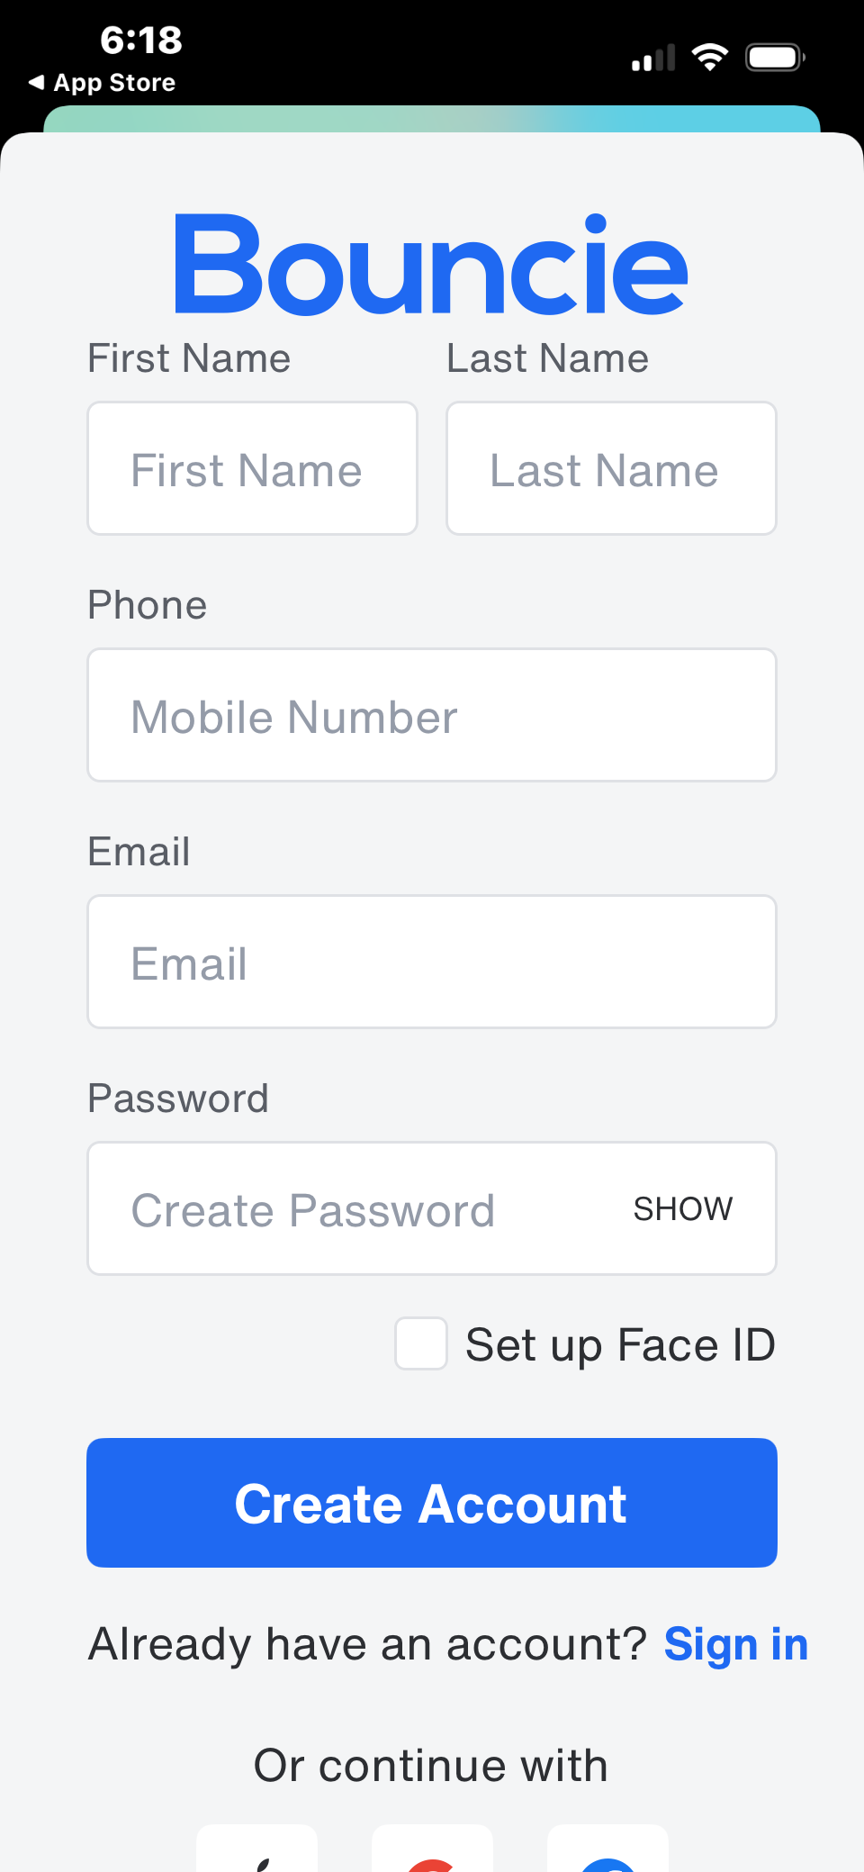
GAP 01
OF 07
No Welcome
Screen
Users land directly on a sign-up form. No intro, no value proposition, no reason to care. The product doesn't introduce itself at all.
WHY THIS HURTS
First impression is a blank registration form — not a product pitch
No context on what the app does before demanding personal data
Increases drop-off before a single field is filled
BOUNCIE — CURRENT STATE
TrackLynk Lite · Bouncie UX Gap Analysis · Competitive Research 2025

Slide 4
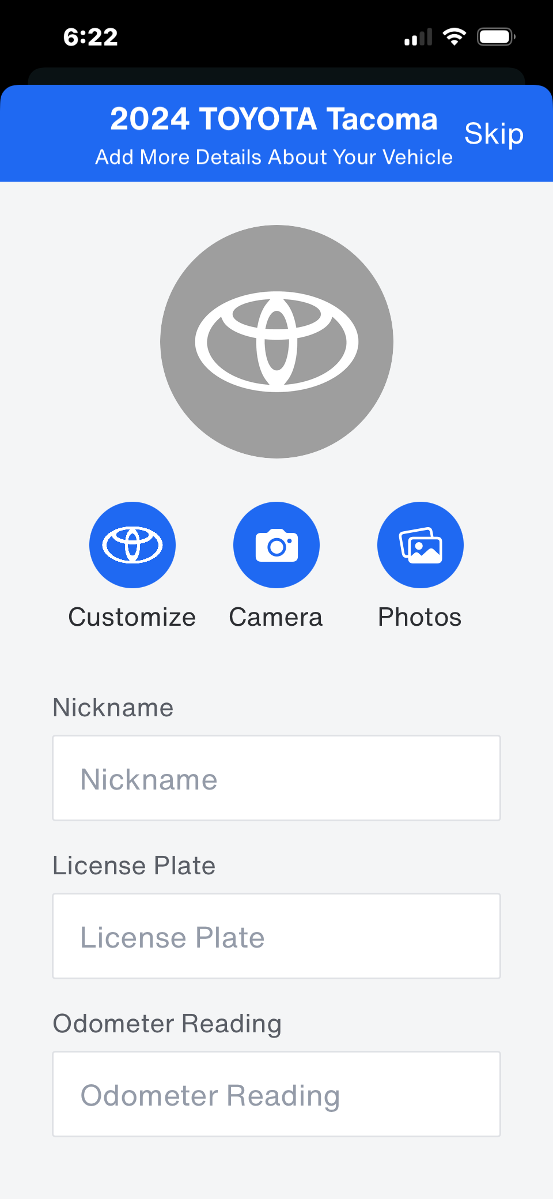
GAP 02
OF 07
No Progress
Indicator
13 screens of setup with zero indication of how far along the user is. They have no idea when it ends — creating anxiety and abandonment.
WHY THIS HURTS
Users can't gauge time investment before committing
No sense of completion creates mid-flow frustration
Industry standard for multi-step flows is to always show progress
BOUNCIE — CURRENT STATE
TrackLynk Lite · Bouncie UX Gap Analysis · Competitive Research 2025

Slide 5
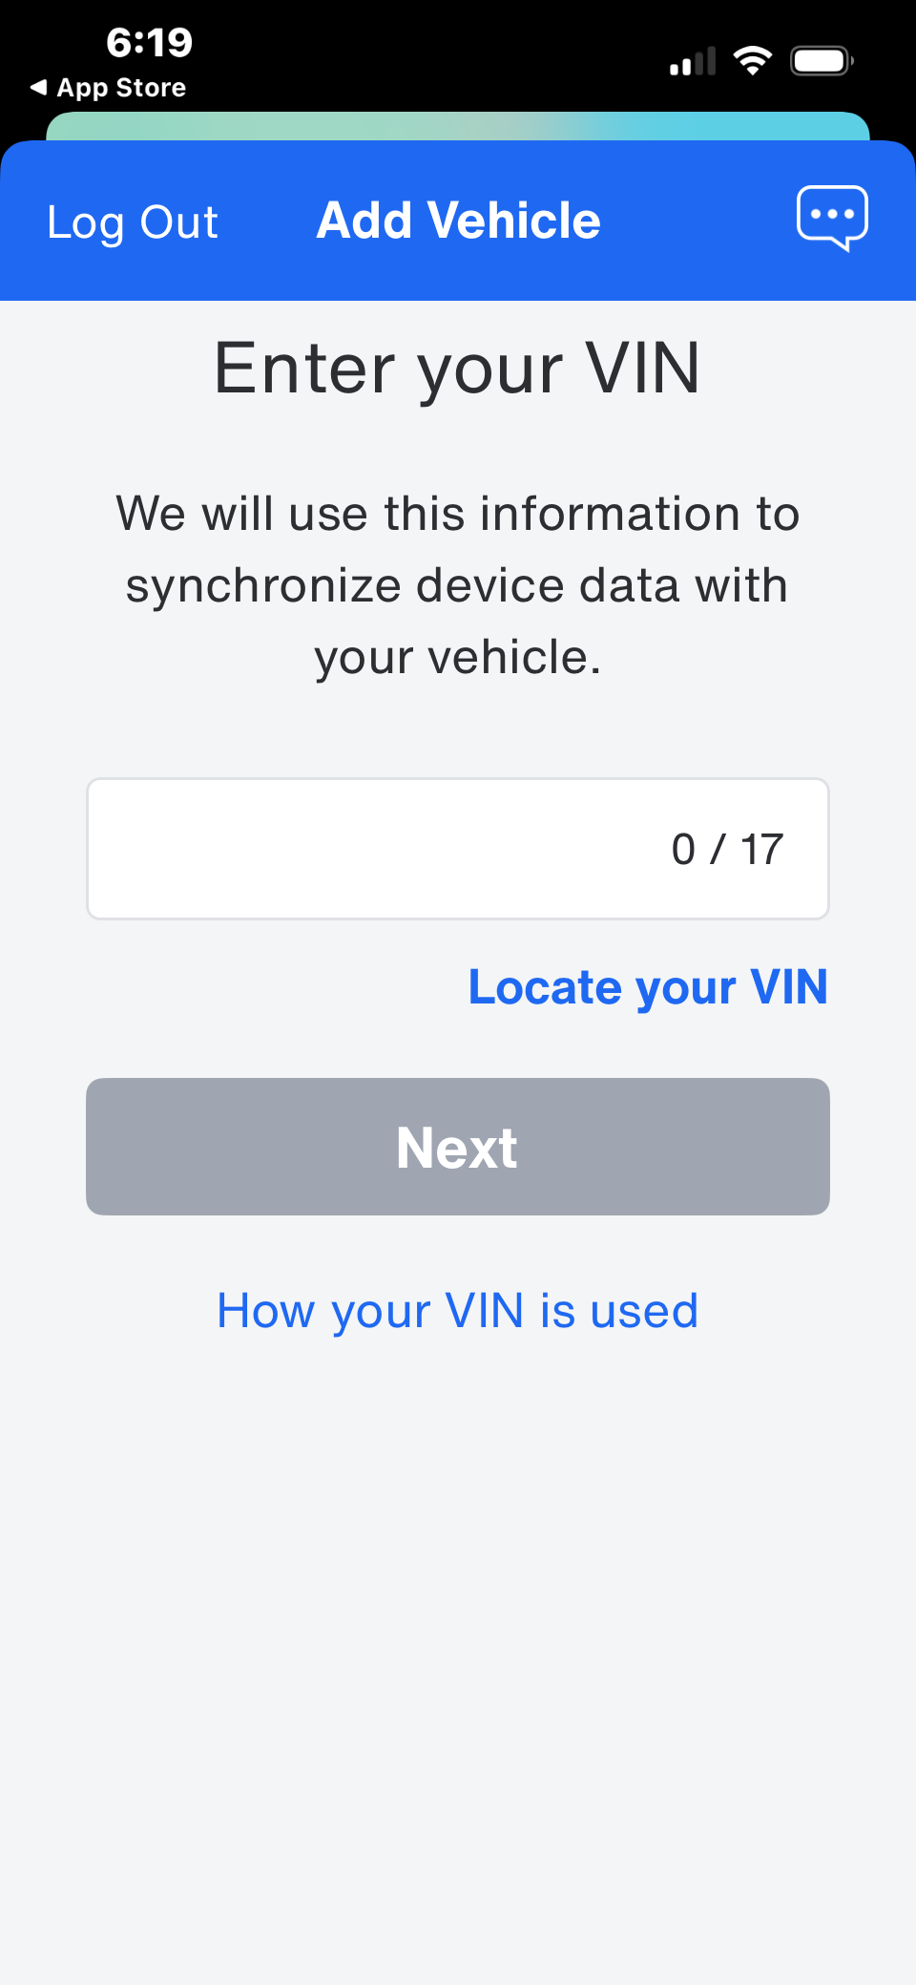
GAP 03
OF 07
Cold
VIN Entry
Step 3 asks for a 17-character alphanumeric code with no guidance on what a VIN is or where to find it. The help link is tiny and easy to miss.
WHY THIS HURTS
"Locate your VIN" is a small hyperlink — no visual hierarchy
No camera scan option at this step (only appears later for the device)
Immediately filters out non-car-savvy users who give up
BOUNCIE — CURRENT STATE
TrackLynk Lite · Bouncie UX Gap Analysis · Competitive Research 2025

Slide 6
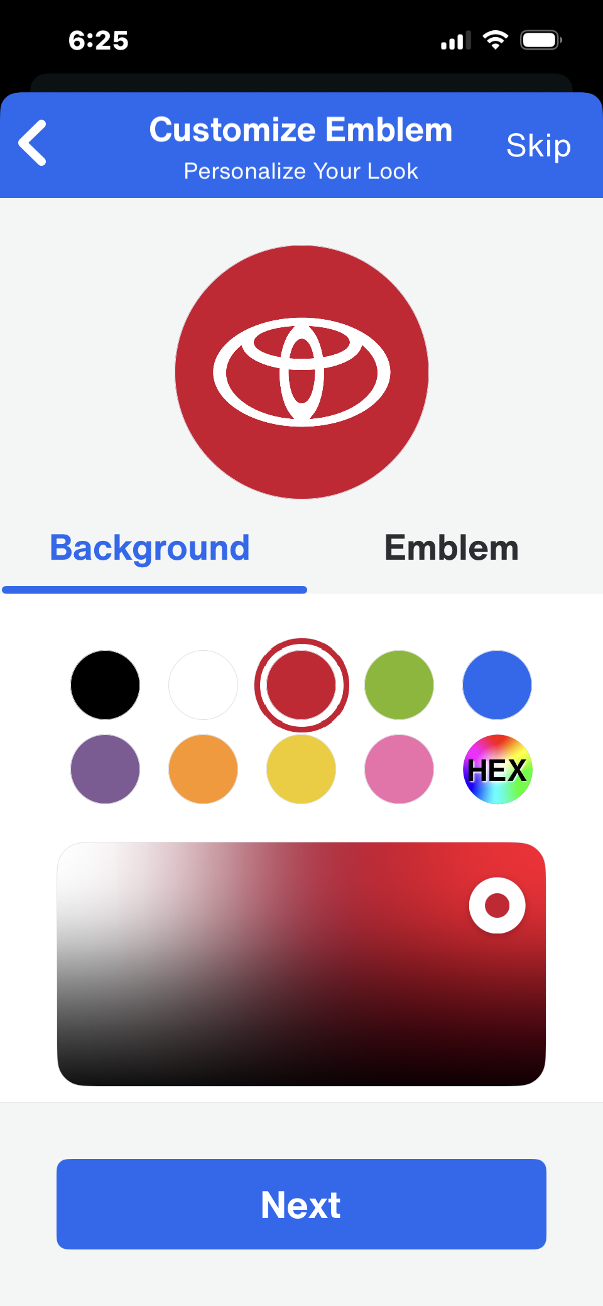
GAP 04
OF 07
Emblem
Customization
Too Early
Before the device is even connected, users are taken through a full color-picker to style their vehicle's logo emblem. Vanity before utility.
WHY THIS HURTS
Users haven't verified setup works — why are they decorating?
Customization belongs post-setup, not mid-onboarding
Signals misaligned product priorities right at the start
BOUNCIE — CURRENT STATE
TrackLynk Lite · Bouncie UX Gap Analysis · Competitive Research 2025

Slide 7
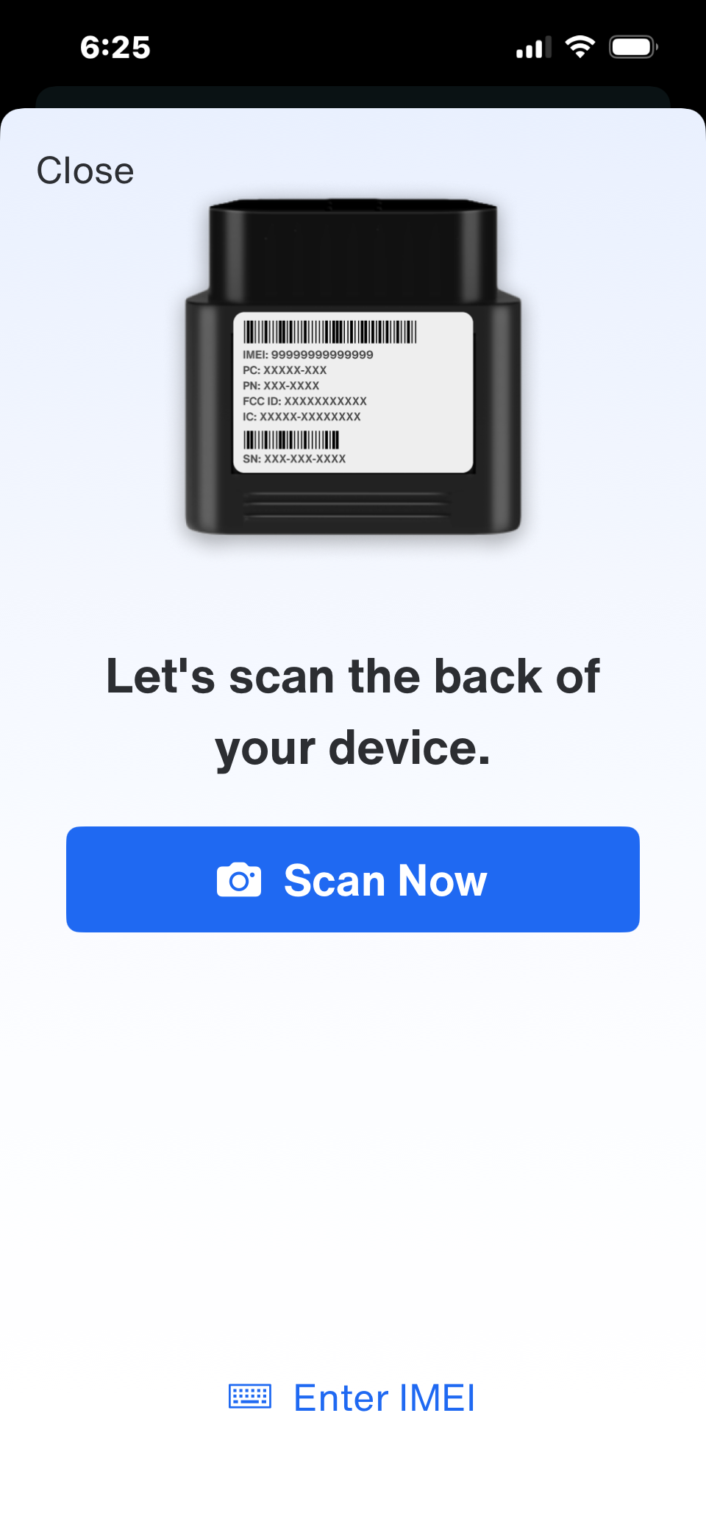
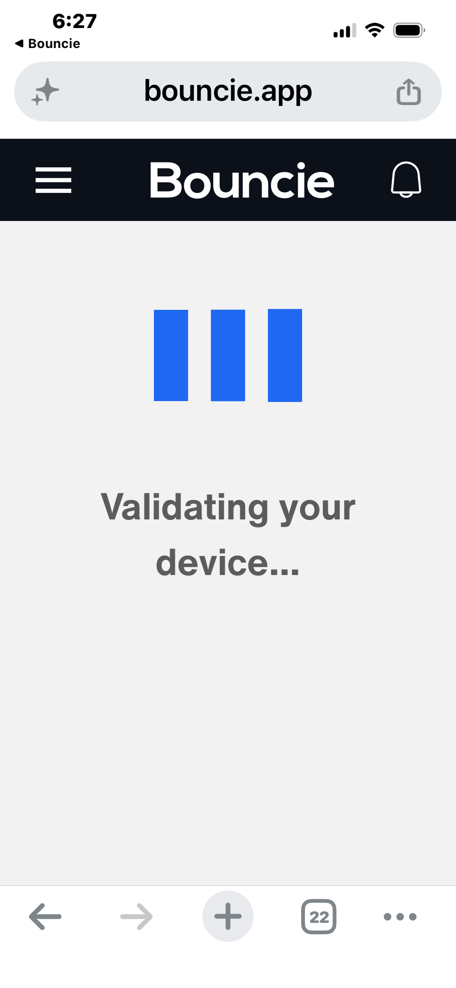
GAP 05
OF 07
App Hands Off
to the Browser
Mid-setup, the native app silently opens a mobile browser (bouncie.app) for device validation and subscription. The experience breaks completely.
!
WHY THIS HURTS
URL bar and browser chrome appear — trust instantly drops
Interaction pattern shifts without warning (native → web)
Users question if they're still in the right place or got phished
NATIVE APP
→ BROWSER
TrackLynk Lite · Bouncie UX Gap Analysis · Competitive Research 2025

Slide 8
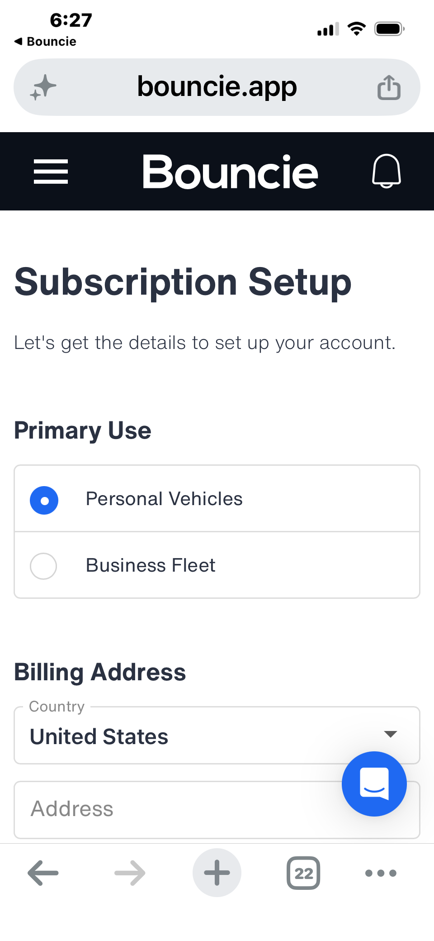
GAP 06
OF 07
Pricing
Hidden Until
Step 13
The $9.65/month subscription cost only appears at the very last screen — after the user has invested time through 12 prior steps.
WHY THIS HURTS
Users don't know what they're committing to until it's too late
Feels like a bait-and-switch — erodes trust at the purchase moment
Informed consent requires showing cost before commitment, not at checkout
BOUNCIE — CURRENT STATE
TrackLynk Lite · Bouncie UX Gap Analysis · Competitive Research 2025

Slide 9
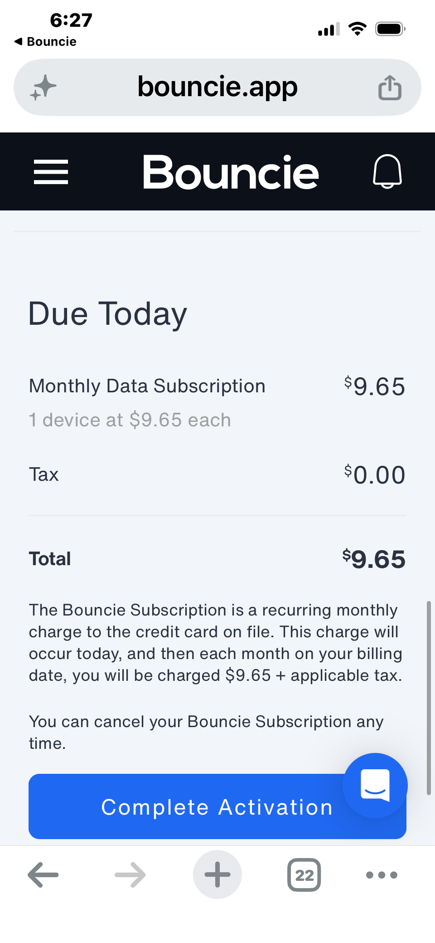
GAP 07
OF 07
No Success
State
The flow ends at "Complete Activation." There's no confirmation, no celebration, no signal that anything actually worked. The journey just stops.
WHY THIS HURTS
Zero positive reinforcement after a 13-step ordeal
Users are left uncertain — did it work? Is the device active?
A missed chance to set expectations for what happens next
⚠ LAST SCREEN — NOTHING FOLLOWS
TrackLynk Lite · Bouncie UX Gap Analysis · Competitive Research 2025

Slide 10
THE OPPORTUNITY
7 Gaps. 7 Places TrackLynk Wins.
01
02
03
04
No Welcome Screen
No Progress Indicator
Cold VIN Entry
Emblem Too Early
→ Lead with value, not a form
→ Show users exactly where they are
→ Guide and scan — don't dump a field
→ Customise after setup is confirmed
05
06
07
App → Browser Switch
Pricing Hidden at Step 13
No Success State
→ Keep the entire flow native
→ Show cost before commitment
→ Celebrate and orient the user
Phase 1 is a UX race — and Bouncie just handed us the roadmap.
TrackLynk Lite · Bouncie UX Gap Analysis · Competitive Research 2025

