Slide 1
Programming with OpenGL
Part 1: Background
Ed Angel
Professor Emeritus of Computer Science
University of New Mexico
E. Angel and D. Shreiner: Interactive Computer Graphics 6E © Addison-Wesley 2012

Slide 2
Objectives
Development of the OpenGL API
OpenGL Architecture
  OpenGL as a state machine
  OpenGL as a data flow machine
Functions
  Types
  Formats
Simple program
E. Angel and D. Shreiner: Interactive Computer Graphics 6E © Addison-Wesley 2012

Slide 3
Early History of APIs
IFIPS (1973) formed two committees to come up with a standard graphics API
  Graphical Kernel System (GKS)
    2D but contained good workstation model
  Core
    Both 2D and 3D
  GKS adopted as IS0 and later ANSI standard (1980s)
GKS not easily extended to 3D (GKS-3D)
  Far behind hardware development
E. Angel and D. Shreiner: Interactive Computer Graphics 6E © Addison-Wesley 2012

Slide 4
PHIGS and X
Programmers Hierarchical Graphics System (PHIGS)
  Arose from CAD community
  Database model with retained graphics (structures)
X Window System
  DEC/MIT effort
  Client-server architecture with graphics
PEX combined the two
  Not easy to use (all the defects of each)
E. Angel and D. Shreiner: Interactive Computer Graphics 6E © Addison-Wesley 2012

Slide 5
SGI and GL
Silicon Graphics (SGI) revolutionized the graphics workstation by implementing the pipeline in hardware (1982)
To access the system, application programmers used a library called GL
With GL, it was relatively simple to program three dimensional interactive applications
E. Angel and D. Shreiner: Interactive Computer Graphics 6E © Addison-Wesley 2012

Slide 6
OpenGL
The success of GL lead to OpenGL (1992), a platform-independent API that was
  Easy to use
  Close enough to the hardware to get excellent performance
  Focus on rendering
  Omitted windowing and input to avoid window system dependencies
E. Angel and D. Shreiner: Interactive Computer Graphics 6E © Addison-Wesley 2012

Slide 7
OpenGL Evolution
Originally controlled by an Architectural Review Board (ARB)
  Members included SGI, Microsoft, Nvidia, HP, 3DLabs, IBM,…….
  Now Kronos Group
  Was relatively stable (through version 2.5)
    Backward compatible
    Evolution reflected new hardware capabilities
      3D texture mapping and texture objects
      Vertex and fragment programs
  Allows platform specific features through extensions
E. Angel and D. Shreiner: Interactive Computer Graphics 6E © Addison-Wesley 2012

Slide 8
Modern OpenGL
Performance is achieved by using GPU rather than CPU
Control GPU through programs called shaders
Application’s job is to send data to GPU
GPU does all rendering
E. Angel and D. Shreiner: Interactive Computer Graphics 6E © Addison-Wesley 2012

Slide 9
OpenGL 3.1
Totally shader-based
  No default shaders
  Each application must provide both a vertex and a fragment shader
No immediate mode
Few state variables
Most 2.5 functions deprecated
Backward compatibility not required
E. Angel and D. Shreiner: Interactive Computer Graphics 6E © Addison-Wesley 2012

Slide 10
Other Versions
OpenGL ES
  Embedded systems
  Version 1.0 simplified OpenGL 2.1
  Version 2.0 simplified OpenGL 3.1
    Shader based
WebGL
  Javascript implementation of ES 2.0
  Supported on newer browsers
OpenGL 4.1 and 4.2
  Add geometry shaders and tessellator
E. Angel and D. Shreiner: Interactive Computer Graphics 6E © Addison-Wesley 2012

Slide 11
What About Direct X?
Windows only
Advantages
  Better control of resources
  Access to high level functionality
Disadvantages
  New versions not backward compatible
  Windows only
Recent advances in shaders are leading to convergence with OpenGL
E. Angel and D. Shreiner: Interactive Computer Graphics 6E © Addison-Wesley 2012

Slide 12
OpenGL Libraries
OpenGL core library
  OpenGL32 on Windows
  GL on most unix/linux systems (libGL.a)
OpenGL Utility Library (GLU)
  Provides functionality in OpenGL core but avoids having to rewrite code
  Will only work with legacy code
Links with window system
  GLX for X window systems
  WGL for Windows
  AGL for Macintosh
E. Angel and D. Shreiner: Interactive Computer Graphics 6E © Addison-Wesley 2012

Slide 13
GLUT
OpenGL Utility Toolkit (GLUT)
  Provides functionality common to all window systems
    Open a window
    Get input from mouse and keyboard
    Menus
    Event-driven
  Code is portable but GLUT lacks the functionality of a good toolkit for a specific platform
    No slide bars
E. Angel and D. Shreiner: Interactive Computer Graphics 6E © Addison-Wesley 2012

Slide 14
freeglut
GLUT was created long ago and has been unchanged
  Amazing that it works with OpenGL 3.1
  Some functionality can’t work since it requires deprecated functions
freeglut updates GLUT
  Added capabilities
  Context checking
E. Angel and D. Shreiner: Interactive Computer Graphics 6E © Addison-Wesley 2012

Slide 15
GLEW
OpenGL Extension Wrangler Library
Makes it easy to access OpenGL extensions available on a particular system
Avoids having to have specific entry points in Windows code
Application needs only to include glew.h and run a glewInit()
E. Angel and D. Shreiner: Interactive Computer Graphics 6E © Addison-Wesley 2012

Slide 16
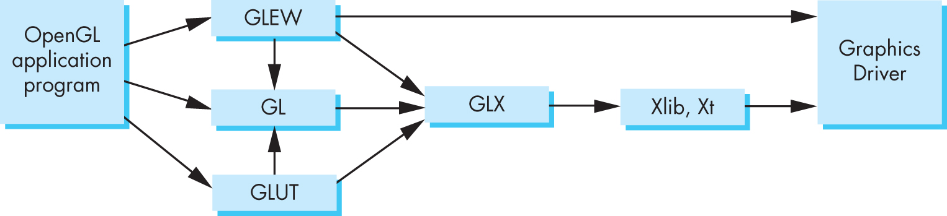
Software Organization
E. Angel and D. Shreiner: Interactive Computer Graphics 6E © Addison-Wesley 2012

Slide 17
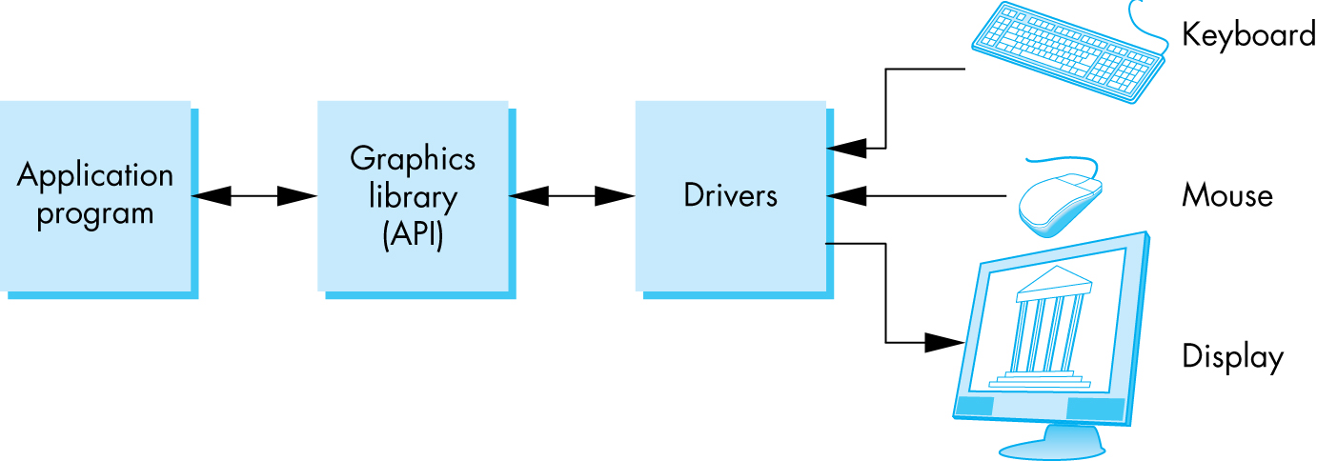
OpenGL Architecture
E. Angel and D. Shreiner: Interactive Computer Graphics 6E © Addison-Wesley 2012

Slide 18
OpenGL Functions
Primitives
  Points
  Line Segments
  Triangles
Attributes
Transformations
  Viewing
  Modeling
Control (GLUT)
Input (GLUT)
Query
E. Angel and D. Shreiner: Interactive Computer Graphics 6E © Addison-Wesley 2012

Slide 19
OpenGL State
OpenGL is a state machine
OpenGL functions are of two types
  Primitive generating
    Can cause output if primitive is visible
    How vertices are processed and appearance of primitive are controlled by the state
  State changing
    Transformation functions
    Attribute functions
    Under 3.1 most state variables are defined by the application and sent to the shaders
E. Angel and D. Shreiner: Interactive Computer Graphics 6E © Addison-Wesley 2012

Slide 20
Lack of Object Orientation
OpenGL is not object oriented so that there are multiple functions for a given logical function
  glUniform3f
  glUniform2i
  glUniform3dv
Underlying storage mode is the same
Easy to create overloaded functions in C++ but issue is efficiency
E. Angel and D. Shreiner: Interactive Computer Graphics 6E © Addison-Wesley 2012

Slide 21
OpenGL function format
function name
dimensions
glUniform3f(x,y,z)
x,y,z are floats
belongs to GL library
glUniform3fv(p)
p is a pointer to an array
E. Angel and D. Shreiner: Interactive Computer Graphics 6E © Addison-Wesley 2012

Slide 22
OpenGL #defines
Most constants are defined in the include files gl.h, glu.h and glut.h
  Note #include <GL/glut.h> should automatically include the others
  Examples
  glEnable(GL_DEPTH_TEST)
  glClear(GL_COLOR_BUFFER_BIT)
include files also define OpenGL data types: GLfloat, GLdouble,….
E. Angel and D. Shreiner: Interactive Computer Graphics 6E © Addison-Wesley 2012

Slide 23
OpenGL and GLSL
Shader based OpenGL is based less on a state machine model than a data flow model
Most state variables, attributes and related pre 3.1 OpenGL functions have been deprecated
Action happens in shaders
Job is application is to get data to GPU
E. Angel and D. Shreiner: Interactive Computer Graphics 6E © Addison-Wesley 2012

Slide 24
GLSL
OpenGL Shading Language
C-like with
  Matrix and vector types (2, 3, 4 dimensional)
  Overloaded operators
  C++ like constructors
Similar to Nvidia’s Cg and Microsoft HLSL
Code sent to shaders as source code
New OpenGL functions to compile, link and get information to shaders
E. Angel and D. Shreiner: Interactive Computer Graphics 6E © Addison-Wesley 2012

Slide 25
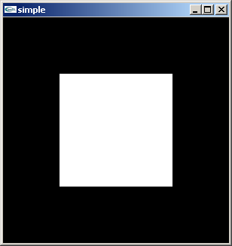
A Simple Program (?)
Generate a square on a solid background
E. Angel and D. Shreiner: Interactive Computer Graphics 6E © Addison-Wesley 2012

Slide 26

It used to be easy
#include <GL/glut.h>
void mydisplay(){
glClear(GL_COLOR_BUFFER_BIT);
glBegin(GL_QUAD;
glVertex2f(-0.5, -0.5);
glVertex2f(-0,5, 0,5);
glVertex2f(0.5, 0.5);
glVertex2f(0.5, -0.5);
glEnd()
}
int main(int argc, char** argv){
glutCreateWindow("simple");
glutDisplayFunc(mydisplay);
glutMainLoop();
}
E. Angel and D. Shreiner: Interactive Computer Graphics 6E © Addison-Wesley 2012

Slide 27
What happened
Most OpenGL functions deprecated
Makes heavy use of state variable default values that no longer exist
  Viewing
  Colors
  Window parameters
Next version will make the defaults more explicit
However, processing loop is the same
E. Angel and D. Shreiner: Interactive Computer Graphics 6E © Addison-Wesley 2012

Slide 28
simple.c
#include <GL/glut.h>
void mydisplay(){
glClear(GL_COLOR_BUFFER_BIT);
// need to fill in this part
// and add in shaders
}
int main(int argc, char** argv){
glutCreateWindow("simple");
glutDisplayFunc(mydisplay);
glutMainLoop();
}
E. Angel and D. Shreiner: Interactive Computer Graphics 6E © Addison-Wesley 2012

Slide 29
Event Loop
Note that the program specifies a display callback function named mydisplay
  Every glut program must have a display callback
  The display callback is executed whenever OpenGL decides the display must be refreshed, for example when the window is opened
  The main function ends with the program entering an event loop
E. Angel and D. Shreiner: Interactive Computer Graphics 6E © Addison-Wesley 2012

Slide 30
Notes on compilation
See website and ftp for examples
Unix/linux
  Include files usually in …/include/GL
  Compile with –lglut –lgl loader flags
  May have to add –L flag for X libraries
  Mesa implementation included with most linux distributions
  Check web for latest versions of Mesa and glut
E. Angel and D. Shreiner: Interactive Computer Graphics 6E © Addison-Wesley 2012

Slide 31
Compilation on Windows
Visual C++
  Get glut.h, glut32.lib and glut32.dll from web
  Install in same places as corresponding OpenGL files
  Create an empty application
  Add glut32.lib to project settings (under link tab)
  Same for freeglut and GLEW
Cygwin (linux under Windows)
  Can use gcc and similar makefile to linux
  Use –lopengl32–lglut32 flags
E. Angel and D. Shreiner: Interactive Computer Graphics 6E © Addison-Wesley 2012

