Slide 1
Programming with OpenGL
Part 2: Complete Programs
Ed Angel
Professor of Emeritus of Computer Science
University of New Mexico
E. Angel and D. Shreiner: Interactive Computer Graphics 6E © Addison-Wesley 2012

Slide 2
Objectives
Build a complete first program
  Introduce shaders
  Introduce a standard program structure
Simple viewing
  Two-dimensional viewing as a special case of three-dimensional viewing
Initialization steps and program structure
E. Angel and D. Shreiner: Interactive Computer Graphics 6E © Addison-Wesley 2012

Slide 3
Program Structure
Most OpenGL programs have a similar structure that consists of the following functions
  main():
    specifies the callback functions
    opens one or more windows with the required properties
    enters event loop (last executable statement)
  init(): sets the state variables
    Viewing
    Attributes
  initShader():read, compile and link shaders
  callbacks
    Display function
    Input and window functions
E. Angel and D. Shreiner: Interactive Computer Graphics 6E © Addison-Wesley 2012

Slide 4
simple.c revisited
main() function similar to last lecture
  Mostly GLUT functions
init() will allow more flexible colors
initShader() will hides details of setting up shaders for now
Key issue is that we must form a data array to send to GPU and then render it
E. Angel and D. Shreiner: Interactive Computer Graphics 6E © Addison-Wesley 2012

Slide 5
main.c
#include <GL/glew.h>
#include <GL/glut.h>
int main(int argc, char** argv)
{
glutInit(&argc,argv);
glutInitDisplayMode(GLUT_SINGLE|GLUT_RGB);
glutInitWindowSize(500,500);
glutInitWindowPosition(0,0);
glutCreateWindow("simple");
glutDisplayFunc(mydisplay);
glewInit();
init();
glutMainLoop();
}
includes gl.h
specify window properties
display callback
set OpenGL state and initialize shaders
enter event loop
E. Angel and D. Shreiner: Interactive Computer Graphics 6E © Addison-Wesley 2012

Slide 6
GLUT functions
glutInit allows application to get command line arguments and initializes system
gluInitDisplayMode requests properties for the window (the rendering context)
  RGB color
  Single buffering
  Properties logically ORed together
glutWindowSize in pixels
glutWindowPosition from top-left corner of display
glutCreateWindow create window with title “simple”
glutDisplayFunc display callback
glutMainLoop enter infinite event loop
E. Angel and D. Shreiner: Interactive Computer Graphics 6E © Addison-Wesley 2012

Slide 7
Immediate Mode Graphics
Geometry specified by vertices
  Locations in space( 2 or 3 dimensional)
  Points, lines, circles, polygons, curves, surfaces
Immediate mode
  Each time a vertex is specified in application, its location is sent to the GPU
  Old style uses glVertex
  Creates bottleneck between CPU and GPU
  Removed from OpenGL 3.1
E. Angel and D. Shreiner: Interactive Computer Graphics 6E © Addison-Wesley 2012

Slide 8
Retained Mode Graphics
Put all vertex and attribute data in array
Send array to GPU to be rendered immediately
Almost OK but problem is we would have to send array over each time we need another render of it
Better to send array over and store on GPU for multiple renderings
E. Angel and D. Shreiner: Interactive Computer Graphics 6E © Addison-Wesley 2012

Slide 9
Display Callback
Once we get data to GLU, we can initiate the rendering with a simple callback
Arrays are buffer objects that contain vertex arrays
  void mydisplay()
  {
  glClear(GL_COLOR_BUFFER_BIT);
  glDrawArrays(GL_TRIANGLES, 0, 3);
  glFlush();
  }
E. Angel and D. Shreiner: Interactive Computer Graphics 6E © Addison-Wesley 2012

Slide 10
Vertex Arrays
Vertices can have many attributes
  Position
  Color
  Texture Coordinates
  Application data
A vertex array holds these data
Using types in vec.h
point2 vertices[3] = {point2(0.0, 0.0),
point2( 0.0, 1.0), point2(1.0, 1.0)};
E. Angel and D. Shreiner: Interactive Computer Graphics 6E © Addison-Wesley 2012

Slide 11
Vertex Array Object
Bundles all vertex data (positions, colors, ..,)
Get name for buffer then bind
At this point we have a current vertex array but no contents
Use of glBindVertexArray lets us switch between VBOs
Glunit abuffer;
glGenVertexArrays(1, &abuffer);
glBindVertexArray(abuffer);
E. Angel and D. Shreiner: Interactive Computer Graphics 6E © Addison-Wesley 2012

Slide 12
Buffer Object
Buffers objects allow us to transfer large amounts of data to the GPU
Need to create, bind and identify data
Data in current vertex array is sent to GPU
Gluint buffer;
glGenBuffers(1, &buffer);
glBindBuffer(GL_ARRAY_BUFFER, buffer);
glBufferData(GL_ARRAY_BUFFER,
sizeof(points), points);
E. Angel and D. Shreiner: Interactive Computer Graphics 6E © Addison-Wesley 2012

Slide 13
Initialization
Vertex array objects and buffer objects can be set up on init()
Also set clear color and other OpeGL parameters
Also set up shaders as part of initialization
  Read
  Compile
  Link
First let’s consider a few other issues
E. Angel and D. Shreiner: Interactive Computer Graphics 6E © Addison-Wesley 2012

Slide 14
Coordinate Systems
The units in points are determined by the application and are called object, world, model or problem coordinates
Viewing specifications usually are also in object coordinates
Eventually pixels will be produced in window coordinates
OpenGL also uses some internal representations that usually are not visible to the application but are important in the shaders
E. Angel and D. Shreiner: Interactive Computer Graphics 6E © Addison-Wesley 2012

Slide 15
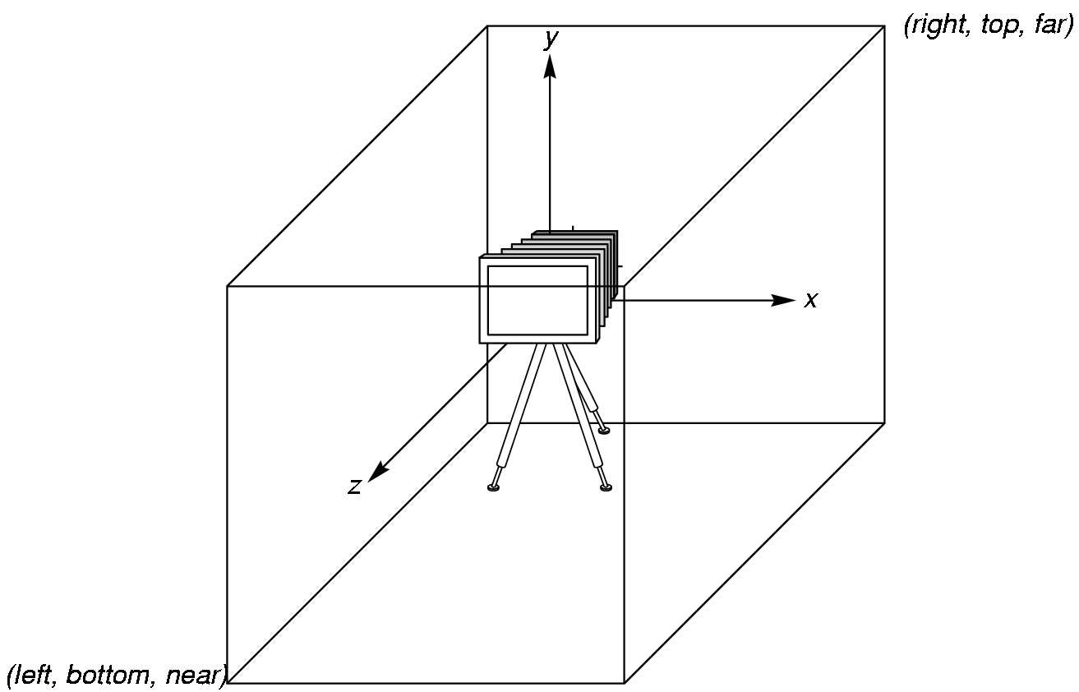
OpenGL Camera
OpenGL places a camera at the origin in object space pointing in the negative z direction
The default viewing volume
is a box centered at the
origin with sides of
length 2
E. Angel and D. Shreiner: Interactive Computer Graphics 6E © Addison-Wesley 2012

Slide 16
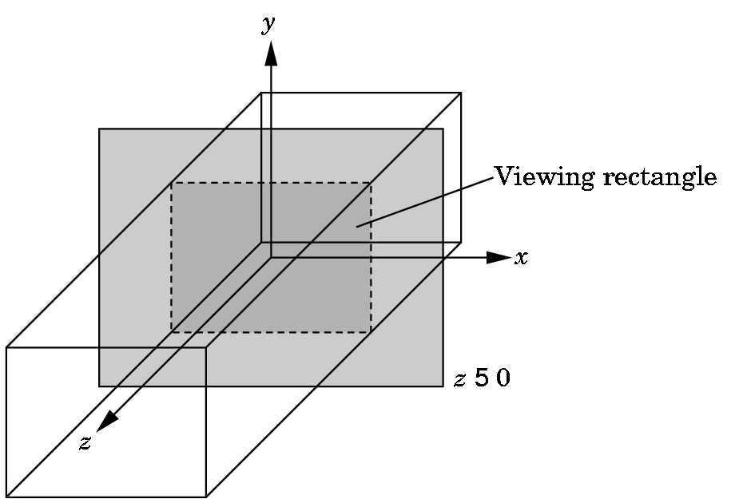
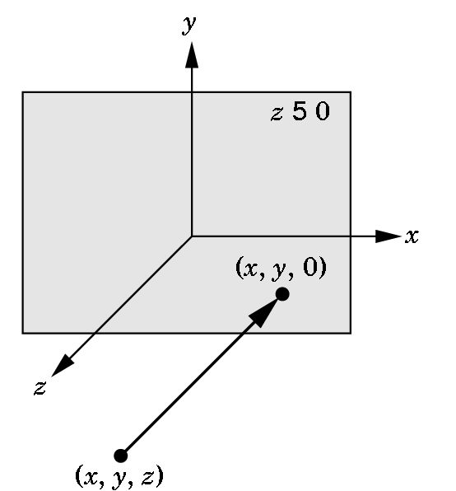
Orthographic Viewing
In the default orthographic view, points are
projected forward along the z axis onto the
plane z=0
z=0
z=0
E. Angel and D. Shreiner: Interactive Computer Graphics 6E © Addison-Wesley 2012

Slide 17
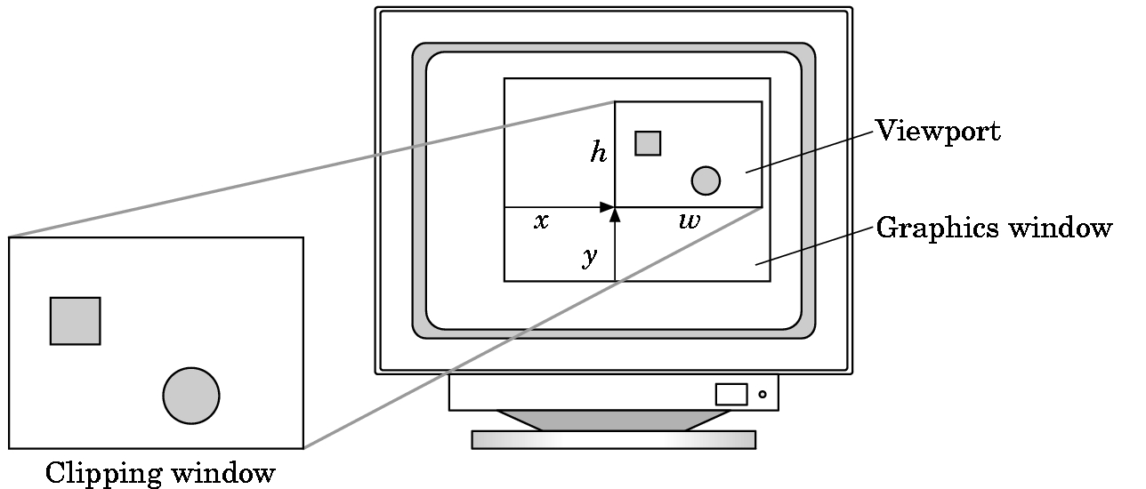
Viewports
Do not have use the entire window for the image: glViewport(x,y,w,h)
Values in pixels (window coordinates)
E. Angel and D. Shreiner: Interactive Computer Graphics 6E © Addison-Wesley 2012

Slide 18
Transformations and Viewing
In OpenGL, projection is carried out by a projection matrix (transformation)
Transformation functions are also used for changes in coordinate systems
Pre 3.0 OpenGL had a set of transformation functions which have been deprecated
Three choices
  Application code
  GLSL functions
  vec.h and mat.h
E. Angel and D. Shreiner: Interactive Computer Graphics 6E © Addison-Wesley 2012

