Slide 1
Programming with OpenGL
Part 4: Color and Attributes
Ed Angel
Professor of Emeritus of Computer Science
University of New Mexico
E. Angel and D. Shreiner: Interactive Computer Graphics 6E © Addison-Wesley 2012

Slide 2
Objectives
Expanding primitive set
Adding color
Vertex attributes
Uniform variables
E. Angel and D. Shreiner: Interactive Computer Graphics 6E © Addison-Wesley 2012

Slide 3
OpenGL Primitives
GL_POINTS
GL_LINES
GL_LINE_STRIP
GL_LINE_LOOP
GL_TRIANGLES
GL_TRIANGLE_STRIP
GL_TRIANGLE_FAN
E. Angel and D. Shreiner: Interactive Computer Graphics 6E © Addison-Wesley 2012

Slide 4
Polygon Issues
OpenGL will only display triangles
  Simple: edges cannot cross
  Convex: All points on line segment between two points in a polygon are also in the polygon
  Flat: all vertices are in the same plane
Application program must tessellate a polygon into triangles (triangulation)
OpenGL 4.1 contains a tessellator
nonconvex polygon
nonsimple polygon
E. Angel and D. Shreiner: Interactive Computer Graphics 6E © Addison-Wesley 2012

Slide 5
Polygon Testing
Conceptually simple to test for simplicity and convexity
Time consuming
Earlier versions assumed both and left testing to the application
Present version only renders triangles
Need algorithm to triangulate an arbitrary polygon
E. Angel and D. Shreiner: Interactive Computer Graphics 6E © Addison-Wesley 2012

Slide 6
Good and Bad Triangles
Long thin triangles render badly
Equilateral triangles render well
Maximize minimum angle
Delaunay triangulation for unstructured points
E. Angel and D. Shreiner: Interactive Computer Graphics 6E © Addison-Wesley 2012

Slide 7
Triangularization
Convex polygon
Start with abc, remove b, then acd, ….
d
c
b
a
E. Angel and D. Shreiner: Interactive Computer Graphics 6E © Addison-Wesley 2012

Slide 8
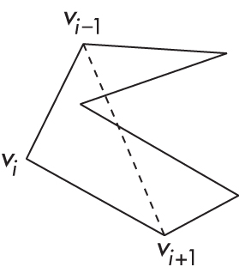
Non-convex (concave)
E. Angel and D. Shreiner: Interactive Computer Graphics 6E © Addison-Wesley 2012

Slide 9
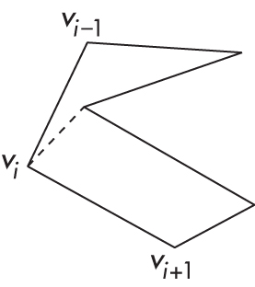
Recursive Division
Find leftmost vertex and split
E. Angel and D. Shreiner: Interactive Computer Graphics 6E © Addison-Wesley 2012

Slide 10
Attributes
Attributes determine the appearance of objects
  Color (points, lines, polygons)
  Size and width (points, lines)
  Stipple pattern (lines, polygons)
  Polygon mode
    Display as filled: solid color or stipple pattern
    Display edges
    Display vertices
Only a few (glPointSize) are supported by OpenGL functions
E. Angel and D. Shreiner: Interactive Computer Graphics 6E © Addison-Wesley 2012

Slide 11
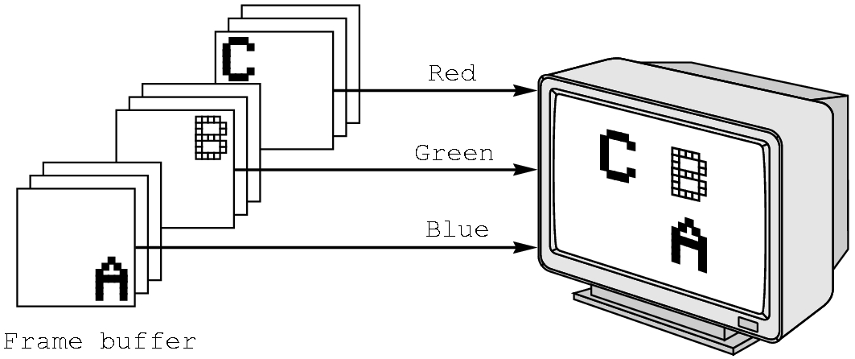
RGB color
Each color component is stored separately in the frame buffer
Usually 8 bits per component in buffer
Color values can range from 0.0 (none) to 1.0 (all) using floats or over the range from 0 to 255 using unsigned bytels
E. Angel and D. Shreiner: Interactive Computer Graphics 6E © Addison-Wesley 2012

Slide 12
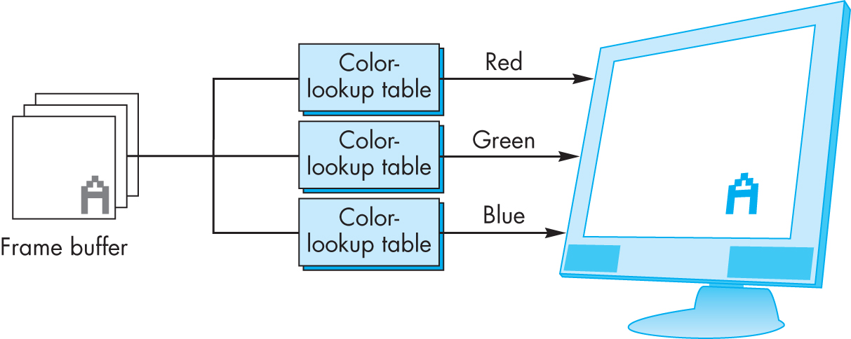
Indexed Color
Colors are indices into tables of RGB values
Requires less memory
  indices usually 8 bits
  not as important now
    Memory inexpensive
    Need more colors for shading
E. Angel and D. Shreiner: Interactive Computer Graphics 6E © Addison-Wesley 2012

Slide 13
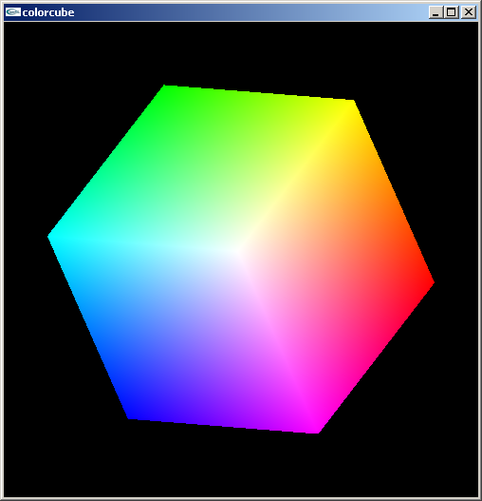
Smooth Color
Default is smooth shading
  OpenGL interpolates vertex colors across visible polygons
Alternative is flat shading
  Color of first vertex
  determines fill color
  Handle in shader
E. Angel and D. Shreiner: Interactive Computer Graphics 6E © Addison-Wesley 2012

Slide 14
Setting Colors
Colors are ultimately set in the fragment shader but can be determined in either shader or in the application
Application color: pass to vertex shader as a uniform variable (next lecture) or as a vertex attribute
Vertex shader color: pass to fragment shader as varying variable (next lecture)
Fragment color: can alter via shader code
E. Angel and D. Shreiner: Interactive Computer Graphics 6E © Addison-Wesley 2012

