Slide 1
Geometry
Ed Angel
Professor Emeritus of Computer Science
University of New Mexico
E. Angel and D. Shreiner: Interactive Computer Graphics 6E © Addison-Wesley 2012.

Slide 2
Objectives
Introduce the elements of geometry
  Scalars
  Vectors
  Points
Develop mathematical operations among them in a coordinate-free manner
Define basic primitives
  Line segments
  Polygons
E. Angel and D. Shreiner: Interactive Computer Graphics 6E © Addison-Wesley 2012.

Slide 3
Basic Elements
Geometry is the study of the relationships among objects in an n-dimensional space
  In computer graphics, we are interested in objects that exist in three dimensions
Want a minimum set of primitives from which we can build more sophisticated objects
We will need three basic elements
  Scalars
  Vectors
  Points
E. Angel and D. Shreiner: Interactive Computer Graphics 6E © Addison-Wesley 2012.

Slide 4
Coordinate-Free Geometry
When we learned simple geometry, most of us started with a Cartesian approach
  Points were at locations in space p=(x,y,z)
  We derived results by algebraic manipulations involving these coordinates
This approach was nonphysical
  Physically, points exist regardless of the location of an arbitrary coordinate system
  Most geometric results are independent of the coordinate system
  Example Euclidean geometry: two triangles are identical if two corresponding sides and the angle between them are identical
E. Angel and D. Shreiner: Interactive Computer Graphics 6E © Addison-Wesley 2012.

Slide 5
Scalars
Need three basic elements in geometry
  Scalars, Vectors, Points
Scalars can be defined as members of sets which can be combined by two operations (addition and multiplication) obeying some fundamental axioms (associativity, commutivity, inverses)
Examples include the real and complex number systems under the ordinary rules with which we are familiar
Scalars alone have no geometric properties
E. Angel and D. Shreiner: Interactive Computer Graphics 6E © Addison-Wesley 2012.

Slide 6
Vectors
Physical definition: a vector is a quantity with two attributes
  Direction
  Magnitude
Examples include
  Force
  Velocity
  Directed line segments
    Most important example for graphics
    Can map to other types
v
E. Angel and D. Shreiner: Interactive Computer Graphics 6E © Addison-Wesley 2012.

Slide 7
Vector Operations
Every vector has an inverse
  Same magnitude but points in opposite direction
Every vector can be multiplied by a scalar
There is a zero vector
  Zero magnitude, undefined orientation
The sum of any two vectors is a vector
  Use head-to-tail axiom
v
w
v
-v
αv
u
E. Angel and D. Shreiner: Interactive Computer Graphics 6E © Addison-Wesley 2012.

Slide 8
Linear Vector Spaces
Mathematical system for manipulating vectors
Operations
  Scalar-vector multiplication u=αv
  Vector-vector addition: w=u+v
Expressions such as
  v=u+2w-3r
Make sense in a vector space
E. Angel and D. Shreiner: Interactive Computer Graphics 6E © Addison-Wesley 2012.

Slide 9
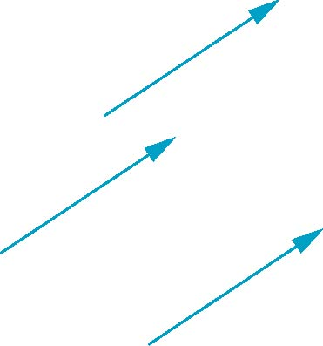
Vectors Lack Position
These vectors are identical
  Same length and magnitude
Vectors spaces insufficient for geometry
  Need points
E. Angel and D. Shreiner: Interactive Computer Graphics 6E © Addison-Wesley 2012.

Slide 10
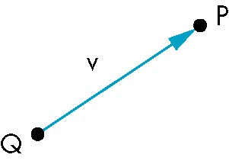
Points
Location in space
Operations allowed between points and vectors
  Point-point subtraction yields a vector
  Equivalent to point-vector addition
v=P-Q
P=v+Q
E. Angel and D. Shreiner: Interactive Computer Graphics 6E © Addison-Wesley 2012.

Slide 11
Affine Spaces
Point + a vector space
Operations
  Vector-vector addition
  Scalar-vector multiplication
  Point-vector addition
  Scalar-scalar operations
For any point define
  1 • P = P
  0 • P = 0 (zero vector)
E. Angel and D. Shreiner: Interactive Computer Graphics 6E © Addison-Wesley 2012.

Slide 12
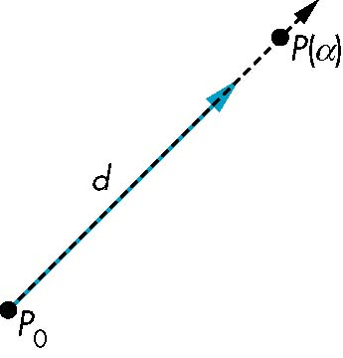
Lines
Consider all points of the form
  P(α)=P₀ + α d
  Set of all points that pass through P₀ in the direction of the vector d
E. Angel and D. Shreiner: Interactive Computer Graphics 6E © Addison-Wesley 2012.

Slide 13
Parametric Form
This form is known as the parametric form of the line
  More robust and general than other forms
  Extends to curves and surfaces
Two-dimensional forms
  Explicit: y = mx +h
  Implicit: ax + by +c =0
  Parametric:
  x(α) = αx₀ + (1-α)x₁
  y(α) = αy₀ + (1-α)y₁
E. Angel and D. Shreiner: Interactive Computer Graphics 6E © Addison-Wesley 2012.

Slide 14
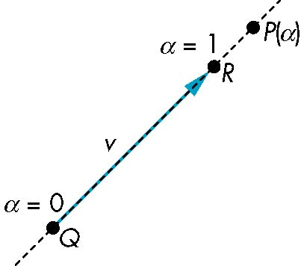
Rays and Line Segments
If α >= 0, then P(α) is the ray leaving P₀ in the direction d
If we use two points to define v, then
P( α) = Q + α (R-Q)=Q+αv
=αR + (1-α)Q
For 0<=α<=1 we get all the
points on the line segment
joining R and Q
E. Angel and D. Shreiner: Interactive Computer Graphics 6E © Addison-Wesley 2012.

Slide 15
Convexity
An object is convex iff for any two points in the object all points on the line segment between these points are also in the object
P
P
Q
Q
not convex
convex
E. Angel and D. Shreiner: Interactive Computer Graphics 6E © Addison-Wesley 2012.

Slide 16
Affine Sums
Consider the “sum”
P=α₁P₁+α₂P₂+…..+α_{n}P_{n}
Can show by induction that this sum makes sense iff
α₁+α₂+…..α_{n}=1
in which case we have the affine sum of the points P₁,P₂,…..P_{n}
If, in addition, α_{i}>=0, we have the convex hull of P₁,P₂,…..P_{n}
E. Angel and D. Shreiner: Interactive Computer Graphics 6E © Addison-Wesley 2012.

Slide 17
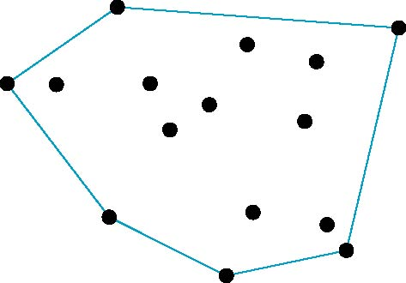
Convex Hull
Smallest convex object containing P₁,P₂,…..P_{n}
Formed by “shrink wrapping” points
E. Angel and D. Shreiner: Interactive Computer Graphics 6E © Addison-Wesley 2012.

Slide 18
Curves and Surfaces
Curves are one parameter entities of the form P(α) where the function is nonlinear
Surfaces are formed from two-parameter functions P(α, β)
  Linear functions give planes and polygons
P(α)
P(α, β)
E. Angel and D. Shreiner: Interactive Computer Graphics 6E © Addison-Wesley 2012.

Slide 19
Planes
A plane can be defined by a point and two vectors or by three points
P
v
Q
R
u
R
P(α,β)=R+αu+βv
P(α,β)=R+α(Q-R)+β(P-Q)
E. Angel and D. Shreiner: Interactive Computer Graphics 6E © Addison-Wesley 2012.

Slide 20
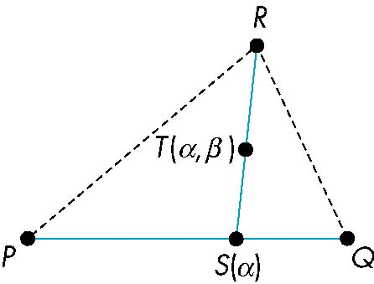
Triangles
convex sum of S(α) and R
convex sum of P and Q
for 0<=α,β<=1, we get all points in triangle
E. Angel and D. Shreiner: Interactive Computer Graphics 6E © Addison-Wesley 2012.

Slide 21
Barycentric Coordinates
Triangle is convex so any point inside can be represented as an affine sum
P(α_{1,} α_{2,} α₃)=α₁P+α₂Q+α₃R
where
α₁ +α₂ +α₃ = 1
α_{i}>=0
The representation is called the barycentric coordinate representation of P
E. Angel and D. Shreiner: Interactive Computer Graphics 6E © Addison-Wesley 2012.

Slide 22
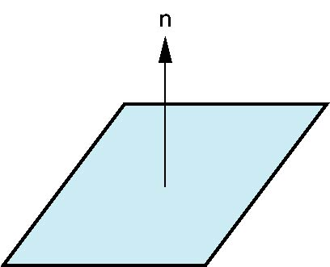
Normals
Every plane has a vector n normal (perpendicular, orthogonal) to it
From point-two vector form P(α,β)=R+αu+βv, we know we can use the cross product to find n = u × v and the equivalent form
(P(α)-P) ⋅ n=0
v
u
P
E. Angel and D. Shreiner: Interactive Computer Graphics 6E © Addison-Wesley 2012.

