Slide 1
Computer Viewing
Ed Angel
Professor Emeritus of Computer Science
University of New Mexico
E. Angel and D. Shreiner: Interactive Computer Graphics 6E © Addison-Wesley 2012

Slide 2
Objectives
Introduce the mathematics of projection
Introduce OpenGL viewing functions
Look at alternate viewing APIs
E. Angel and D. Shreiner: Interactive Computer Graphics 6E © Addison-Wesley 2012

Slide 3
Computer Viewing
There are three aspects of the viewing process, all of which are implemented in the pipeline,
  Positioning the camera
    Setting the model-view matrix
  Selecting a lens
    Setting the projection matrix
  Clipping
    Setting the view volume
E. Angel and D. Shreiner: Interactive Computer Graphics 6E © Addison-Wesley 2012

Slide 4
The OpenGL Camera
In OpenGL, initially the object and camera frames are the same
  Default model-view matrix is an identity
The camera is located at origin and points in the negative z direction
OpenGL also specifies a default view volume that is a cube with sides of length 2 centered at the origin
  Default projection matrix is an identity
E. Angel and D. Shreiner: Interactive Computer Graphics 6E © Addison-Wesley 2012

Slide 5
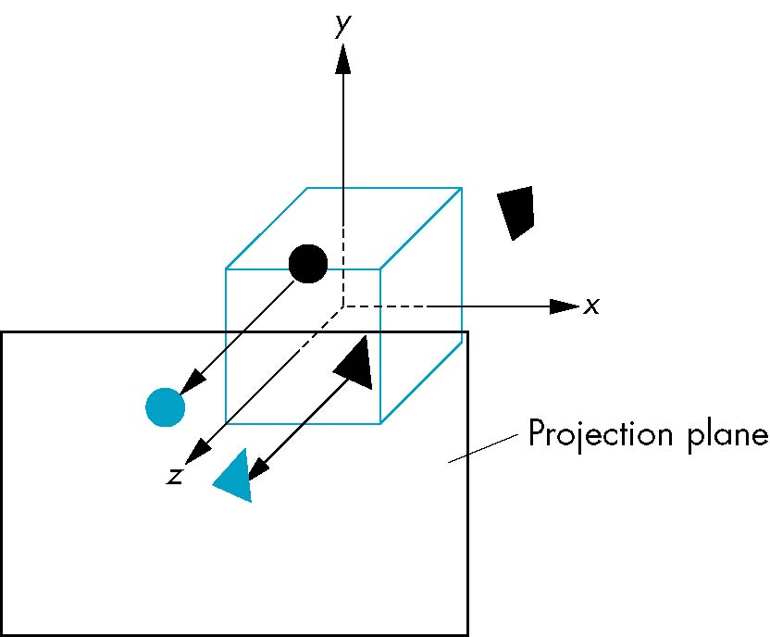
Default Projection
Default projection is orthogonal
clipped out
2
z=0
E. Angel and D. Shreiner: Interactive Computer Graphics 6E © Addison-Wesley 2012

Slide 6
Moving the Camera Frame
If we want to visualize object with both positive and negative z values we can either
  Move the camera in the positive z direction
    Translate the camera frame
  Move the objects in the negative z direction
    Translate the world frame
Both of these views are equivalent and are determined by the model-view matrix
  Want a translation (Translate(0.0,0.0,-d);)
  d > 0
E. Angel and D. Shreiner: Interactive Computer Graphics 6E © Addison-Wesley 2012

Slide 7
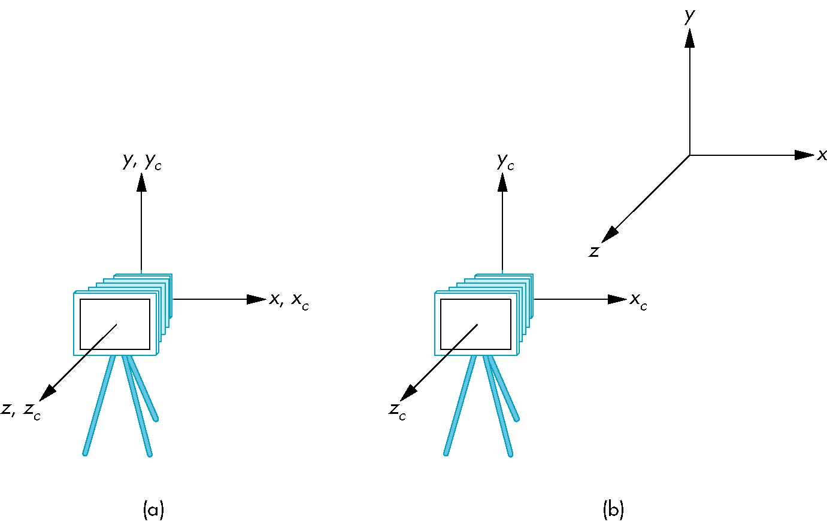
Moving Camera back from Origin
frames after translation by –d
d > 0
default frames
E. Angel and D. Shreiner: Interactive Computer Graphics 6E © Addison-Wesley 2012

Slide 8
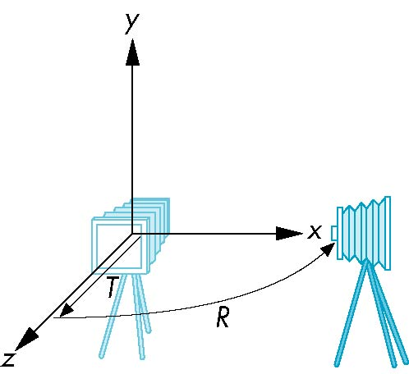
Moving the Camera
We can move the camera to any desired position by a sequence of rotations and translations
Example: side view
  Rotate the camera
  Move it away from origin
  Model-view matrix C = TR
E. Angel and D. Shreiner: Interactive Computer Graphics 6E © Addison-Wesley 2012

Slide 9
OpenGL code
Remember that last transformation specified is first to be applied
// Using mat.h
mat4 t = Translate (0.0, 0.0, -d);
mat4 ry = RotateY(90.0);
mat4 m = t*ry;
E. Angel and D. Shreiner: Interactive Computer Graphics 6E © Addison-Wesley 2012

Slide 10
The LookAt Function
The GLU library contained the function gluLookAt to form the required modelview matrix through a simple interface
Note the need for setting an up direction
Replaced by LookAt() in mat.h
  Can concatenate with modeling transformations
Example: isometric view of cube aligned with axes
mat4 mv = LookAt(vec4 eye, vec4 at, vec4 up);
E. Angel and D. Shreiner: Interactive Computer Graphics 6E © Addison-Wesley 2012

Slide 11
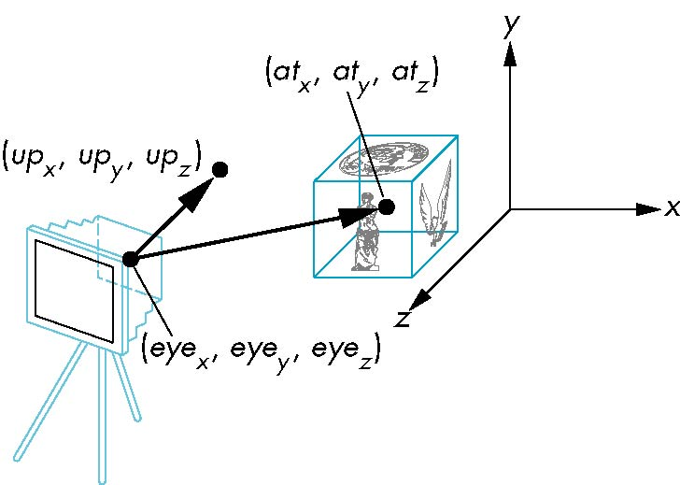
gluLookAt
LookAt(eye, at, up)
E. Angel and D. Shreiner: Interactive Computer Graphics 6E © Addison-Wesley 2012

Slide 12
Other Viewing APIs
The LookAt function is only one possible API for positioning the camera
Others include
  View reference point, view plane normal, view up (PHIGS, GKS-3D)
  Yaw, pitch, roll
  Elevation, azimuth, twist
  Direction angles
E. Angel and D. Shreiner: Interactive Computer Graphics 6E © Addison-Wesley 2012

Slide 13
Projections and Normalization
The default projection in the eye (camera) frame is orthogonal
For points within the default view volume
Most graphics systems use view normalization
  All other views are converted to the default view by transformations that determine the projection matrix
  Allows use of the same pipeline for all views
x_{p} = x
y_{p} = y
z_{p} = 0
E. Angel and D. Shreiner: Interactive Computer Graphics 6E © Addison-Wesley 2012

Slide 14
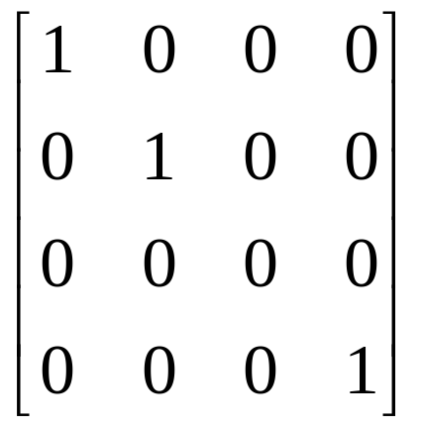
Homogeneous Coordinate Representation
default orthographic projection
x_{p} = x
y_{p} = y
z_{p} = 0
w_{p} = 1
p_{p} = Mp
M =
In practice, we can let M = I and set
the z term to zero later
E. Angel and D. Shreiner: Interactive Computer Graphics 6E © Addison-Wesley 2012

Slide 15
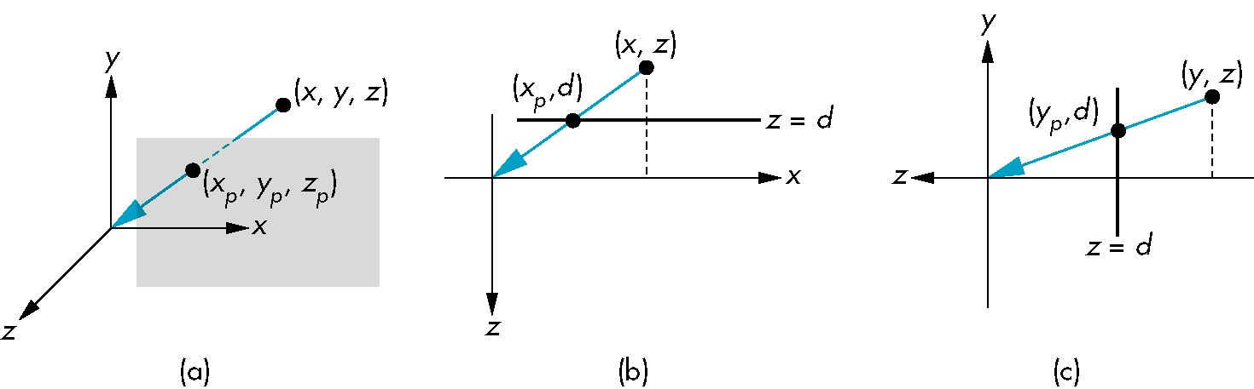
Simple Perspective
Center of projection at the origin
Projection plane z = d, d < 0
E. Angel and D. Shreiner: Interactive Computer Graphics 6E © Addison-Wesley 2012

Slide 16
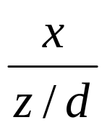
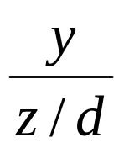
Perspective Equations
Consider top and side views
x_{p} =
y_{p} =
z_{p} = d
E. Angel and D. Shreiner: Interactive Computer Graphics 6E © Addison-Wesley 2012

Slide 17
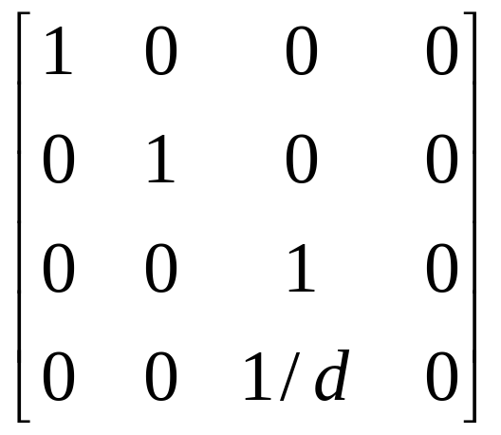
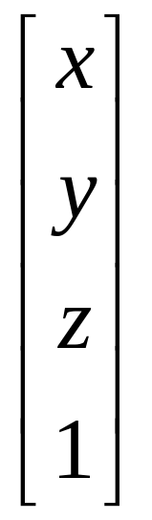
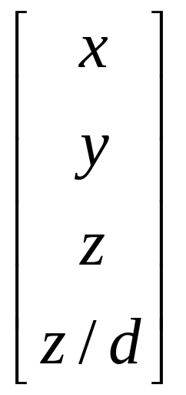
Homogeneous Coordinate Form
consider q = Mp where
M =
q =
⇒ p =
E. Angel and D. Shreiner: Interactive Computer Graphics 6E © Addison-Wesley 2012

Slide 18
Perspective Division
However w ≠ 1, so we must divide by w to return from homogeneous coordinates
This perspective division yields
the desired perspective equations
We will consider the corresponding clipping volume with mat.h functions that are equivalent to deprecated OpenGL functions
x_{p} =
y_{p} =
z_{p} = d
E. Angel and D. Shreiner: Interactive Computer Graphics 6E © Addison-Wesley 2012

Slide 19
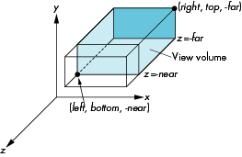
OpenGL Orthogonal Viewing
Ortho(left,right,bottom,top,near,far)
near and far measured from camera
E. Angel and D. Shreiner: Interactive Computer Graphics 6E © Addison-Wesley 2012

Slide 20
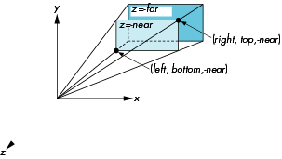
OpenGL Perspective
Frustum(left,right,bottom,top,near,far)
E. Angel and D. Shreiner: Interactive Computer Graphics 6E © Addison-Wesley 2012

Slide 21
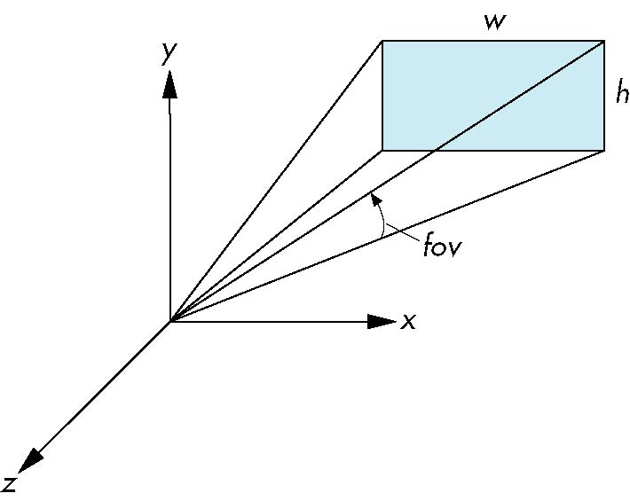
Using Field of View
With Frustum it is often difficult to get the desired view
Perpective(fovy, aspect, near, far) often provides a better interface
front plane
aspect = w/h
E. Angel and D. Shreiner: Interactive Computer Graphics 6E © Addison-Wesley 2012

