Slide 1
Buffers
Ed Angel
Professor Emeritus of Computer Science
University of New Mexico
E. Angel and D. Shreiner: Interactive Computer Graphics 6E © Addison-Wesley 2012

Slide 2
Objectives
Introduce additional OpenGL buffers
Learn to read from buffers
Learn to use blending
E. Angel and D. Shreiner: Interactive Computer Graphics 6E © Addison-Wesley 2012

Slide 3
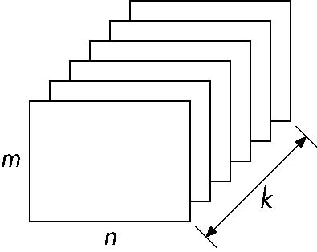
Buffer
Define a buffer by its spatial resolution (n x m) and its depth (or precision) k, the number of bits/pixel
pixel
E. Angel and D. Shreiner: Interactive Computer Graphics 6E © Addison-Wesley 2012

Slide 4
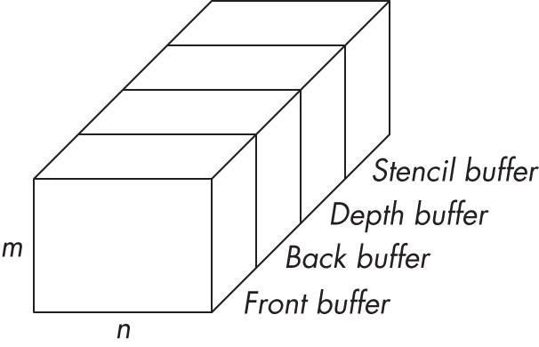
OpenGL Frame Buffer
E. Angel and D. Shreiner: Interactive Computer Graphics 6E © Addison-Wesley 2012

Slide 5
OpenGL Buffers
Color buffers can be displayed
  Front
  Back
  Auxiliary
  Stereo
Depth
Stencil
  Holds masks
Most RGBA buffers 8 bits per component
Latest are floating point (IEEE)
E. Angel and D. Shreiner: Interactive Computer Graphics 6E © Addison-Wesley 2012

Slide 6
Writing in Buffers
Conceptually, we can consider all of memory as a large two-dimensional array of pixels
We read and write rectangular block of pixels
  Bit block transfer (bitblt) operations
The frame buffer is part of this memory
memory
source
frame buffer
(destination)
writing into frame buffer
E. Angel and D. Shreiner: Interactive Computer Graphics 6E © Addison-Wesley 2012

Slide 7
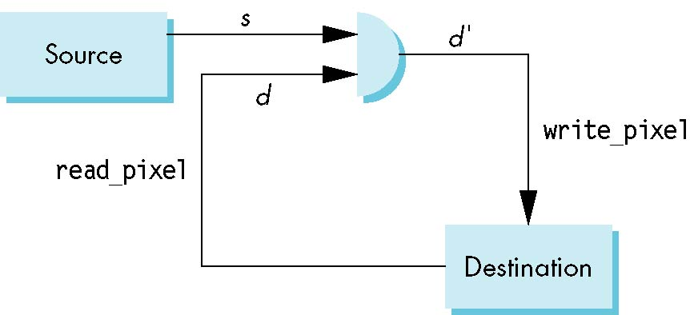
Writing Model
Read destination pixel before writing source
E. Angel and D. Shreiner: Interactive Computer Graphics 6E © Addison-Wesley 2012

Slide 8
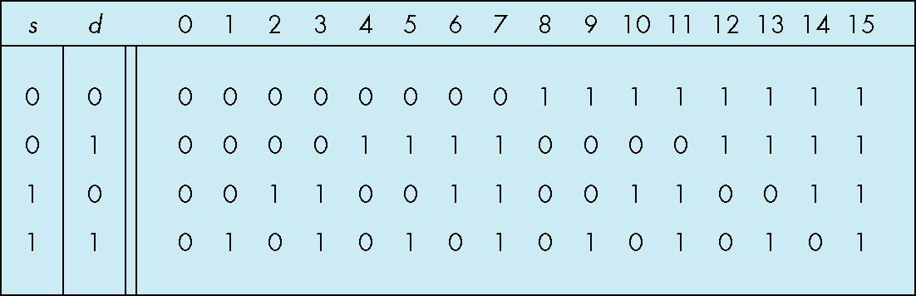
Bit Writing Modes
Source and destination bits are combined bitwise
16 possible functions (one per column in table)
replace
XOR
OR
E. Angel and D. Shreiner: Interactive Computer Graphics 6E © Addison-Wesley 2012

Slide 9
XOR mode
Recall from Chapter 3 that we can use XOR by enabling logic operations and selecting the XOR write mode
XOR is especially useful for swapping blocks of memory such as menus that are stored off screen
If S represents screen and M represents a menu
the sequence
S ← S ⊕ M
M ← S ⊕ M
S ← S ⊕ M
swaps the S and M
E. Angel and D. Shreiner: Interactive Computer Graphics 6E © Addison-Wesley 2012

Slide 10
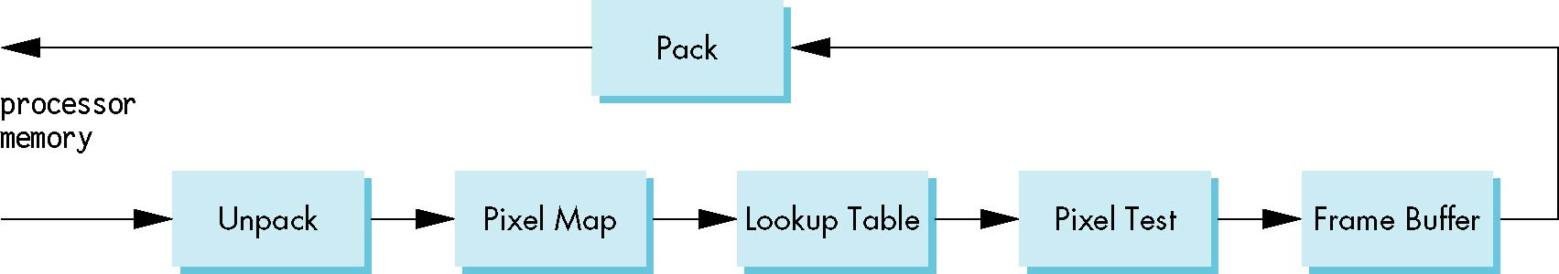
The Pixel Pipeline
OpenGL has a separate pipeline for pixels
  Writing pixels involves
    Moving pixels from processor memory to the frame buffer
    Format conversions
    Mapping, Lookups, Tests
  Reading pixels
    Format conversion
E. Angel and D. Shreiner: Interactive Computer Graphics 6E © Addison-Wesley 2012

Slide 11
Buffer Selection
OpenGL can read from any of the buffers (front, back, depth)
Default to the back buffer
Change with glReadBuffer
Note that format of the pixels in the frame buffer is different from that of processor memory and these two types of memory reside in different places
  Need packing and unpacking
  Reading can be slow
Drawing through texture functions
E. Angel and D. Shreiner: Interactive Computer Graphics 6E © Addison-Wesley 2012

Slide 12
OpenGL Pixel Functions
glReadPixels(x,y,width,height,format,type,myimage)
start pixel in frame buffer
size
type of pixels
type of image
pointer to processor
memory
GLubyte myimage[512][512][3];
glReadPixels(0,0, 512, 512, GL_RGB,
GL_UNSIGNED_BYTE, myimage);
E. Angel and D. Shreiner: Interactive Computer Graphics 6E © Addison-Wesley 2012

Slide 13
Deprecated Functionality
glDrawPixels
glCopyPixels
glBitMap
Replace by use of texture functionality, glBltFrameBuffer, frame buffer objects
E. Angel and D. Shreiner: Interactive Computer Graphics 6E © Addison-Wesley 2012

Slide 14
Render to Texture
GPUs now include a large amount of texture memory that we can write into
Advantage: fast (not under control of window system)
Using frame buffer objects (FBOs) we can render into texture memory instead of the frame buffer and then read from this memory
  Image processing
  GPGPU
E. Angel and D. Shreiner: Interactive Computer Graphics 6E © Addison-Wesley 2012

