Slide 1
OpenGL Texture Mapping
Ed Angel
Professor Emeritus of Computer Science
University of New Mexico
E. Angel and D. Shreiner: Interactive Computer Graphics 6E © Addison-Wesley 2012

Slide 2
Objectives
Introduce the OpenGL texture functions and options
E. Angel and D. Shreiner: Interactive Computer Graphics 6E © Addison-Wesley 2012

Slide 3
Basic Stragegy
Three steps to applying a texture
  specify the texture
    read or generate image
    assign to texture
    enable texturing
  assign texture coordinates to vertices
    Proper mapping function is left to application
  specify texture parameters
    wrapping, filtering
E. Angel and D. Shreiner: Interactive Computer Graphics 6E © Addison-Wesley 2012

Slide 4
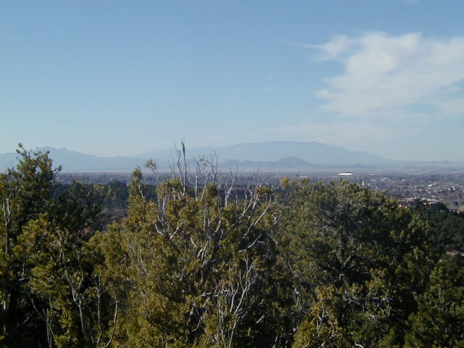
Texture Mapping
y
z
x
geometry
display
t
image
s
E. Angel and D. Shreiner: Interactive Computer Graphics 6E © Addison-Wesley 2012

Slide 5
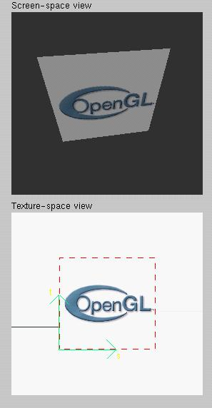
Texture Example
The texture (below) is a 256 x 256 image that has been mapped to a rectangular polygon which is viewed in perspective
E. Angel and D. Shreiner: Interactive Computer Graphics 6E © Addison-Wesley 2012

Slide 6
Texture Mapping and the OpenGL Pipeline
Images and geometry flow through separate pipelines that join during fragment processing
  “complex” textures do not affect geometric complexity
vertices
geometry pipeline
fragmentprocessor
image
pixel pipeline
E. Angel and D. Shreiner: Interactive Computer Graphics 6E © Addison-Wesley 2012

Slide 7
Specifying a Texture Image
Define a texture image from an array of
texels (texture elements) in CPU memory
  Glubyte my_texels[512][512];
Define as any other pixel map
  Scanned image
  Generate by application code
Enable texture mapping
  glEnable(GL_TEXTURE_2D)
  OpenGL supports 1-4 dimensional texture maps
E. Angel and D. Shreiner: Interactive Computer Graphics 6E © Addison-Wesley 2012

Slide 8
Define Image as a Texture
glTexImage2D( target, level, components,
w, h, border, format, type, texels );
target: type of texture, e.g. GL_TEXTURE_2D
level: used for mipmapping (discussed later)
components: elements per texel
w, h: width and height of texels in pixels
border: used for smoothing (discussed later)
format and type: describe texels
texels: pointer to texel array
glTexImage2D(GL_TEXTURE_2D, 0, 3, 512, 512, 0, GL_RGB, GL_UNSIGNED_BYTE, my_texels);
E. Angel and D. Shreiner: Interactive Computer Graphics 6E © Addison-Wesley 2012

Slide 9
Mapping a Texture
Based on parametric texture coordinates
glTexCoord*() specified at each vertex
Texture Space
Object Space
t
1, 1
(s, t) = (0.2, 0.8)
0, 1
A
a
c
(0.4, 0.2)
b
B
C
0, 0
1, 0
s
(0.8, 0.4)
E. Angel and D. Shreiner: Interactive Computer Graphics 6E © Addison-Wesley 2012

Slide 10
Typical Code
offset = 0;
GLuint vPosition = glGetAttribLocation( program, "vPosition" );
glEnableVertexAttribArray( vPosition );
glVertexAttribPointer( vPosition, 4, GL_FLOAT, GL_FALSE, 0,BUFFER_OFFSET(offset) );
offset += sizeof(points);
GLuint vTexCoord = glGetAttribLocation( program, "vTexCoord" );
glEnableVertexAttribArray( vTexCoord );
glVertexAttribPointer( vTexCoord, 2,GL_FLOAT,
GL_FALSE, 0, BUFFER_OFFSET(offset) );
E. Angel and D. Shreiner: Interactive Computer Graphics 6E © Addison-Wesley 2012

Slide 11
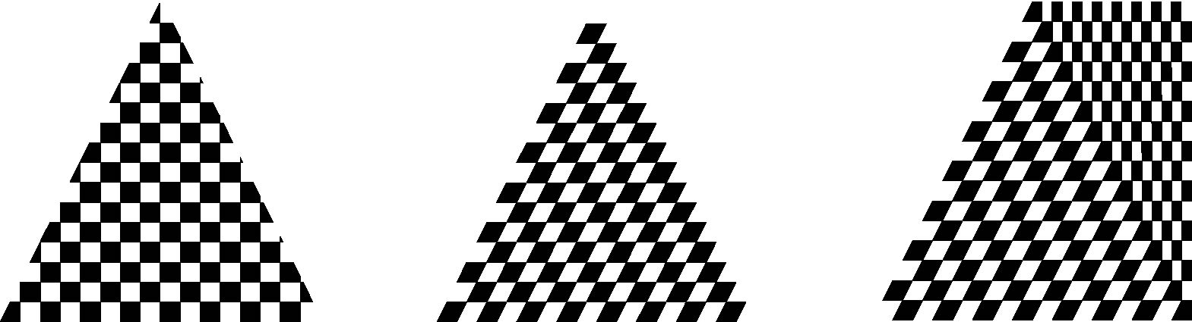
Interpolation
OpenGL uses interpolation to find proper texels from specified texture coordinates
Can be distortions
texture stretched
over trapezoid
showing effects of
bilinear interpolation
good selection
of tex coordinates
poor selection
of tex coordinates
E. Angel and D. Shreiner: Interactive Computer Graphics 6E © Addison-Wesley 2012

Slide 12
Texture Parameters
OpenGL has a variety of parameters that determine how texture is applied
  Wrapping parameters determine what happens if s and t are outside the (0,1) range
  Filter modes allow us to use area averaging instead of point samples
  Mipmapping allows us to use textures at multiple resolutions
  Environment parameters determine how texture mapping interacts with shading
E. Angel and D. Shreiner: Interactive Computer Graphics 6E © Addison-Wesley 2012

Slide 13
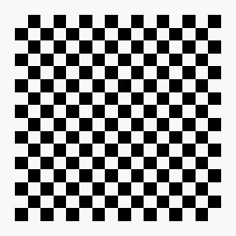
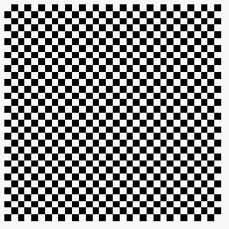

Wrapping Mode
Clamping: if s,t > 1 use 1, if s,t <0 use 0
Wrapping: use s,t modulo 1
  glTexParameteri( GL_TEXTURE_2D,
  GL_TEXTURE_WRAP_S, GL_CLAMP )
  glTexParameteri( GL_TEXTURE_2D,
  GL_TEXTURE_WRAP_T, GL_REPEAT )
t
s
GL_REPEAT
wrapping
GL_CLAMP
wrapping
texture
E. Angel and D. Shreiner: Interactive Computer Graphics 6E © Addison-Wesley 2012

Slide 14
Magnification and Minification
More than one texel can cover a pixel (minification) or
more than one pixel can cover a texel (magnification)
Can use point sampling (nearest texel) or linear filtering
( 2 x 2 filter) to obtain texture values
Texture
Polygon
Texture
Polygon
Magnification
Minification
E. Angel and D. Shreiner: Interactive Computer Graphics 6E © Addison-Wesley 2012

Slide 15
Filter Modes
Modes determined by
  glTexParameteri( target, type, mode )
glTexParameteri(GL_TEXTURE_2D, GL_TEXURE_MAG_FILTER,
GL_NEAREST);
glTexParameteri(GL_TEXTURE_2D, GL_TEXURE_MIN_FILTER,
GL_LINEAR);
Note that linear filtering requires a border of an
extra texel for filtering at edges (border = 1)
E. Angel and D. Shreiner: Interactive Computer Graphics 6E © Addison-Wesley 2012

Slide 16
Mipmapped Textures
Mipmapping allows for prefiltered texture maps of decreasing resolutions
Lessens interpolation errors for smaller textured objects
Declare mipmap level during texture definition
  glTexImage2D( GL_TEXTURE_*D, level, … )
E. Angel and D. Shreiner: Interactive Computer Graphics 6E © Addison-Wesley 2012

Slide 17
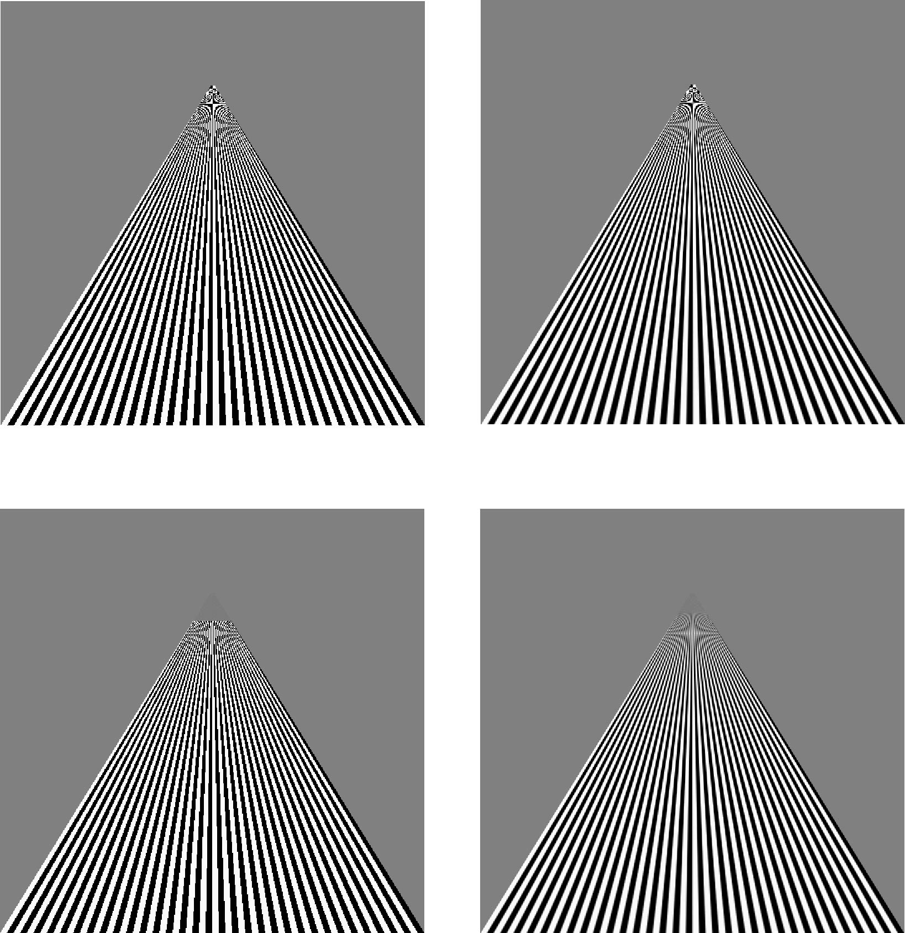
Example
point
sampling
linear
filtering
mipmapped
point
sampling
mipmapped
linear
filtering
E. Angel and D. Shreiner: Interactive Computer Graphics 6E © Addison-Wesley 2012

Slide 18
Texture Functions
Controls how texture is applied
glTexEnv{fi}[v]( GL_TEXTURE_ENV, prop, param )
GL_TEXTURE_ENV_MODE modes
  GL_MODULATE: modulates with computed shade
  GL_BLEND: blends with an environmental color
  GL_REPLACE: use only texture color
  GL(GL_TEXTURE_ENV, GL_TEXTURE_ENV_MODE, GL_MODULATE);
Set blend color with GL_TEXTURE_ENV_COLOR
E. Angel and D. Shreiner: Interactive Computer Graphics 6E © Addison-Wesley 2012

Slide 19
Using Texture Objects
specify textures in texture objects
set texture filter
set texture function
set texture wrap mode
set optional perspective correction hint
bind texture object
enable texturing
supply texture coordinates for vertex
  coordinates can also be generated
E. Angel and D. Shreiner: Interactive Computer Graphics 6E © Addison-Wesley 2012

Slide 20
Other Texture Features
Environment Maps
  Start with image of environment through a wide angle lens
    Can be either a real scanned image or an image created in OpenGL
  Use this texture to generate a spherical map
  Alternative is to use a cube map
Multitexturing
  Apply a sequence of textures through cascaded texture units
E. Angel and D. Shreiner: Interactive Computer Graphics 6E © Addison-Wesley 2012

Slide 21
Applying Textures
Textures are applied during fragments shading by a sampler
Samplers return a texture color from a texture object
in vec4 color; //color from rasterizer
in vec2 texCoord; //texure coordinate from rasterizer
uniform sampler2D texture; //texture object from application
void main() {
gl_FragColor = color * texture2D( texture, texCoord );
}
E. Angel and D. Shreiner: Interactive Computer Graphics 6E © Addison-Wesley 2012

Slide 22
Vertex Shader
Usually vertex shader will output texture coordinates to be rasterized
Must do all other standard tasks too
  Compute vertex position
  Compute vertex color if needed
in vec4 vPosition; //vertex position in object coordinates
in vec4 vColor; //vertex color from application
in vec2 vTexCoord; //texture coordinate from application
out vec4 color; //output color to be interpolated
out vec2 texCoord; //output tex coordinate to be interpolated
E. Angel and D. Shreiner: Interactive Computer Graphics 6E © Addison-Wesley 2012

Slide 23
Checkerboard Texture
GLubyte image[64][64][3];
// Create a 64 x 64 checkerboard pattern
for ( int i = 0; i < 64; i++ ) {
for ( int j = 0; j < 64; j++ ) {
GLubyte c = (((i & 0x8) == 0) ^ ((j & 0x8) == 0)) * 255;
image[i][j][0] = c;
image[i][j][1] = c;
image[i][j][2] = c;
E. Angel and D. Shreiner: Interactive Computer Graphics 6E © Addison-Wesley 2012

Slide 24
Adding Texture Coordinates
void quad( int a, int b, int c, int d )
{
quad_colors[Index] = colors[a];
points[Index] = vertices[a];
tex_coords[Index] = vec2( 0.0, 0.0 );
index++;
quad_colors[Index] = colors[a];
points[Index] = vertices[b];
tex_coords[Index] = vec2( 0.0, 1.0 );
Index++;
// other vertices
}
E. Angel and D. Shreiner: Interactive Computer Graphics 6E © Addison-Wesley 2012

Slide 25
Texture Object
GLuint textures[1];
glGenTextures( 1, textures );
glBindTexture( GL_TEXTURE_2D, textures[0] );
glTexImage2D( GL_TEXTURE_2D, 0, GL_RGB, TextureSize,
TextureSize, 0, GL_RGB, GL_UNSIGNED_BYTE, image );
glTexParameterf( GL_TEXTURE_2D, GL_TEXTURE_WRAP_S,
GL_REPEAT );
glTexParameterf( GL_TEXTURE_2D, GL_TEXTURE_WRAP_T,
GL_REPEAT );
glTexParameterf( GL_TEXTURE_2D,
GL_TEXTURE_MAG_FILTER, GL_NEAREST );
glTexParameterf( GL_TEXTURE_2D,
GL_TEXTURE_MIN_FILTER, GL_NEAREST );
glActiveTexture( GL_TEXTURE0 );
E. Angel and D. Shreiner: Interactive Computer Graphics 6E © Addison-Wesley 2012

Slide 26
Linking with Shaders
GLuint vTexCoord = glGetAttribLocation( program, "vTexCoord" );
glEnableVertexAttribArray( vTexCoord );
glVertexAttribPointer( vTexCoord, 2, GL_FLOAT, GL_FALSE, 0,
BUFFER_OFFSET(offset) );
// Set the value of the fragment shader texture sampler variable
// ("texture") to the the appropriate texture unit. In this case,
// zero, for GL_TEXTURE0 which was previously set by calling
// glActiveTexture().
glUniform1i( glGetUniformLocation(program, "texture"), 0 );
E. Angel and D. Shreiner: Interactive Computer Graphics 6E © Addison-Wesley 2012

