Slide 1
Graphical Objects and Scene Graphs
Ed Angel
Professor Emeritus of Computer Science
University of New Mexico
E. Angel and D. Shreiner: Interactive Computer Graphics 6E © Addison-Wesley 2012

Slide 2
Objectives
Introduce graphical objects
Generalize the notion of objects to include lights, cameras, attributes
Introduce scene graphs
E. Angel and D. Shreiner: Interactive Computer Graphics 6E © Addison-Wesley 2012

Slide 3
Limitations of Immediate Mode Graphics
When we define a geometric object in an application, upon execution of the code the object is passed through the pipeline
It then disappears from the graphical system
To redraw the object, either changed or the same, we must reexecute the code
Display lists provide only a partial solution to this problem
E. Angel and D. Shreiner: Interactive Computer Graphics 6E © Addison-Wesley 2012

Slide 4
OpenGL and Objects
OpenGL lacks an object orientation
Consider, for example, a green sphere
  We can model the sphere with polygons or use OpenGL quadrics
  Its color is determined by the OpenGL state and is not a property of the object
Defies our notion of a physical object
We can try to build better objects in code using object-oriented languages/techniques
E. Angel and D. Shreiner: Interactive Computer Graphics 6E © Addison-Wesley 2012

Slide 5
Imperative Programming Model
Example: rotate a cube
The rotation function must know how the cube is represented
  Vertex list
  Edge list
cube data
Application
Rotate
results
E. Angel and D. Shreiner: Interactive Computer Graphics 6E © Addison-Wesley 2012

Slide 6
Object-Oriented Programming Model
In this model, the representation is stored with the object
The application sends a message to the object
The object contains functions (methods) which allow it to transform itself
Application
Cube Object
message
E. Angel and D. Shreiner: Interactive Computer Graphics 6E © Addison-Wesley 2012

Slide 7
C/C++
Can try to use C structs to build objects
C++ provides better support
  Use class construct
  Can hide implementation using public, private, and protected members in a class
  Can also use friend designation to allow classes to access each other
E. Angel and D. Shreiner: Interactive Computer Graphics 6E © Addison-Wesley 2012

Slide 8
Cube Object
Suppose that we want to create a simple cube object that we can scale, orient, position and set its color directly through code such as
cube mycube;
mycube.color[0]=1.0;
mycube.color[1]= mycube.color[2]=0.0;
mycube.matrix[0][0]=………
E. Angel and D. Shreiner: Interactive Computer Graphics 6E © Addison-Wesley 2012

Slide 9
Cube Object Functions
We would also like to have functions that act on the cube such as
  mycube.translate(1.0, 0.0,0.0);
  mycube.rotate(theta, 1.0, 0.0, 0.0);
  setcolor(mycube, 1.0, 0.0, 0.0);
We also need a way of displaying the cube
  mycube.render();
E. Angel and D. Shreiner: Interactive Computer Graphics 6E © Addison-Wesley 2012

Slide 10
Building the Cube Object
class cube {
public:
float color[3];
float matrix[4][4];
// public methods
private:
// implementation
}
E. Angel and D. Shreiner: Interactive Computer Graphics 6E © Addison-Wesley 2012

Slide 11
The Implementation
Can use any implementation in the private part such as a vertex list
The private part has access to public members and the implementation of class methods can use any implementation without making it visible
Render method is tricky but it will invoke the standard OpenGL drawing functions
E. Angel and D. Shreiner: Interactive Computer Graphics 6E © Addison-Wesley 2012

Slide 12
Other Objects
Other objects have geometric aspects
  Cameras
  Light sources
But we should be able to have nongeometric objects too
  Materials
  Colors
  Transformations (matrices)
E. Angel and D. Shreiner: Interactive Computer Graphics 6E © Addison-Wesley 2012

Slide 13
Application Code
cube mycube;
material plastic;
mycube.setMaterial(plastic);
camera frontView;
frontView.position(x ,y, z);
E. Angel and D. Shreiner: Interactive Computer Graphics 6E © Addison-Wesley 2012

Slide 14
Light Object
class light { // match Phong model
public:
boolean type; //ortho or perspective
boolean near;
float position[3];
float orientation[3];
float specular[3];
float diffuse[3];
float ambient[3];
}
E. Angel and D. Shreiner: Interactive Computer Graphics 6E © Addison-Wesley 2012

Slide 15
Scene Descriptions
If we recall figure model, we saw that
  We could describe model either by tree or by equivalent code
  We could write a generic traversal to display
If we can represent all the elements of a scene (cameras, lights,materials, geometry) as C++ objects, we should be able to show them in a tree
  Render scene by traversing this tree
E. Angel and D. Shreiner: Interactive Computer Graphics 6E © Addison-Wesley 2012

Slide 16
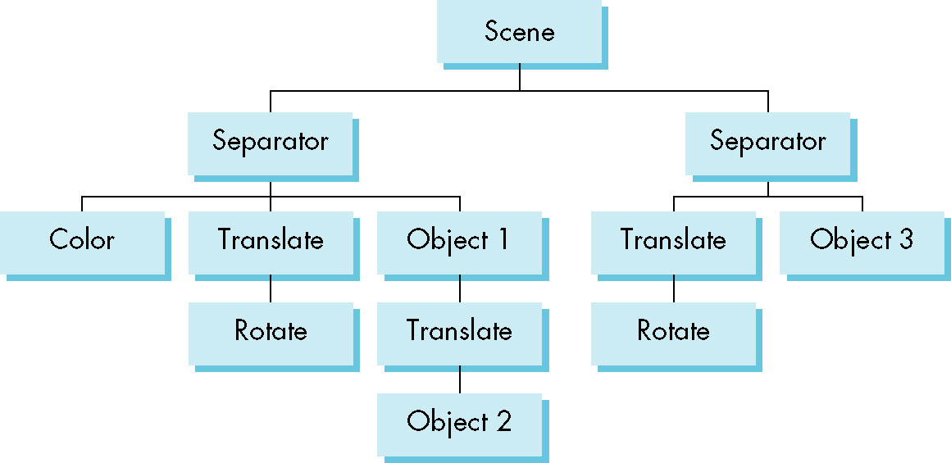
Scene Graph
E. Angel and D. Shreiner: Interactive Computer Graphics 6E © Addison-Wesley 2012

Slide 17
Preorder Traversal
PushAttrib
PushMatrix
Color
Translate
Rotate
Object1
Translate
Object2
PopMatrix
PopAttrib
…
E. Angel and D. Shreiner: Interactive Computer Graphics 6E © Addison-Wesley 2012

Slide 18
Group Nodes
Necessary to isolate state chages
  Equivalent to Push/Pop
Note that as with the figure model
  We can write a universal traversal algorithm
  The order of traversal can matter
    If we do not use the group node, state changes can persist
E. Angel and D. Shreiner: Interactive Computer Graphics 6E © Addison-Wesley 2012

Slide 19
Inventor and Java3D
Inventor and Java3D provide a scene graph API
Scene graphs can also be described by a file (text or binary)
  Implementation independent way of transporting scenes
  Supported by scene graph APIs
However, primitives supported should match capabilities of graphics systems
  Hence most scene graph APIs are built on top of OpenGL or DirectX (for PCs)
E. Angel and D. Shreiner: Interactive Computer Graphics 6E © Addison-Wesley 2012

Slide 20
VRML
Want to have a scene graph that can be used over the World Wide Web
Need links to other sites to support distributed data bases
Virtual Reality Markup Language
  Based on Inventor data base
  Implemented with OpenGL
E. Angel and D. Shreiner: Interactive Computer Graphics 6E © Addison-Wesley 2012

Slide 21
Open Scene Graph
Supports very complex geometries by adding occulusion culling in first path
Supports translucently through a second pass that sorts the geometry
First two passes yield a geometry list that is rendered by the pipeline in a third pass
E. Angel and D. Shreiner: Interactive Computer Graphics 6E © Addison-Wesley 2012

