Slide 1
Marching Squares
Ed Angel
Professor Emeritus of Computer Science
University of New Mexico
E. Angel and D. Shreiner: Interactive Computer Graphics 6E © Addison-Wesley 2012

Slide 2
Objectives
Nontrivial two-dimensional application
Important method for
  Contour plots
  Implicit function visualization
Extends to important method for volume visualization
This lecture is optional
Material not needed to continue to Chapter 3
E. Angel and D. Shreiner: Interactive Computer Graphics 6E © Addison-Wesley 2012

Slide 3
Displaying Implicit Functions
Consider the implicit function
g(x,y)=0
Given an x, we cannot in general find a corresponding y
Given an x and a y, we can test if they are on the curve
E. Angel and D. Shreiner: Interactive Computer Graphics 6E © Addison-Wesley 2012

Slide 4
Height Fields and Contours
In many applications, we have the heights given by a function of the form z=f(x,y)
To find all the points that have a given height c, we have to solve the implicit equation g(x,y)=f(x,y)-c=0
Such a function determines the isosurfaces or contours of f for the isosurface value c
E. Angel and D. Shreiner: Interactive Computer Graphics 6E © Addison-Wesley 2012

Slide 5
Marching Squares
Displays isocurves or contours for functions f(x,y) = t
Sample f(x,y) on a regular grid yielding samples {f_{ij}(x,y)}
These samples can be greater than, less than, or equal to t
Consider four samples f_{ij}(x,y), f_{i+1,j}(x,y), f_{i+1,j+1}(x,y), f_{i,j+1}(x,y)
These samples correspond to the corners of a cell
Color the corners by whether than exceed or are less than the contour value t
E. Angel and D. Shreiner: Interactive Computer Graphics 6E © Addison-Wesley 2012

Slide 6
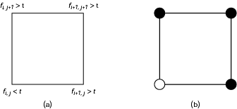
Cells and Coloring
E. Angel and D. Shreiner: Interactive Computer Graphics 6E © Addison-Wesley 2012

Slide 7
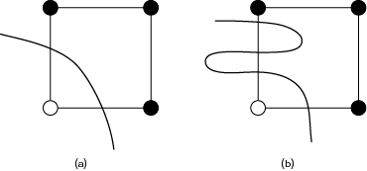
Occum’s Razor
Contour must intersect edge between a black and white vertex an odd number of times
Pick simplest interpretation: one crossing
E. Angel and D. Shreiner: Interactive Computer Graphics 6E © Addison-Wesley 2012

Slide 8
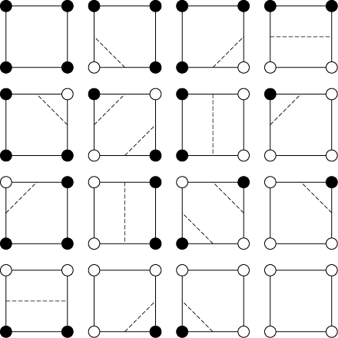
16 Cases
E. Angel and D. Shreiner: Interactive Computer Graphics 6E © Addison-Wesley 2012

Slide 9

Unique Cases
Taking out rotational and color swapping symmetries leaves four unique cases
First three have a simple interpretation
E. Angel and D. Shreiner: Interactive Computer Graphics 6E © Addison-Wesley 2012

Slide 10

Ambiguity Problem
Diagonally opposite cases have two equally simple possible interpretations
E. Angel and D. Shreiner: Interactive Computer Graphics 6E © Addison-Wesley 2012

Slide 11
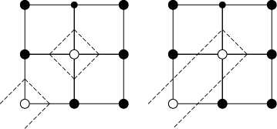
Ambiguity Example
Two different possibilities below
More possibilities on next slide
E. Angel and D. Shreiner: Interactive Computer Graphics 6E © Addison-Wesley 2012

Slide 12
Ambiguity Problem
E. Angel and D. Shreiner: Interactive Computer Graphics 6E © Addison-Wesley 2012

Slide 13
Is Problem Resolvable?
Problem is a sampling problem
  Not enough samples to know the local detail
  No solution in a mathematical sense without extra information
More of a problem with volume extension (marching cubes) where selecting “wrong” interpretation can leave a hole in a surface
Multiple methods in literature to give better appearance
  Supersampling
  Look at larger area before deciding
E. Angel and D. Shreiner: Interactive Computer Graphics 6E © Addison-Wesley 2012

Slide 14
Interpolating Edges
We can compute where contour intersects edge in multiple ways
  Halfway between vertics
  Interpolated based on difference between contour value and value at vertices
E. Angel and D. Shreiner: Interactive Computer Graphics 6E © Addison-Wesley 2012

Slide 15


Example: Oval of Cassini
f(x,y)=(x²+y²+a²)²-4a²x²-b⁴
Depending on a and b we can have 0, 1, or 2 curves
midpoint intersections
interpolating intersections
E. Angel and D. Shreiner: Interactive Computer Graphics 6E © Addison-Wesley 2012

Slide 16
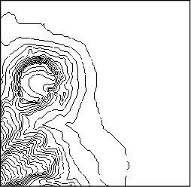
Contour Map
Diamond Head, Oahu Hawaii
Shows contours for many contour values
E. Angel and D. Shreiner: Interactive Computer Graphics 6E © Addison-Wesley 2012

Slide 17
Marching Cubes
Isosurface: solution of g(x,y,z)=c
Same argument to derive method but use cubic cell (8 vertices, 256 colorings)
Standard method of volume visualization
Suggested by Lorensen and Kline before marching squares
E. Angel and D. Shreiner: Interactive Computer Graphics 6E © Addison-Wesley 2012

