Slide 1
Virtual Trackball and
Quaterion Rotation
Ed Angel
Professor Emeritus of Computer Science
University of New Mexico
E. Angel and D. Shriener : Interactive Computer Graphics 6E © Addison-Wesley 2012

Slide 2
Objectives
This is an optional lecture that
  Introduces the use of graphical (virtual) devices that can be created using OpenGL
  Illustrates the difference between using direction angles and Euler angles
  Makes use of transformations
  Leads to reusable code that will be helpful later
E. Angel and D. Shriener : Interactive Computer Graphics 6E © Addison-Wesley 2012

Slide 3
Specifying a Rotation
Pre 3.1 OpenGL had a function glRotate (theta, dx, dy dz) which incrementally changed the current rotation matrix by a rotation with fixed point of the origin about a vector in the direction (dx, dy, dz)
Implementations of glRotate often decompose the general rotation into a sequence of rotations about the coordinate axes as in Chapter 3.
E. Angel and D. Shriener : Interactive Computer Graphics 6E © Addison-Wesley 2012

Slide 4
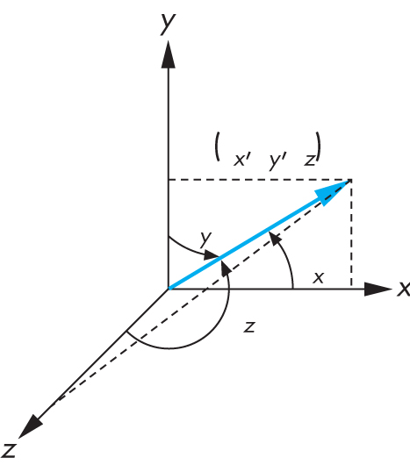
Euler from Direction Angles
E. Angel and D. Shriener : Interactive Computer Graphics 6E © Addison-Wesley 2012

Slide 5
Efficiency
should be able to write as
If we knew the angles, we could use RotateX, RotateY
and RotateZ from mat.h
But is this an efficient method?
No, we can do better with quaterions
E. Angel and D. Shriener : Interactive Computer Graphics 6E © Addison-Wesley 2012

Slide 6
Quaterion Rotation
Definition:
Quaterian Arithmetic:
Representing a 3D point:
Representing a Rotation:
Rotating a Point:
E. Angel and D. Shriener : Interactive Computer Graphics 6E © Addison-Wesley 2012

Slide 7
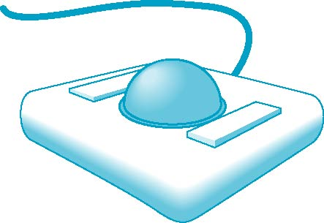
Physical Trackball
The trackball is an “upside down” mouse
If there is little friction between the ball and the rollers, we can give the ball a push and it will keep rolling yielding continuous changes
Two possible modes of operation
  Continuous pushing or tracking hand motion
  Spinning
E. Angel and D. Shriener : Interactive Computer Graphics 6E © Addison-Wesley 2012

Slide 8
A Trackball from a Mouse
Problem: we want to get the two behavior modes from a mouse
We would also like the mouse to emulate a frictionless (ideal) trackball
Solve in two steps
  Map trackball position to mouse position
  Use GLUT to obtain the proper modes
E. Angel and D. Shriener : Interactive Computer Graphics 6E © Addison-Wesley 2012

Slide 9
Working with Quaterians
Quaterian arithmetic works well for representing rotations around the origin
There is no simple way to convert a quaterian to a matrix representation
Usually copy elements back and forth between quaterians and matrices
Can use directly without rotation matrices in the virtual trackball
Quaterian shaders are simple
E. Angel and D. Shriener : Interactive Computer Graphics 6E © Addison-Wesley 2012

Slide 10
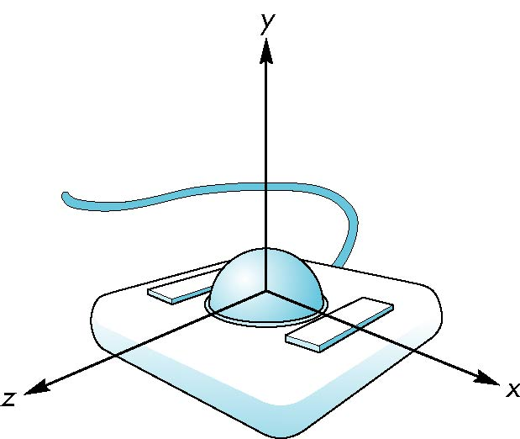
Trackball Frame
origin at center of ball
E. Angel and D. Shriener : Interactive Computer Graphics 6E © Addison-Wesley 2012

Slide 11
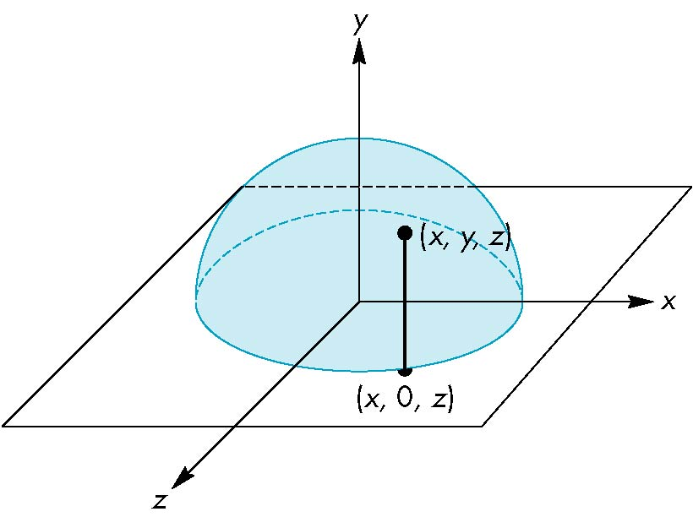
Projection of Trackball Position
We can relate position on trackball to position on a normalized mouse pad by projecting orthogonally onto pad
E. Angel and D. Shriener : Interactive Computer Graphics 6E © Addison-Wesley 2012

Slide 12
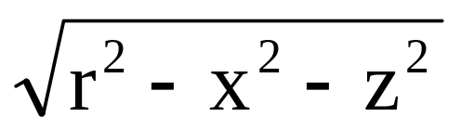
Reversing Projection
Because both the pad and the upper hemisphere of the ball are two-dimensional surfaces, we can reverse the projection
A point (x,z) on the mouse pad corresponds to the point (x,y,z) on the upper hemisphere where
y =
if r ≥ |x|≥ 0, r ≥ |z| ≥ 0
E. Angel and D. Shriener : Interactive Computer Graphics 6E © Addison-Wesley 2012

Slide 13
Computing Rotations
Suppose that we have two points that were obtained from the mouse.
We can project them up to the hemisphere to points p₁ and p₂
These points determine a great circle on the sphere
We can rotate from p₁ to p₂ by finding the proper axis of rotation and the angle between the points
E. Angel and D. Shriener : Interactive Computer Graphics 6E © Addison-Wesley 2012

Slide 14
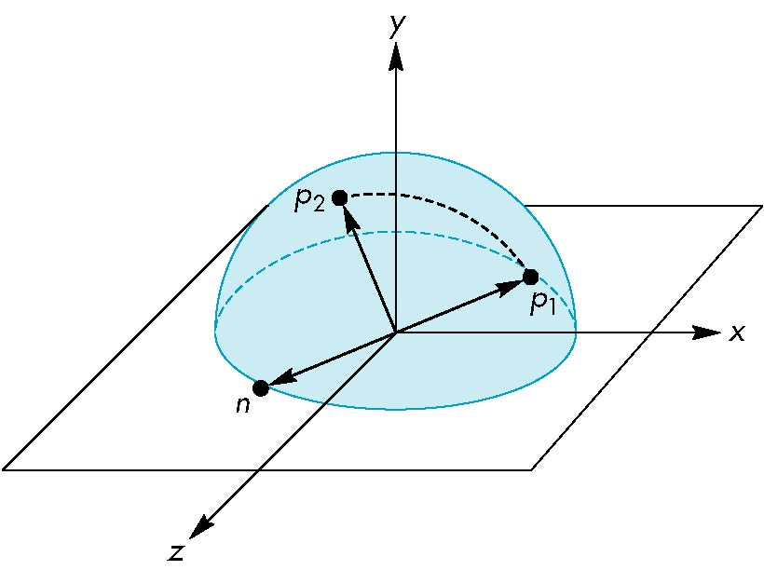
Using the cross product
The axis of rotation is given by the normal to the plane determined by the origin, p₁ , and p₂
n = p₁ × p₂
E. Angel and D. Shriener : Interactive Computer Graphics 6E © Addison-Wesley 2012

Slide 15
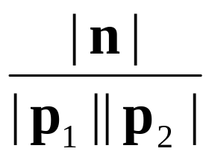
Obtaining the angle
The angle between p₁ and p₂ is given by
If we move the mouse slowly or sample its position frequently, then θ will be small and we can use the approximation
| sin θ| =
sin θ ≈ θ
E. Angel and D. Shriener : Interactive Computer Graphics 6E © Addison-Wesley 2012

Slide 16
Implementing with GLUT
We will use the idle, motion, and mouse callbacks to implement the virtual trackball
Define actions in terms of three booleans
trackingMouse: if true update trackball position
redrawContinue: if true, idle function posts a redisplay
trackballMove: if true, update rotation matrix
E. Angel and D. Shriener : Interactive Computer Graphics 6E © Addison-Wesley 2012

Slide 17
Example
In this example, we use the virtual trackball to rotate the color cube we modeled earlier
The code for the colorcube function is omitted because it is unchanged from the earlier examples
E. Angel and D. Shriener : Interactive Computer Graphics 6E © Addison-Wesley 2012

Slide 18
Initialization
int winWidth, winHeight;
_x0018_
bool trackingMouse = false;
bool redrawContinue = false;
bool trackballMove = false;
// quaternion initialization
GLuint rquat_loc; //uniform variable location
vec4 rquat = vec4(1.0, 0.0, 0.0, 0.0);
// initial rotation quaterion
vec3 axis; //axis of rotation
GLfloat angle;//angle of rotation
E. Angel and D. Shriener : Interactive Computer Graphics 6E © Addison-Wesley 2012

Slide 19
Quaterion Multiplication
vec4 multq(vec4 a, vec4 b)
{
// extract axes
vec3 aa = vec3(a[1], a[2], a[3]);
vec3 bb = vec3(b[1], b[2], b[3]);
vec3 cc = a[0]*bb+b[0]*aa+cross(bb, aa);
// reassemble quaterion in vec4
return(vec4(a[0]*b[0] - dot(aa, bb), cc[0], cc[1], cc[2]));
}
E. Angel and D. Shriener : Interactive Computer Graphics 6E © Addison-Wesley 2012

Slide 20
The Projection Step
vec3 lastPos = vec3(0.0, 0.0, 0.0);
int curx, cury;
int startX, startY;
vec3 trackball_ptov(int x, int y, int width, int height)
{
float d, a;
vec3 v;
// project x,y onto a hemi-sphere centered within width, height
v[0] = (2.0*x - width) / width;
v[1] = (height - 2.0*y) / height;
E. Angel and D. Shriener : Interactive Computer Graphics 6E © Addison-Wesley 2012

Slide 21
The Porjection Step II
// ensure that we are inside the circle on the z = 0 plane
d = sqrt(v[0]*v[0] + v[1]*v[1]);
if(d < 1.0) v[2] = cos((M_PI/2.0)*d);
else v[2] = 0.0;
a = 1.0 / sqrt(dot(v,v));
v *= a;
return v;
}
E. Angel and D. Shriener : Interactive Computer Graphics 6E © Addison-Wesley 2012

Slide 22
glutMotionFunc (1)
void
mouseMotion(int x, int y)
{
vec3 curPos;
vec3 d;
curPos = trackball_ptov(x, y, winWidth, winHeight);
if(trackingMouse)
{
d = curPos - lastPos;
float a = dot(d,d);
E. Angel and D. Shriener : Interactive Computer Graphics 6E © Addison-Wesley 2012

Slide 23
glutMotionFunc (2)
//check if mouse moved
if (a)
{
// slow down rotation if needed by changed speed
float speed = 1.1;
angle = speed * (M_PI/2.0)*sqrt(a);
// compute and normalize rotatation direction vector
axis = cross(lastPos, curPos);
a = 1.0/sqrt(dot(axis, axis));
lastPos = curPos;
}
}
glutPostRedisplay();
}
E. Angel and D. Shriener : Interactive Computer Graphics 6E © Addison-Wesley 2012

Slide 24
Display Callback
void display( void )
{
glClear(GL_COLOR_BUFFER_BIT GL_DEPTH_BUFFER_BIT );
// form quaterion from angle and axis and increment present rotation quaterion
if (trackballMove)rquat = multq(vec4(cos(angle/2.0), sin(angle/2.0)*axis[0], sin(angle/2.0)*axis[1], sin(angle/2.0)*axis[2]), rquat);
glUniform4fv( rquat_loc, 4, rquat );
glDrawArrays( GL_TRIANGLES, 0, NumVertices );
glutSwapBuffers();
}
E. Angel and D. Shriener : Interactive Computer Graphics 6E © Addison-Wesley 2012

Slide 25
Mouse Callback
void mouseButton(int button, int state, int x, int y)
{
// use right button to start mouse tracking when down and stop when up
if(button==GLUT_RIGHT_BUTTON) exit(0);
if(button==GLUT_LEFT_BUTTON) switch(state)
{
case GLUT_DOWN:
y=winHeight-y;
startMotion( x,y);
break;
case GLUT_UP:
stopMotion( x,y);
break;
}
}
E. Angel and D. Shriener : Interactive Computer Graphics 6E © Addison-Wesley 2012

Slide 26
Start Function and Idle Callback
void startMotion(int x, int y)
{
trackingMouse = true;
redrawContinue = false;
startX = x; startY = y;
curx = x; cury = y;
lastPos = trackball_ptov(x, y, winWidth, winHeight);
trackballMove=true;
}
void spinCube()
{
if (redrawContinue) glutPostRedisplay();
}
E. Angel and D. Shriener : Interactive Computer Graphics 6E © Addison-Wesley 2012

Slide 27
Stop Function
void stopMotion(int x, int y)
{
trackingMouse = false;
if (startX != x || startY != y) {
redrawContinue = true;
} else {
angle = 0.0F;
redrawContinue = false;
trackballMove = false;
}
}
E. Angel and D. Shriener : Interactive Computer Graphics 6E © Addison-Wesley 2012

Slide 28
Vertex Shader I
in vec4 vPosition;
in vec4 vColor;
out vec4 color;
uniform vec4 rquat; // rotation quaterion
// quaternion multiplier
vec4 multq(vec4 a, vec4 b)
{
return(vec4(a.x*b.x - dot(a.yzw, b.yzw),
a.x*b.yzw+b.x*a.yzw+cross(b.yzw, a.yzw)));
}
E. Angel and D. Shriener : Interactive Computer Graphics 6E © Addison-Wesley 2012

Slide 29
Vertex Shader II
// inverse quaternion
vec4 invq(vec4 a)
{ return(vec4(a.x, -a.yzw)/dot(a,a)); }
void main() {
vec3 axis = rquat.yxw;
float theta = rquat.x;
vec4 r, p;
p = vec4(0.0, vPosition.xyz); // input point quaternion
p = multq(rquat, multq(p, invq(rquat))); // rotated point quaternion
gl_Position = vec4( p.yzw, 1.0); // back to homogeneous coordinates
color = vColor;
}
E. Angel and D. Shriener : Interactive Computer Graphics 6E © Addison-Wesley 2012

