Slide 1
Environment Maps
Ed Angel
Professor Emeritus of Computer Science
University of New Mexico
E. Angel and D. Shreiner: Interactive Computer Graphics 6E © Addison-Wesley 2012

Slide 2
Introduction
Environmental mapping is way to create the appearance of highly reflective surfaces without ray tracing which requires global calculations
Examples: The Abyss, Terminator 2
Is a form of texture mapping
  Supported by OpenGL and Cg
E. Angel and D. Shreiner: Interactive Computer Graphics 6E © Addison-Wesley 2012

Slide 3


Example
E. Angel and D. Shreiner: Interactive Computer Graphics 6E © Addison-Wesley 2012

Slide 4
Reflecting the Environment
N
V
R
E. Angel and D. Shreiner: Interactive Computer Graphics 6E © Addison-Wesley 2012

Slide 5
Mapping to a Sphere
N
V
R
E. Angel and D. Shreiner: Interactive Computer Graphics 6E © Addison-Wesley 2012

Slide 6
Hemisphere Map as a Texture
If we map all objects to hemisphere, we cannot tell if they are on the sphere or anywhere else along the reflector
Use the map on the sphere as a texture that can be mapped onto the object
Can use other surfaces as the intermediate
  Cube maps
  Cylinder maps
E. Angel and D. Shreiner: Interactive Computer Graphics 6E © Addison-Wesley 2012

Slide 7
Issues
Must assume environment is very far from object (equivalent to the difference between near and distant lights)
Object cannot be concave (no self reflections possible)
No reflections between objects
Need a reflection map for each object
Need a new map if viewer moves
E. Angel and D. Shreiner: Interactive Computer Graphics 6E © Addison-Wesley 2012

Slide 8
OpenGL Implementation
OpenGL supports spherical and cube maps
First must form map
  Use images from a real camera
  Form images with OpenGL
Texture map it to object
E. Angel and D. Shreiner: Interactive Computer Graphics 6E © Addison-Wesley 2012

Slide 9
Cube Map
E. Angel and D. Shreiner: Interactive Computer Graphics 6E © Addison-Wesley 2012

Slide 10
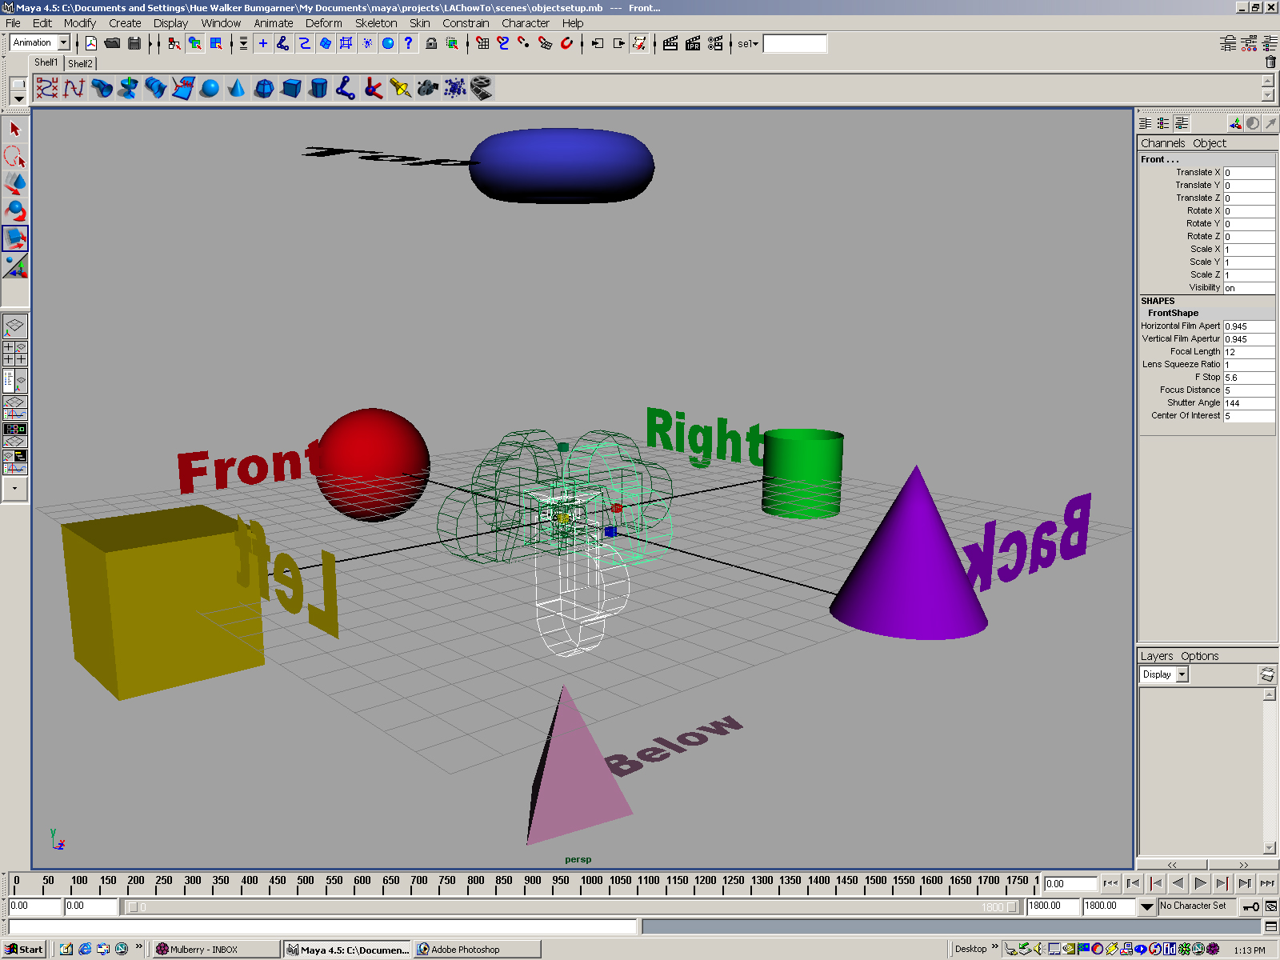
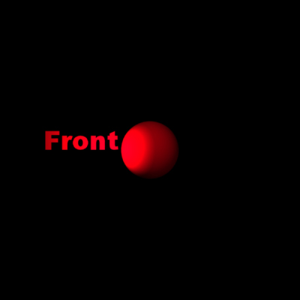

Forming Cube Map
Use six cameras, each with a 90 degree angle of view
E. Angel and D. Shreiner: Interactive Computer Graphics 6E © Addison-Wesley 2012

Slide 11
Indexing into Cube Map
Compute R = 2(N·V)N-V
Object at origin
Use largest magnitude component of R to determine face of cube
Other two components give texture coordinates
V
R
E. Angel and D. Shreiner: Interactive Computer Graphics 6E © Addison-Wesley 2012

Slide 12
Example
R = (-4, 3, -1)
Same as R = (-1, 0.75, -0.25)
Use face x = -1 and y = 0.75, z = -0.25
Not quite right since cube defined by x, y, z = ± 1 rather than [0, 1] range needed for texture coordinates
Remap by s = ½ + ½ y, t = ½ + ½ z
Hence, s =0.875, t = 0.375
E. Angel and D. Shreiner: Interactive Computer Graphics 6E © Addison-Wesley 2012

Slide 13
Doing it in OpenGL
glTextureMap2D(
GL_TEXTURE_CUBE_MAP_POSITIVE_X,
level, rows, columns, border, GL_RGBA,
GL_UNSIGNED_BYTE, image1)
Same for other five images
Make one texture object out of the six images
E. Angel and D. Shreiner: Interactive Computer Graphics 6E © Addison-Wesley 2012

Slide 14
OpenGL Cube Map (cont)
Parameters apply to all six images
glTexParameteri( GL_TEXTURE_CUBE_MAP,
GL_TEXTURE_MAP_WRAP_S, GL_REPEAT)
Same for t and r
Note that texture coordinates are in 3D space (s, t, r)
E. Angel and D. Shreiner: Interactive Computer Graphics 6E © Addison-Wesley 2012

Slide 15
Cube Map Example (init)
// colors for sides of cube
GLubyte red[3] = {255, 0, 0};
GLubyte green[3] = {0, 255, 0};
GLubyte blue[3] = {0, 0, 255};
GLubyte cyan[3] = {0, 255, 255};
GLubyte magenta[3] = {255, 0, 255};
GLubyte yellow[3] = {255, 255, 0};
glEnable(GL_TEXTURE_CUBE_MAP);
// texture object
glGenTextures(1, tex);
glActiveTexture(GL_TEXTURE1);
glBindTexture(GL_TEXTURE_CUBE_MAP, tex[0]);
E. Angel and D. Shreiner: Interactive Computer Graphics 6E © Addison-Wesley 2012

Slide 16
Cube Map (init II)
glTexImage2D(GL_TEXTURE_CUBE_MAP_POSITIVE_X ,
0,3,1,1,0,GL_RGB,GL_UNSIGNED_BYTE, red);
glTexImage2D(GL_TEXTURE_CUBE_MAP_NEGATIVE_X ,
0,3,1,1,0,GL_RGB,GL_UNSIGNED_BYTE, green);
glTexImage2D(GL_TEXTURE_CUBE_MAP_POSITIVE_Y ,
0,3,1,1,0,GL_RGB,GL_UNSIGNED_BYTE, blue);
glTexImage2D(GL_TEXTURE_CUBE_MAP_NEGATIVE_Y ,
0,3,1,1,0,GL_RGB,GL_UNSIGNED_BYTE, cyan);
glTexImage2D(GL_TEXTURE_CUBE_MAP_POSITIVE_Z ,
0,3,1,1,0,GL_RGB,GL_UNSIGNED_BYTE, magenta);
glTexImage2D(GL_TEXTURE_CUBE_MAP_NEGATIVE_Z ,
0,3,1,1,0,GL_RGB,GL_UNSIGNED_BYTE, yellow);
glTexParameteri(GL_TEXTURE_CUBE_MAP,
GL_TEXTURE_MAG_FILTER,GL_NEAREST);
E. Angel and D. Shreiner: Interactive Computer Graphics 6E © Addison-Wesley 2012

Slide 17
Cube Map (init III)
GLuint texMapLocation;
GLuint tex[1];
texMapLocation = glGetUniformLocation(program, "texMap");
glUniform1i(texMapLocation, tex[0]);
E. Angel and D. Shreiner: Interactive Computer Graphics 6E © Addison-Wesley 2012

Slide 18
Adding Normals
void quad(int a, int b, int c, int d)
{
static int i =0;
normal = normalize(cross(vertices[b] - vertices[a],
vertices[c] - vertices[b]));
normals[i] = normal;
points[i] = vertices[a];
i++;
// rest of data
E. Angel and D. Shreiner: Interactive Computer Graphics 6E © Addison-Wesley 2012

Slide 19
Vertex Shader
out vec3 R;
in vec4 vPosition;
in vec4 Normal;
uniform mat4 ModelView;
uniform mat4 Projection;
void main() {
gl_Position = Projection*ModelView*vPosition;
vec4 eyePos = vPosition;
vec4 NN = ModelView*Normal;
vec3 N =normalize(NN.xyz);
R = reflect(eyePos.xyz, N)
}
E. Angel and D. Shreiner: Interactive Computer Graphics 6E © Addison-Wesley 2012

Slide 20
Fragment Shader
in vec3 R;
uniform samplerCube texMap;
void main()
{
vec4 texColor = textureCube(texMap, R);
gl_FragColor = texColor;
}
E. Angel and D. Shreiner: Interactive Computer Graphics 6E © Addison-Wesley 2012

Slide 21
Sphere Mapping
Original environmental mapping technique proposed by Blinn and Newell based in using lines of longitude and latitude to map parametric variables to texture coordinates
OpenGL supports sphere mapping which requires a circular texture map equivalent to an image taken with a fisheye lens
E. Angel and D. Shreiner: Interactive Computer Graphics 6E © Addison-Wesley 2012

Slide 22
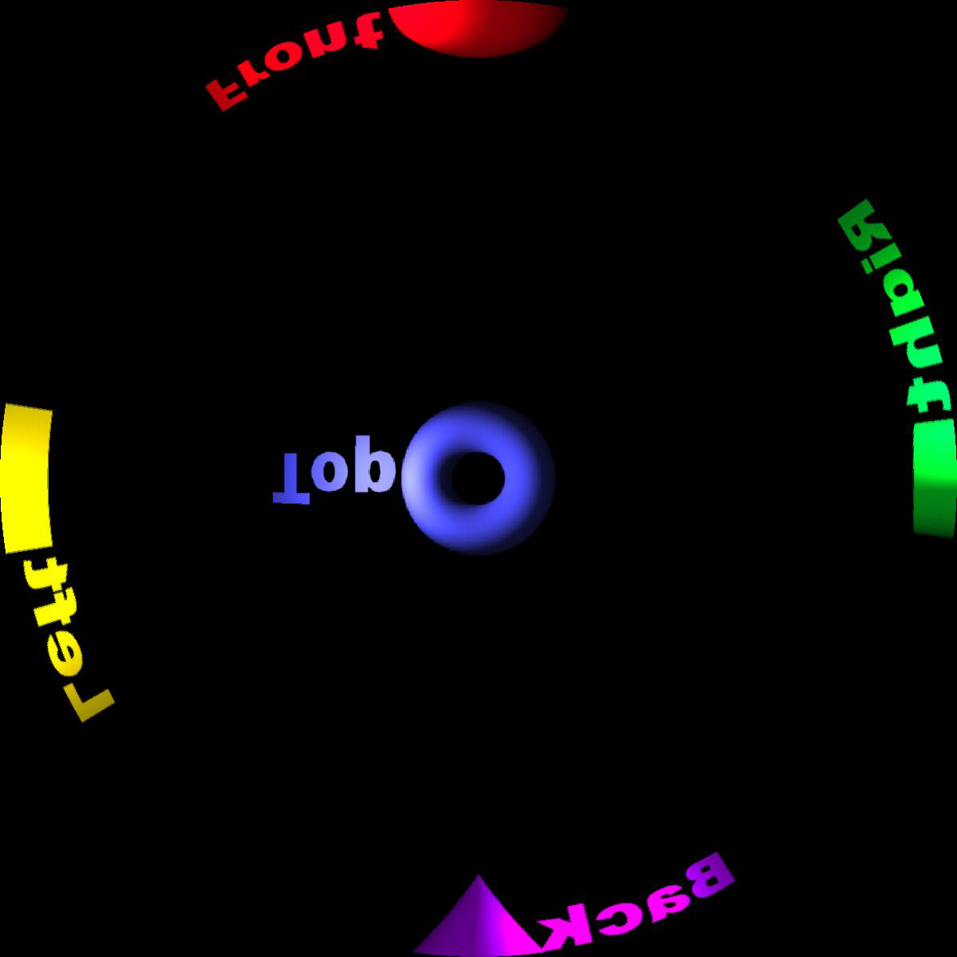
Sphere Map
E. Angel and D. Shreiner: Interactive Computer Graphics 6E © Addison-Wesley 2012

Slide 23
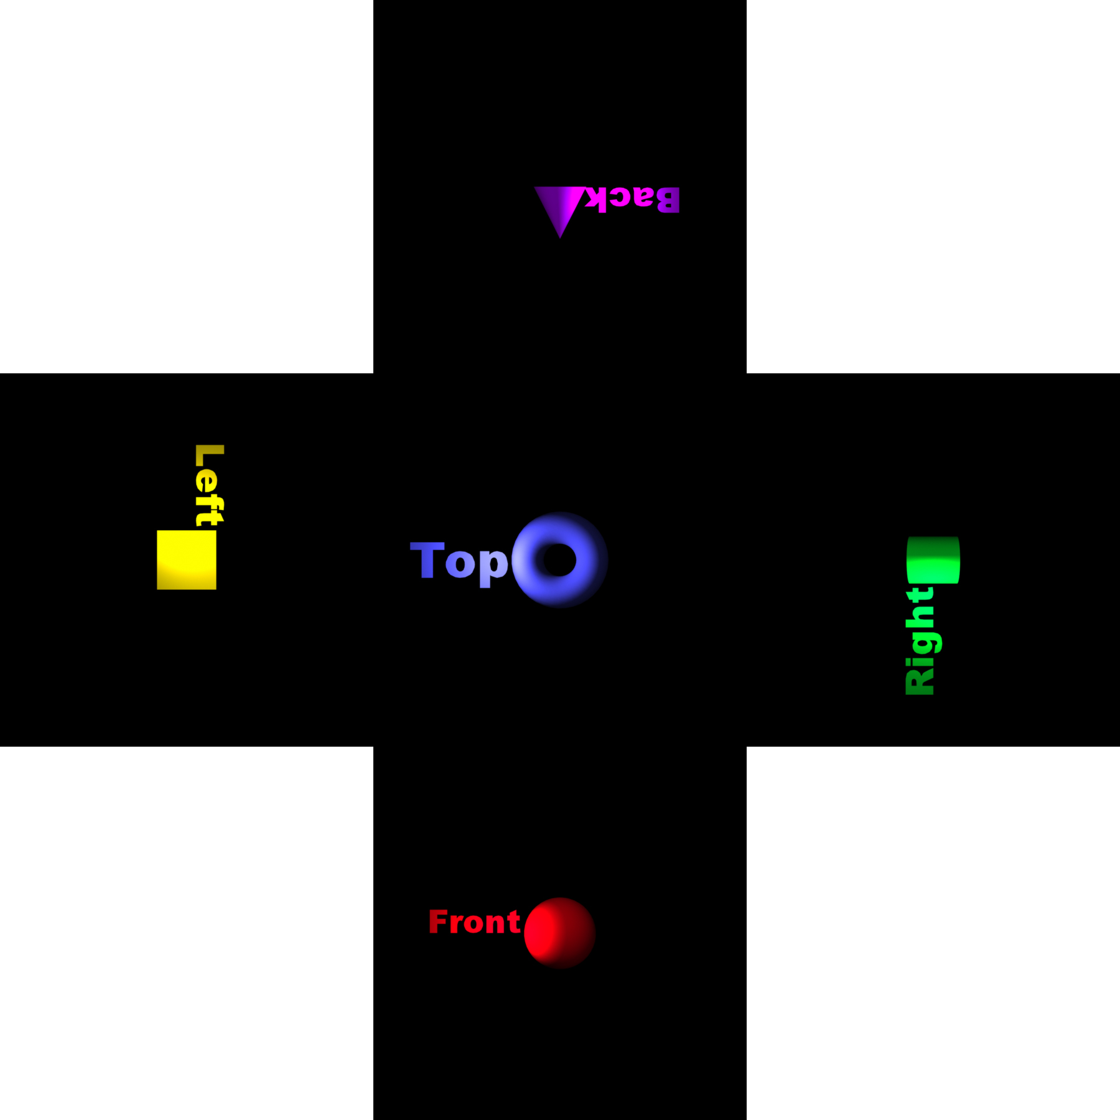
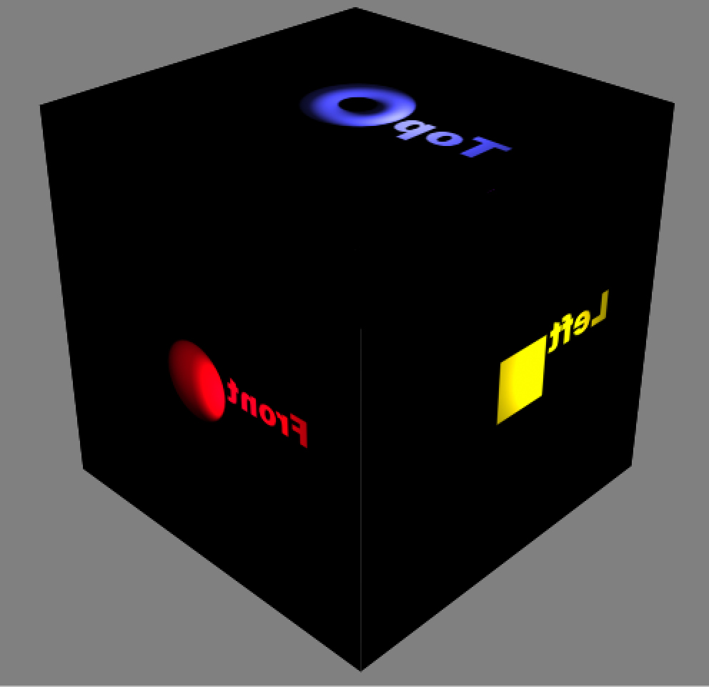
vs Cube Image
E. Angel and D. Shreiner: Interactive Computer Graphics 6E © Addison-Wesley 2012

Slide 24
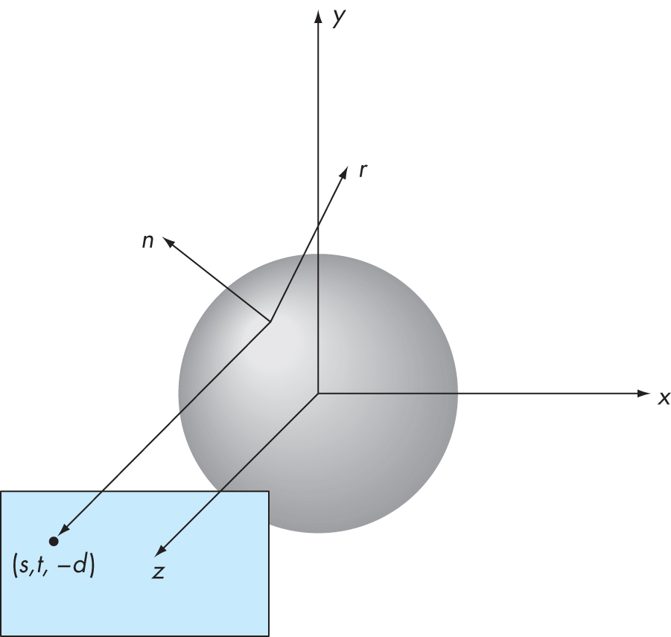
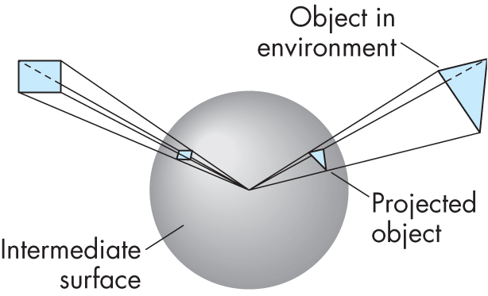
Reflection Map
Objects are mapped to unit sphere
All objects along a reflector map to same point on sphere
E. Angel and D. Shreiner: Interactive Computer Graphics 6E © Addison-Wesley 2012

Slide 25
Mapping Equations
Consider a unit sphere and the viewer at at (s, t, 0)
Normal is (s, t, sqrt(1 – s*s – t*t)
Can compute r = 2(n.v)n –v
Going backwards, given r, we get
s = rx/f + ½, t = ry/f+1/2
where
f = sqrt(rx*rx+ry*ry +(rz+1)(rz+1))
E. Angel and D. Shreiner: Interactive Computer Graphics 6E © Addison-Wesley 2012

