Slide 1
Shadows
Ed Angel
Professor Emeritus of Computer Science
University of New Mexico
E. Angel and D. Shreiner: Interactive Computer Graphics 6E © Addison-Wesley 2012

Slide 2
Objectives
Introduce Shadow Algorithms
Expand to projective textures
E. Angel and D. Shreiner: Interactive Computer Graphics 6E © Addison-Wesley 2012

Slide 3
Flashlight in the Eye Graphics
When do we not see shadows in a real scene?
When the only light source is a point source at the eye or center of projection
  Shadows are behind objects and not visible
Shadows are a global rendering issue
  Is a surface visible from a source
  May be obscured by other objects
E. Angel and D. Shreiner: Interactive Computer Graphics 6E © Addison-Wesley 2012

Slide 4
Projective Shadows
Oldest methods
  Used in flight simulators to provide visual clues
Projection of a polygon is a polygon called a shadow polygon
Given a point light source and a polygon, the vertices of the shadow polygon are the projections of the original polygon’s vertices from a point source onto a surface
E. Angel and D. Shreiner: Interactive Computer Graphics 6E © Addison-Wesley 2012

Slide 5
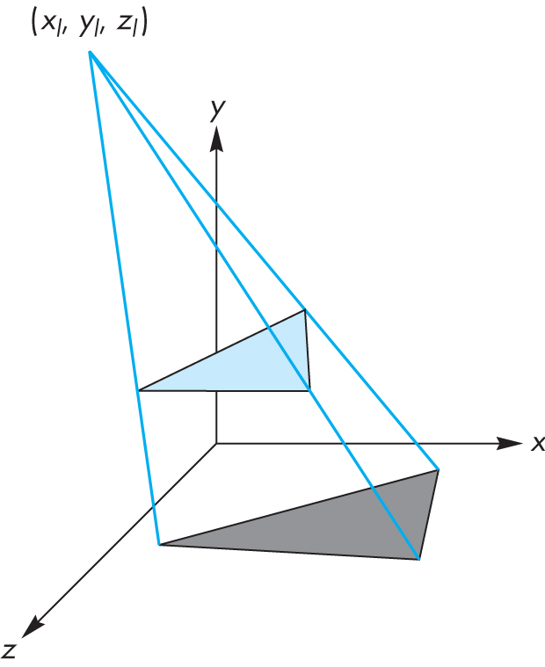
Shadow Polygon
E. Angel and D. Shreiner: Interactive Computer Graphics 6E © Addison-Wesley 2012

Slide 6
Computing Shadow Vertex
Source at (x_{l}, y_{l}, z_{l})
Vertex at (x, y, z)
Consider simple case of shadow projected onto ground at (x_{p}, 0, z_{p})
Translate source to origin with T(-x_{l}, -y_{l}, -z_{l})
Perspective projection
Translate back
E. Angel and D. Shreiner: Interactive Computer Graphics 6E © Addison-Wesley 2012

Slide 7
Shadow Process
  Put two identical triangles and their colors on GPU (black for shadow triangle)
  Compute two model view matrices as uniforms
  Send model view matrix for original triangle
  Render original triangle
  Send second model view matrix
  Render shadow triangle
  Note shadow triangle undergoes two transformations
  Note hidden surface removal takes care of depth issues
E. Angel and D. Shreiner: Interactive Computer Graphics 6E © Addison-Wesley 2012

Slide 8
Generalized Shadows
Approach was OK for shadows on a single flat surface
Note with geometry shader we can have the shader create the second triangle
Cannot handle shadows on general objects
Exist a variety of other methods based on same basic idea
We’ll pursue methods based on projective textures
E. Angel and D. Shreiner: Interactive Computer Graphics 6E © Addison-Wesley 2012

Slide 9
Image Based Lighting
We can project a texture onto the surface in which case the are treating the texture as a “slide projector”
This technique the basis of projective textures and image based lighting
Supporting in OpenGL and GLSL through four dimensional texture coordinates
E. Angel and D. Shreiner: Interactive Computer Graphics 6E © Addison-Wesley 2012

Slide 10
4D Textures Coordinates
Texture coordinates (s, t, r, q) are affected by a perspective division so the actual coordinates used are (s/q, t/q, r/q) or (s/q, t/q) for a two dimensional texture
GLSL has a variant of the function texture textureProj which will use the two- or three-dimensional texture coordinate obtained by a perspective division of a 4D texture coordinate a texture value from a sampler
color = textureProj(my_sampler, tex_coord)
E. Angel and D. Shreiner: Interactive Computer Graphics 6E © Addison-Wesley 2012

Slide 11
Shadow Maps
If we render a scene from a light source, the depth buffer will contain the distances from the source to each fragment.
We can store these depths in a texture called a depth map or shadow map
Note that although we don’t care about the image in the shadow map, if we render with some light, anything lit is not in shadow.
Form a shadow map for each source
E. Angel and D. Shreiner: Interactive Computer Graphics 6E © Addison-Wesley 2012

Slide 12
Final Rendering
During the final rendering we compared the distance from the fragment to the light source with the distance in the shadow map
If the depth in the shadow map is less than the distance from the fragment to the source the fragment is in shadow (from this source)
Otherwise we use rendered color
E. Angel and D. Shreiner: Interactive Computer Graphics 6E © Addison-Wesley 2012

Slide 13
Applications Side
Start with vertex in object coordinates
Want to convert representation to texture coordinates
Form LookAt matrix from light source to origin in object coordinates (MVL)
From projection matrix for light source (PL)
From a matrix to convert from [-1, 1] clip coordinates to [0, 1] texture coordinates
Concatenate to form object to texture coordinate matrix (OTC)
E. Angel and D. Shreiner: Interactive Computer Graphics 6E © Addison-Wesley 2012

Slide 14
Vertex Shader I
uniform mat4 modelview;
uniform mat4 projection;
uniform normalmatrix; //for diffuse lighting
uniform mat4 otc; //object to texture coordinate
unifrom vec4 diffuseproduct; //diffuse light*diffuse reflectivity
in vec4 vPosition;
in vec4 normal;
out vec4 color;
out vec4 shadowCoord;
E. Angel and D. Shreiner: Interactive Computer Graphics 6E © Addison-Wesley 2012

Slide 15
Vertex Shader II
void main()
{
// compute diffuse color as usual
// using normal, normal matrix, diffuse product
color =
gl_Position = projection*modelview*vPosition;
shadowCoord = OTC*vPosition;
}
E. Angel and D. Shreiner: Interactive Computer Graphics 6E © Addison-Wesley 2012

Slide 16
Fragment Shader I
Application provides the shadow map as a texture object
The GLSL function textureProj compares the third value of the texture coordinate with the third value of the texture image
For nearest filtering of the texture object, textureProj returns 0.0 if the shadow map value is less than the third coordinate and 1.0 otherwise
For other filtering options, texture project returns values between 0.0 and 1.0
E. Angel and D. Shreiner: Interactive Computer Graphics 6E © Addison-Wesley 2012

Slide 17
Fragment Shader II
uniform sampler2DShadow ShadowMap;
in vec4 shadowCoord;
in vec4 Color;
main()
{
// assume nearest sampling in ShadowMap
float shadeFactor = textureProj(ShadowMap, ShadowCoord);
gl_FragColor = vec4(shadeFactor*Color.rgb, Color.a)
}
E. Angel and D. Shreiner: Interactive Computer Graphics 6E © Addison-Wesley 2012

