Slide 1
Parallel Rendering
Ed Angel
Professor Emeritus of Computer Science
University of New Mexico
E. Angel and D. Shreiner: Interactive Computer Graphics 6E © Addison-Wesley 2012

Slide 2
Introduction
In many situations, a standard rendering pipeline might not be sufficient
  Need higher resolution display
  More primitives than one pipeline can handle
Want to use commodity components to build a system that can render in parallel
Use standard network to connect
E. Angel and D. Shreiner: Interactive Computer Graphics 6E © Addison-Wesley 2012

Slide 3
Power Walls
Where do we display large data sets?
  CRTs have low resolution (1 Mpixel)
  LCD panels improving but still expensive
  Need resolution comparable to data set to see detail
    CT/MRI/MEG
    Ocean data
Solution?
  Multiple projectors
    Commodity
    High-end
    See IEECE CG & A (July)
E. Angel and D. Shreiner: Interactive Computer Graphics 6E © Addison-Wesley 2012

Slide 4
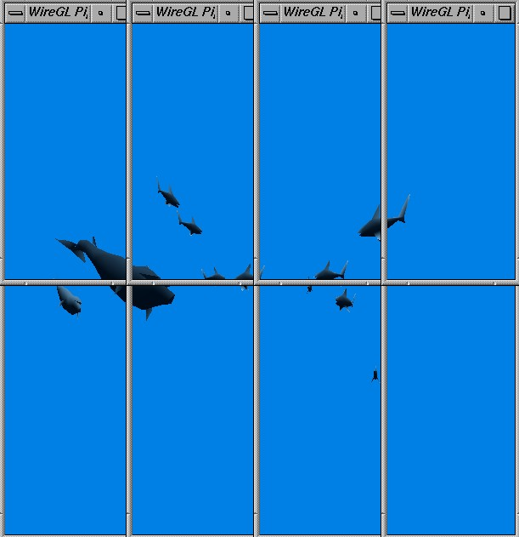
Tiled Display
E. Angel and D. Shreiner: Interactive Computer Graphics 6E © Addison-Wesley 2012

Slide 5
CS Power Wall
6 dual processor Intellestations
G Force 3 Graphics cards
6 commodity projectors (1024 x 768)
Gigabit ethernet
Back projected screen
Shared facility with scalable system group
  Investigate OS and network issues
E. Angel and D. Shreiner: Interactive Computer Graphics 6E © Addison-Wesley 2012

Slide 6
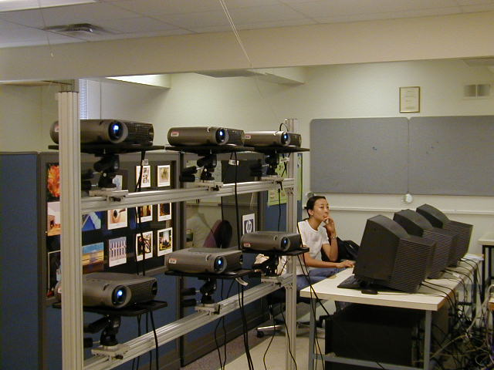
CS Power Wall
E. Angel and D. Shreiner: Interactive Computer Graphics 6E © Addison-Wesley 2012

Slide 7
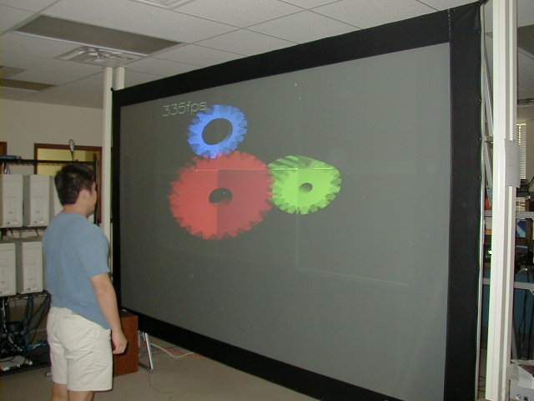
CS Power Wall
E. Angel and D. Shreiner: Interactive Computer Graphics 6E © Addison-Wesley 2012

Slide 8
Power Wall
Inexpensive solution but there are some problems
  Color matching
  Vignetting
  Alignment
    Overlap areas
  Synching
  Dark field
E. Angel and D. Shreiner: Interactive Computer Graphics 6E © Addison-Wesley 2012

Slide 9
Graphics Architectures
Pipeline Architecture
  SGI Geometry Engine
  Geometry passes through pipeline
  Hardware for
    clipping
    transformations
    texture mapping
Transform
Clip
Project/Sort
Rasterize
Screen
E. Angel and D. Shreiner: Interactive Computer Graphics 6E © Addison-Wesley 2012

Slide 10
Building Blocks
Graphics processors consist of geometric blocks and rasterizers
Geometric units: transformations, clipping, lighting
Rasterization: scan conversion, shading
Parallelize by using mutiple blocks
Where to do depth check?
G
G
G
R
R
R
E. Angel and D. Shreiner: Interactive Computer Graphics 6E © Addison-Wesley 2012

Slide 11
Sorting Paradigm
We can categorize different ways of interconnecting blocks using a sorting paradigm: each projector is responsible for one area of the screen. Hence, we must sort the primitives and assign them to the proper projector
Algorithms can be categorized by where this sorting occurs
E. Angel and D. Shreiner: Interactive Computer Graphics 6E © Addison-Wesley 2012

Slide 12
Three Rendering Methods
Sort
G
G
G
G
G
G
G
G
G
Sort
R
R
R
R
R
R
R
R
R
Composite
Sort-First Rendering
Sort-Middle Rendering
Sort-Last Rendering
E. Angel and D. Shreiner: Interactive Computer Graphics 6E © Addison-Wesley 2012

Slide 13
Sort First
Each rasterization unit assigned to an area of the screen
Each geometric unit coupled to its own rasterizer
Must sort primitives first
Can use commodity cards
Sort
G
G
G
R
R
R
E. Angel and D. Shreiner: Interactive Computer Graphics 6E © Addison-Wesley 2012

Slide 14

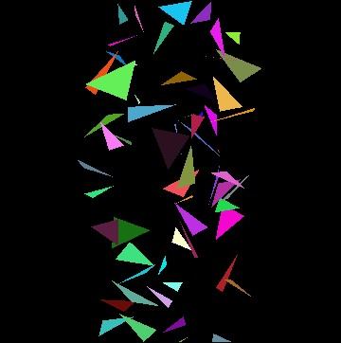
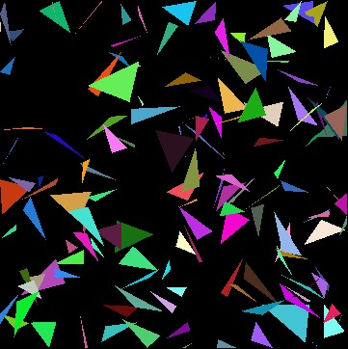
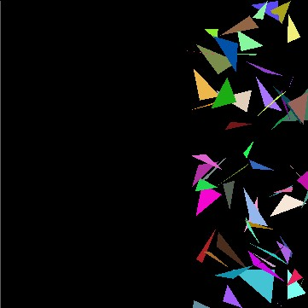
Sort-First Rendering for a Random
Triangles Application
E. Angel and D. Shreiner: Interactive Computer Graphics 6E © Addison-Wesley 2012

Slide 15
Sort Middle
Geometric units and rasterization units decoupled
Each geometric unit can be assigned any group of objects
Each rasterizer is assigned to an area of the screen
Must sort between stages
G
G
G
Sort
R
R
R
E. Angel and D. Shreiner: Interactive Computer Graphics 6E © Addison-Wesley 2012

Slide 16
Sort Last
Couple rasterizers and geometric units
Assign objects to geometric units to load balance or via application
Composite results at end
G
G
G
R
R
R
Composite
E. Angel and D. Shreiner: Interactive Computer Graphics 6E © Addison-Wesley 2012

Slide 17
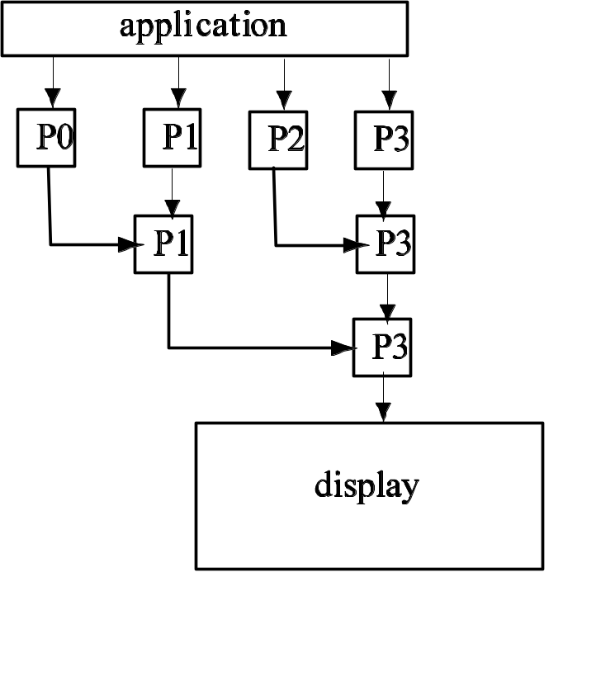
Tree Compositing
Composite in pairs
Send color and depth buffers
Each time half processors become idle
E. Angel and D. Shreiner: Interactive Computer Graphics 6E © Addison-Wesley 2012

Slide 18
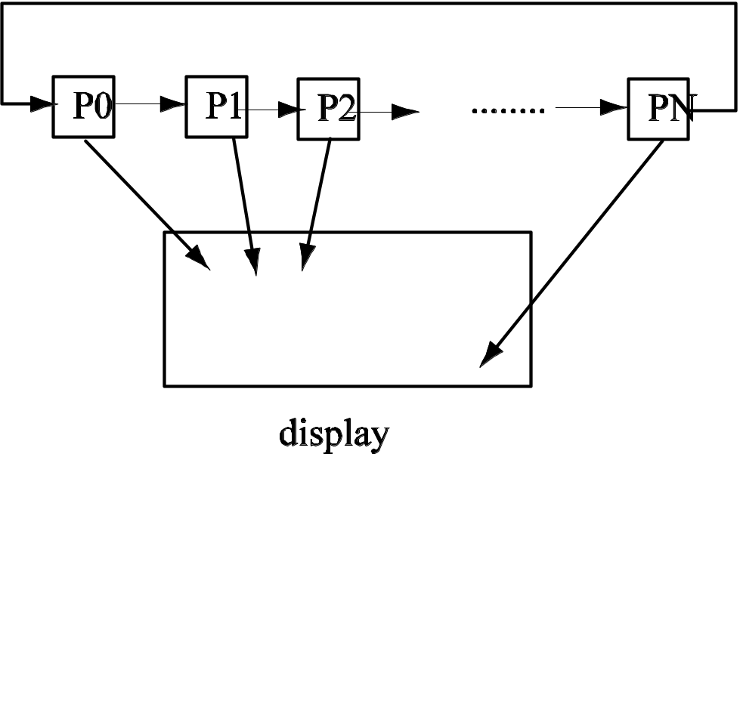
Binary Swap Compositing
Each processor responsible for one part of display
Pass data to right n times
E. Angel and D. Shreiner: Interactive Computer Graphics 6E © Addison-Wesley 2012

Slide 19
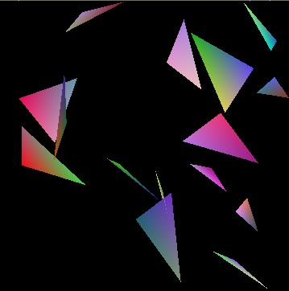
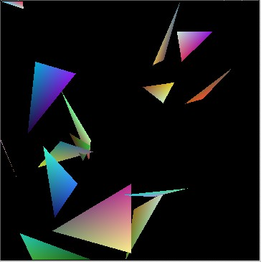
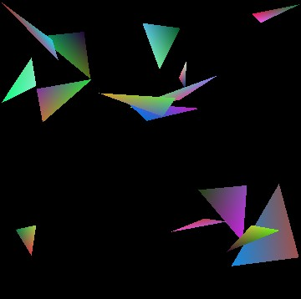
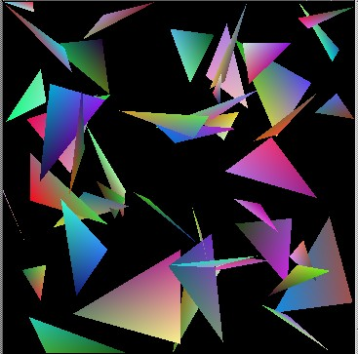
Sort-Last Rendering for a Random Triangles Application
E. Angel and D. Shreiner: Interactive Computer Graphics 6E © Addison-Wesley 2012

Slide 20
Comparison
Sort first
  Appealing but hard to implement
Sort middle
  Used in hardware pipelines
  More difficult to implement with add-on commodity cards
Sort last
  Easy to implement with a compositing stage
  High network traffic
E. Angel and D. Shreiner: Interactive Computer Graphics 6E © Addison-Wesley 2012

