Slide 1
Sampling and Aliasing
Ed Angel
Professor Emeritus of Computer Science
University of New Mexico
E. Angel and D. Shreiner: Interactive Computer Graphics 6E © Addison-Wesley 2012

Slide 2
Introduction
In computer graphics, we use the term “aliasing” but where does it come from?
Sampling theory explains where these errors arise and what we might do to avoid them
Explains both digitization and display
E. Angel and D. Shreiner: Interactive Computer Graphics 6E © Addison-Wesley 2012

Slide 3
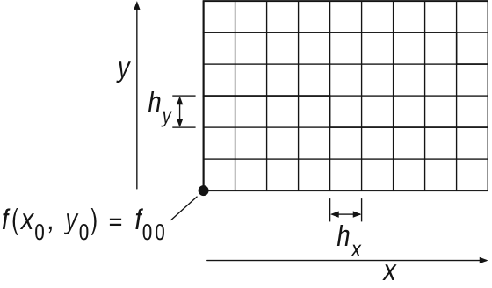
Sampling Process
Measure f(x,y) on grid
E. Angel and D. Shreiner: Interactive Computer Graphics 6E © Addison-Wesley 2012

Slide 4
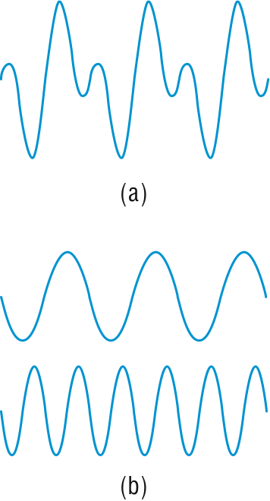
Ambiguity from Samples
E. Angel and D. Shreiner: Interactive Computer Graphics 6E © Addison-Wesley 2012

Slide 5
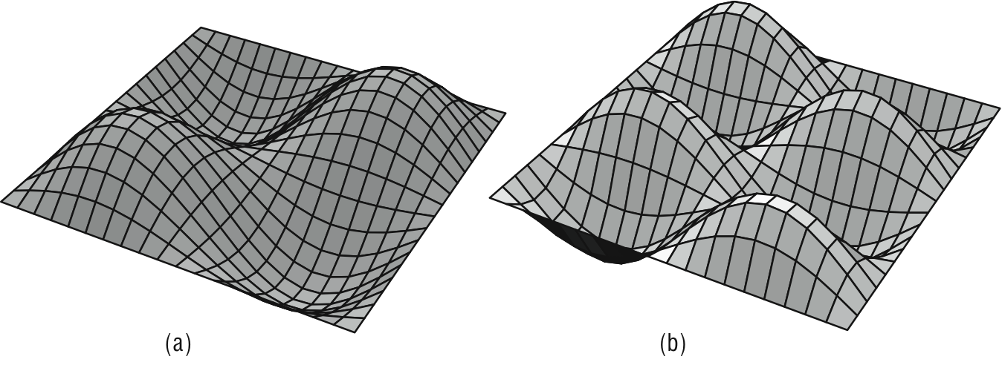
Basis Images
E. Angel and D. Shreiner: Interactive Computer Graphics 6E © Addison-Wesley 2012

Slide 6
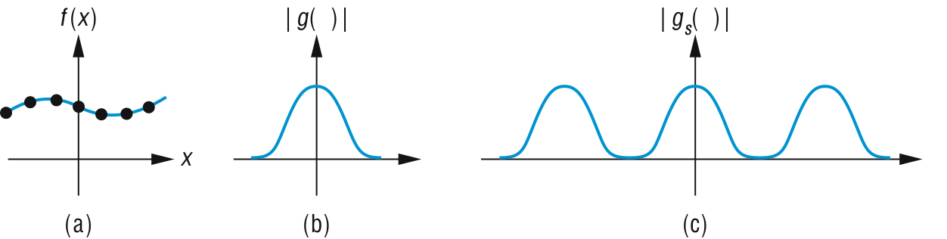
Sampling and Replication
E. Angel and D. Shreiner: Interactive Computer Graphics 6E © Addison-Wesley 2012

Slide 7
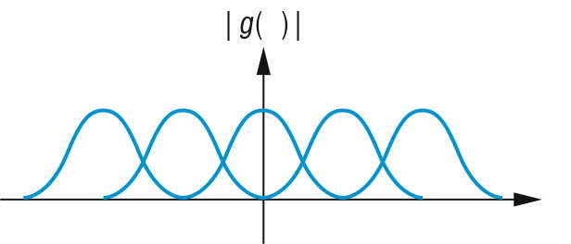
Replication with Overlap
E. Angel and D. Shreiner: Interactive Computer Graphics 6E © Addison-Wesley 2012

Slide 8
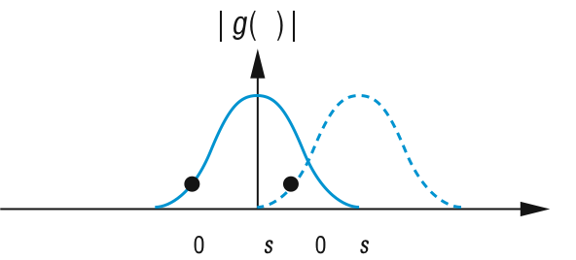
Aliasing
E. Angel and D. Shreiner: Interactive Computer Graphics 6E © Addison-Wesley 2012

Slide 9
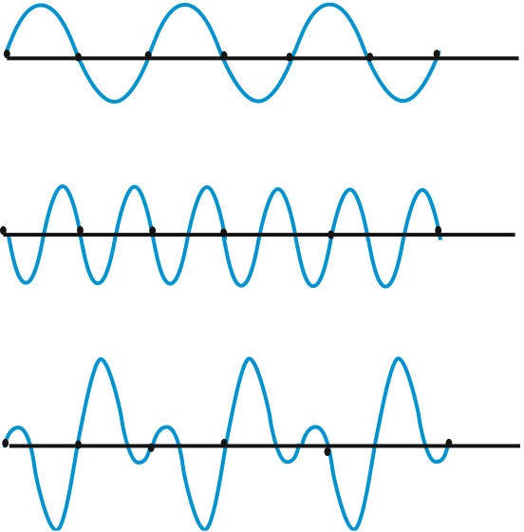
E. Angel and D. Shreiner: Interactive Computer Graphics 6E © Addison-Wesley 2012

Slide 10
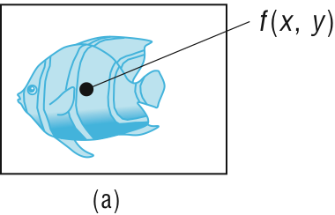
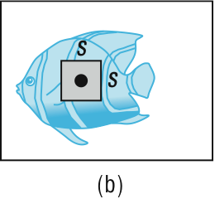
Sampling
point sampling
area sampling
E. Angel and D. Shreiner: Interactive Computer Graphics 6E © Addison-Wesley 2012

Slide 11
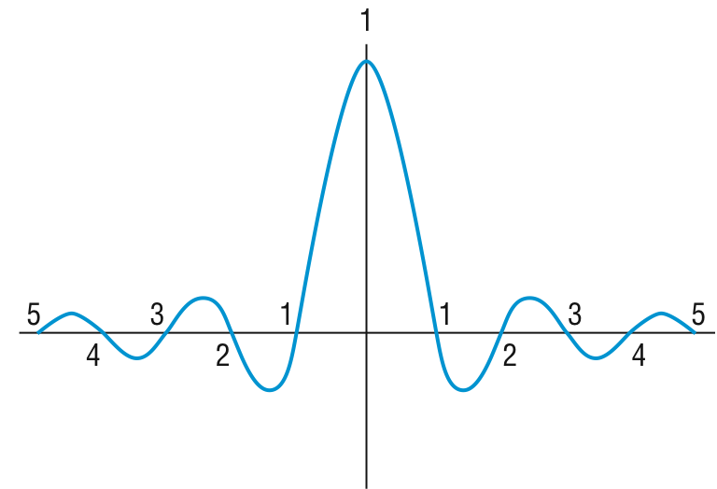
Sinc function
E. Angel and D. Shreiner: Interactive Computer Graphics 6E © Addison-Wesley 2012

Slide 12
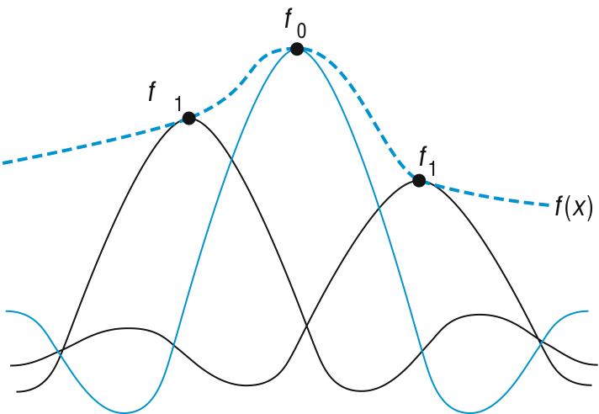
Reconstruction with Sinc
E. Angel and D. Shreiner: Interactive Computer Graphics 6E © Addison-Wesley 2012

Slide 13
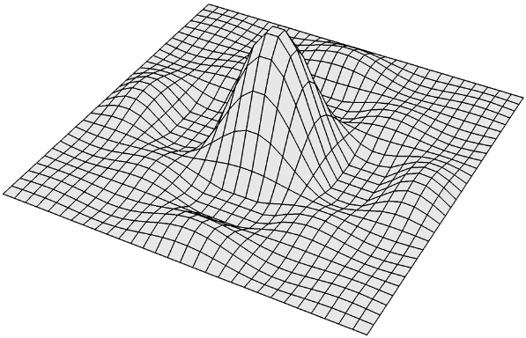
Two dimensional sinc
E. Angel and D. Shreiner: Interactive Computer Graphics 6E © Addison-Wesley 2012

Slide 14
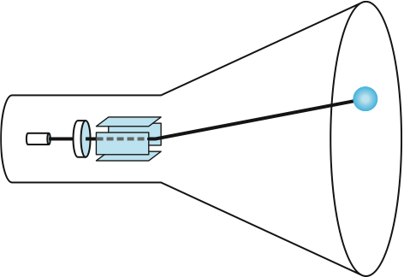
Point Spread of CRT Beam
E. Angel and D. Shreiner: Interactive Computer Graphics 6E © Addison-Wesley 2012

Slide 15
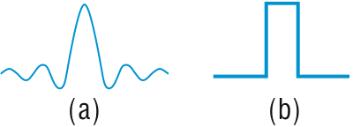
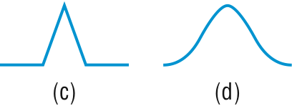
Reconstruction functions
sinc
rectangle
triangle
Gaussian
E. Angel and D. Shreiner: Interactive Computer Graphics 6E © Addison-Wesley 2012

Slide 16
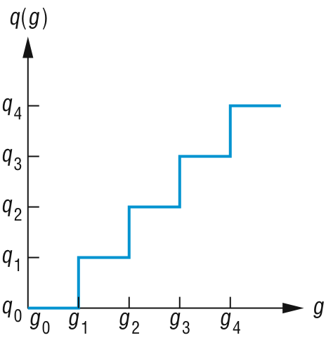
Quantizer
E. Angel and D. Shreiner: Interactive Computer Graphics 6E © Addison-Wesley 2012

