Slide 1
Ceratec surfaces
Scraping Navigation Document by shoeb370

Slide 2
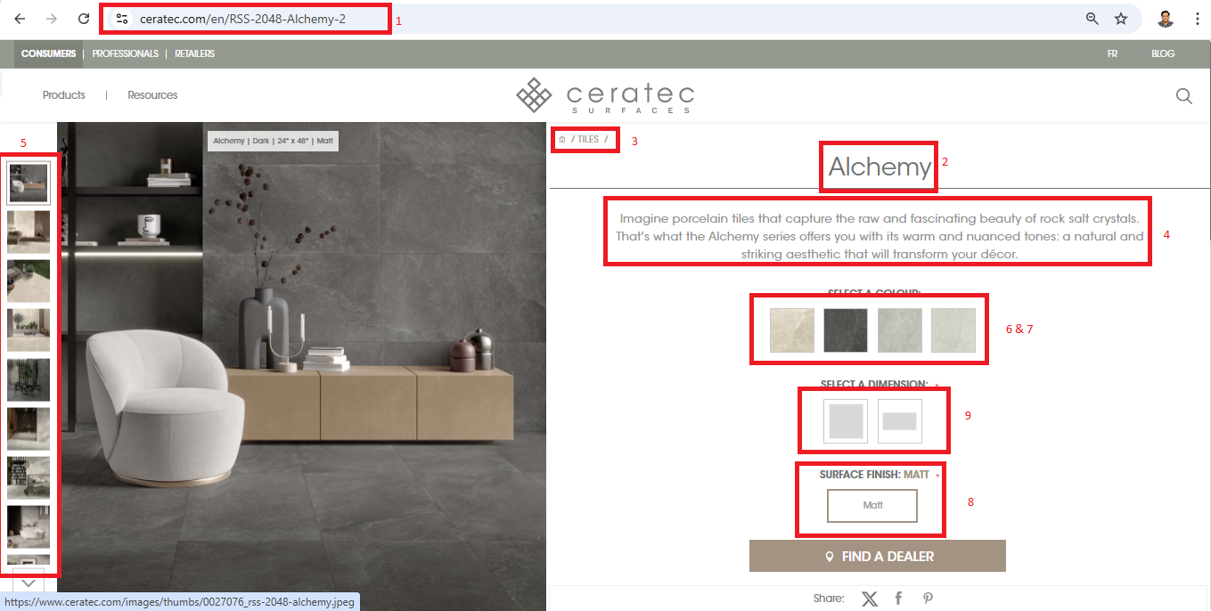
PoiNT Data PoiNt
1. Url
2. Title
3. Breacrumb
4. Description
5. Image urls
6. Color of Variant
7. Color grouping
8. Material
9. Dimension available
10. Technical Document Link

Slide 3
