Slide 1
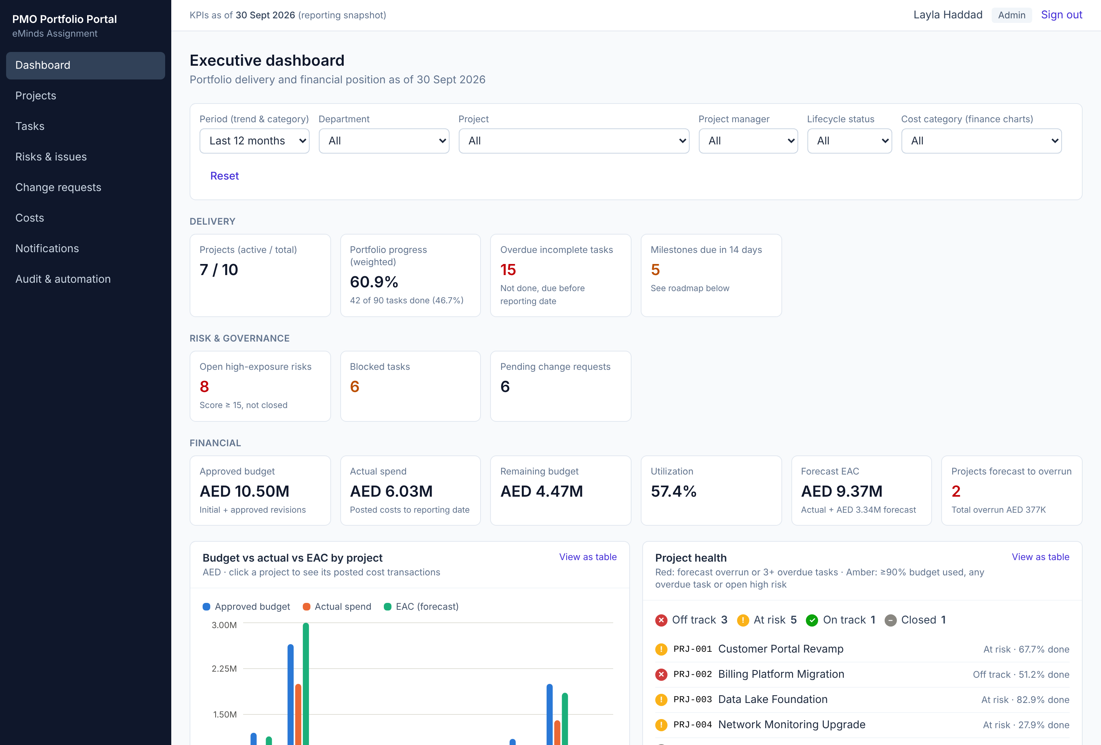
Project Portfolio & Financial Control Portal
One trusted view of delivery, risk and cost - built as a working full-stack application
Spreadsheets, emails, trackers
→ One PostgreSQL source of truth
No trusted view of health or cost
→ Live KPIs with drill-down to records
Manual chasing of late work
→ Automated overdue-task alerts
Shoeb Shaikh · Full Stack Developer assessment · October 2026
Notes:
The PMO today works from spreadsheets, emails and individual trackers, so leadership has no trusted view of delivery health or cost exposure. I built a working portal: operational teams maintain projects, tasks, risks, change requests and costs; management gets a live dashboard calculated from the same SQL database. Everything you will see is running code, not a prototype.

Slide 2








Seven connected modules on one database
Project portfolio
Tasks & milestones
Risks & issues
Change requests
Create, edit, search and filter by department, owner, status and dates
Weighted progress, overdue and due-soon flags, assignee updates
Score = probability × impact; open high-exposure items surfaced
Approve, reject or return with a reason; no self-approval; full history
Financial control
Executive dashboard
Access & audit
3 roles, server-checked
Budgets, revisions, draft vs posted costs, forecasts, EAC alerts
Live SQL KPIs, 7 visuals, 6 filters, drill-down to records
Secure login, project-scoped access, append-only audit log
Contributor - own tasks
Manager - own projects
Admin - everything + audit
Notes:
All modules share users, project ids and business rules in one PostgreSQL database - no disconnected pages. The six business journeys from the brief all run end to end: create a project, update a task, update a milestone or risk, post a cost, approve a change request, and drill from a dashboard KPI to its records. Permissions are enforced by the API: a contributor calling the approval or cost-posting endpoint directly gets 403.

Slide 3



Three layers; rules live in the API and the database
Browser
React 19 + Vite + Tailwind
TanStack Query refetches after every save
Recharts dashboard
Node.js API (Express 5)
requestId → logger → login check
routes: URLs + zod validation
services: business rules
PostgreSQL 16
17 tables, Docker
CHECK, UNIQUE, triggers
SQL migrations + seed
/api + cookie
parameterized SQL
Rules enforced twice
All-or-nothing writes
Safe under concurrency
Role and project checks in every service; the database also blocks self-approval and edits to posted costs.
A decision, its history row and its audit event commit in one transaction - never half saved.
Version check returns 409 on stale edits; idempotency key stops a double-posted cost.
Notes:
Requests flow browser → API → database. In the API every request gets an ID that appears in logs, audit events and error messages. Routes only validate input; all business rules live in one service file per module, so any rule can be found and changed in one place. Critical rules are repeated in PostgreSQL itself, so even a buggy endpoint or a manual SQL statement cannot self-approve or delete a posted cost.

Slide 4
Finance KPIs follow one documented formula set
Current budget Initial budget + APPROVED revisions only
Actual spend POSTED costs dated on or before 30 Sep 2026
Remaining Current budget − actual spend
Utilization Actual ÷ current budget (n/a if budget is 0)
EAC Actual + forecast for future months
Variance Current budget − EAC (negative = overrun)
PRJ-002 flagged FORECAST OVERRUN
EAC AED 3.00M vs approved budget AED 2.65M
Notes:
Finance is a real module, not just a chart: budgets, budget revisions with approval, draft and posted costs, monthly forecasts. The formulas live in ONE SQL query shared by the project finance page and the dashboard, so the two can never disagree. Each one-to-many table - revisions, costs, forecasts - is summed per project before joining, so totals are never inflated. PRJ-002 shows why this matters: actual spend looks fine at 75%, but the forecast pushes EAC to 3.0M against a 2.65M budget, and the system flags it.

Slide 5
The executive dashboard is calculated live from SQL
16
7
KPI cards
interactive visuals
6
4 / 4
filters in one row
KPIs match hand-written SQL
Every card and chart drills down to the exact records; the list total equals the KPI
After an edit the dashboard refetches: overdue 3 → 2, actual spend 3.79M → 3.89M
Each KPI is summed from one table, so joins never inflate totals
Notes:
One API call returns every KPI and chart, computed in SQL for the projects the user may see and the filters selected. Click Actual spend and you get the 114 posted transactions that add up to exactly AED 6,026,500. The brief asks that the dashboard recompute after a task update and a new posted cost, with no client-side patching - both were tested in the browser. Power BI was not delivered; instead I reconciled four KPIs between hand-written SQL and the web dashboard, unfiltered and filtered by department - all identical.

Slide 6
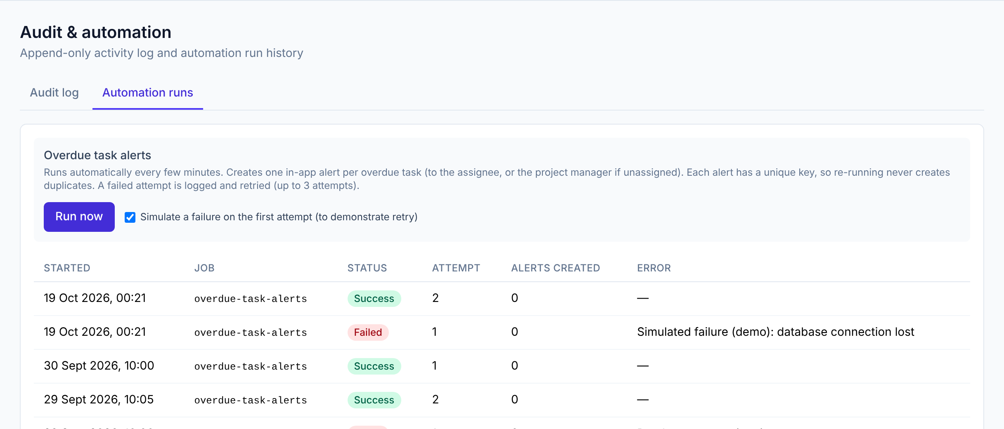




Overdue-task alerts run on a schedule, safely
Trigger
Every 5 minutes, or an admin clicks Run now
Rule
Task not done and past its due date, on an open project
Outcome
In-app alert to the assignee (or the PM if unassigned)
No duplicate alerts
Safe retry
Run log
Each alert has a unique key (TASK_OVERDUE:task:42); the insert skips existing keys.
A failed attempt is rolled back, logged as Failed and retried up to 3 times.
Every attempt recorded: success or failure, error, alerts created
Notes:
The automation finds overdue tasks and creates one in-app alert per task. The screenshot shows a demo run with a simulated failure: attempt 1 failed and was logged with its error, attempt 2 succeeded. Running it again creates zero new alerts, because every alert has a unique event key and the database ignores duplicates - so retries and parallel runs are safe.

Slide 7
AI sped up the build; every output was verified
How I worked with AI
Where the AI was wrong, and the fix
1
Turned the brief into phases, each with a "done when" check
Hard-coded SQL placeholder
Search used $2 - wrong once access filters were added. Fixed in the filter helper.
2
Gave exact rules: approved revisions only, posted costs to the cutoff, no self-approval
Silent data loss
Task list omitted description, so editing would wipe it. Added to the query.
3
Asked for readable code: one job per file, rules in one place
Charts at the wrong width
Grid item would not shrink; fixed with min-width 0, checked by screenshot.
4
Ran every phase on real PostgreSQL before accepting it, then on my machine
Filter reset itself
"All statuses" fell back to the default. Fixed with an explicit ALL value.
Tests were checked too: I broke a permission rule on purpose → 3 tests failed → restored → 10 / 10 pass
Notes:
AI was a pair-programmer; I decided scope, stack and trade-offs and validated each phase on my own machine. The full log with prompts, results, what I accepted or rejected and the evidence is in docs/ai-development-log.md. Four real examples where the AI was wrong are on the right - each was caught by review, by comparing data, or by looking at the rendered screen. I can open any file and explain or change it live.

Slide 8
Tested end to end and ready to run
10 / 10
49
41
8
automated API tests (npm test)
API journey checks during development
browser checks across all journeys
acceptance tests A-H, step by step
Delivered
Scope notes
Source on GitHub with one commit per phase
docker compose up → migrate → seed → run (README)
Generator, CSVs, schema, route list, Postman collection
ER diagram, SQL queries, security notes, AI log
Power BI not delivered - SQL reconciliation provided instead
MS Access (optional) not delivered
Next: login rate limiting, security headers, company SSO, hosted deployment
Notes:
Ten automated tests run against a separate test database, so demo data is never touched; they cover role denial, self-approval, workflow history, finance formulas, drafts, and the automation. During development I also ran 49 API checks and 41 browser checks covering all six journeys. Everything runs locally with Docker in a few commands. I was open about scope: Power BI and Access were not delivered, and I listed the next security improvements. Happy to demo any journey or change something live.

