Slide 1
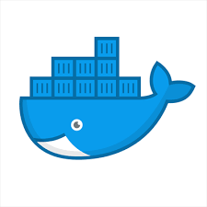






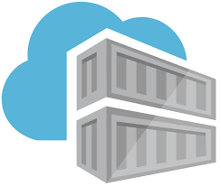
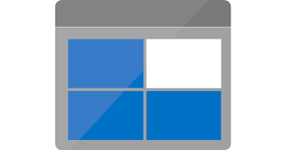
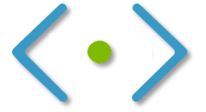










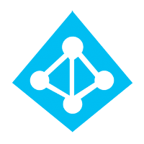
Micro Service Architecture & Deployment
App build ,image creation, push to Docker Hub
3
7
1
Key Vault
Sensitive info
Application Code
AWS CodeCommit
Service Principal Info
Group Variables
Storage Account (Terraform State)
Terrform Code
YAML (if Needed)
Pull code
POD1
4
…
9
5
6
DevOps Operation
DevOps & Admin User could login
Configure Pipeline
Doc Creation
Run Pipeline
Jenkin
POD2
Push code
Kubernetes Ingress
…
10
POD3
Amazon Route 53
DevOps
2
Access with domain/Public IP
8
Admin
Users

Slide 2
Main Domain
Order
Product
Payment
Customer
Recommendation
Cart
Authentication
Delivery
Authorization
Sub Domain
Generic Domain

Slide 3
Customer Frontend
Frontend
Order Frontend
Customer API
Orders API
Customer Service
CustomerOrders API
Order Service
Customer DB
Order DB

