Slide 1
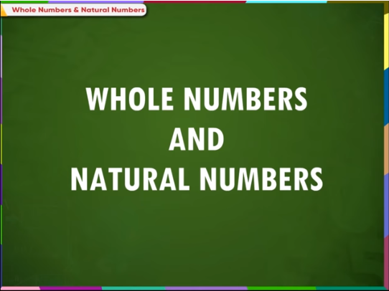

Slide 2
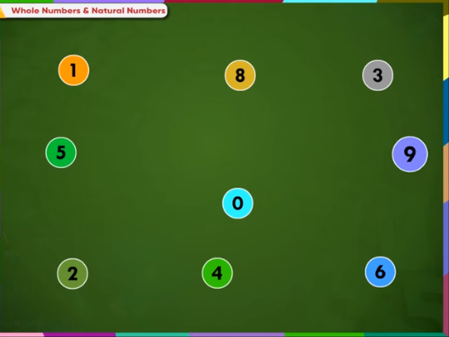
Notes:
Numbers are everywhere

Slide 3
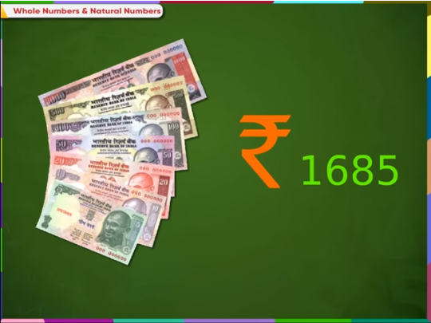
Notes:
Money in Numbers

Slide 4
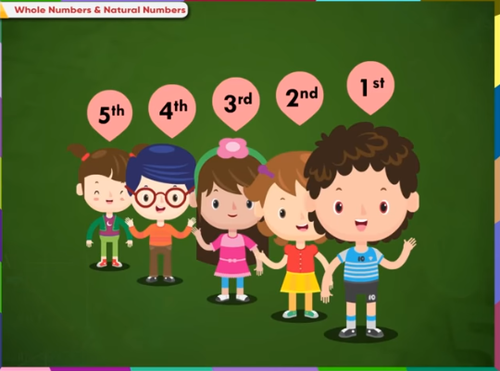
Notes:
Students standing in a queue in numbers

Slide 5
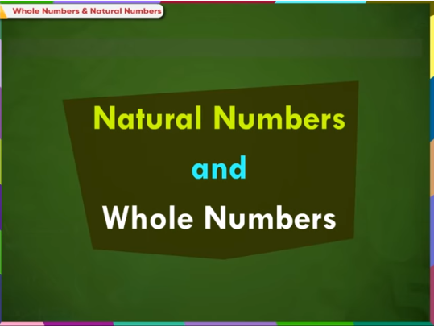

Slide 6
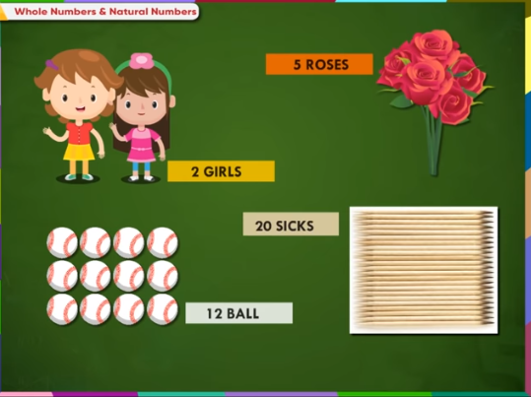
Notes:
We use numbers to count objects

Slide 7
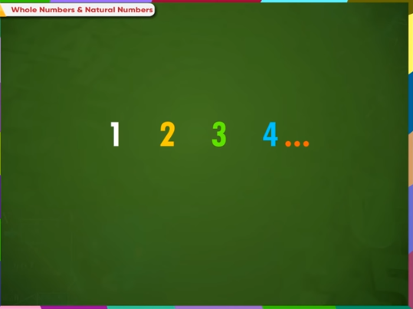
Notes:
These numbers are called as natural numbers or counting numbers.

Slide 8
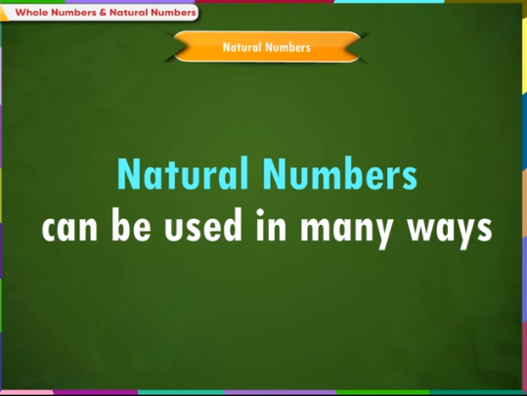

Slide 9
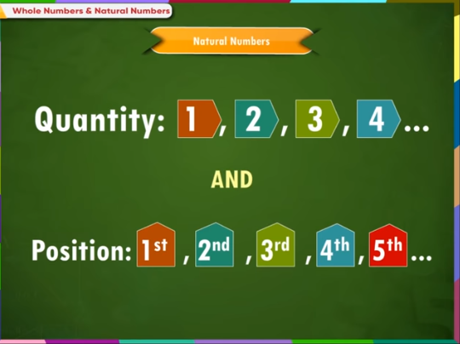
Notes:
They can be used to show quantity or position

Slide 10
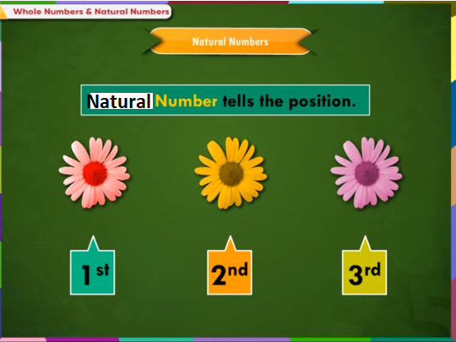

Slide 11
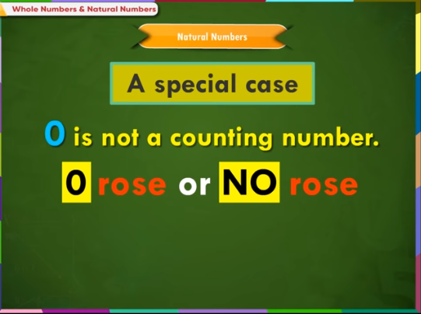
Notes:
Let us study a special case where there are no rose so we say there are no rose or Zero rose

Slide 12
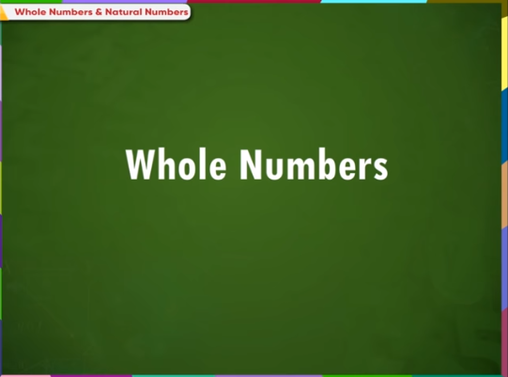

Slide 13
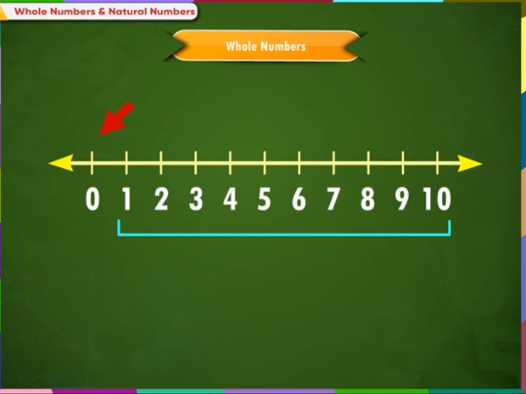
Notes:
This is a number line showing images from 0 to 10. Numbers from 1 to 10 are called natural or counting numbers

Slide 14
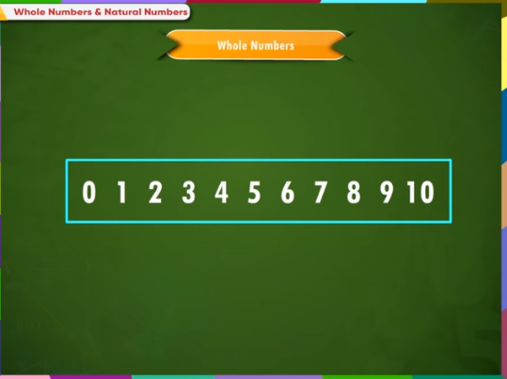
Notes:
The number 0 together with the collection of natural numbers is called as whole number

