Slide 1
Test Cases

Slide 2
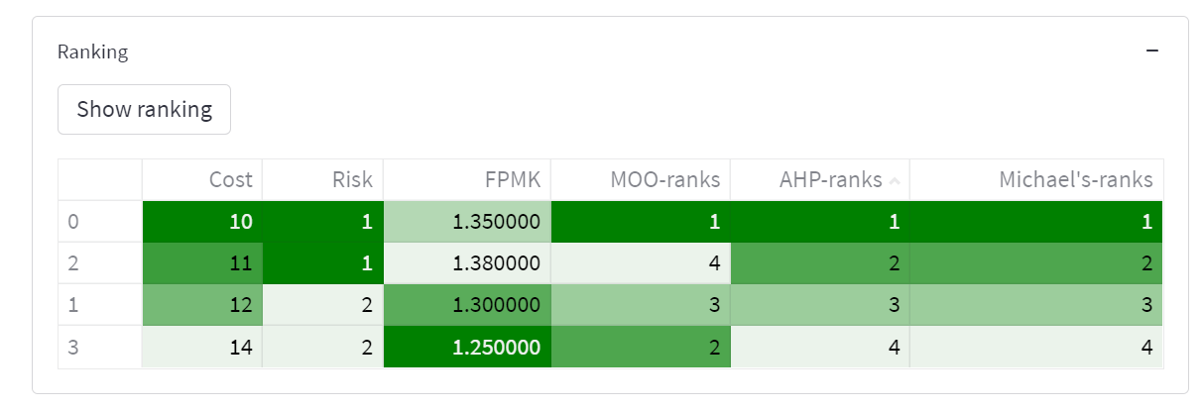
MOO output != [AHP, Michael’s] method

Slide 3
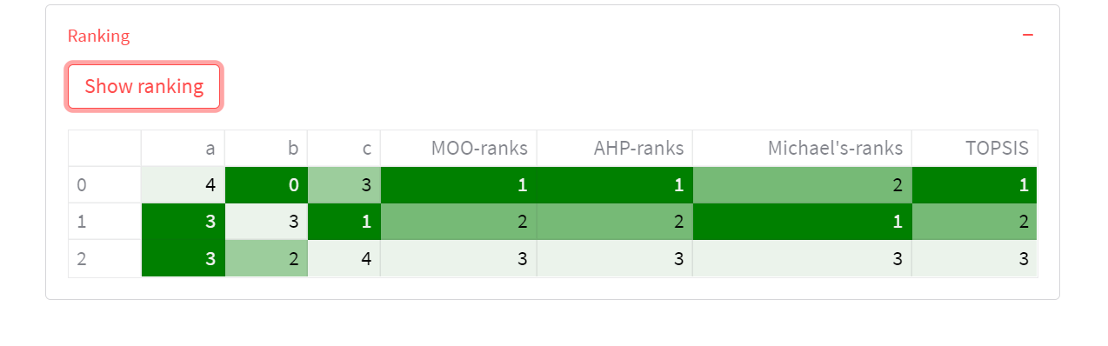
AHP not matching sum_of_rankings

