Slide 1

CA2 – PDAS Presentation
DAAA/FT/1B/03
P2309248
Randal Hong

Slide 2
Is Singapore a place with good job prospects and opportunities?
John has just graduated from university and is considering whether to find a job in Singapore or overseas
He decided to research about this topic by analysing
General age of the population and number of people who are out of the workforce
Number of people who are employed/unemployed by qualification
Number of foreign talents and median income

Slide 3
1. Number of Foreign Talents In The Workforce

Slide 4
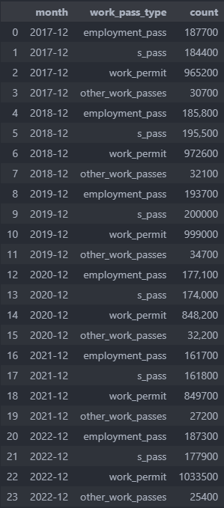
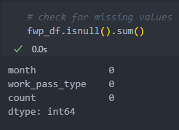
1. Number of Foreign Talents
As locals often have to compete with foreign talents for jobs, we can view the distribution of pass types and their general trend over the years
No missing data in this dataset
However, notice that the count column contains commas
We will have to preprocess the data into the correct format before plotting the graph

Slide 5
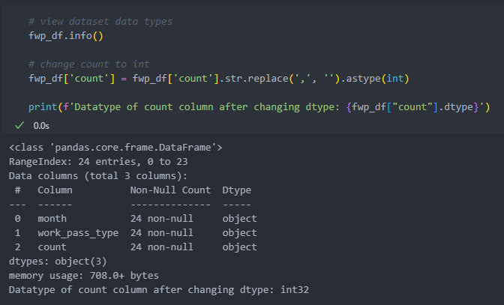
1. Number of Foreign Talents
After converting the column datatype into an integer type, we can now use it to plot graphs

Slide 6
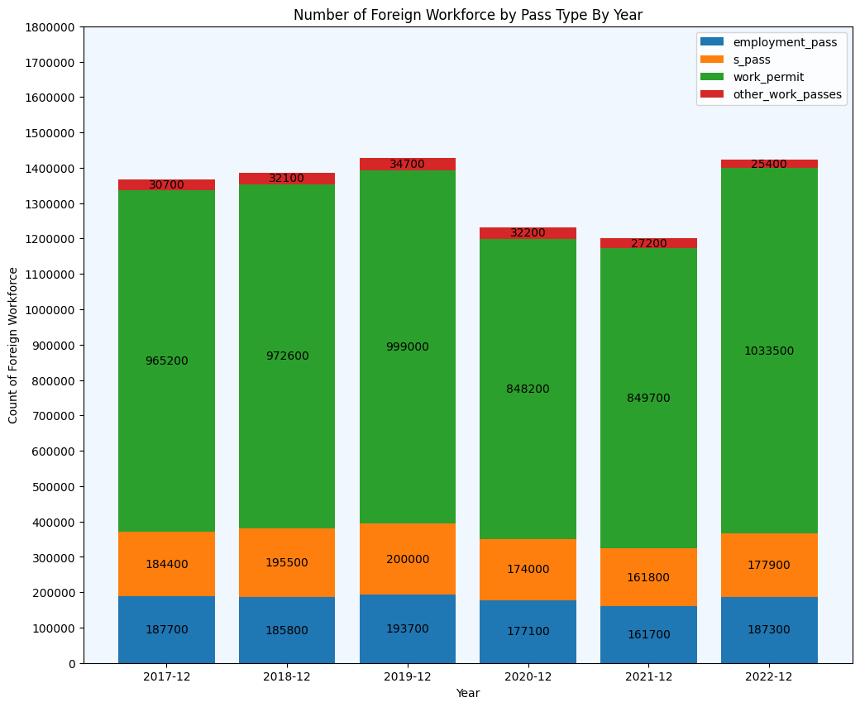
1. Number of Foreign Talents
Types of pass:
Work Permit
Usually for labour-intensive sectors, e.g. construction, service
S Pass
Have a relevant diploma, professional certificate or degree
Employment Pass
Have a good degree or professional qualifications who work in managerial, executive or specialised roles

Slide 7
1. Number of Foreign Talents
We will focus on S Pass and Employment Pass holders as John has a university degree
There was a drop in the foreign workforce in general in 2020 and 2021 due to COVID-19
Although the number of both S Pass and Employment Pass holders are slowly climbing back up in 2022, they are still lower than pre-COVID levels
This could be due to the fact that new laws were passed in 2022, such as increasing the minimum salary requirements for S Pass and Employment Pass holders and giving incentives to companies that increase their overall local employee count
As the number of foreign talents are lesser than pre-COVID levels, there will be more job vacancies for locals

Slide 8
2. Relationship Between Number of Foreign Talents and Median Income

Slide 9
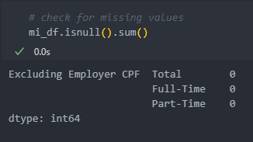
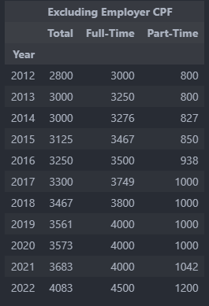
2. Relationship Between Number of Foreign Talents and Median Income
Median monthly income can be used as an indicator of the demand of job
Lower supply, higher demand, higher monthly income to attract more people
No missing data in this dataset

Slide 10
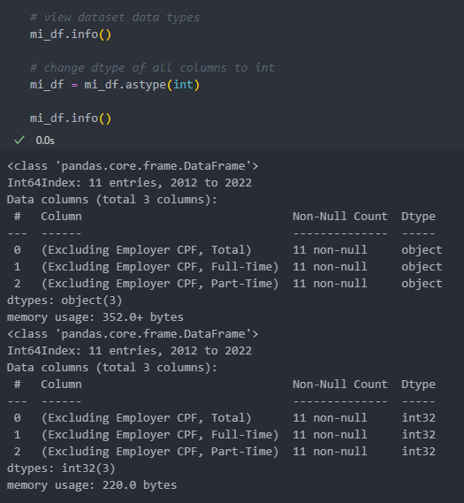
2. Relationship Between Number of Foreign Talents and Median Income
As the datatypes of this dataset are objects, we need to convert them into integers to plot the graphs

Slide 11
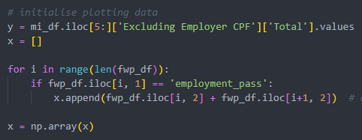
2. Relationship Between Number of Foreign Talents and Median Income
As the years of the two datasets are not the same, we will only be looking at the years 2017 to 2022
Filter number of foreign talents dataset
Add S Pass and Employment Pass holder counts for each year

Slide 12
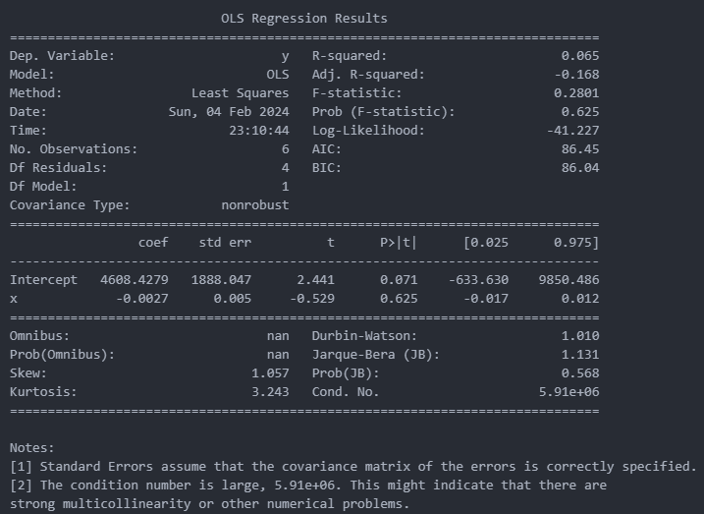
2. Relationship Between Number of Foreign Talents and Median Income
Fit data into an OLS regression model
R-squared is low, meaning the data does not fit well to the regression model
Does low R-squared mean poor relationship?

Slide 13
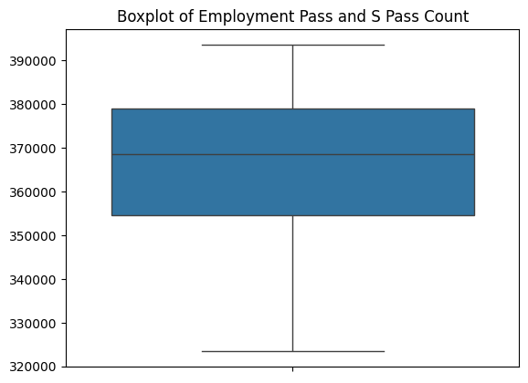
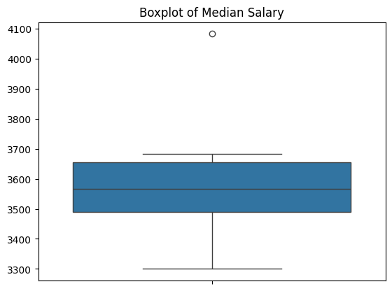
2. Relationship Between Number of Foreign Talents and Median Income
One of the years for median salary is an outlier (2022)

Slide 14
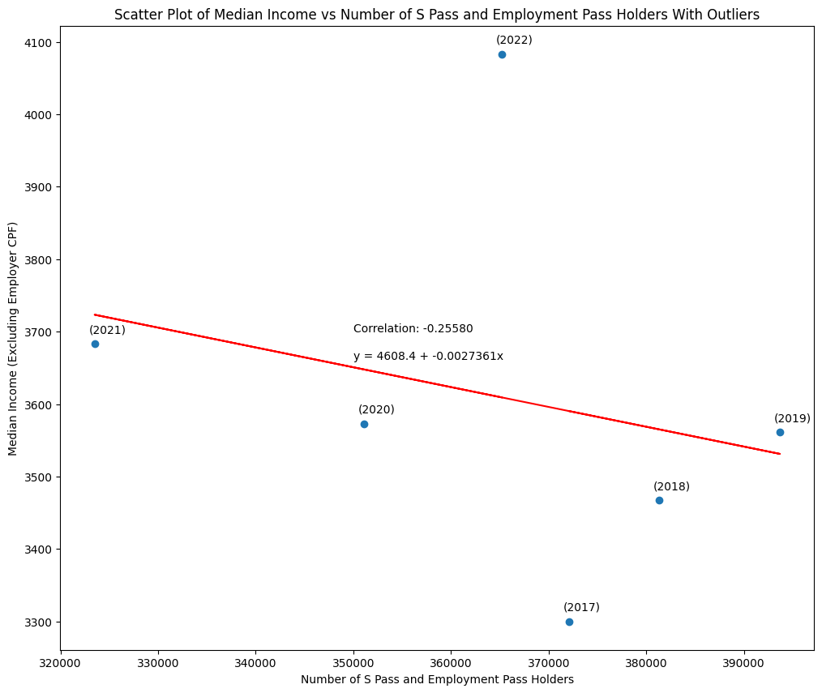
2. Relationship Between Number of Foreign Talents and Median Income
Visualise regression equation
Generally the lesser the number of S Pass and Employment Pass holders, the higher the median income
2022 is an outlier
Could be due to high inflation from COVID-19 and Russia-Ukraine war
Correlation score is low
Could the correlation score be heavily affected by outliers like 2022?

Slide 15

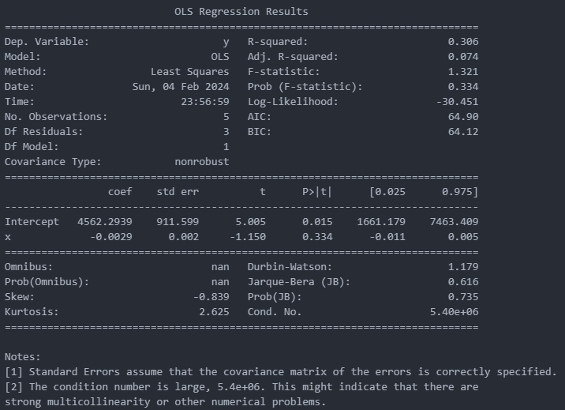
2. Relationship Between Number of Foreign Talents and Median Income (Without Outliers)
Remove last element of x and y (2022 values)
Fit data into another OLS regression model
R-squared is higher as outlier is removed

Slide 16
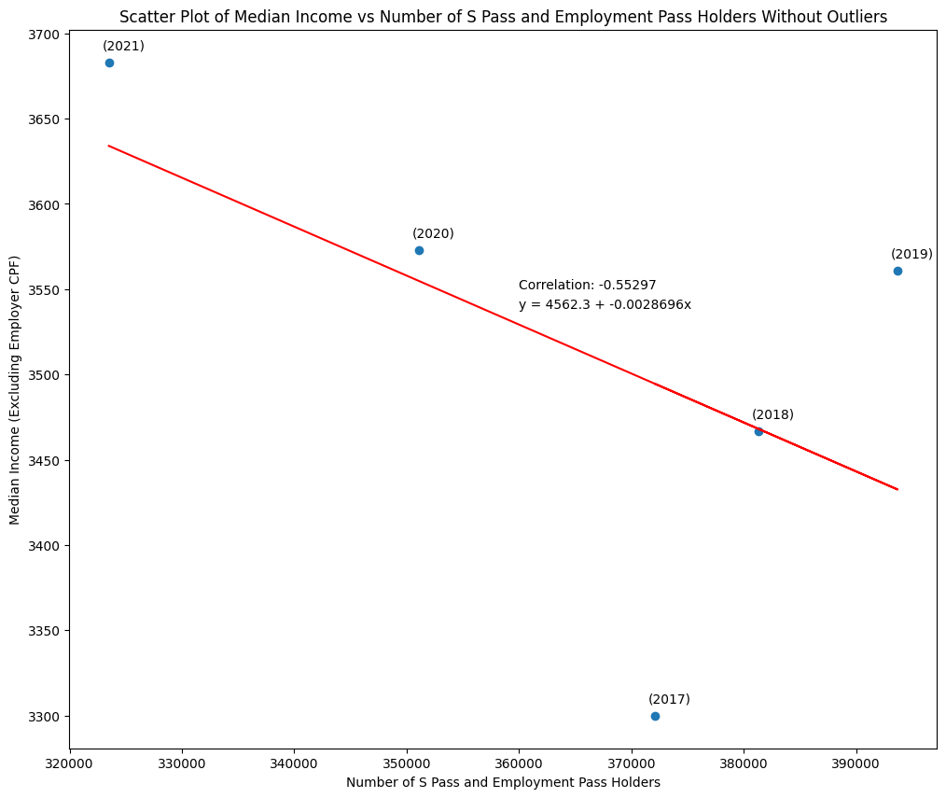
2. Relationship Between Number of Foreign Talents and Median Income (Without Outliers)
Visualise regression equation
Same general trend
Higher correlation score
Negative relationship between number of S Pass and Employment Pass holders and median income
Conclude that lesser foreign talents, more job vacancies, more demand, higher monthly income to attract more people is not false

Slide 17
3. Number of people outside of workforce and job vacancy to unemployment ratio

Slide 18
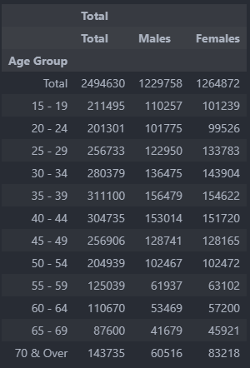
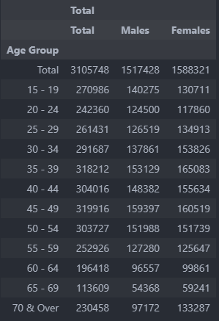
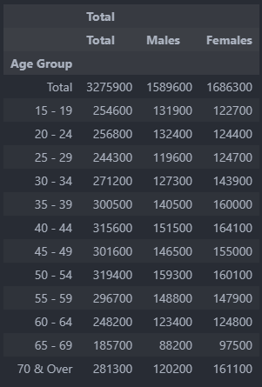
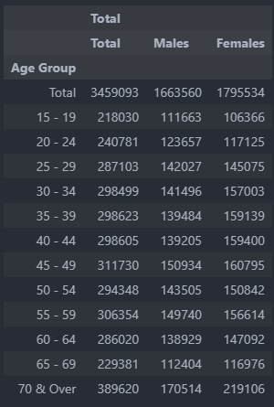
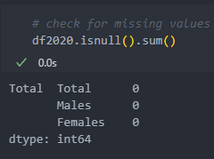
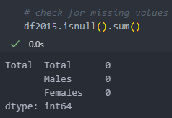
3. Number of people outside of workforce and job vacancy to unemployment ratio
Number of residents by age group in 2000, 2010, 2015, 2020
View general trend of age groups over the years
No missing data in these datasets
2000
2010
2015
2020

Slide 19
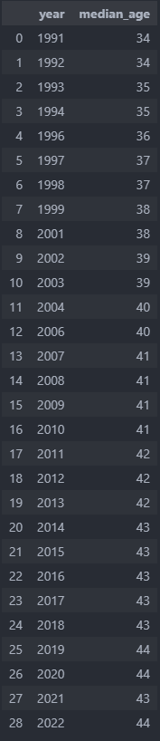
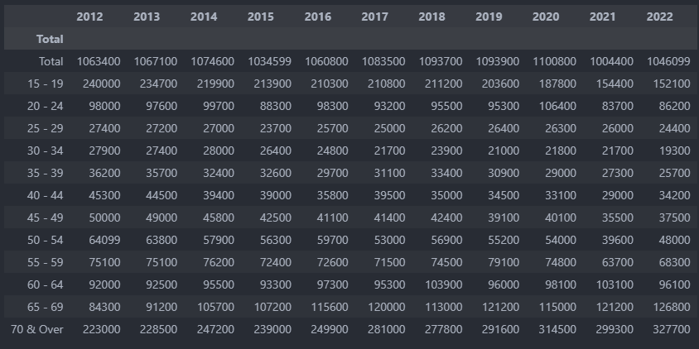
3. Number of people outside of workforce and job vacancy to unemployment ratio
Median age of residents in the labour force by year
Higher median age indicates more people reach retirement age
Number of residents outside of workforce
Outside of workforce means not looking for job (various reasons e.g. retire)

Slide 20
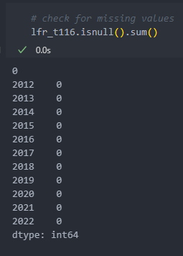
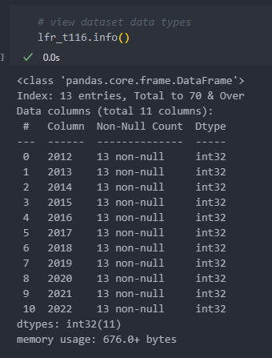
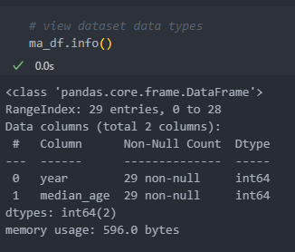
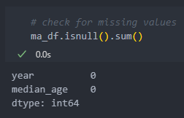
3. Number of people outside of workforce and job vacancy to unemployment ratio
Both datasets do not have missing values
Changed datatypes to int

Slide 21
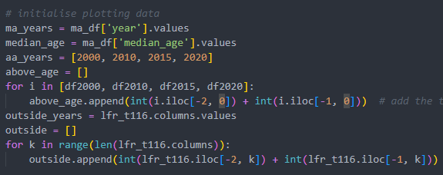
3. Number of people outside of workforce and job vacancy to unemployment ratio
Focus is on whether an ageing population will bring about more job vacancies (since more people retire)
Retirement age: 63
Data:
Number of people above retirement age (>=65 years old)
Number of people outside of workforce
Median age of labour force

Slide 22
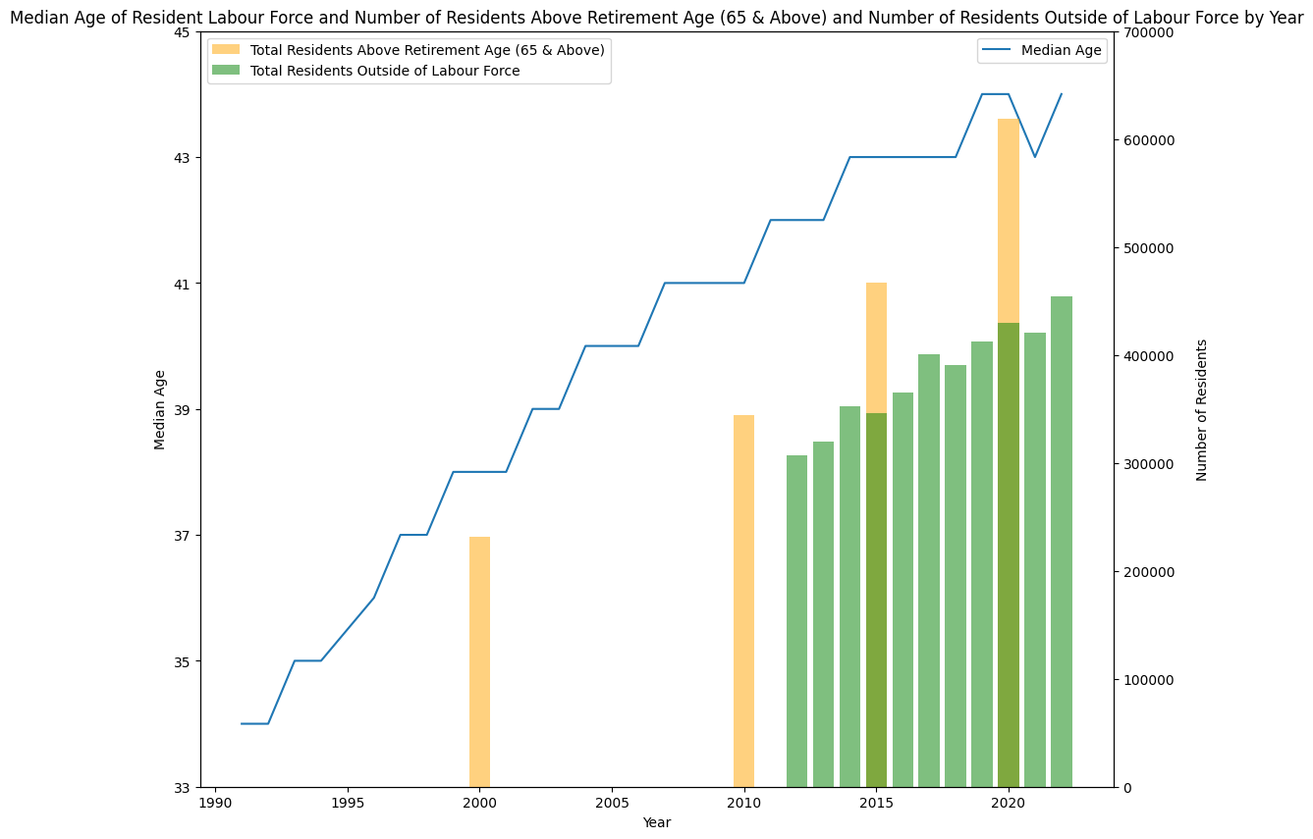
3. Number of people outside of workforce and job vacancy to unemployment ratio
Trend of number of people above retirement age and trend of median age: increasing
Population is getting older; more people reach retirement age
More people retire -> More jobs available
Trend of number of people outside of labour force: increasing
More people are not looking for jobs
Could be many reasons (Housewives, financially independent)
But one major one will be retirement

Slide 23
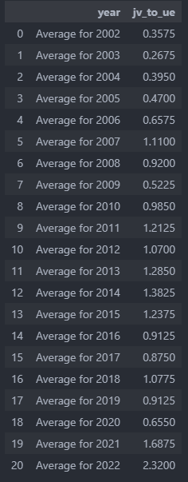
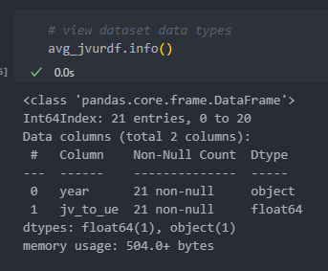
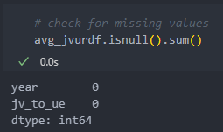
3. Number of people outside of workforce and job vacancy to unemployment ratio
Find out if the number of people who are outside of the workforce indicates more job vacancies
Positive job vacancy to unemployment ratio means more jobs available than the number of unemployed people
Negative job vacancy to unemployment ratio means less jobs available than the number of unemployed people
No missing data in this dataset

Slide 24
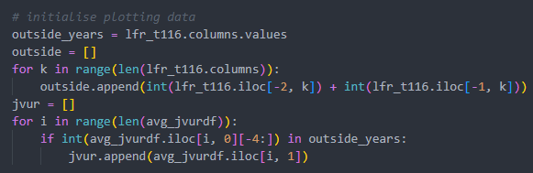
3. Number of people outside of workforce and job vacancy to unemployment ratio
Get average job vacancy to unemployment ratio from 2012 to 2022

Slide 25
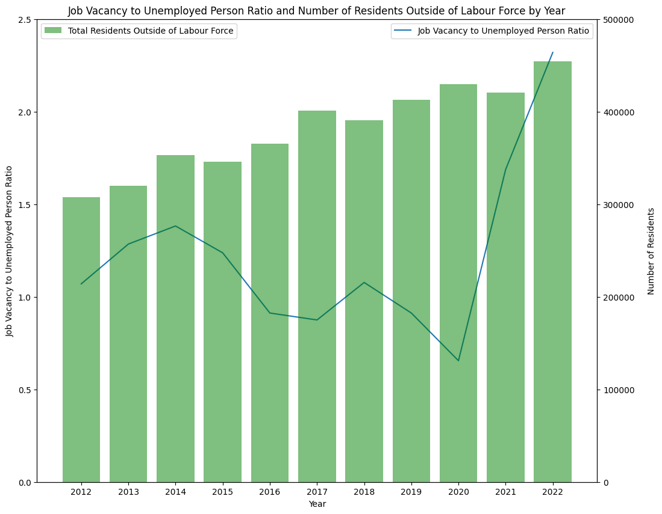
3. Number of people outside of workforce and job vacancy to unemployment ratio
Job vacancy to unemployment ratio lowest in 2020 due to COVID-19
Many people got retrenched and became unemployed
Rapid increase after 2020 post-COVID period
More than 2 job vacancies for every 1 unemployed person in 2022
Although no strong relationship over the years, recent years show that there are more jobs than unemployed people

Slide 26
4. Unemployment by Highest Qualification

Slide 27
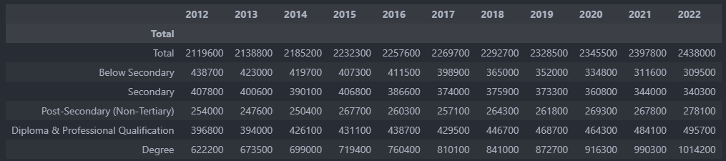
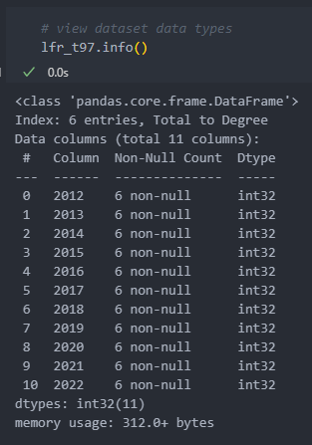
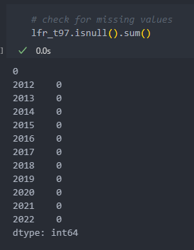
4. Unemployment by Highest Qualification
View number of people who are unemployed by highest qualification by year
No missing data in this dataset

Slide 28
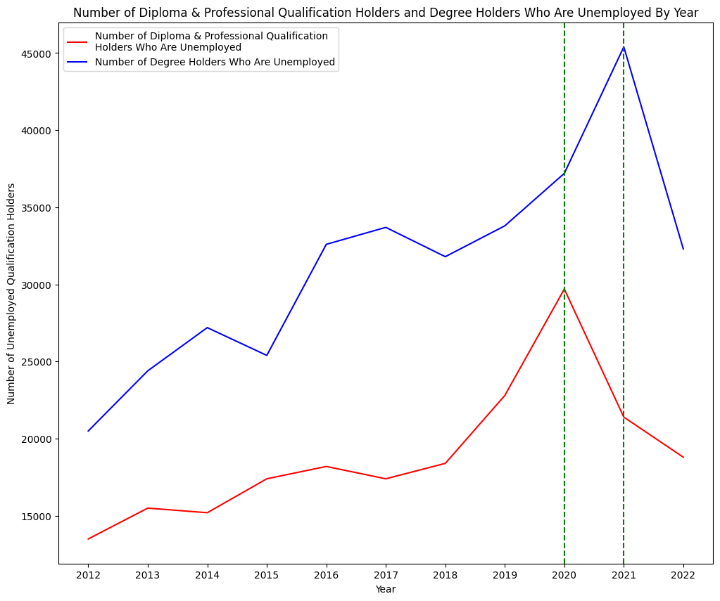
4. Unemployment by Highest Qualification
Interestingly the drop for degree holders was 1 year later than the diploma and professional qualification holders
Could be because companies were just recovering from the COVID-19 period and wanted to hire employees with cheaper costs
Sharp drop in unemployment for degree holders from 2021 onwards
Drop in unemployment for diploma and professional qualification holders from 2020 onwards
Less unemployed people, more job vacancies

Slide 29

Conclusion
After thorough research, John has decided to stay in Singapore and start searching for jobs
Many indicators suggesting that Singapore is recovering well in this post-pandemic period

Slide 30
Datasets
totalresidentsbyage (2000, 2010, 2015, 2020)
https://tablebuilder.singstat.gov.sg/table/CT/6354
StockOfForeignWorkforcebyPassType
https://beta.data.gov.sg/datasets/d_ca90ebca85472a1bf8fb01362b7233fa/view
MedianAgeofResidentLabourForceTotal
https://beta.data.gov.sg/datasets/d_65ae92a010c3ed637e098b52d9fe4413/view
LFR2022
https://stats.mom.gov.sg/Pages/Labour-Force-In-Singapore-2022.aspx
Job Vacancy to Unemployed Person Ratio
https://beta.data.gov.sg/datasets/d_25ef6b778f76dfc1fb17a2b0587eff7e/view

