Slide 1
“SOCIAL BIKERS”
Binod Wosti [33290] Sumit Pradhan [33315]
Sushil Kumar Shrestha[33318]

Slide 2
Presentation outline
Introduction
Problem Statement
Objective
Application
Project Features
Literature Review
Methodology
Result

Slide 3
Presentation Outline
Problem Faced
Limitation
Future Enhancement
Work Schedule

Slide 4
Introduction
Create a platform for bike rental shops.
Site to plan trip and discuss .
Rental cum tour planning site.

Slide 5
Problem Statement
Time consuming.
Unawareness about the trip.
Group formation is difficult.
Choosing bikes is difficult.

Slide 6
Objective
To make rental service more convenient.
To help in planning tours.

Slide 7
Features
Search bikes.
Online booking.
Recommendation.
Sharing experience.

Slide 8
Applications
Highly applicable for tourist.
For those who don’t own bike.
For people who own rental shop.

Slide 9
Literature Review
Peacenepaltreks offered tours with bikes.
Bikehimalayas also offered tours.
Bsmotorbike similar webapp for motor bikes.

Slide 10
Methodology
Requirement of our system was discussed.
Previous system were analyzed.
Incremental model is used.

Slide 11
Use Case Diagram

Slide 12
Activity Diagram

Slide 13
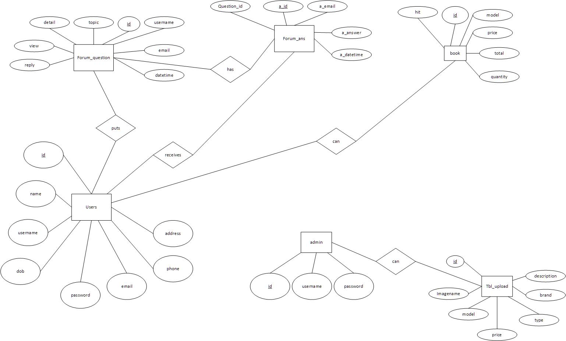
ER Diagram

Slide 14
Result
Searching.
Browsing bikes.
New uploads by admin.
Discussion in forum about trip.
Booking bikes.
Recommendation.

Slide 15
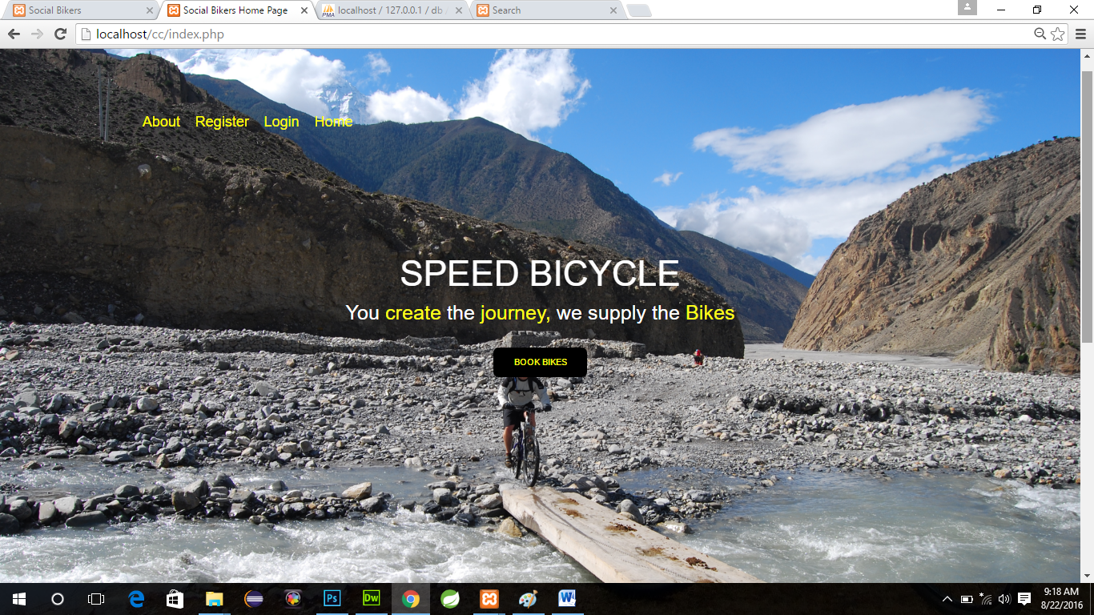
Sample output

Slide 16
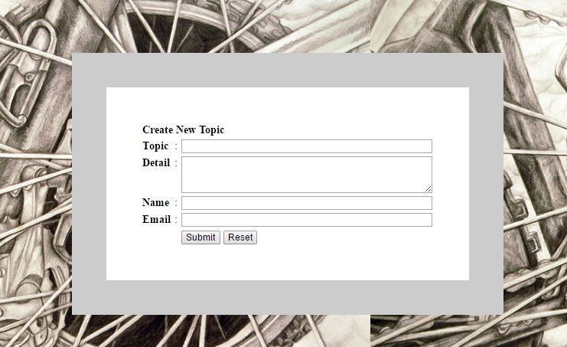
Sample Output

Slide 17
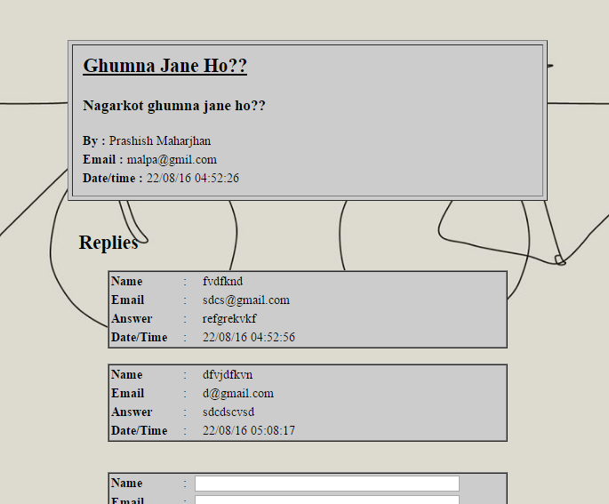
Sample Output

Slide 18
Problem Faced
During forum development
Adding/retrieving images from database
During research
During booking and recommendation
During session handling
On Post and get request

Slide 19
Limitation
Online payment.

Slide 20
Future Enhancement
Online payment.
Verification of customer.

Slide 21
Work Schedule
It has 6 parts:
Research
Familiarization of tools
Designing
Coding
Testing and Debugging
Documentation and report

Slide 22
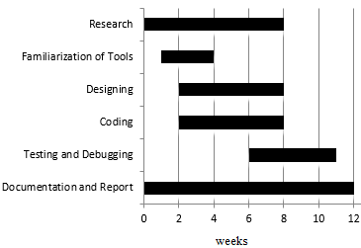
Time Schedule

Slide 23
References
[1] PHP And MySQL Web Development. (2002). Pearson Education.
[2] Loney, K. (2005). Oracle The Complete Reference. Boston: Oracle Press.
[3] Murach, J. (2004). Murach's Php And MySQL. Los Angeles,CA: Fresno.

Slide 24
THANK YOU
Any Queries ??

