Slide 1


Email
Password
login
Home
View Profiles
See Tools
Contact Us
At Abaqual, projects meet experts from virtual companies empowered by instant access to collaborative on-demand computing.
Sign Up
Abaqual © 2013

Slide 2
Home
View Profiles
See Tools
Contact Us
Don’t see the tools you want? Order here
Hardware
Platform
Software
EC2 Small Instance
$0.06/hr
1.7 GiB memory 1 EC2 Compute Unit
160 GB instance storage
64-bit
Ubuntu 12.04 LTS
free
OpenFoam
free
General purpose computational fluid dynamics solver
CentOs 6.4
free
EC2 Large Instance
$0.06/hr
1.7 GiB memory 1 EC2 Compute Unit
160 GB instance storage
64-bit
Abaqual © 2013

Slide 3
Home
View Profiles
See Tools
Contact Us
Requested tool*
Link to the product
Comment
Email address*
We use your email address ONLY to notify you when the product is available on Abaqual.
Order
Abaqual © 2013

Slide 4
Home
View Profiles
See Tools
Contact Us
First Name*
Last Name*
Message
Email address*
Send
Abaqual © 2013

Slide 5
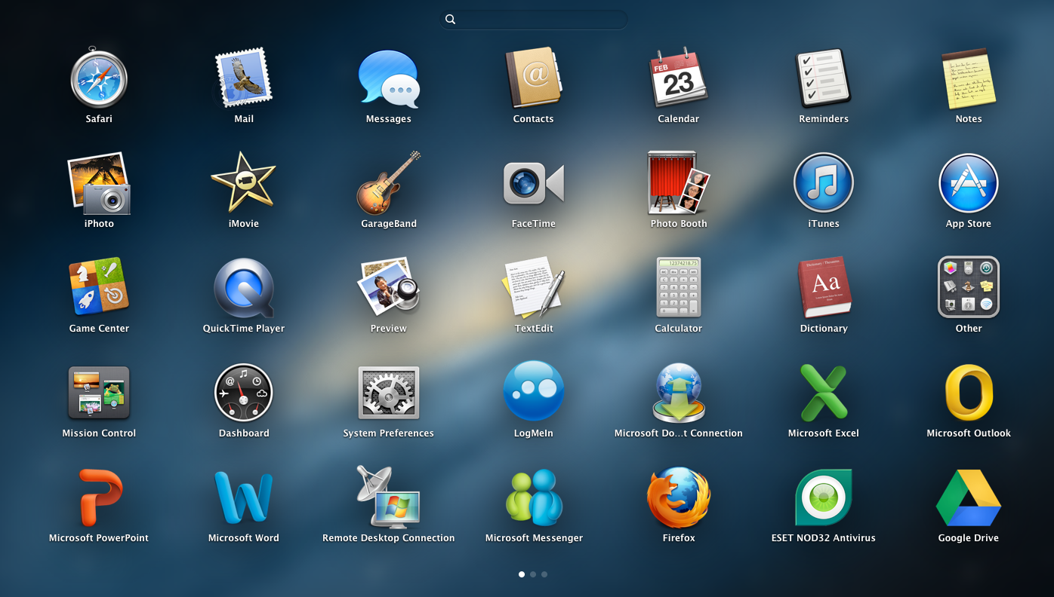
Dave Corson
logout
My Home
View Profiles
See Tools
Contact Us
company name
Launch
Dave and Brothers Co
Team members
+
Dave Corson (owner)
Jim Plumber
new member email
launch a new desktop
invite
Abaqual © 2013

Slide 6
Email
Password
login
Home
Vcompany profiles
Contact Us
Email
First name
Last name
Password
Verify Password
Sign Up
Abaqual © 2013

