Slide 1


Email
Password
login
Home
Vcompany profiles
Contact Us
At Abaqual, projects meet experts from virtual companies empowered by instant access to collaborative on-demand computing.
Sign Up
Abaqual © 2013

Slide 2
Email
Password
login
Home
Vcompany profiles
Contact Us
At Abaqual, projects meet experts from virtual companies empowered by instant access to collaborative on-demand computing.
Sign Up
Abaqual © 2013

Slide 3
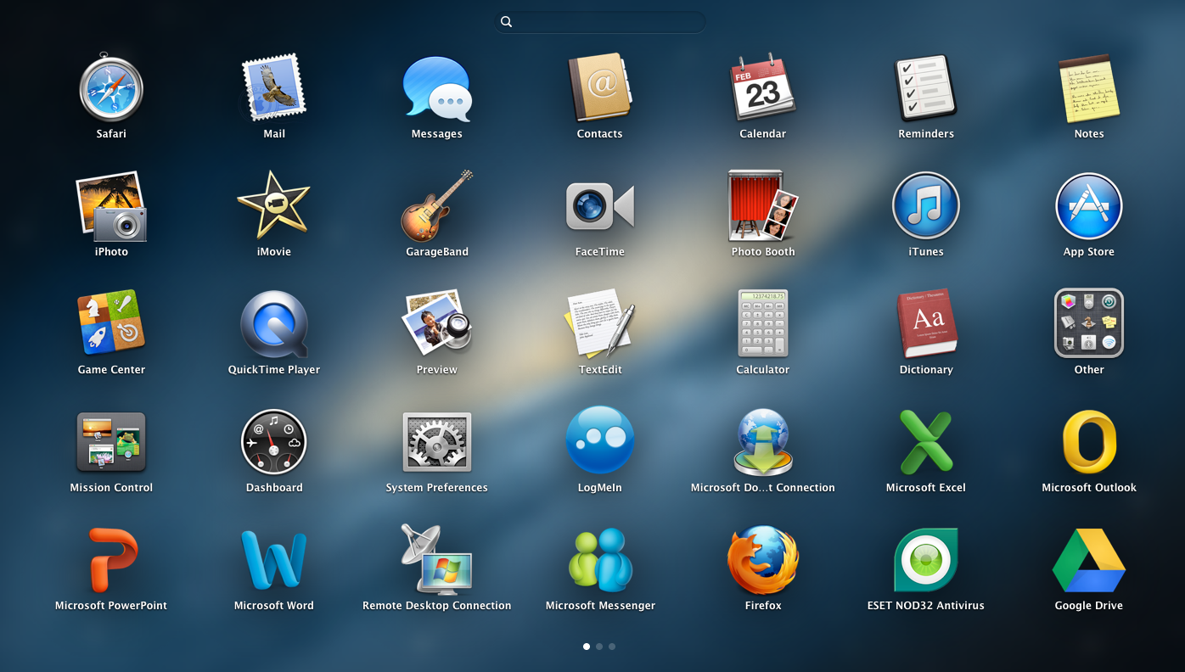
Dave Corson
logout
Home
Vcompany profiles
Contact Us
+
launch a new desktop
Abaqual © 2013

Slide 4
Email
Password
login
Home
Vcompany profiles
Contact Us
Email
First name
Last name
Password
Verify Password
Sign Up
Abaqual © 2013

