Slide 1
Programming in Python
For newbz

Slide 2
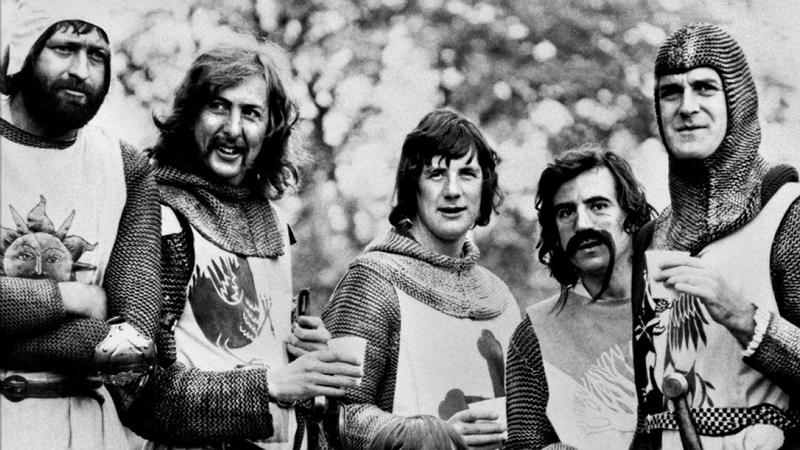
About
Developed by Guido van Rossum
First released in 1991
High Level
OOP*
Platform Independent
Great community
Free and Open Source
Easy to learn

Slide 3
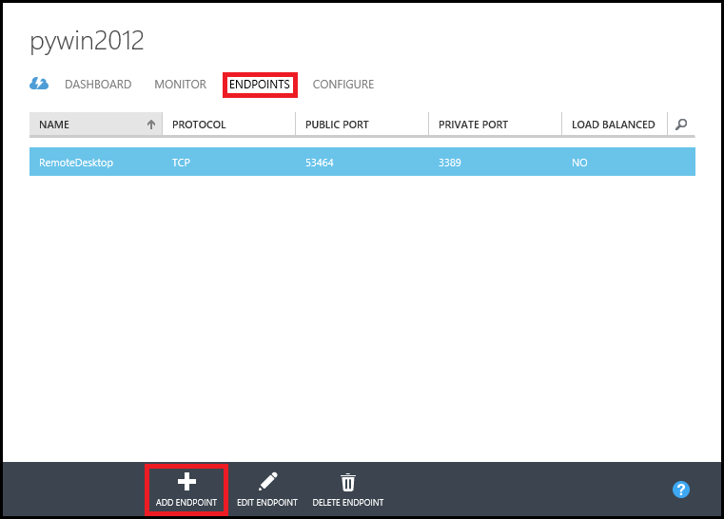
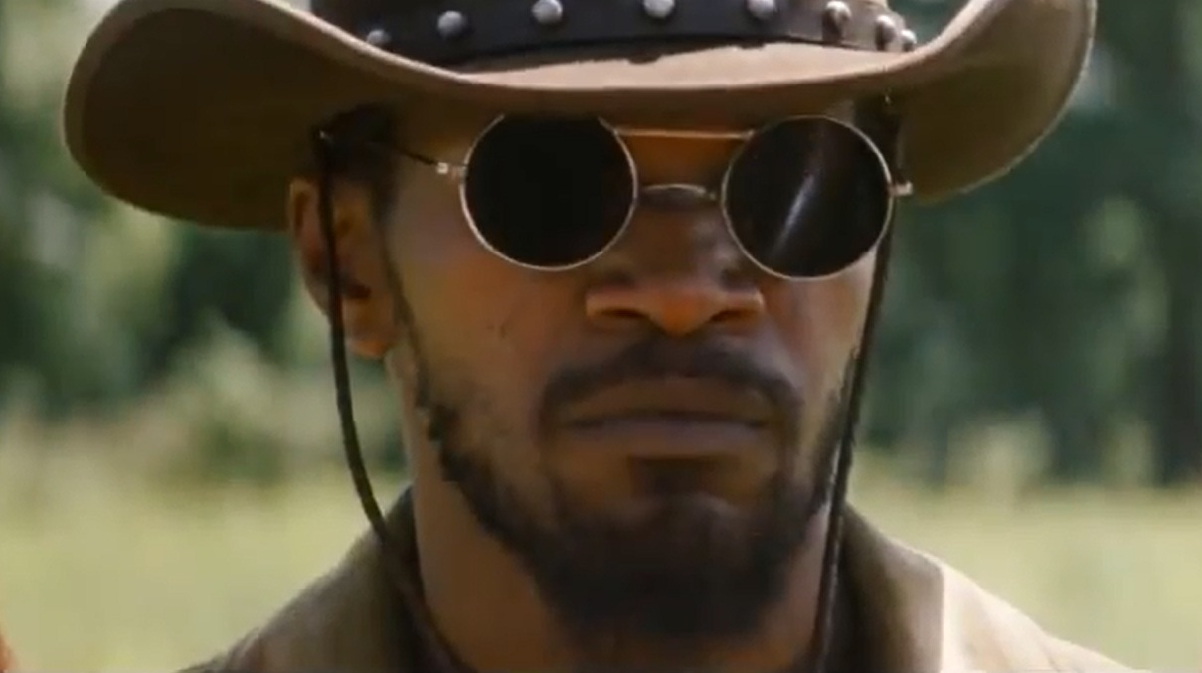
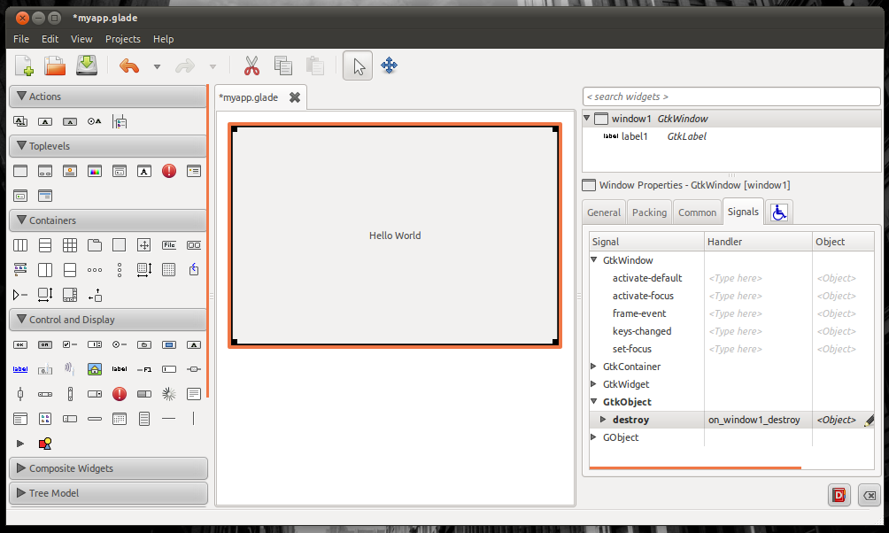
Applications
Console / Scripts
GUI
Web

Slide 4
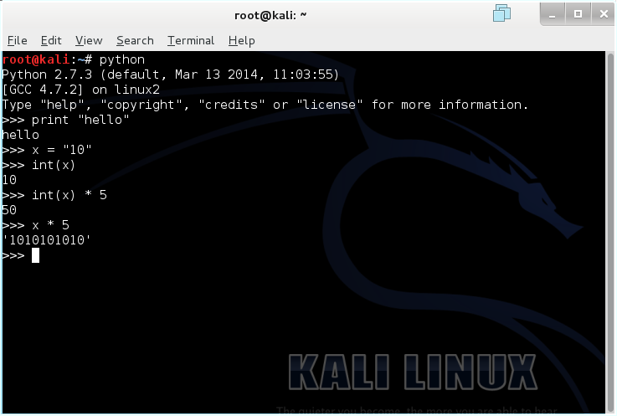
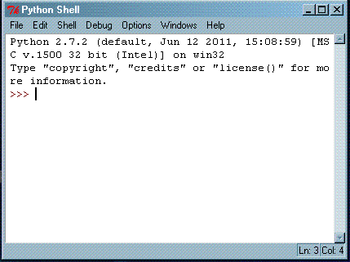
Environment
Lubuntu VM (provided)
Python 2.7 with IDLE
IDLE is a basic Integrated Development Environment (IDE) for Python

Slide 5
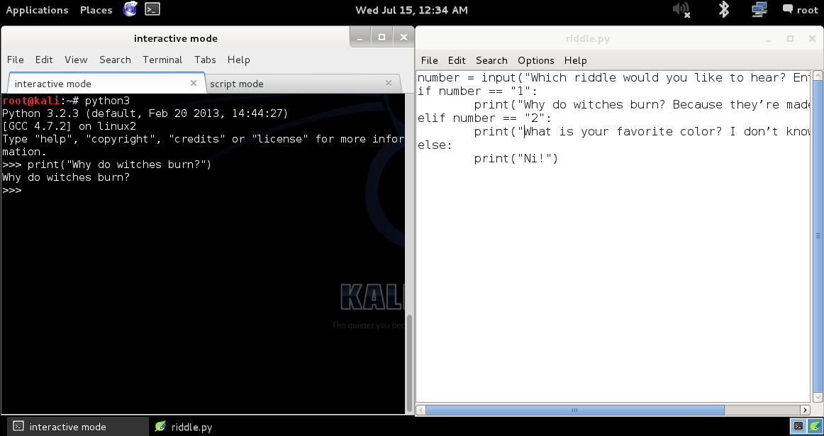

Slide 6
Interactive vs Script Mode
We will start with interactive mode which gives us immediate feedback
# python3
>>>
Most programmers program Python in script mode. In script mode you can write, edit, load, and save your programs
# python3 script.py

Slide 7
Functions
Our first program – “Why do witches burn?”
Open Python in interactive mode and type
print(“Why do witches burn?”)
What happens?
print is a function, everything within parenthesis are arguments
Functions are subroutines that can be reused for common tasks, such as printing to the console
Notes:
“Because they’re made of wood.”

Slide 8
Our First Program – Again
Let’s write our first program in script mode
print(“Why do witches burn?”)
input(“Press enter for the answer”)
print(“Because they’re made of wood.”)
Save the file as riddle.py
From another console, type
# python3 riddle.py

Slide 9
Exercise 1 – 5 Minutes
Edit riddle.py to display the following every time it is run:
Riddle Program
By: [Your Name], accompanied by a(n) [adjective] [your spirit animal]
[new line]
Notes:
Have someone read their neighbor’s output

Slide 10
Exercise 1 – 5 Minutes
Edit riddle.py to display the following every time it is run:
print(“Riddle Program”)
print(“By: Bradford, accompanied by a corpulent camel spider”)
print()
Notes:
Have someone read their neighbor’s output

Slide 11
Comments
Comments are ignored by Python, but are invaluable for programmers
Indicated by ‘#’
# I’m a comment.
# print(“I’m also a comment”)

Slide 12
Exercise 2 – 3 Minutes
Edit riddle.py to notate the following:
The name of your program
The name of the developer
The date the script was created
Notes:
Have someone read their neighbor’s output

Slide 13
Exercise 2 – 3 Minutes
Edit riddle.py to notate the following:
# Riddle Program
# Bradford Law
# 15 July 2015
Notes:
Have someone read their neighbor’s output

Slide 14
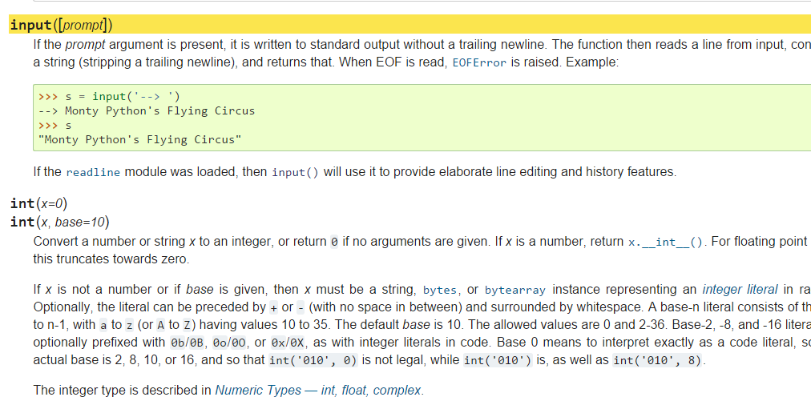
Documentation
https://docs.python.org/3/

Slide 15
Input
Now let’s get input from the console.
name = input(“WHAT... is your name?”)
print(“Your name is”, name)
input([prompt])
If the prompt argument is present, it is written to standard output without a trailing newline. The function then reads a line from input, converts it to a string (stripping a trailing newline), and returns that.
https://docs.python.org/3.2/library/functions.html?highlight=input#input

Slide 16
Decision Making - Conditional Statements
If statement:
if [condition]: [do action] elif [condition]: [do action] else: [do action]
How does Python know when a conditional action ends?

Slide 17
Blocks
Blocks are one or more consecutive lines that form a single unit
Other languages (C, C++, C#, Java) require curly braces {} to indicate the beginning and the end of a block
Python uses indentation to create blocks
Indentation can be either
A combination of spaces (most common & recommended is 4 spaces)
A single tab
Most important rule:
DON’T MIX INDENTATION STYLES

Slide 18
Decision Making - Conditional Statements
If statement:
swallow = “european"
if swallow == “african": print(“It could grip it by the husk.”) elif swallow == “european”: print(“They could carry it on a line.”) else: print(“Are you suggesting coconuts migrate?”)

Slide 19
Exercise 3 – 7 Minutes
Edit riddle.py to perform the following:
Prompt for the user to select a riddle by typing a 1 or 2
Based on the input, display a riddle
Output an error if input either than “1” or “2” is entered
Notes:
Have someone read their neighbor’s output

Slide 20
Exercise 3 – 7 Minutes
Edit riddle.py to perform the following:
number = input("Which riddle would you like to hear? Enter 1 or 2: ")
if number == “1”:
print(“Why do witches burn? Because they’re made of wood!")
elif number == “2”:
print(“What is your favorite color? I don’t know!")
else:
print(“Ni!")
Notes:
Have someone read their neighbor’s output

Slide 21
Loops
While Loop
while [condition]:
[loop body]
The loop will execute the loop body until the condition is no longer true.

Slide 22
Loops
While Loop
limbs = 4
print(“None shall pass.”)
while limbs > 0:
print(“C’mon ya pansy!”)
print(limbs, “limbs left”)
limbs -= 1
print(limbs, “limbs left”)
print(“Alright, we’ll call it a draw.”)
What does the above loop do?

Slide 23
Exercise 4 – 7 Minutes
Edit riddle.py to perform the following:
Ask the user a riddle. Implement a loop that continues to loop until the user provides the right answer.
Bonus: make the input case-insensitive [string.lower()]
Notes:
Have someone read their neighbor’s output

Slide 24
Our Own Function
Let’s create our own function, print_riddle, in our riddle.py:
def print_riddle():
print(“Why do witches burn?”)
print(“Press enter for the answer”)
print(“Because they’re made of wood.”)
print_riddle()
How does Python know when the function begins? Ends?

Slide 25
Python Resources
Python.org Beginner's Guide: https://wiki.python.org/moin/BeginnersGuide
Python.org Beginner's Guide for Programmers: https://wiki.python.org/moin/BeginnersGuide/Programmers
The Hitchhiker's Guide to Python: http://docs.python-guide.org/en/latest/
Safari Books Online (5712 results for 'Python'): http://techbus.safaribooksonline.com/search?q=python
Python Documentation: https://docs.python.org/3/

