Slide 1
Outlier Detection
Lian Duan
Management Sciences, UIOWA

Slide 2
What are outliers?
Hawkins-Outlier: An outlier is an observation that deviates so much from other observations as to arouse suspicion that it is generated by a different mechanism.
A relative concept:
  Situation
  Your angle
  A example: Suppose you are the US president.
  Common Thing: Compare to History and Majority

Slide 3
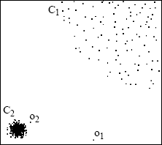
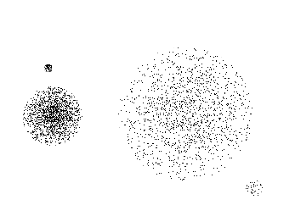
Outlier Detection and Clustering
Interwoven with each other.
  Not all objects should belong to a certain cluster.
  Abnormal events might have temporal or spatial locality. (Body Temperature)
  Single Point Outliers Cluster-based Outleirs

Slide 4
Previous Work
DB(pct,dmin)-Outlier [Binary]: Given an object p, at least percentage pct of the objects in D lies greater than distance dmin from p.
Density-based local outlier [Degree]: Given the lowest acceptable bound of LOF, an object p in a dataset D is a density-based local outlier if LOF(p)>LOFLB.
Other statistical methods.

Slide 5
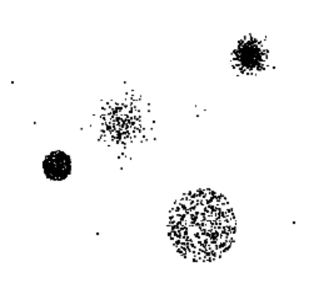
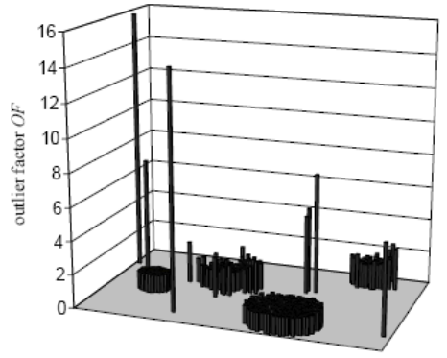
Local Outlier Factor
Local Density: the inverse of the average distance to its k-nearest neighbors.
Local Outlier Factor: the ratio of the local density of p and those of p’s k-nearest neighbors.
  The LOF of each object depends on the density of the cluster relative to it and the distance between it and the cluster.

Slide 6
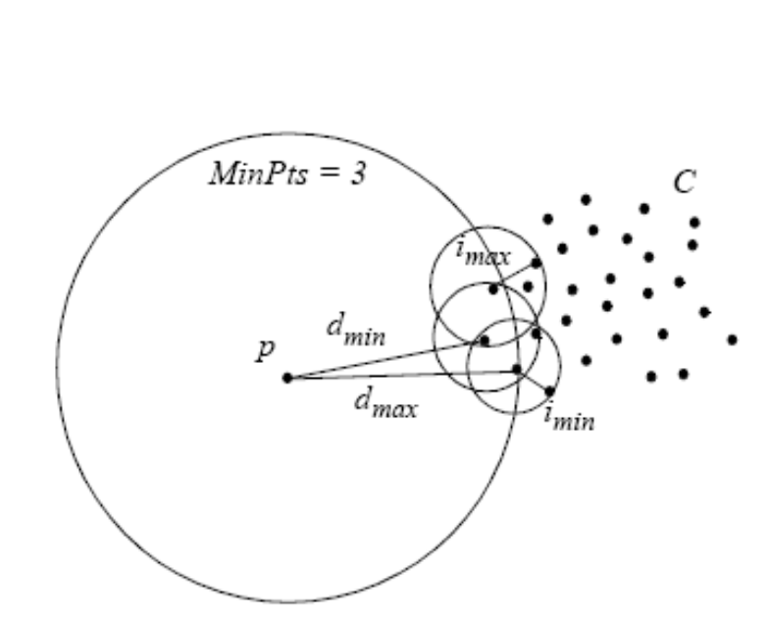
Illustration Of LOF
A example:
LOF-Outlier vs. DB(pct,dmin)-Outlier

Slide 7
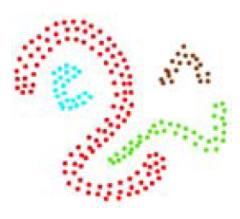
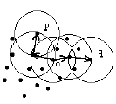
LDBSCAN=DBSCAN+LOF
DBSCAN: Retrieve all points which is density-reachable from the given Core-Point(MinPts, ε).
Problem: How many are many?

Slide 8
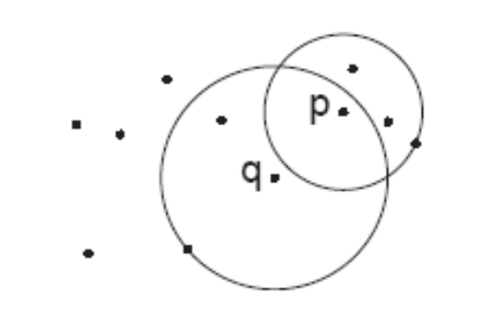
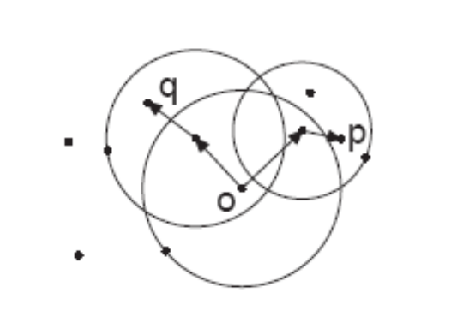
LDBSCAN (continued)
A relative concept of core points and similarity.
  Core Points: LOF<LOFUB
  Similarity: p∈N_{MinPts(q)} and LRD(q)/(1+pct)<LRD(p)<LRD(q)*(1+pct)

Slide 9
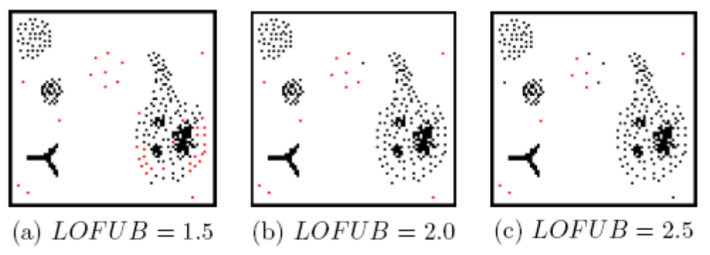
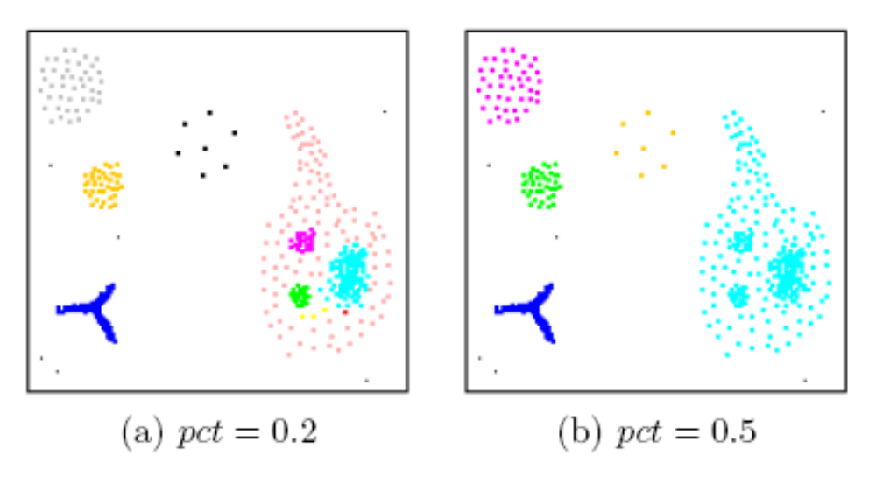
LDBSCAN (continued)
The same clustering idea with DBSCAN
Parameter:
  LOFUB
  pct

Slide 10
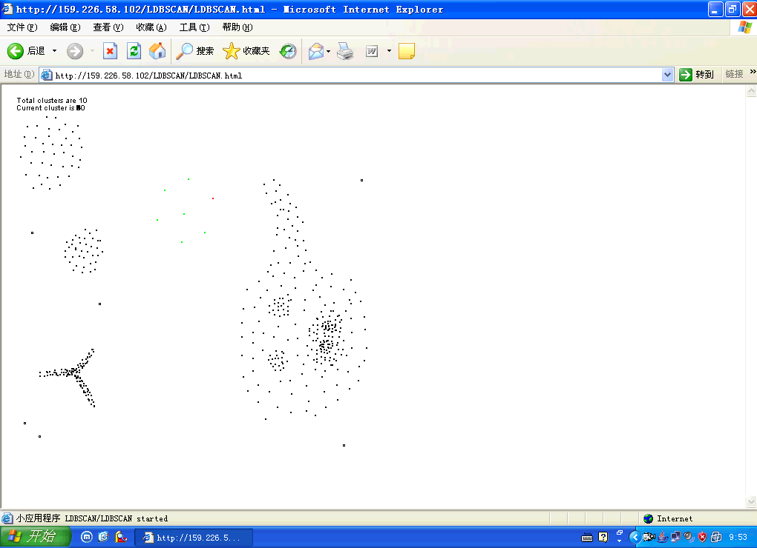
LDBSCAN (continued)

Slide 11
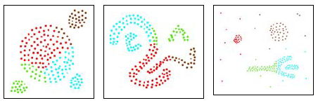
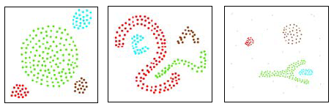
Advantage
Density-based vs Partitioning Clustering:
  Small clusters, arbitrary shape, and noise.

Slide 12
Advantage (continued)
LDBSCAN vs DBSCAN
  Easier to select proper parameters.
  Handle local density problems.

Slide 13
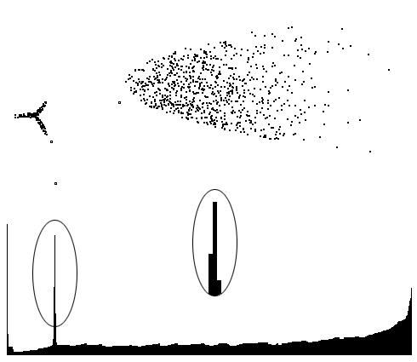
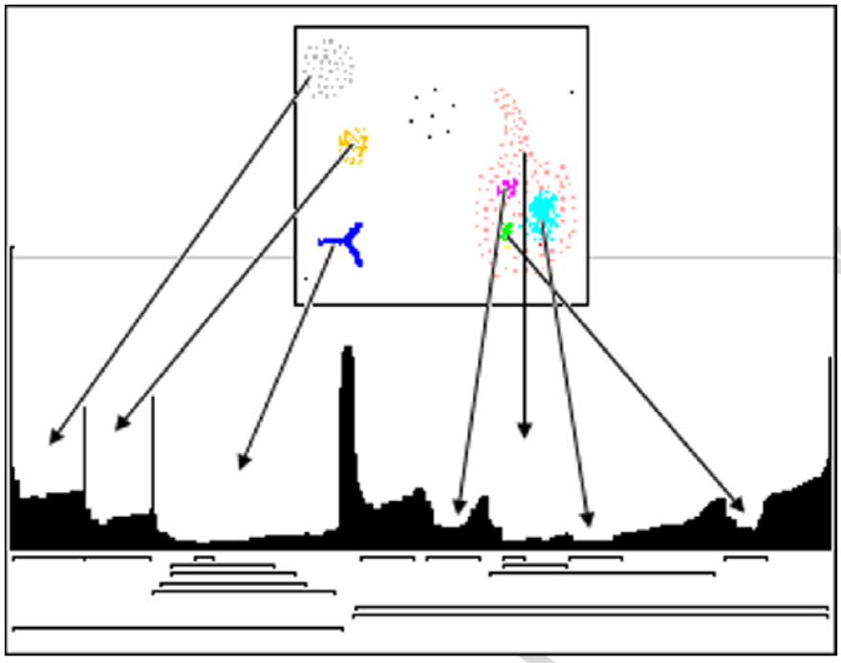
Advantage (continued)
LDBSCAN vs OPTICS
  Comet-like clusters
  Hierarchical structure

Slide 14
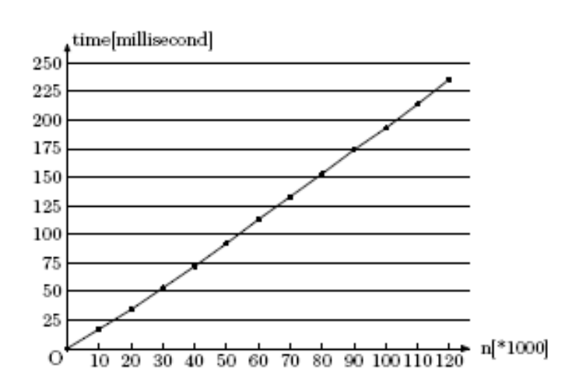
Performance
Experiment facility: PⅣ 2.4G, 512M memory, redhat 9.0, jdk1.4.2
Algorithm steps:
  Search k-nearest neighbors: O(n²) or O(nlogn)
  Calculate LRDs and LOFs: O(n)
  Clustering: O(n)
  Its compute complexity is
  equal to that of LOF.

Slide 15
Experiment
Wisconsin Breast Cancer Data
  After data preprocessing, the resultant dataset has 327 (57.8%) benign records and 239 (42.2%) malignant records with nine attributes.
  Discover two clusters and five single point outliers.
    Cluster A contains 296 benign records and 6 malignant records. Its average local density is 0.743.
    Cluster B contains 26 benign records and 233 malignant records. Its average local density is 0.167.
    Five single point outlier whose LOFs fall into the range from 3 to 5.

Slide 16
Experiment (continued)
Boston Housing Data
  After data preprocessing, the resultant dataset has 506 records with 14 attributes.
  Cluster: (1, 82, 0.556); (2, 345, 0.528); (3, 26, 0.477); (4, 34, 0.266); (5, 9, 0.228); (6, 6, 0.127).
  4 single point outliers.
  Cluster 5 vs Cluster 6 (from cluster 1)
    24.514 (bigger per capita cirme rate) vs 20.005;
  284th record (from cluster 4): LRD=0.155, LOF=1.468.
    2nd attribute: higher proportion of residential land zoned for lots.
    3rd attribute: lower proportion of non-retail bussiness acres per town.

Slide 17

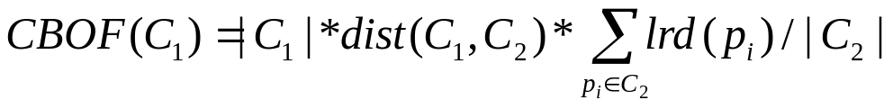
Appendix: Cluster-based Outliers
Definition 1 (Upper Bound of the Cluster-Based Outlier): Let C1, ..., Ck be the clusters of the database D discovered by LDBSCAN in the sequence that |C1|≥|C2|≥…≥|Ck|. Given parameters α, the number of the objects in the cluster Ci is the UBCBO if (|C1|+|C2|+…+|Ci-1|)≥|D|*α and (|C1|+|C2|+…+|Ci-2|)＜|D|*α.
Definition 2 (Cluster-based outlier): Let C1, ..., Ck be the clusters of the database D discovered by LDBSCAN. Cluster-based outliers are the clusters in which the number of the objects is no more than UBCBO.
Definition 3 (Cluster-based outlier factor): Let C1 be a cluster-based outlier and C2 be the nearest non-outlier cluster of C1. The cluster-based outlier factor of C1 is defined as

Slide 18
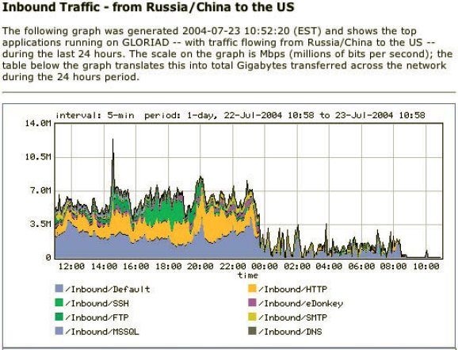
Experiment (continued)
Abnormal Network Throughput Detection
  Network throughput has the characteristic that are consistent with self-similarity.
  Monitoring 300 nodes per 5 minutes: 3600 per hour
  Single point VS. Cluster-based
    30 VS. 3 alerts per hour
    Occasional fluctuations VS. Abnormal events over a period

Slide 19
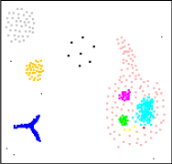
Conclusion
Outlier detection and clustering improve accuracy with each other.
Cluster-based outlier detection is more meaningful.
ADVERTISING: LDBSCAN is good at both outlier detection and clustering.
  Clusters with arbitrary shape and different local density
  Single point outliers and cluster-based outliers
  Degree of outliers

