Slide 1


Deteksi Pencilan Data Titik Api di Provinsi Riau Menggunakan Algoritme Local Outlier Factor
Shofyan G64134009
Dibimbing oleh
Dr Imas Sukaesih Sitanggang, SSi MKom
Departemen Ilmu Kompputer
Fakultas Ilmu Pengetahuan Alam dan Matematika
Institut Pertanian Bogor 2015

Slide 2
Outline
Latar Belakang
Penelitian Sebelumnya
Rumusan Masalah
Tujuan dan Manfaat
Ruang Lingkup
Metode
Lingkungan Pengembangan
Jadwal Penelitian
Daftar Pustaka
Why
How
2

Slide 3
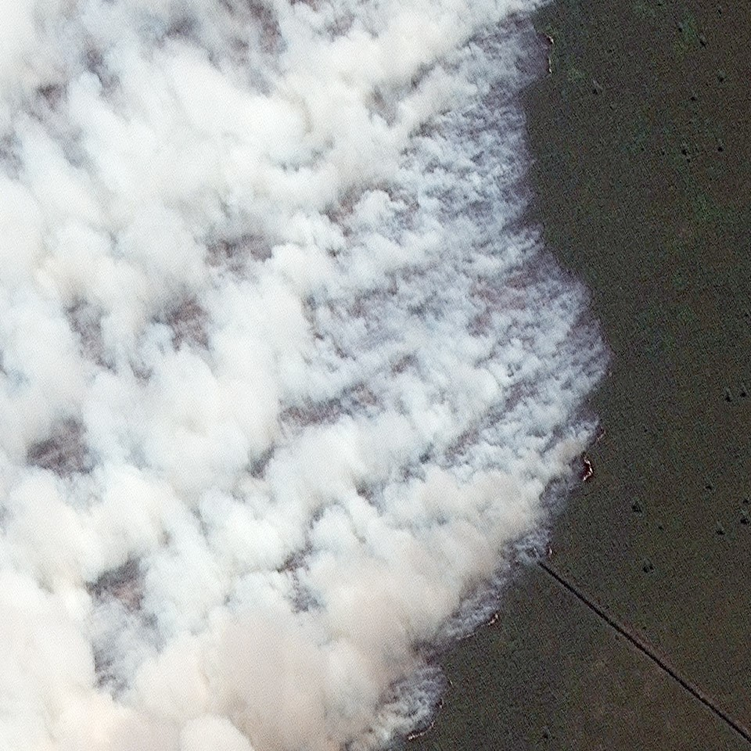
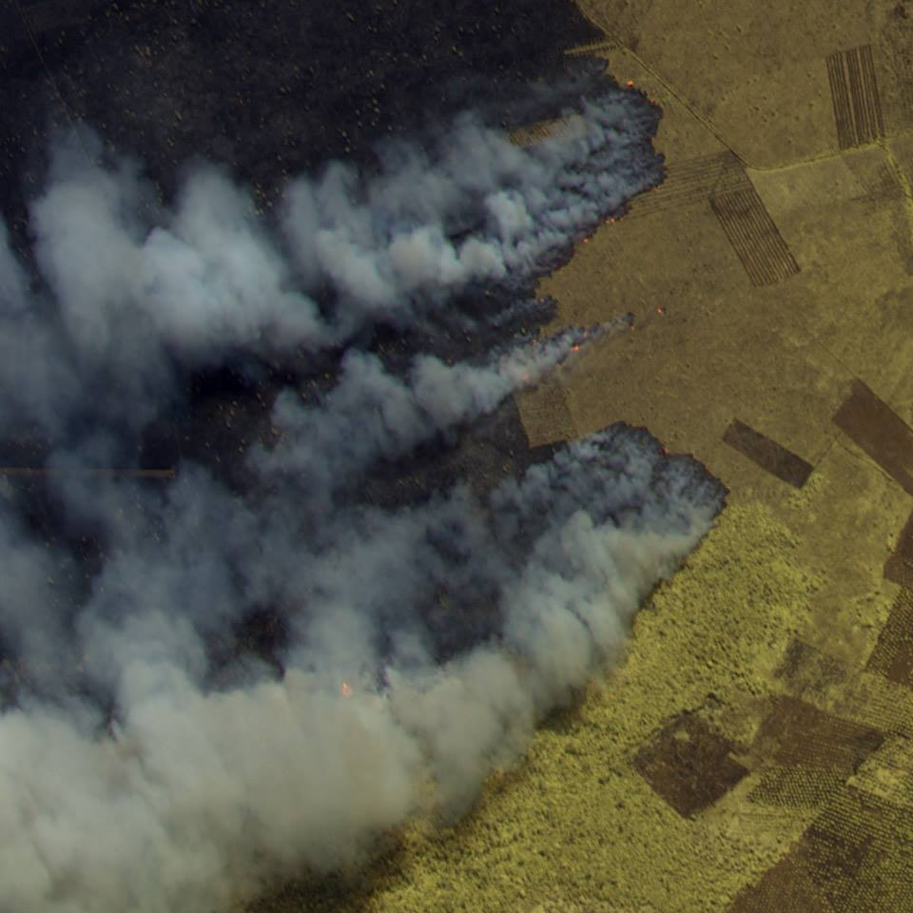
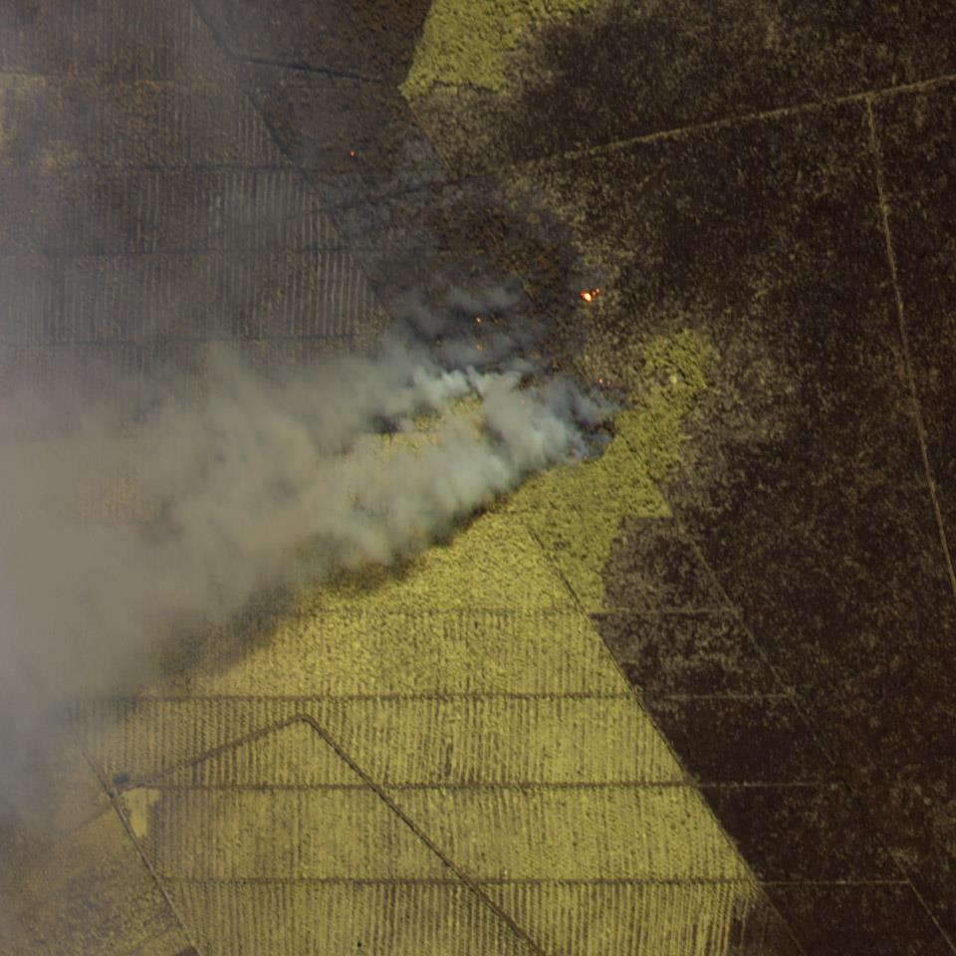
Latar Belakang
Badan National Penanggulangan Bencana (BPBP)
1146
Titik Panas
Riau Agustus 2013
1252
Titik Panas
Riau Agustus 2014
Sumber gambar : http://www.crisp.nus.edu.sg/browsedata/data_viewgmap.php?image_id=WV022014031103484280
Sumber data:
http://geospasial.bnpb.go.id/monitoring/hotspot/
Satelit Terra modis nea
3

Slide 4
Penelitian Sebelumnya
Baehaki D. 2014. Deteksi Pencilan Data Titik Panas Di Provinsi Riau Menggunakan Algoritme Clustering K-means [Skripsi]. Bogor(id): Insitut Pertanian Bogor.
Cahyadarena M B. 2014. Deteksi Pencilan Pada Data Titik Panas Menggunakan Clustering Berbasis Medoids [Skripsi]. Bogor(id): Insitut Pertanian Bogor.
4

Slide 5
Rumusan Masalah
Bagaimana pencilan diidentifikasi dari data titik panas menggunakan metode local outlier factor dan informasi tentang karakteristik pencilan titik panas.
5

Slide 6
Tujuan
Menentukan pencilan pada data titik panas di Provinsi Riau berdasarkan hasil algoritme local outlier factor data titik panas di Provinsi Riau.
Analisis pencilan data titik panas yang dihasilkan berdasarkan aspek lokasi dan waktu.
6

Slide 7

Manfaat
Mengidentifikasi wilayah yang beresiko terjadi
kebakaran hutan
Sumber gambar:
https://www.flickr.com/photos/gpsea/3813694681/in/album-72157621893775165/
7

Slide 8
Ruang Lingkup
Ruang lingkup dari penelitian ini meliputi Pencilan yang dideteksi adalah pencilan lokal dan Implementasi menggunakan library DMwR package R
Pencilan local
Library DMwR package R
8

Slide 9
Tahapan Penelitian
Mulai
Pengumpulan
data titik panas
Praproses data
Analisis pencilan
Visualisasi data
Deteksi pencilan titik panas menggunakan algoritme local outlier factor
Selesai
9

Slide 10

Pengumpulan Data Titik Panas
LATITUDE | 2.0100000000
LONGITUDE | 100.4560000000
BRIGHTNESS | 314.4000000000
SCAN | 1.0000000000
TRACK | 1.0000000000
ACQ_DATE | 1/7/2001
ACQ_TIME | 0358
SATELLITE | T
CONFIDENCE | 61
VERSION | 5.1
BRIGHT_T31 | 300.4000000000
FRP | 10.3000000000
Januari 2001 – Maret 2015
Source: https://earthdata.nasa.gov/earth-observation-data/near-real-time/firms/active-fire-data
10

Slide 11
Praproses Data
Membersihkan data titik api dari wilayah selain Provinsi Riau
Memilih atribut data titik api
Agregasi data
LATITUDE | 2.0100000000
LONGITUDE | 100.4560000000
BRIGHTNESS | 314.4000000000
SCAN | 1.0000000000
TRACK | 1.0000000000
ACQ_DATE | 1/7/2001
ACQ_TIME | 0358
SATELLITE | T
CONFIDENCE | 61
VERSION | 5.1
BRIGHT_T31 | 300.4000000000
FRP | 10.3000000000
LATITUDE | 2.0100000000
LONGITUDE | 100.4560000000
ACQ_DATE | 1/7/2001
11
Notes:
Membersihkan data titik api dari wilayah selain Provinsi Riau pada waktu 2002 hingga 2015
Memilih atribut data titik api
Agregasi data

Slide 12
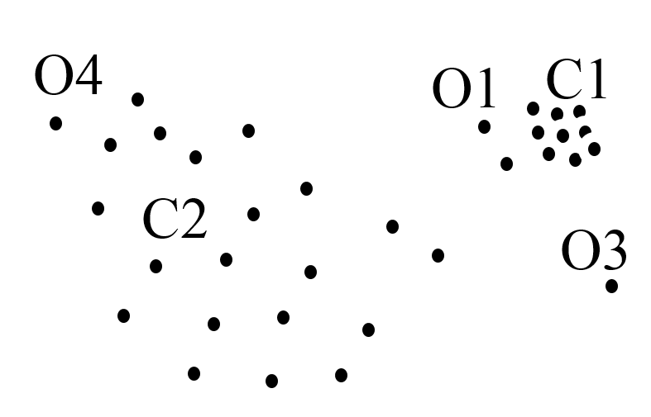
Deteksi Pencilan dengan Local Outlier Factor (Beunig 2000)
Pencilan Local
Pencilan
Global
12
Notes:
Dibikin besar ilustrasinya

Slide 13
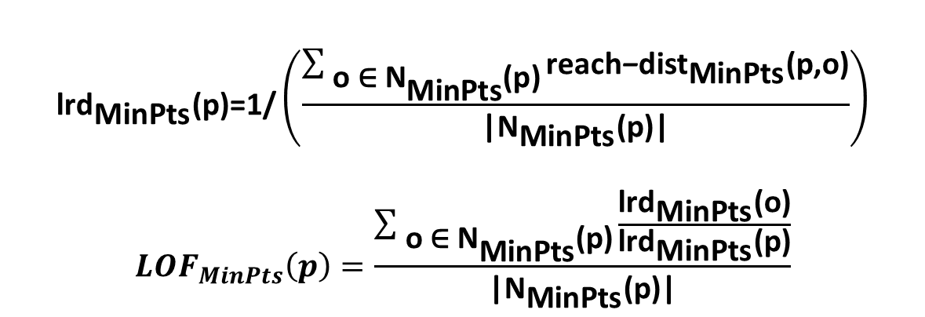
Local Outlier Factor (Beunig 2000)
Sebuah objek local outlier factor adalah rasio rataan dari o
degan jarak k-ketetanggan lokal terdekat. Beunig (2000):
reach-dist k (p, o) = max { k-distance(o), d(p, o) }.
$${\text{lrd}}_{\text{MinPts}}\text{(}\text{p}\text{)=1/}\left(\frac{\sum_{ \text{o}\text{ ∈ }{\text{N}}_{\text{MinPts}}\text{(}\text{p}\text{)}}{{\text{reach}\text{−}\text{dist}}_{\text{MinPts}}\text{(}\text{p}\text{,}\text{o}\text{)}}}{\text{|}{\text{N}}_{\text{MinPts}}\text{(}\text{p}\text{)|}}\right)$$
$${LOF}_{MinPts}\left(p\right)=\frac{\sum_{ \text{o}\text{ ∈ }{\text{N}}_{\text{MinPts}}\text{(}\text{p}\text{)}}{\frac{{\text{lrd}}_{\text{MinPts}}\text{(}\text{o}\text{)}}{{\text{lrd}}_{\text{MinPts}}\text{(}\text{p}\text{)}}}}{\text{|}{\text{N}}_{\text{MinPts}}\text{(}\text{p}\text{)|}}$$
dengan
k = jumlah tetangga
distance = fungsi jarak
lrd = local reachability density
LOF = local outlier factor
13
Notes:
Dibikin besar ilustrasinya

Slide 14
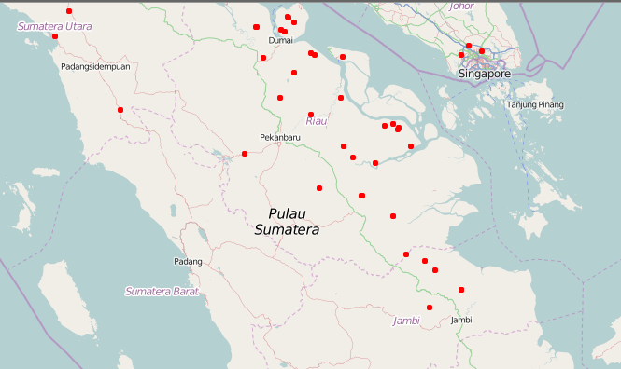
Visualisasi Data
Visualisasi dengan titik panas menggunakan pendekatan spasial
Sumber gambar:
http://geospasial.bnpb.go.id/monitoring/hotspot/
14
Notes:
Ambil visualisasi data dari skripsi bentar

Slide 15
Analisis Pencilan
Pada tahap ini diperlihatkan objek-objek pencilan dari data penelitian. Data hasil deteksi pencilan dianalisis untuk mengetahui informasi yang terdapat pada data
Pencilan Local
Ukuran Pemusatan Pencilan
Waktu Terjadinya Pencilan
15

Slide 16







Lingkungan Pengembang
Intel(R) Core(TM) i7-5500U 2.40GHz
RAM 12288 MB.
16

Slide 17
Jadwal Penelitian
Kegiatan | Tahun 2015
 | 4 | 5 | 6 | 7 | 8 | 9 | 10 | 11 | 12
Penyusunan proposal
Pengumpulan data
Praproses data
Kolokium
Implementasi Local outlier factor
Evaluasi hasil penelitian
Penyusunan skripsi dan makalah seminar
Seminar
Sidang tugas akhir
Revisi Skripsi dan penyelesaian
Lulus (SKL)
17

Slide 18
Daftar Pustaka
Baehaki D. 2014. Deteksi pencilan data titik panas di provinsi Riau menggunakan algoritme clustering K-Means [skripsi]. Bogor(ID): Insitut Pertanian Bogor.
Beunig Markus M, Kriegel Hans-Peter, Ng Raymond T, Sander J. 2000. LOF: Identifying Density-Based Local Outliers. ACM SIGMOD international conference on Management of data; 2, June 2000; New York, USA. New York (USA): ACM SIGMOD Volume 29 Issue Pages 93-104
Cahyadarena M B.2014. Deteksi Pencilan Pada Data Titik Panas Menggunakan Clustering Berbasis Medoids [skripsi]. Bogor(ID): Insitut Pertanian Bogor.
18

Slide 19
Terima kasih
shofyanipb@gmail.com

Slide 20
Frequent Answer Question
GO
Bagaimana cara kerja algoritme LOF dengan data set kecil? (12 slide)
Kenapa Menggunakan library R, Tidak membuat dari awal? (1 slide)
Data mengapa menggunakan algoritme Local Outlier Factor? (2 slide)
Kenapa harus menggunakan analisis deteksi pencilan? (1 sllide)
Apa itu titik panas? (1 slide)
Apa dampak kebakaran hutan? (1 slide)
GO
GO
GO
GO
GO
20

Slide 21
Frequent Answer Question (2)
GO
Bagaimana Kode algoritme LOF di library R?
(4 slide)
21

Slide 22
Algoritme LOF dengan data set kecil
Data 4 data titik:
a(0, 0), b(0, 1), c(1, 1), d(3, 0)
Hitung LOF untuk setiap titik dan tunjukkan 1 outlier teratas, dengan
k = 2 dan fungsi jarak Manhattan
22

Slide 23
Langkah 1: menghitung semua jarak antara masing-masing dua titik data
a(0, 0), b(0, 1), c(1, 1), d(3, 0)
dist(a, b) = 1
dist(a, c) = 2
dist(a, d) = 3
dist(b, c) = 1
dist(b, d) = 3+1=4
dist(c, d) = 2+1=3
23

Slide 24
Langkah 2: menghitung semua dist₂ (o)
dist k (o): jarak antara o dan yang k-th
NN (tetangga terdekat k-th)
dist₂ (a) = dist (a, c) = 2 (c = ke-2 tetangga terdekat)
dist₂ (b) = dist (b, a) = 1 (a / c ke-2 tetangga terdekat)
dist₂ (c) = dist (c, a) = 2 (a ke-2 tetangga terdekat)
dist₂ (d) = dist (d, a) = 3 (a / c ke-2 tetangga terdekat)
24

Slide 25
Langkah 3: menghitung semua N_{k} (o)
k-distance neighborhood dari o,
N k (o) = {o’| o’ in D, dist(o, o’) ≤ dist k (o)}
N₂ (a) = {b, c}
N₂ (b) = {a, c}
N₂ (c) = {b, a}
N₂ (d) = {a, c}
25

Slide 26
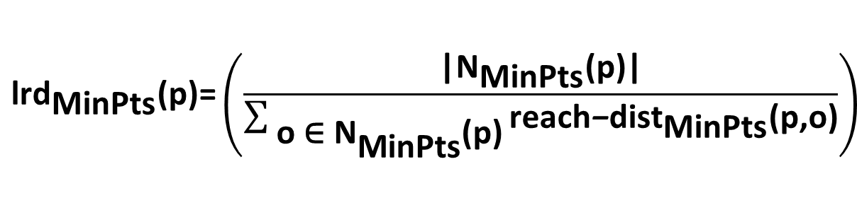
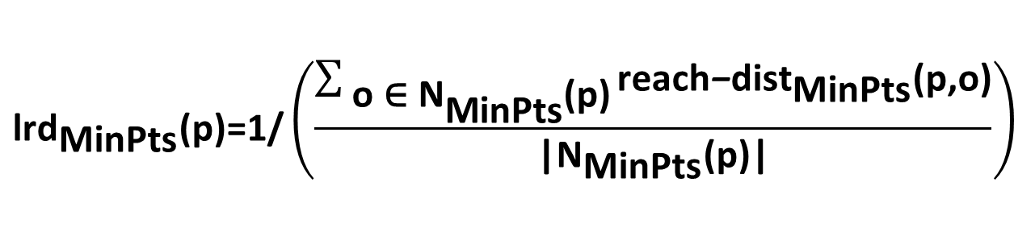
Langkah 4: menghitung semua lrd_{k} (o)
reach-dist k (p, o) = max { k-distance(o), d(p, o) }
$${\text{lrd}}_{\text{MinPts}}\text{(}\text{p}\text{)=1/}\left(\frac{\sum_{ \text{o}\text{ ∈ }{\text{N}}_{\text{MinPts}}\text{(}\text{p}\text{)}}{{\text{reach}\text{−}\text{dist}}_{\text{MinPts}}\text{(}\text{p}\text{,}\text{o}\text{)}}}{\text{|}{\text{N}}_{\text{MinPts}}\text{(}\text{p}\text{)|}}\right)$$
$${\text{lrd}}_{\text{MinPts}}\text{(}\text{p}\text{)=}\left(\frac{\text{|}{\text{N}}_{\text{MinPts}}\text{(}\text{p}\text{)|}}{\sum_{ \text{o}\text{ ∈ }{\text{N}}_{\text{MinPts}}\text{(}\text{p}\text{)}}{{\text{reach}\text{−}\text{dist}}_{\text{MinPts}}\text{(}\text{p}\text{,}\text{o}\text{)}}}\right)$$
26

Slide 27
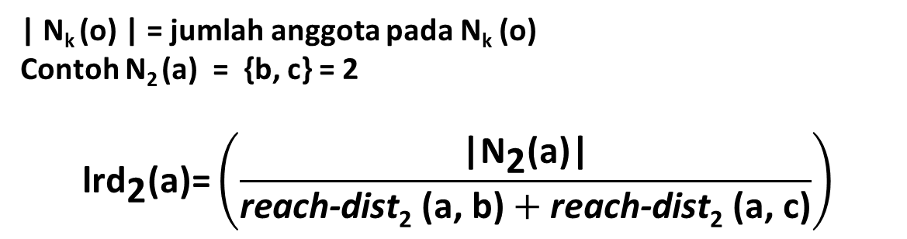
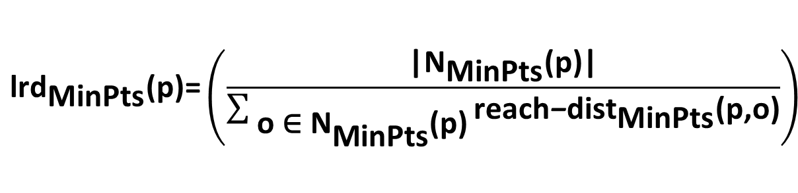
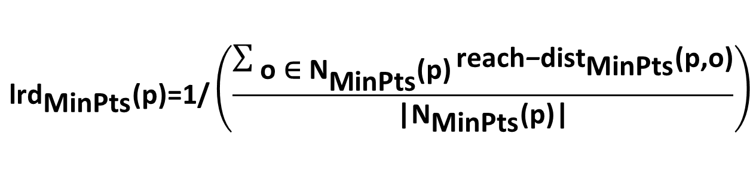
Langkah 4: menghitung semua lrd_{k} (o)
reach-dist_{k} (p, o) = max { k-distance(o), d(p, o) }
$${\text{lrd}}_{\text{MinPts}}\text{(}\text{p}\text{)=1/}\left(\frac{\sum_{ \text{o}\text{ ∈ }{\text{N}}_{\text{MinPts}}\text{(}\text{p}\text{)}}{{\text{reach}\text{−}\text{dist}}_{\text{MinPts}}\text{(}\text{p}\text{,}\text{o}\text{)}}}{\text{|}{\text{N}}_{\text{MinPts}}\text{(}\text{p}\text{)|}}\right)$$
$${\text{lrd}}_{\text{MinPts}}\text{(}\text{p}\text{)=}\left(\frac{\text{|}{\text{N}}_{\text{MinPts}}\text{(}\text{p}\text{)|}}{\sum_{ \text{o}\text{ ∈ }{\text{N}}_{\text{MinPts}}\text{(}\text{p}\text{)}}{{\text{reach}\text{−}\text{dist}}_{\text{MinPts}}\text{(}\text{p}\text{,}\text{o}\text{)}}}\right)$$
| N_{k} (o) | = jumlah anggota pada N_{k} (o)
Contoh N₂ (a) = {b, c} = 2
$${\text{lrd}}_{\text{2}}\text{(}\text{a}\text{)=}\left(\frac{\text{|}{\text{N}}_{\text{2}}\text{(}\text{a}\text{)|}}{\text{reach}\text{-}\text{dist}\text{2}\text{ (}\text{a}\text{, }\text{b}\text{)}+\text{reach}\text{-}\text{dist}\text{2}\text{ (}\text{a}\text{, }\text{c}\text{)}}\right)$$
27

Slide 28
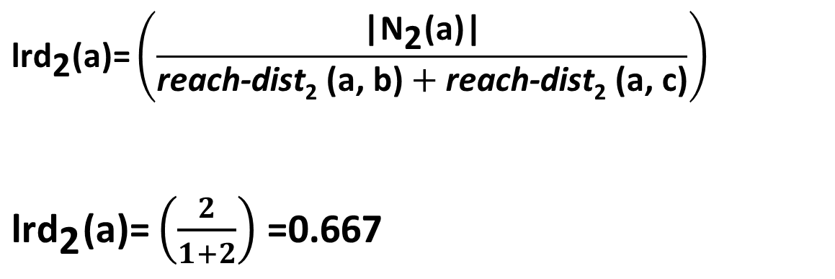
Langkah 4: menghitung semua lrd_{k} (o)
reach-dist_{k} (p, o) = max { k-distance(o), d(p, o) }
reachdist₂ (b, a) = max{dist₂(b), dist(b, a)} = max{1, 1} = 1
reachdist₂ (c, a) = max{dist₂(c), dist(c, a)} = max{2, 2} = 2
$${\text{lrd}}_{\text{2}}\text{(}\text{a}\text{)=}\left(\frac{\text{|}{\text{N}}_{\text{2}}\text{(}\text{a}\text{)|}}{\text{reach}\text{-}\text{dist}\text{2}\text{ (}\text{a}\text{, }\text{b}\text{)}+\text{reach}\text{-}\text{dist}\text{2}\text{ (}\text{a}\text{, }\text{c}\text{)}}\right)$$
${\text{lrd}}_{\text{2}}\text{(}\text{a}\text{)=}\left(\frac{2}{1+2}\right)$ =0.667
28

Slide 29
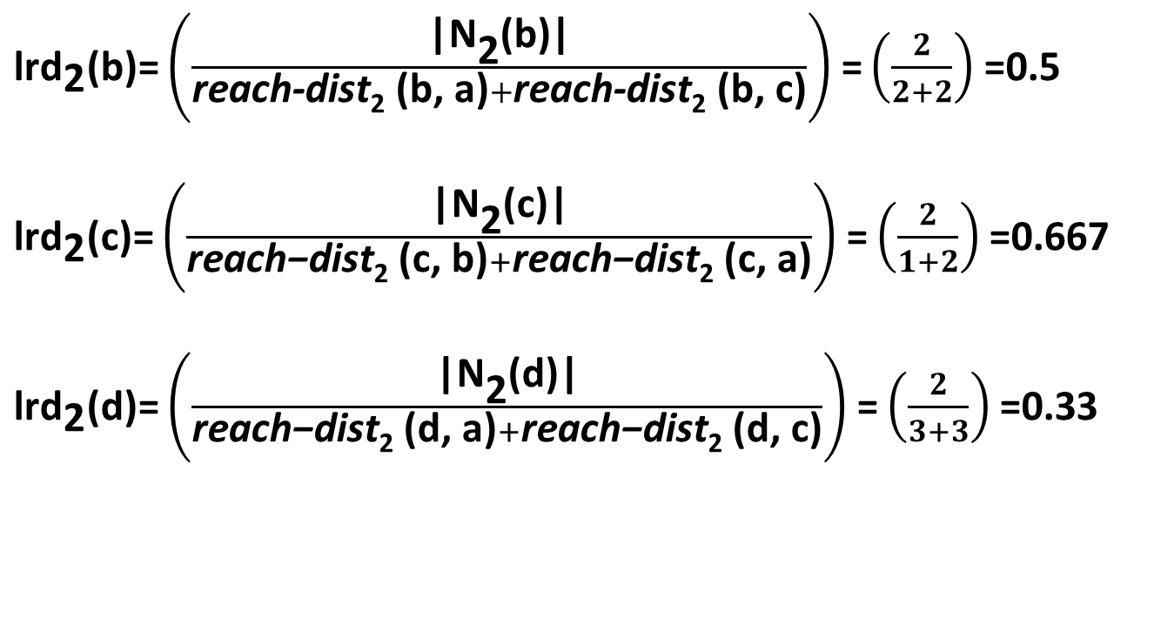
Langkah 4: menghitung semua lrd_{k} (o)
Lakukan juga terhadap titik yang lain
${\text{lrd}}_{\text{2}}\text{(}\text{b}\text{)=}\left(\frac{\text{|}{\text{N}}_{\text{2}}\text{(}\text{b}\text{)|}}{\text{reach}\text{-}\text{dist}\text{2}\text{ (}\text{b}\text{, }\text{a}\text{)}+\text{reach}\text{-}\text{dist}\text{2}\text{ (}\text{b}\text{, }\text{c}\text{)}}\right)$ $\text{=}\left(\frac{2}{2+2}\right)$ =0.5
${\text{lrd}}_{\text{2}}\text{(}\text{c}\text{)=}\left(\frac{\text{|}{\text{N}}_{\text{2}}\text{(}\text{c}\text{)|}}{\text{reach}\text{−}\text{dist}\text{2}\text{ (}\text{c}\text{, }\text{b}\text{)}+\text{reach}\text{−}\text{dist}\text{2}\text{ (}\text{c}\text{, }\text{a}\text{)}}\right)$ $\text{=}\left(\frac{2}{1+2}\right)$ =0.667
${\text{lrd}}_{\text{2}}\text{(}\text{d}\text{)=}\left(\frac{\text{|}{\text{N}}_{\text{2}}\text{(}\text{d}\text{)|}}{\text{reach}\text{−}\text{dist}\text{2}\text{ (}\text{d}\text{, }\text{a}\text{)}+\text{reach}\text{−}\text{dist}\text{2}\text{ (}\text{d}\text{, }\text{c}\text{)}}\right)$ $\text{=}\left(\frac{2}{3+3}\right)$ =0.33
29

Slide 30
Langkah 5: menghitung semua LOF_{k} (o)
Lakukan juga terhadap titik yang lain
${\text{lrd}}_{\text{2}}\text{(}\text{b}\text{)=}\left(\frac{\text{|}{\text{N}}_{\text{2}}\text{(}\text{b}\text{)|}}{\text{reach}\text{-}\text{dist}\text{2}\text{ (}\text{b}\text{, }\text{a}\text{)}+\text{reach}\text{-}\text{dist}\text{2}\text{ (}\text{b}\text{, }\text{c}\text{)}}\right)$ $\text{=}\left(\frac{2}{2+2}\right)$ =0.5
${\text{lrd}}_{\text{2}}\text{(}\text{c}\text{)=}\left(\frac{\text{|}{\text{N}}_{\text{2}}\text{(}\text{c}\text{)|}}{\text{reach}\text{−}\text{dist}\text{2}\text{ (}\text{c}\text{, }\text{b}\text{)}+\text{reach}\text{−}\text{dist}\text{2}\text{ (}\text{c}\text{, }\text{a}\text{)}}\right)$ $\text{=}\left(\frac{2}{1+2}\right)$ =0.667
${\text{lrd}}_{\text{2}}\text{(}\text{d}\text{)=}\left(\frac{\text{|}{\text{N}}_{\text{2}}\text{(}\text{d}\text{)|}}{\text{reach}\text{−}\text{dist}\text{2}\text{ (}\text{d}\text{, }\text{a}\text{)}+\text{reach}\text{−}\text{dist}\text{2}\text{ (}\text{d}\text{, }\text{c}\text{)}}\right)$ $\text{=}\left(\frac{2}{3+3}\right)$ =0.33
30

Slide 31
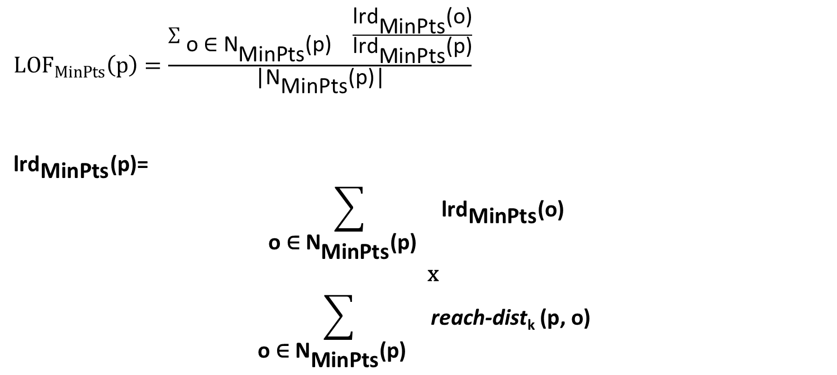
Langkah 5: menghitung semua LOF_{k} (o)
${LOF}_{MinPts}\left(p\right)=\frac{\sum_{ \text{o}\text{ ∈ }{\text{N}}_{\text{MinPts}}\text{(}\text{p}\text{) }}{\frac{{\text{lrd}}_{\text{MinPts}}\text{(}\text{o}\text{)}}{{\text{lrd}}_{\text{MinPts}}\text{(}\text{p}\text{)}}}}{\text{|}{\text{N}}_{\text{MinPts}}\text{(}\text{p}\text{)|}}$
${\text{lrd}}_{\text{MinPts}}\text{(}\text{p}\text{)=}$
$$\sum_{ \text{o}\text{ ∈ }{\text{N}}_{\text{MinPts}}\text{(}\text{p}\text{) }}{{\text{lrd}}_{\text{MinPts}}\text{(}\text{o}\text{) }}$$
x
$$\sum_{ \text{o}\text{ ∈ }{\text{N}}_{\text{MinPts}}\text{(}\text{p}\text{) }}{\text{reach}\text{-}\text{dist}\text{k}\text{ (}\text{p}\text{, }\text{o}\text{)}}$$
31

Slide 32
Langkah 5: menghitung semua LOF_{k} (o)
LOF ₂ (a) =
(lrd ₂ (b) + lrd ₂ (c)) * ( reachdist ₂ (a,b) + reachdist ₂ (a,c)) =
(0.5+0.667) * (1+2) = 3.501
LOF ₂ (b) =
(lrd ₂ (a) + lrd ₂ (c)) * ( reachdist ₂ (b,a) + reachdist ₂ (b,c)) =
(0.667+0.667) * (2+2) = 5.336
LOF ₂ (c) =
(lrd ₂ (b) + lrd ₂ (a)) * ( reachdist ₂ (c,b) + reachdist ₂ (c,a)) =
(0.5+0.667) * (1+2) = 3.501
LOF ₂ (d) =
(lrd ₂ (a) + lrd ₂ (c)) * ( reachdist ₂ (d,a) + reachdist ₂ (d,c)) =
(0.667+0.667) * (3+3) = 8.004
32

Slide 33
Langkah 6: Urutkan semua LOF_{k} (o)
LOF₂(d) = 8.004
LOF₂(b) = 5.336
LOF₂ (a) = 3.501
LOF₂ (c) = 3.501
Data 4 data titik:
a(0, 0), b(0, 1), c(1, 1), d(3, 0)
Outlier adalah titik d.
Back to list FAQ
33

Slide 34
Mengapa Menggunakan R ?
Back to list FAQ
R Gratis :open-source project
R adalah bahasa. : experimentation and exploration
Graphics dan data visualization
Access to powerful :Akademisi Terkemuka dan peneliti dari seluruh dunia menggunakan R. Lebih dari 2000 packages yang memperluas library R
A robust, community yang ramai
R is excellent for "mash-ups" : Mysql,Apache web server, Google API, Quatum GIS, Postgres
34
Notes:
Why use R?
There's lots of software available for data analysis today: spreadsheets like Excel, batch-oriented procedure-based systems like SAS; point-and-click GUI-based systems like SPSS; data mining systems, and so on. What makes R different?
R is free. As an open-source project, you can use R free of charge: no worries about subscription fees, license managers, or user limits. But just as importantly, R is open: you can inspect the code and tinker with it as much as you like (provided you respect the terms of the GNU General Public License version 2 under which it is distributed). Thousands of experts around the world have done just that, and their contributions benefit the millions of people who use R today.
R is a language. In R, you do data analysis by writing functions and scripts, not by pointing and clicking. That may sound daunting, but it's an easy language to learn, and a very natural and expressive one for data analysis. But once you learn the language, there are many benefits. As an interactive language (as opposed to a data-in-data-out black-box procedures), R promotes experimentation and exploration, which improves data analysis and often leads to discoveries that wouldn't be made otherwise. A script documents all your work, from data access to reporting, and can instantly be re-run at any time. (This makes it much easier to update results when the data change.) Scripts also make it easy to automate a sequence of tasks that can be integrated into other processes. Many R users who have used other software report that they can do their data analyses in a fraction of the time.
Graphics and data visualization. One of the design principles of R was that visualization of data through charts and graphs is an essential part of the data analysis process. As a result, it has excellent tools for creating graphics, from staples like bar charts and scatterplots to multi-panel Lattice charts to brand new graphics of your own devising. R's graphical system is heavily influenced by thought leaders in data visualization like Bill Cleveland and Edward Tufte, and as a result graphics based on R appear regularly in venues like the New York Times, the Economist, and the FlowingData blog.
A flexible statistical analysis toolkit. All of the standard data analysis tools are built right into the R language: from accessing data in various formats, to data manipulation (transforms, merges, aggregations, etc.), to traditional and modern statistical models (regression, ANOVA, GLM, tree models, etc). All are included in an object-oriented framework that makes it easy to programatically extract out and combine just the information you need from the results, rather than having to cut-and-paste from a static report.
Access to powerful, cutting-edge analytics. Leading academics and researches from around the world use R to develop the latest methods in statistics, machine learning, and predictive modeling. There are expansive, cutting-edge edge extensions to R in finance, genomics, and dozens of other fields. To date, more than 2000 packages extending the R language in every domain are available for free download, with more added every day.
A robust, vibrant community. With thousands of contributors and more than two million users around the world, if you've got a question about R chances are, someone's answered it (or can). There's a wealth of community resources for R available on the Web, for help in just about every domain.
Unlimited possibilities. With R, you're not restricted to choosing a pre-defined set of routines. You can use code contributed by others in the open-source community, or extend R with your own functions. And R is excellent for "mash-ups" with other applications: combine R with a MySQL database, an Apache web-server, and the Google Maps API and you've got yourself a real-time GIS analysis toolkit. That's just one big idea -- what's yours?

Slide 35
Mengapa Menggunakan LOF ?
Back to list FAQ
Baehaki D. 2014. Deteksi Pencilan Data Titik Panas Di Provinsi Riau Menggunakan Algoritme Clustering K-means [Skripsi]. Bogor(id): Insitut Pertanian Bogor.
Cahyadarena M B. 2014. Deteksi Pencilan Pada Data Titik Panas Menggunakan Clustering Berbasis Medoids [Skripsi]. Bogor(id): Insitut Pertanian Bogor.
Risti. 2015 . 2014. Deteksi Pencilan Pada Data Titik Panas Menggunakan DB Scan [Skripsi]. Bogor(id): Insitut Pertanian Bogor. (Masih Proses)
SUCI A M Y A .2015. Aplikasi Berbasis Web untuk Mendeteksi Pencilan Titik PanasMenggunakan Algoritme Clustering K-Means dan Framework Shiny. [Skripsi]. Bogor(id): Insitut Pertanian Bogor. (Masih Proses)
35

Slide 36
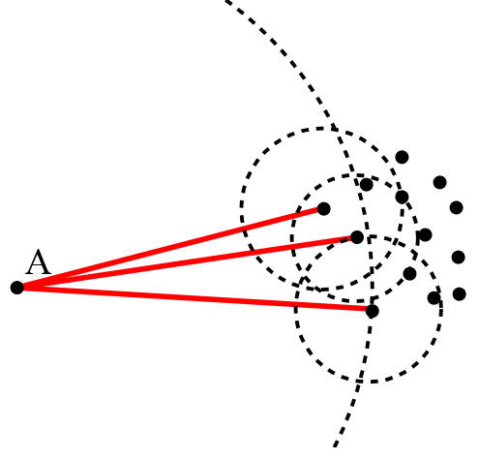
Mengapa Menggunakan LOF ?
Back to list FAQ
Ide dasar dari LOF: membandingkan kepadatan lokal titik dengan kepadatan tetangganya. A memiliki kepadatan yang jauh lebih rendah dibandingkan tetangganya.
Sumber gambar:
https://upload.wikimedia.org/wikipedia/commons/4/4e/LOF-idea.svg
36

Slide 37
Kenapa menggunakan analisis pencilan?
Agar segera diselidiki sumber titik panas, apakah berbahaya atau tidak
Karena jika pencilan itu adalah Kebakaran, harus diselidiki lagi kenapa terjadi kebakaran di daerah tersebut
Mencegah terjadinya kebakaran berdasarkan karakteristik pencilan titik panas.
Back to list FAQ
37

Slide 38
Apa itu titik panas?
Back to list FAQ
Titik panas merupakan suatu daerah di permukaan bumi yang memiliki suhu relatif lebih tinggi dibandingkan daerah di sekitarnya berdasarkan ambang batas suhu tertentu (Suwarsono et al 2013).
Ambang batas yang digunakan oleh Kementrian Kehutanan dan Japan International Cooperation Agency untuk data titik panas satelit NOAA adalah 315º K atau 42º C (Guswanto dan Heriyanto 2009).
Guswanto, Heriyanto E. 2009. Operational Weather System for National Fire Danger Rating. Jurnal Meteorologi dan Geofisika. 10(2): 77-87
Suwarsono, Rokhmatuloh, Waryono T. 2013. Pengembangan Model Identifikasi Daerah Bekas Kebakaran Hutan dan Lahan (Burned Area) Menggunakan Citra MODIS di Kalimantan [Model Development of Burned Area Identification Using MODIS Imagery in Kalimantan]. Jurnal Penginderaan Jauh. 10(2): 93-112.
38

Slide 39
Apa dampak kebakaran hutan?
Back to list FAQ
Menurut Sri Lestari S .2000. Dampak Dan Antisipasi Kebakaran Hutan . Jurnal Teknologi Lingkungan. 1(2) :171-175.
Polusi Udara
Konsentrasi Debu meningkat antara 300 % hingga 700 %
Jarak Pandang (Visibility)
Penurunan Intensitas Curah Hujan.
Menurut Rasyid F .2014.Permasalahan dan Dampak Kebakaran Hutan.Jurnal Lingkar Widyaiswara. 1(4: 47-49
kerugian antara US $ 2,84 - US $ 4,86 milyar
Berbagai jenis kayu kini telah menjadi langka. Kayu eboni (Dyospyros ebenum dan D. celebica), kayu ulin (Eusyderoxylon zwageri), ramin (Gonystylus bancanus), dan beberapa jenis meranti (Shorea spp.)
39

Slide 40
Implementasi LOF di R?
Back to list FAQ
function (data, k) {
data <- as.matrix(data)
distdata <- dist.to.knn(data, k)
p <- dim(distdata)[2L]
lrddata <- reachability(distdata, k)
lof <- rep(0, p)
for (i in 1:p) {
nneigh <- distdata[2, i] - distdata[1, i] + 1
j <- seq(0, (nneigh - 1))
local.factor <- sum(lrddata[distdata[3 + j, i]]/lrddata[i])/nneigh
lof[i] <- local.factor
}
lof
}
40

Slide 41
Implementasi LOF di R? (2)
Back to list FAQ
dist.to.knn <- function(dataset,neighbors) {
numrow <- dim(dataset)[1L]
mxNN <- neighbors*2+2
knndist <- matrix(0,nrow=mxNN,ncol=numrow)
for (i in 1:numrow) {
neighdist <- knneigh.vect(dataset[i,],dataset,neighbors)
x <- length(neighdist)
if (x > mxNN) {
knndist <- rbind(knndist,matrix(rep(0,(x-mxNN)*numrow),ncol=numrow))
mxNN <- x
}
knndist[1:x,i] <- neighdist
}
return(knndist[1:mxNN,])
}
41

Slide 42
Implementasi LOF di R? (3)
Back to list FAQ
knneigh.vect <- function(x,data,k) {
temp <- as.matrix(data)
numrow <- dim(data)[1L]
dimnames(temp) <- NULL
difference<- scale(temp, x, FALSE)
dtemp <- drop(difference^2 %*% rep(1, ncol(data)))
dtemp <- sqrt(dtemp)
order.dist <- order(dtemp)
nndist <- dtemp[order.dist]
knndist <- nndist[k+1]
neighborhood <- drop(nndist[nndist<=knndist])
neighborhood <- neighborhood[-1]
numneigh <- length(neighborhood)
index.neigh <- order.dist[1:numneigh+1]
num1 <- numneigh+3
num2 <- numneigh+numneigh+2
return(c(num1,num2,index.neigh,neighborhood))}
42

Slide 43
Implementasi LOF di R? (4)
Back to list FAQ
reachability <- function(distdata,k) {
p <- dim(distdata)[2]
lrd <- rep(0,p)
for (i in 1:p) {
j <- seq(3,3+(distdata[2,i]-distdata[1,i]))
numneigh <- distdata[2,i]-distdata[1,i]+1
temp <- rbind(diag(distdata[distdata[2,distdata[j,i]],distdata[j,i]]),distdata[j
+numneigh,i])
reach <- 1/(sum(apply(temp,2,max))/numneigh)
lrd[i] <- reach
}
lrd
}
43

