Slide 1
Setup for Confluent for Kubernetes (CFK) Setup

Slide 2
Agenda
Kafka Ecosystem Architecture
Kafka/Confluent Major Components
Other Confluent/CFK Components
Kafka/Confluent: Distributed System
Kafka Core Concepts: Producers, Consumers, Brokers, Zookeepers, Consumer Groups, Topics, Partitions, Replicas, Leaders/Folloers, Messages/Events/Records
Kafka Ecosystem Architecture
Infra: Azure Kubernetes (AKS) & CFK Platform
Security (TLS, SSL & SASL, ACL)
Advanced Topics: Monitoring and Operations, Custom Connectors, Best Practices, Troubleshooting, and Cronjobs
Demos: Kafka Setup with Docker compose & SendMessage/ReceiveMessage for Cloud Team as Users

Slide 3
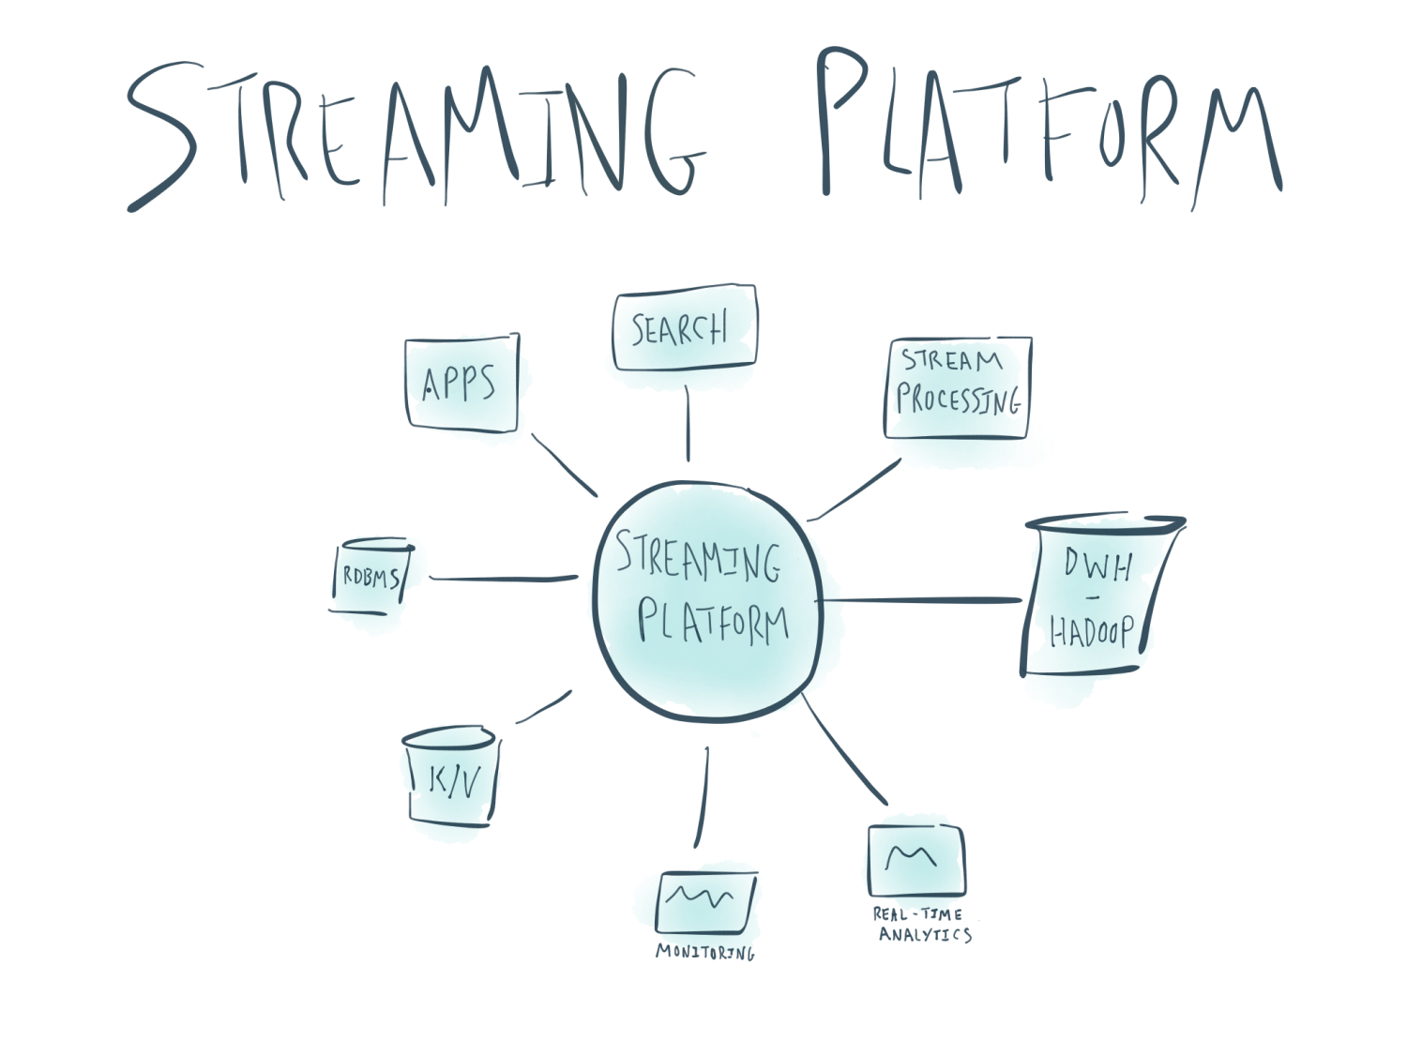
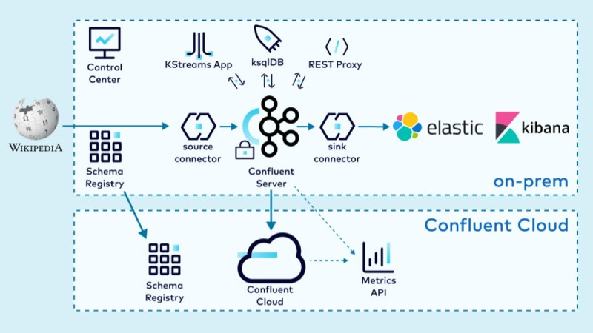
Kafka/Confluent
What is Kafka/Confluent?
Kafka was originally developed by LinkedIn, and was subsequently is an open-source distributed event store and stream-processing platform.
Kafka enterprise version is called Confluent.
Event-Driven Architectures and Real-Time Data Use, not landed in a Store, which is powerful for fraud detection, payments etc.
Since 2012, it has gained increasing popularity among users due to its excellent performance and flexible configuration. Today, more than 80% of all Fortune 100 companies is using Kafka.
Traditionally, data is often stored in a static storage like database or data warehouse, and then processes like analytics, reporting, or other operations are run after the data has been stored.
Notes:
Once data is in Kafka, it is “just” a message; its source is irrelevant when it comes to how we want to use it.
Events: are Notification and State Change….are Everywhere…… a sale, a Stcock Market Movement, Networking, IoT, Applications

Slide 4
Other Confluent/CFK Components
Kafka/Confluent Components
Kafka Brokers
Zookeepers/Kfraft
Kafka Connect
Consumers
Producers
Connect Cluster
Control Center
Schema Registry
Connectors: Sources & Sinks
Confluent Hub
Cluster Linking

Slide 5
Kafka/Confluent: Distributed System
Reliability: ensures no data loss by replication across brokers.
Fault-tolerant: when one broker goes down, it redistribute the partition among brokers.
Scalability: able to handle increasing load by horizontal scaling.
High Availability: ensure that services are available with minimal or no downtime by replication etc.

Slide 6
Kafka Core Concepts
Cluster: A set of Linux servers running Kafka nodes, a simple cluster normally compose by 3 nodes
Broker: A host in the Kafka cluster
Topic: A topic in a Kafka cluster, similar as queue concept in SQS or a Table in a Database, can have multi producers and consumers
Record: Also called event, or message
Partition: One topic can be divided into multi partitions. Each partition can be store in different broker, each partition has leader and follower, the follower partition is the replica of the leader
Leader-Follower: The Primary partition and the replicas
ISR(In Sync Replica): Kafka uses ISR to ensure that at least a certain number of replicas have the same data as the leader before confirming a message is delivered.
Segment: Each partition is separated into segments. Each segment is stored in a single data file on the disk. By default, each segment contains either 1 GB of data or a week of data
Offset: A position within a partition for the next message to be sent, all records behind this pointer were considered deleted
Offset Index: An offset to position index, helps Kafka know what part of a segment to read to find a message.
Timestamp Index: A timestamp to offset index, allows Kafka to find messages with a specific timestamp.
log: The sequential store include all records in the segment
Notes:
Human generated events vs Machine generated Events

Slide 7
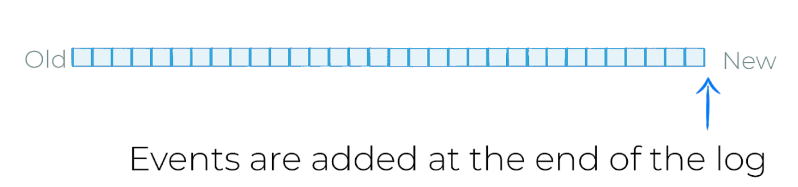
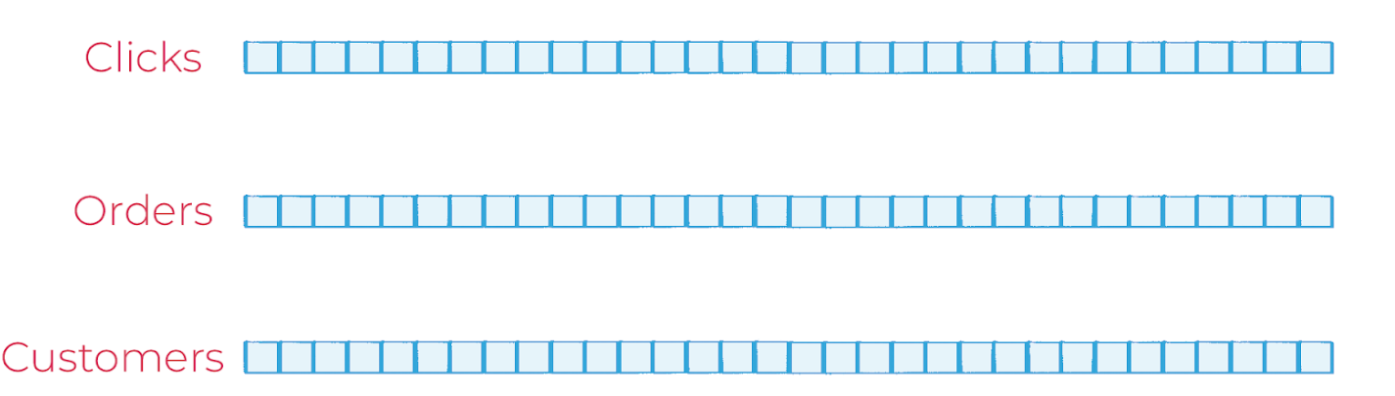
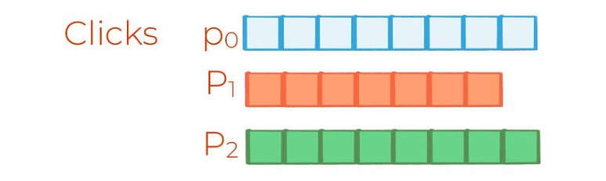
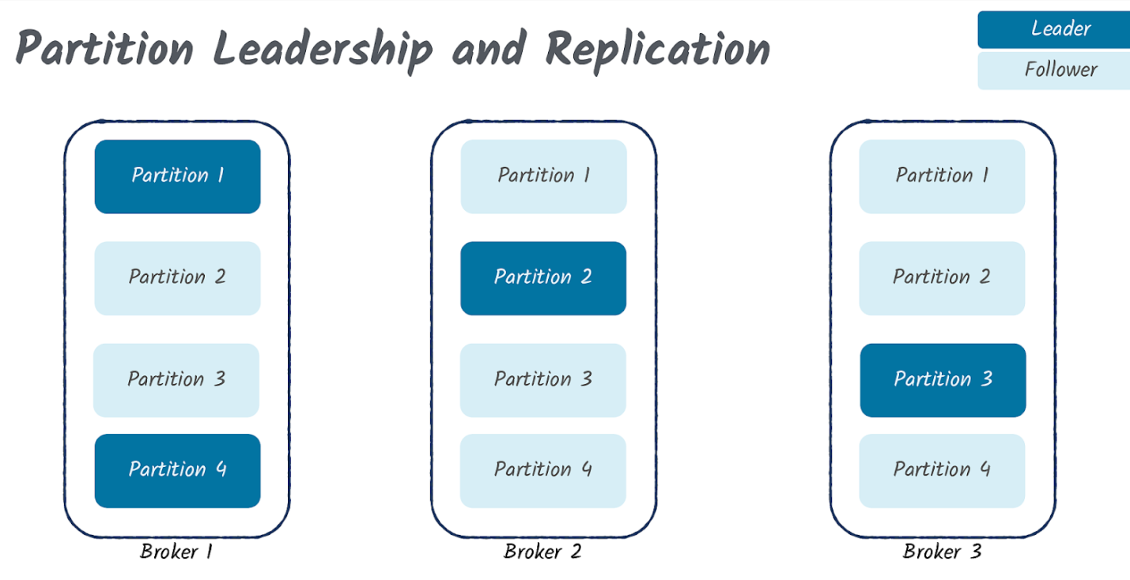
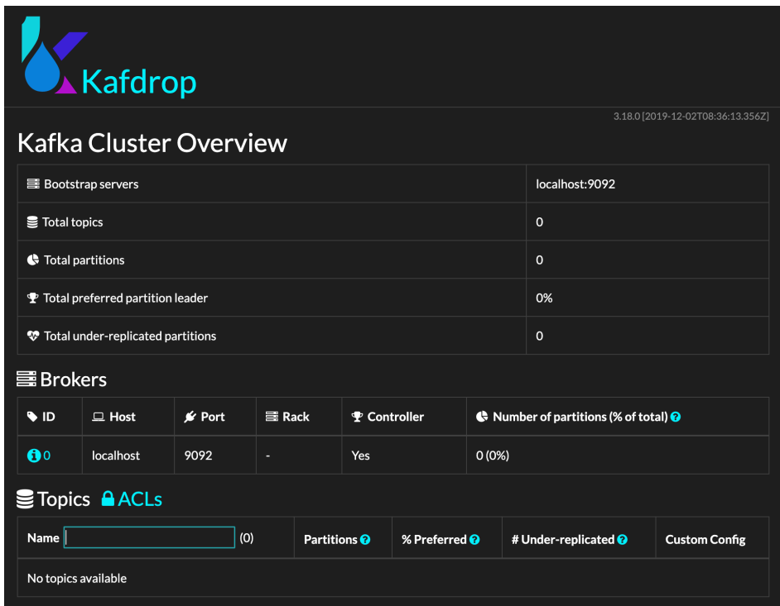
Kafka Core Concepts
Topics & Offsets
Immutable Event Log
Partitions
Leaders, Followers and Replication
Kafdrop

Slide 8
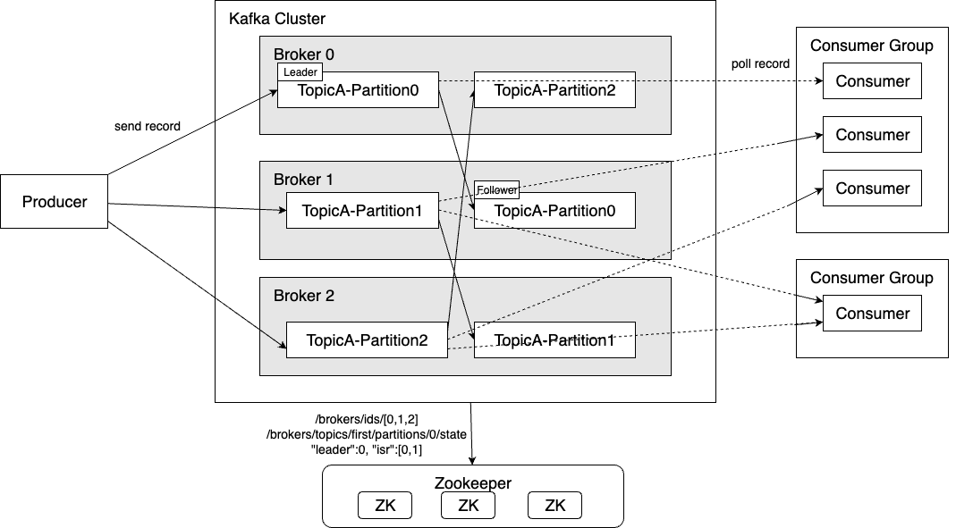
Kafka Ecosystem Architecture

Slide 9
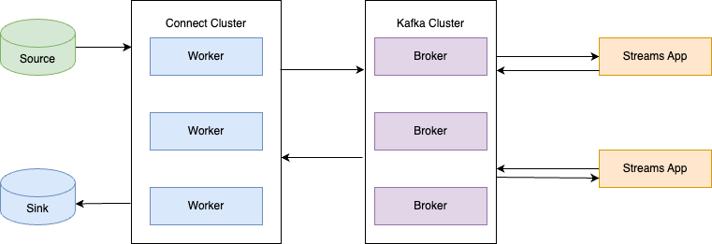
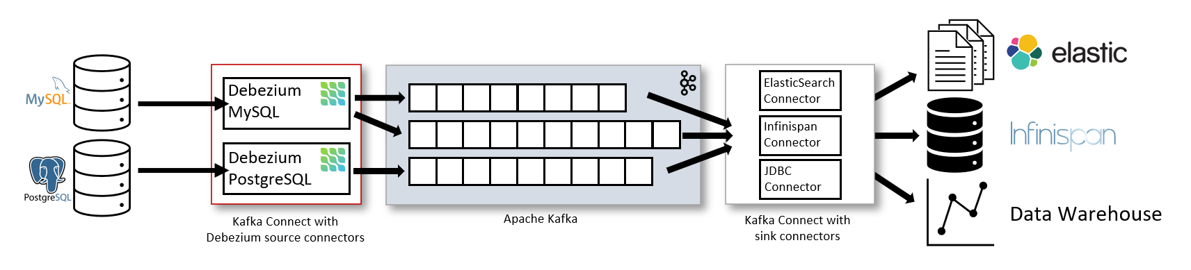
Connect Cluster
Source connectors: such as Debezium that send records into Kafka
Sink connectors: that propagate records from Kafka topics to other systems
SOURCE CONNECTORS
SINK CONNECTORS
Notes:
https://debezium.io/documentation/reference/stable/architecture.html

Slide 10
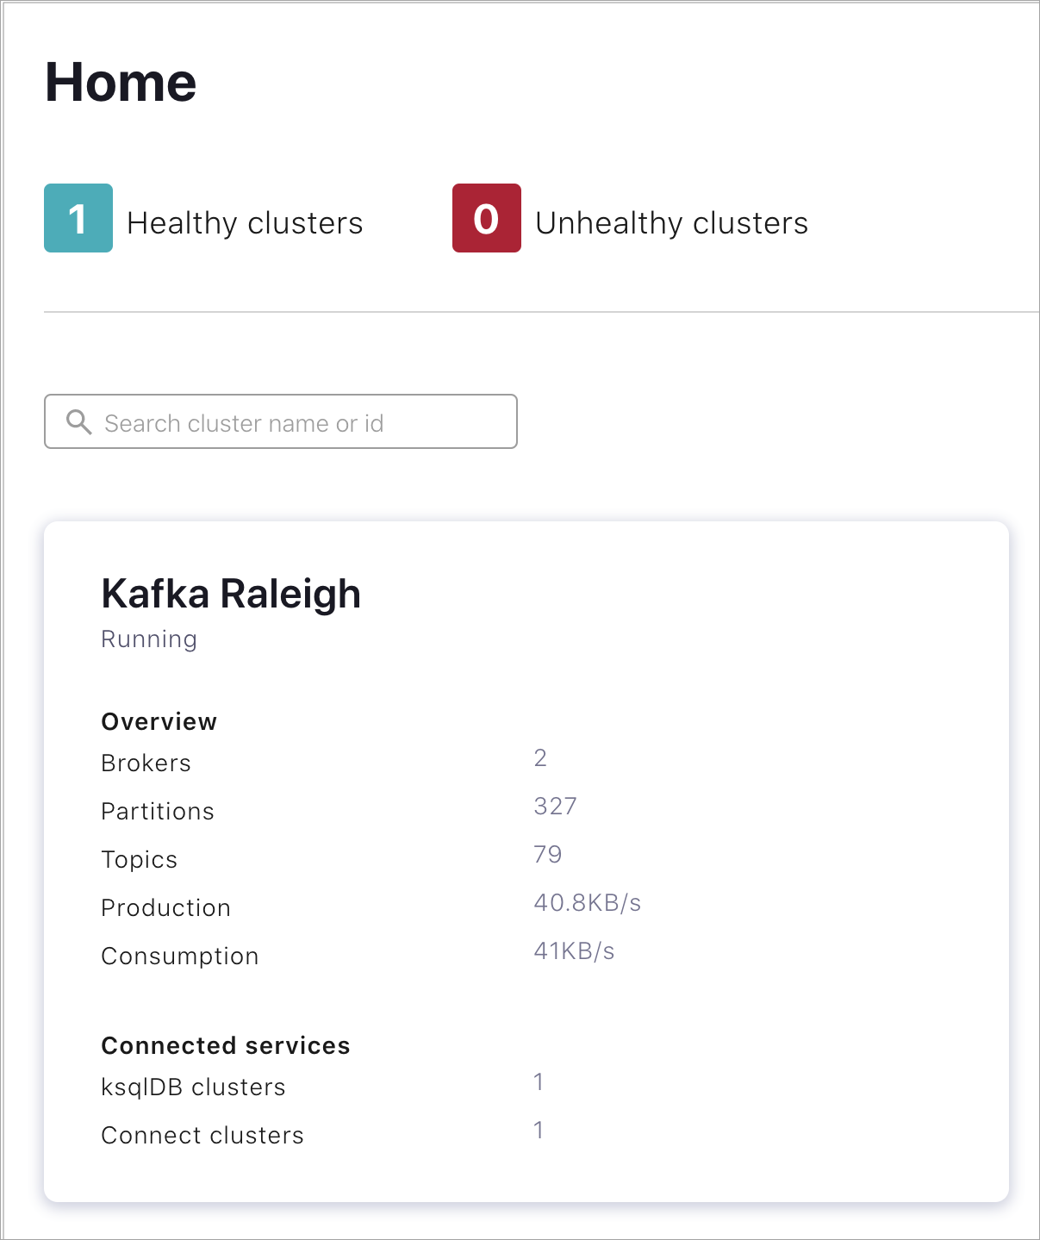
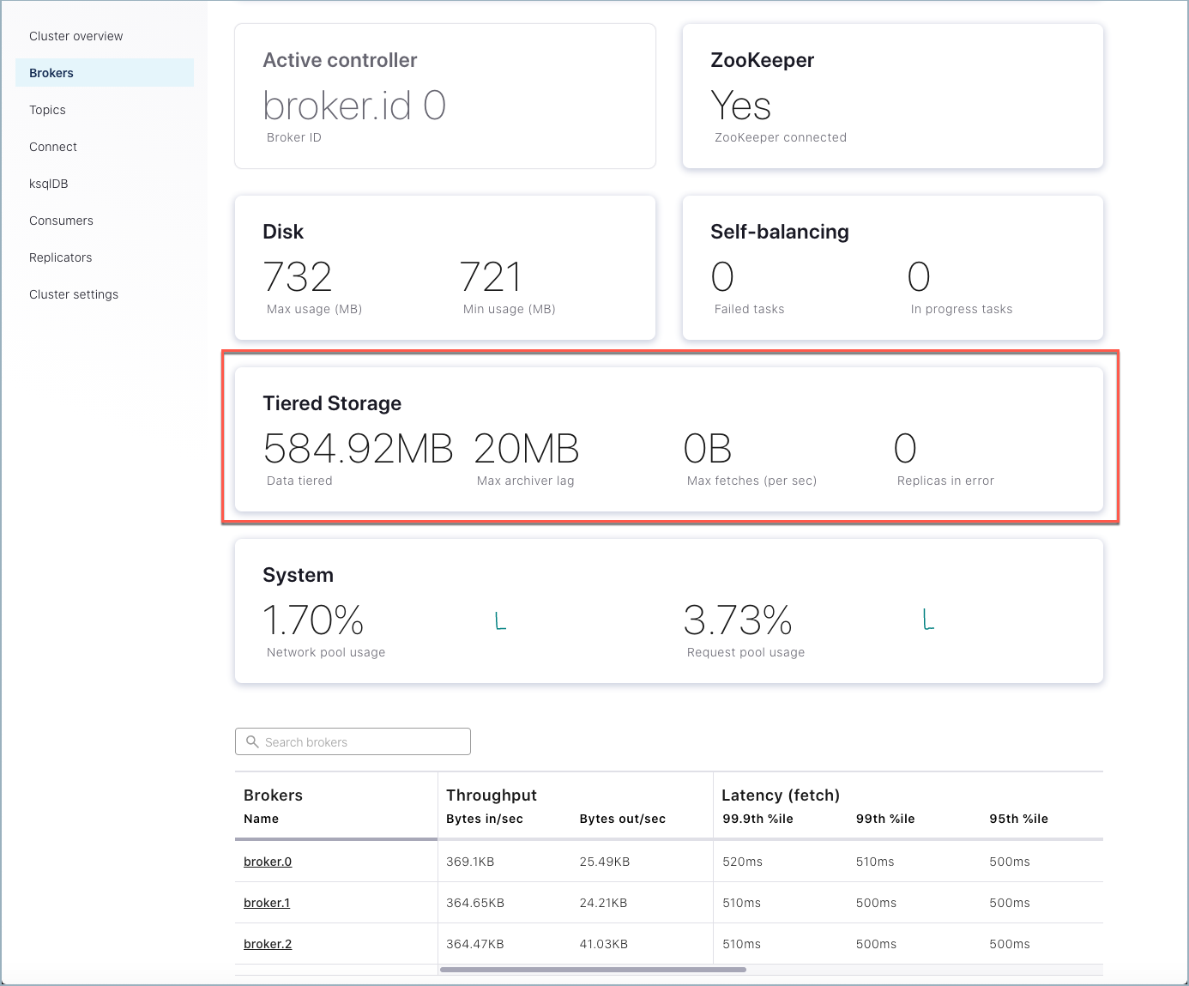
Control Center
To access Control Center, when Confluent Platform including Control Center is running, open your web browser and navigate to the host and port where Control Center runs. By default, Control Center runs at http://localhost:9021/
Notes:
https://teamraft.com/2021/05/19/kafka-connect/

Slide 11

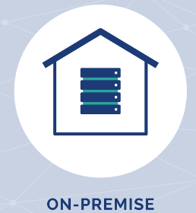
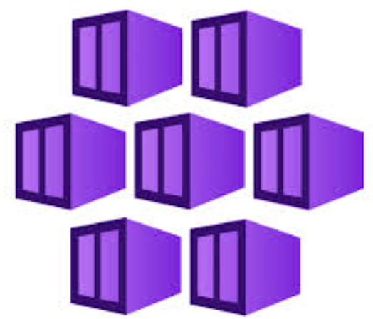



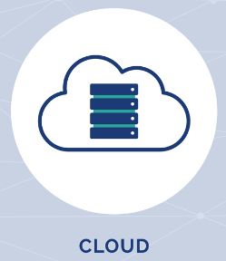






AKS & CFK Platform
Elasticsearch,
UI/Dashboard
MongoDB
ML/AI Modeling
Source Connectors
Sink Connectors
CFK Operators
Create Databricks
Create AKS
Create Confluent/Kafka
AKS
CFK
Helm
Databricks
Notes:
Stream your data from source into Kafka, and from there to target

Slide 12
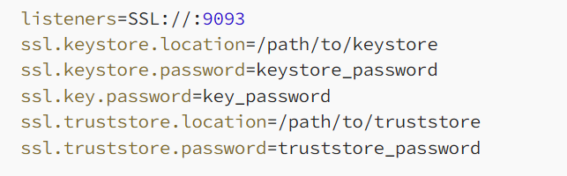
Security (TLS, SSL & SASL, ACL)
Broker Configuration (server.properties)
Authentication Methods:
SASL (PLAIN, SCRAM, GSSAPI (Kerberos), OAuthBearer) - Used for authentication with various mechanisms.
TLS Client Authentication - Uses TLS/SSL certificates for authentication.
mTLS (Mutual TLS) – Uses for both client and server authentication.
JWT (OAuth Integration) - Uses JSON Web Tokens for external identity provider integration.
Authorization Methods
ACLs (Access Control Lists) - Used for authorization by defining permissions for users, groups or applications.
RBAC (Role-Based Access Control) - Available in Confluent Platform for role-based authorization.
Notes:
You need to provide CA and key.
For mTLS- Set following in broker configuration : ssl.client.auth=required for producers and consumers as clients etc.

Slide 13
Advanced Topics
Monitoring and Operations
Custom Connectors
Best Practices
Troubleshooting
Cronjobs
REST API
Integrate License Keys into CFK
Cluster Linking
Replicators
Notes:
DEBUG logging in authorizer logs

Slide 14
Demo
Installing Kafka Cluster
SendMessage/ReceiveMessage for Cloud Team Users

Slide 15
References
https://github.com/apache/kafka
https://kafka.apache.org/documentation/
https://docs.confluent.io/kafka/introduction.html
https://www.conduktor.io/kafka/what-is-apache-kafka/
https://www.youtube.com/playlist?list=PLmOn9nNkQxJHTVxt3wxWXyheQPLlh-9T6
https://duyidong-archive.s3.amazonaws.com/pdf/kafka-tutorial.pdf
https://developer.confluent.io/courses/architecture/get-started/
https://stackoverflow.com/questions/52338890/kafka-partition-index-file
https://strimzi.io/blog/2021/12/17/kafka-segment-retention/
Kafka API models
https://levelup.gitconnected.com/kafka-connect-overview-7eb9e39df8b1

Slide 16
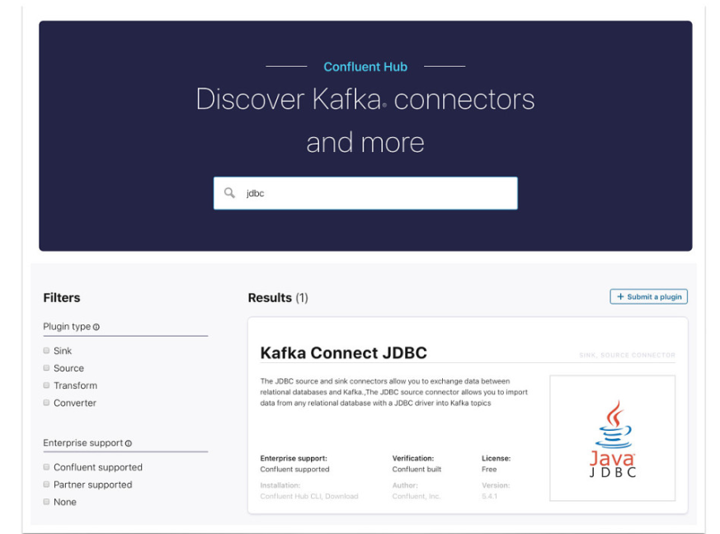
Kafka Core Concepts
Topics & Offsets
Immutable Event Log
Partitions
Confluent Hub for Connectors

