Slide 1
Azure Storage Services

Slide 2
Agenda
Introduction to Azure Storage Services
Azure Storage Concepts/Types: Blob, File, Queue, Table
Azure Storage Ecosystem Architecture Deep Dive
Storage Account Types
Storage Account Kind
Replication
Redundancy
Cost Optimization
Autoscaling and Lifecycle Policies
Common Use Cases at Bxxx
Integration with Other Azure Services: Azure Functions, Logic Apps, etc.
Access and Security
Demos: Portal Walkthrough/Creating a storage account, setting up containers, file shares, and queues
Questions & Answers

Slide 3
Introduction to Azure Storage Services
What is Azure Storage Service/Account?
Cloud computing enables new scenarios for applications requiring scalable, durable and highly available storage for their data – which is exactly why Microsoft developed Azure Storage Service.
Azure Storage is a PaaS service that you can use to store both unstructured and partially structured data.
Azure Storage is massively scalable and elastic: It can store and process hundreds of terabytes of data to support the big data scenarios required by scientific, financial analysis, and media applications. Or you can store the small amounts of data required for a small business website.
By default, you can create up to 100 storage accounts in a single Azure subscription. Each standard storage account can contain up to 500 TB of combined blob, queue, table and file data.
As the demands on your storage application grow, Azure Storage automatically allocates the appropriate resources to meet them. We are charged only for what we use.
It offers four types of storage services, depending on the type of data that they are designed to store.

Slide 4
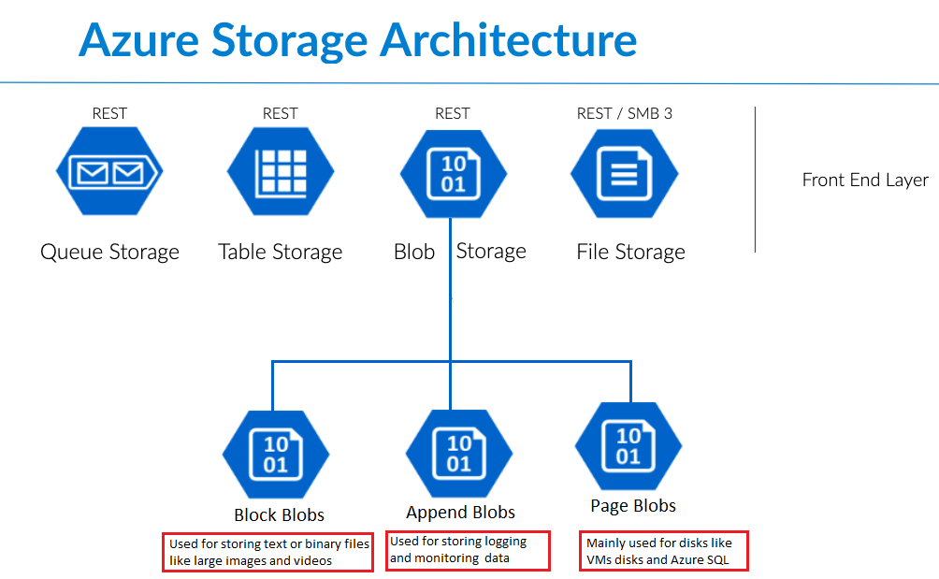

Blob Storage stores file data. A blob can be any type of text or binary data, such as a document, media file, or application installer. Blob Storage is sometimes referred to as Object storage.
File Storage Similar to blobs, these provide storage for unstructured files, but they offer support for file sharing in the same manner as traditional on-premises Windows file shares.
Table Storage stores partially structured datasets. Table storage is a NoSQL key-attribute data store, which allows for rapid development and fast access to large quantities of data.
Queue Storage provides reliable messaging for workflow processing and for communication between components of cloud services
Azure Storage concepts

Slide 5
Azure Storage Ecosystem Architecture Deep Dive
Azure Storage Account: An Azure storage account is a secure account that gives you access to services in Azure Storage.
Two Types of Storage Account
A standard storage account
Blob, Table, Queue, and File storage.
Standard storage accounts are backed by magnetic drives (HDD) and provide the lowest cost per GB.
They are best for applications that require bulk storage or where data is accessed infrequently.
Focus: Uses magnetic disks for cost-effective storage of large amounts of data with moderate performance requirements.
A premium storage account
ideally supposed to be used for Azure Virtual Machine disks.
Premium storage accounts are backed by solid state drives (SSD) and offer consistent low-latency performance.
They can only be used with Azure virtual machine disks and are best for I/O-intensive applications, like databases. Additionally, virtual machines that use Premium storage for all disks qualify for a 99.9% SLA, even when running outside an availability set.
Focus: Uses solid-state drives (SSDs) for low-latency and high-performance workloads.

Slide 6
Azure Storage Ecosystem Architecture Deep Dive
Azure Storage Account
Three Types of Storage Account Kind
General-purpose v2 accounts: Basic storage account type for blobs, files, queues, and tables.
Recommended for most scenarios using Azure Storage.
Block blob storage accounts: Blob-only storage accounts with premium performance characteristics.
Recommended for scenarios with high transaction rates, using smaller objects, or requiring consistently low storage latency.
File Storage storage accounts: Files-only storage accounts with premium performance characteristics.
Recommended for enterprise or high-performance scale applications.
File system supports NFS (Network File System) file shares.
NFS is commonly used in Unix/Linux environments and is ideal for scenarios that require NFS protocol compatibility

Slide 7
Azure Storage Ecosystem Architecture Deep Dive
Performance:
Standard: Standard use HDD Drives and Premiun use SSD Drives
Premium: Premium is used for disks of VMs (Page Blobs)
Note: it is not possible to convert a Standard storage account to Premium storage account or vice versa because are built on different underlying hardware architectures optimized for different use cases.
Alternative solution:
Create a New Storage Account
Migrate Data

Slide 8
Azure Storage Ecosystem Architecture Deep Dive
Replication:
Locally Redundant Storage (LRS): Replicates 3 times within a single data center in a single region where Storage Account is created.
Zone-Redundant Storage (ZRS): Replicates your data across three (3) storage clusters in a single region in different availability zones. Each storage cluster is physically separated from the others and resides in its own availability zone.
Geo-Redundant Storage (GRS): GRS maintains 6 copies of your data. 3 replicas in primary region and also replicates your data 3 additional times to a secondary region that is hundreds of miles away from the primary region.
Geo-Redundant Storage (RA-GRS): As with GRS, your data replicates asynchronously across two regions and synchronously within each region, yielding six copies of a storage account.

Slide 9
Azure Storage Ecosystem Architecture Deep Dive
Access Tier:
Hot: if objects will be more frequently accessed. This allows you to store data at a lower access cost. Higher Storage Cost.
Cool: if objects will be less frequently accessed. This allows you to store data at a lower data storage cost. Higher RW Cost. Min 30 days.
Cold: if objects will be less frequently accessed. This allows you to store data at a lower data storage cost. Higher RW Cost. Min 90 days.
Archive: The archive tier is optimized for data that can tolerate several hours of retrieval latency and will remain in the Archive tier for at least 180 days.
The archive tier is the most cost-effective option for storing data, but accessing that data is more expensive than accessing data in the hot or cool tiers. It is available at the level of an individual blob only, not at the storage account level. Only block blobs and append blobs can be archived. Min 180 days.

Slide 10
Azure Storage Ecosystem Architecture Deep Dive
Other Topics of Interest
Manage Access / Securing Storage
Create and Manage Shared Access Signature
Account SAS vs Service SAS
Using Stored Access Policies
Regenerating Keys
Encrypt Keys using Azure Key Vault integration
Working with Table Storage
Understanding NoSQL Database
Creating Table and Entities using Storage Explorer
Entities and Properties
Table storage vs COSMOS DB Table API
Programming Table Storage
Azure Queues Storage
Understanding Async Communication using Queues
Comparing Azure Queues and Service Bus Queues
Programming Queues
Azure File Sync
Azure Storage Explorer, Transfer Data with the AzCopy, Import and Export Service with Import/Export tools
Configure diagnostics, monitoring and analytics
Capturing Metrics Data/Logs
Analyzing Diagnostic Data/ Analyzing Logs
Enable Monitoring/Enabling Alerts

Slide 11
Azure Storage Ecosystem Architecture Deep Dive
Other Topics of Interest
Common Use Cases at Bxxx:
Azure Data Lake Gen2
Integration with Other Azure Services:
Azure Functions
Azure Logic Apps
Databricks
Kafka/CFK
Azure Diagnostic Settings

Slide 12
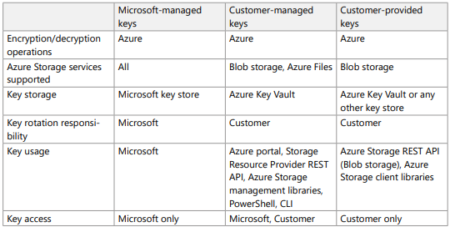
Azure Storage Services: Security
Setting RBAC roles for storage.
Implementing Private Endpoints, Service Endpoints, Private Link Service
Azure Firewalls and virtual networks
Storage encryption for data at rest
Azure Storage automatically encrypts your data when persisting it to the cloud.
All Azure Storage resources are encrypted, including blobs, disks, files, queues, and tables. All object metadata is also encrypted.
Encryption does not affect Azure Storage performance.
You can rely on Microsoft-managed keys for the encryption of your storage account, or you can manage encryption with your own keys.
If you choose to manage encryption with your own keys, you have two options:
You can specify a customer-managed key. It is used to encrypt all data in all services.
You can specify a customer-provided key on Blob storage operations. A client making a read or write request against Blob storage can include an encryption key on the request for granular control over how blob data is encrypted and decrypted.

Slide 13
Other Confluent/CFK Components
Azure Storage Ecosystem Architecture Deep Dive
Kafka Brokers
Zookeepers/Kfraft
Kafka Connect
Consumers
Producers
Connect Cluster
Control Center
Schema Registry
Connectors: Sources & Sinks
Confluent Hub
Cluster Linking

Slide 14
Demo
Installing Kafka Cluster
SendMessage/ReceiveMessage for Cloud Team Users

Slide 15
References
https://learn.microsoft.com/en-us/azure/storage/common/storage-account-overview

