Slide 1
Databricks Overview

Slide 2
Agenda
Azure Databricks
AKS & CFK Platform vs Databricks
Azure Databricks Components: Clusters, Workspaces, Data Storage Integrations, Notebooks, Database and tables
Databricks Ecosystem Architecture
Azure Databricks: Distributed System
Common Use Cases for Azure Databricks
Event-based analytical data processing with Azure Databricks
Azure Databricks Data Governance/Security
Q & A

Slide 3
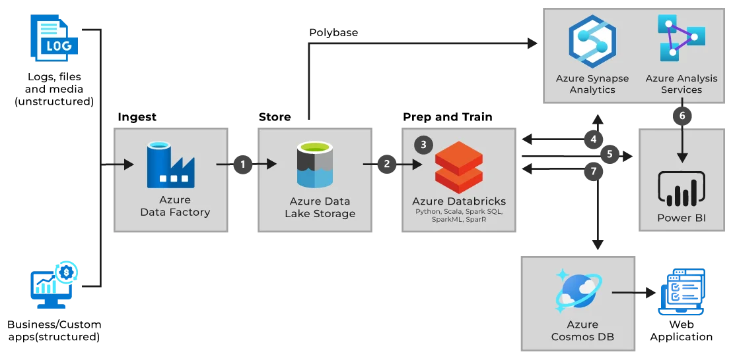
Azure Databricks
Azure Databrick Service
What is Azure Databricks?
Azure Databricks is a unified or centralized, open analytics platform for building, deploying, sharing, and maintaining enterprise-grade data, analytics, and AI solutions at scale.
Databricks Data Platform integrates with cloud storage and security in our cloud account and manages and deploys cloud infrastructure on your behalf.
Databricks for Large Volume of Data or Big Data Analytics.
Azure Databricks provides tools that help you connect your sources of data to one platform to process, store, share, analyze, model, and monetize datasets with solutions from BI to generative AI.
Databricks part of Large Volume of Data or Big Data Analytics
Notes:
Unity Catalog provides a unified data governance model for the data lakehouse.
Cloud administrators configure and integrate coarse access control permissions for Unity Catalog, and then Azure Databricks administrators can manage permissions for teams and individuals.

Slide 4
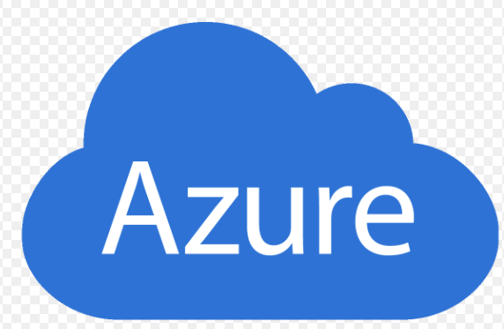
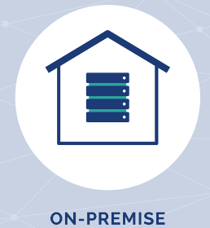
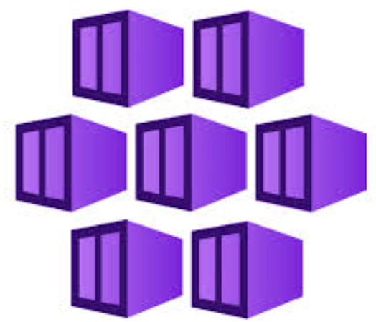
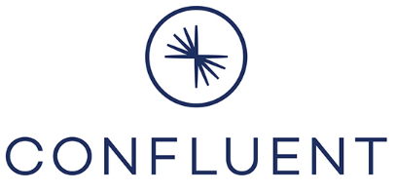

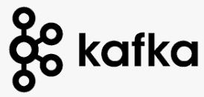
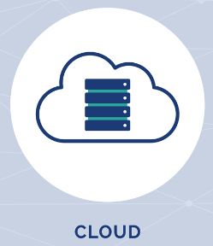

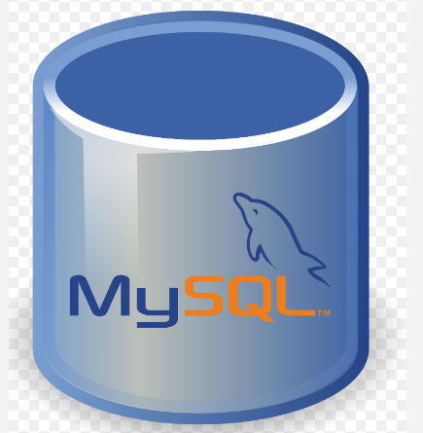
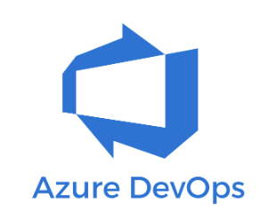

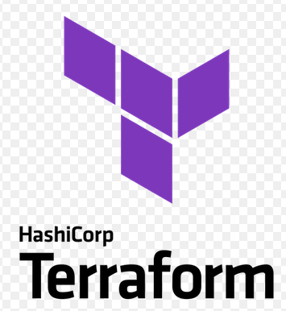

AKS & CFK Platform vs Databricks
Elasticsearch,
UI/Dashboard
MongoDB
ML/AI Modeling
Source Connectors
Sink Connectors
CFK Operators
Create Databricks
Create AKS
Create Confluent/Kafka
AKS
CFK
Helm
Databricks
Notes:
Stream your data from source into Kafka, and from there to target

Slide 5
Azure Databrick Core Components
Cluster: is made up of one or more worker nodes, along with a driver node:
Driver Node (master): Acts as the master node that oversees the entire workload.
Worker Nodes: The worker nodes are the nodes that execute the tasks assigned by the driver. They perform the actual computation and data processing by running Spark tasks in parallel.
Notebook: A notebook is an interactive document that combines code, markdown, and visualizations. Databricks notebooks are used by data engineers, data scientists, and analysts for interactive data exploration, model training, and collaboration. These notebooks support Python, SQL, Scala, and R.
Data Storage Integrations: Azure Databricks integrates seamlessly with different Azure storage options like Azure Data Lake Storage (ADLS), Azure Blob Storage, and SQL Data Warehouse. It ensures easy access to both structured and unstructured data stored in Azure.
Database and Tables: Database and tables in Azure Databricks refer to managed or unmanaged tables created using Apache Spark SQL. They are organized logically and can store both batch and streaming data, providing structured access for data analysis and processing.
Spark Connectors: Spark connectors enable Databricks to connect and access external data sources, such as SQL databases, NoSQL databases, or cloud storage systems. Azure Databricks uses these connectors to perform data integration tasks easily.
RDD (Resilient Distributed Dataset): represents an immutable collection of objects that can be divided across nodes of a cluster and processed in parallel.
Notes:
Human generated events vs Machine generated Events

Slide 6
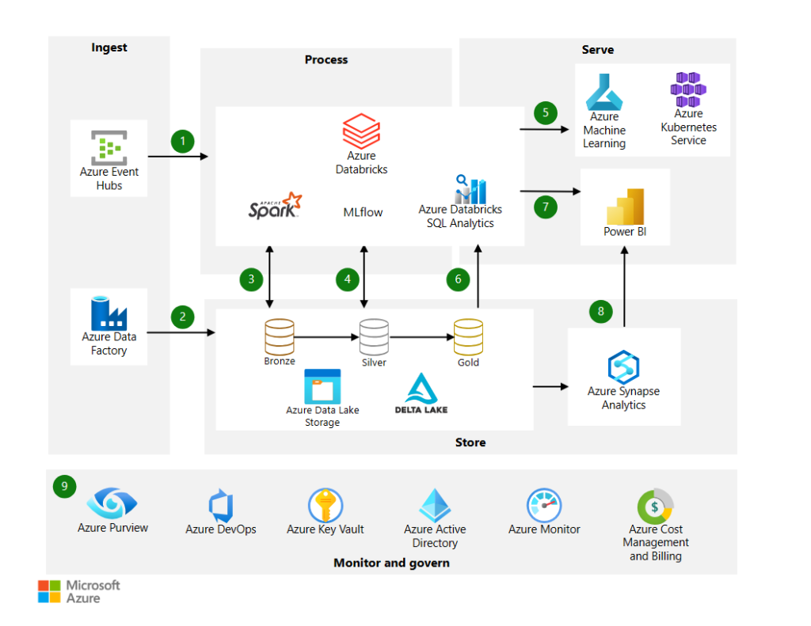
Analytics Architecture with Azure Databricks
Notes:
low latency, Cosmos DB is an excellent platform to achieve low-millisecond latencies with global geodistribution

Slide 7
Azure Databricks: Distributed System
Reliability: ensures no data loss by replication across storage systems or nodes.
Fault-tolerant: when one node uses RDDS(Resilient Distributed Datasets) to provide rollback and recompute functionality
Scalability: able to handle increasing workloads by horizontal scaling and autoscaling clusters based on demands.
High Availability: ensure that clusters are available with minimal or no downtime by redundant cluster nodes etc.
ADLS: Databricks supports only ADLS Gen2, Hierarchical namespace (HNS), support

Slide 8
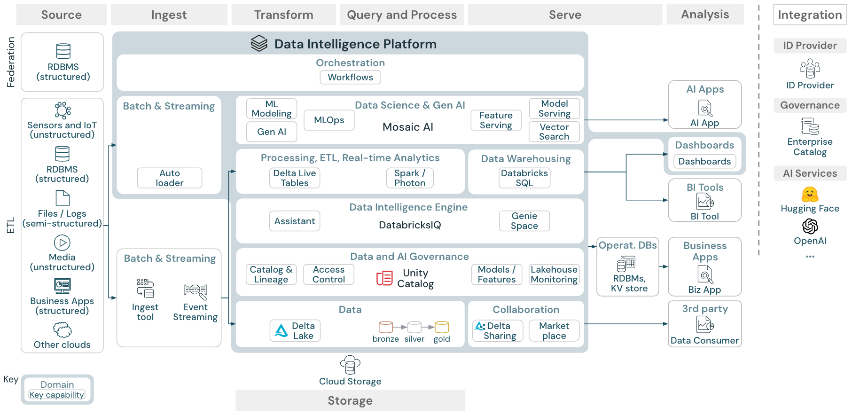
Common Use Cases for Azure Databricks
Build an enterprise data Lakehouse
ETL and data engineering
Machine learning, AI, and data science
Large language models and generative AI
Data warehousing, analytics, and BI
Data governance and secure data sharing
Real-time and streaming analytics
DevOps, CI/CD, and task orchestration

Slide 9
Azure Databricks Data Governance/Security
Unity Catalog Metastore
A metastore is the top-level container for data in Unity Catalog
Metastore registers metadata about securable objects (such as tables, volumes, external locations, and shares) and the permissions that govern access to them. Metastore has three-level Namespace to organize data: Catalog, Schema, and Table (View, Volume, Model, and Function).
Workspaces: Create a metastore and attach a Workspace.
How to Connect Azure Databricks to Object Storage or ADLS Gen2
Create a storage credentials for authentication and authorization to access data stored in ADLS Gen2
Create an external location in Unity Catalog
Create an Azure Managed Identity or Service Principal to access storage location
Create Access Connector and attach it to ADLS Gen2
Create Metastore in Azure Databricks, attach storage location, external location and assign Workspaces to the Metastore

Slide 10
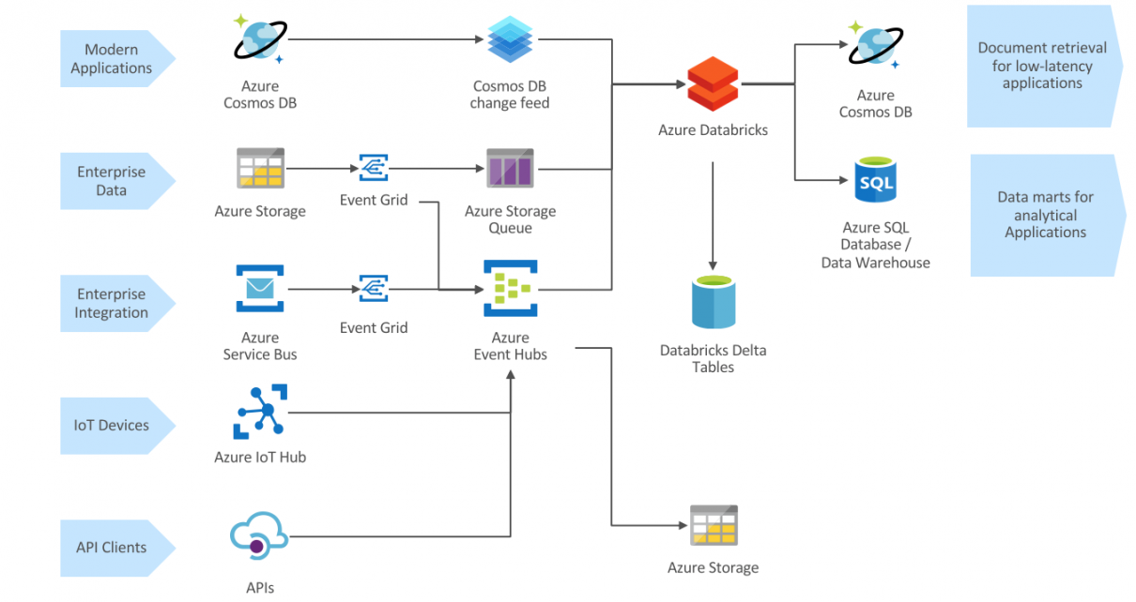
Event-based analytical data processing with Azure Databricks
Low latency
ADLS: Databricks supports only ADLS Gen2, Hierarchical namespace (HNS), support
Notes:
low latency, Cosmos DB is an excellent platform to achieve low-millisecond latencies with global geodistribution

Slide 11
References
https://learn.microsoft.com/en-us/azure/databricks/introduction/
https://learn.microsoft.com/en-us/azure/databricks/connect/unity-catalog/
https://learn.microsoft.com/en-us/azure/databricks/data-governance/unity-catalog/create-metastore

