Slide 1
Project Final: Exploring Assistive Technology for Older Adults
Presented by: Md. Ahsan Kabir (0122520016)
& Efat Jahan Ema (0122520030)
Date: 25th October 2025
United International University (UIU)
Course: Human-Computer Interaction (HCI)

Slide 2
Background and Motivation
Rapid increase in older adult population using digital technology.
Many face visual, motor, and cognitive barriers.
Current apps designed mainly for younger users.
Goal: Create inclusive and assistive mobile technology.

Slide 3
Research Objectives
Understand older adults’ interaction with mobile apps.
Identify usability and accessibility challenges.
Explore preferences for assistive features (voice, font size, contrast).
Propose design guidelines for inclusive technologies.

Slide 4
Research Questions
What primary challenges faced by older adults can be alleviated through mobile app technology?
How do older adults interact with current technologies, and what are their preferences?
What features most effectively increase usability of tech products for older adults?

Slide 5
Methodology Overview (1/2)
Mixed Methods Approach: Interviews, Contextual Enquiries, Surveys.
14 participants aged 50–74 from Dhaka, Meherpur and Chuadanga, Bangladesh (mainly relative and parents).
Data triangulated for comprehensive insights.

Slide 6
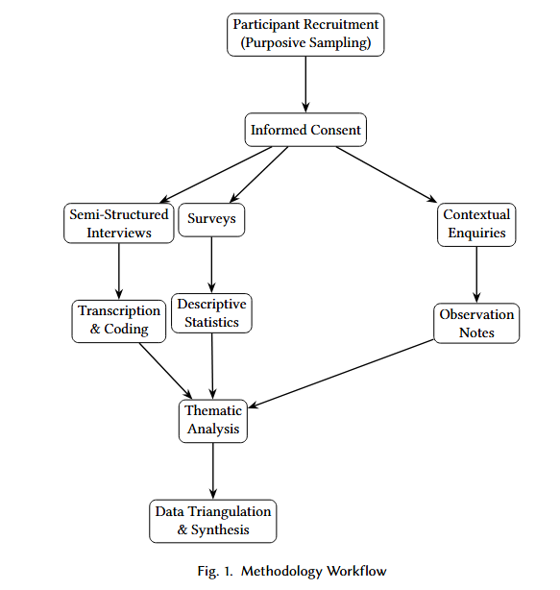
Methodology Overview (2/2)

Slide 7
Data Collection Methods (1/2)
Interviews (20-30 mins each): Usage experiences, frustrations, needs.
Contextual Enquiry (Observation): Real-life app use, gestures.
Survey (16 Qs): Demographics, confidence, device habits, feature preferences.

Slide 8
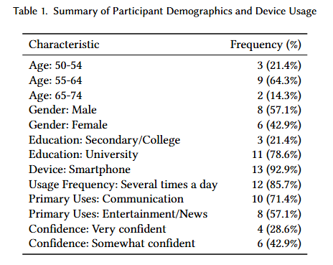
Data Collection Methods (2/2)

Slide 9
Key Findings
(Usability Challenges) (1/2)
Small icons and text cause frequent errors.
Unwanted advertisements/adult contents cause pain to use.
Shorts video not properly complete makes frustration.
Sensitive info sometimes goes to the story!
Users rely on relatives for troubleshooting.

Slide 10
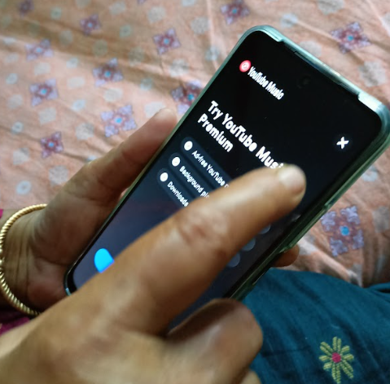
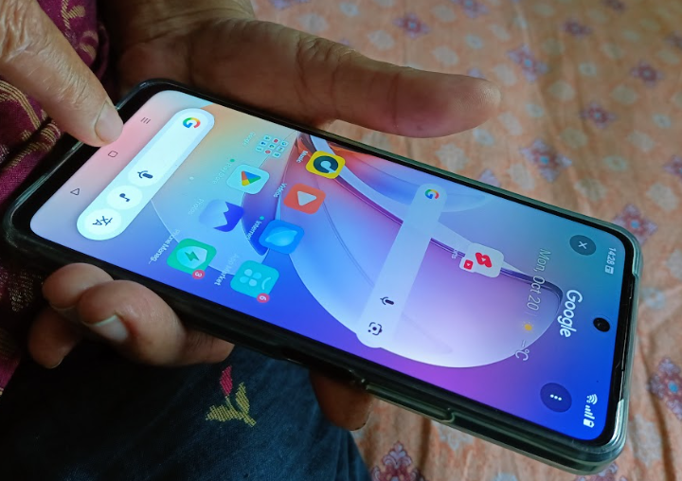
Key Findings
(Usability Challenges) (2/2)

Slide 11
Key Findings (Accessibility Preferences)
Preference for large fonts, Medium size text. For color, there is no preference.
Both Voice and Picture based applications are preferable.
Learning tool like how to send photo/file to other, suggest islamic content playlist etc. One user suggested if possible offline application as internet is still not cheap or available sometimes.
Simple layouts improve navigation to avoid confusion.

Slide 12
Design Implications
Prioritize clarity through minimal layouts and large, simple buttons/icons.
Enable easy customization of text size, contrast, and brightness.
Offer voice and gesture-based alternatives to typing.
Maintain consistency between app updates and provide offline capabilities where possible.
Avoid too much advertising.
Add a sensitive information check before upload, or give a proper alert to the user.
Provide the onboarding content for how to use this application.
Provide the common troubleshooting content or make a helpdesk.

Slide 13
Prototype Vision (Future Work)
Develop and test adaptive interface prototype.
Integrate findings into accessible design toolkit.
Conduct user testing and iteration.

Slide 14
Contributions and Reflection
Ahsan Kabir: Interview and Survey design, data collection, analysis and Contextual enquiry data collection, analysis.
Efat Jahan: Contextual enquiry design, data collection, and Survey data collection, Thematic analysis.
Both: Writing and presentation development.

Slide 15
Acknowledgment
Thanks to participants for their valuable input.
Guidance by course instructors and mentors.

Slide 16
Q&A
Thank you for your attention!
Questions and feedback welcome.

