Slide 1

Knowledge Sharing Presentation (CT2)
Agile Software Requirements Engineering
Challenges, Solutions & A Conceptual Framework
A systematic literature review examining requirements engineering practices, challenges, and solutions in agile software development from 2009-2023.
RESEARCH REVIEW
REQUIREMENTS ENGINEERING
Presented by: Abu Ekhtiar Tawhid (0122230018),
Md. Ahsan Kabir (0122520016)
& Abu Sadat Al Rafi (0122230017)
Date: 17th January 2026
United International University (UIU)
Course: CSE 6159 (M) Software Specification Analysis (SSA)

Slide 2
Title: Agile Software Requirements Engineering Challenges-Solutions—A Conceptual Framework from Systematic Literature Review
Author: Zoe Hoy and Mark Xu
Portsmouth Business School, University of Portsmouth, Portsmouth PO1 3DE, UK; zoe.hoy@port.ac.uk
* Correspondence: mark.xu@port.ac.uk
Publication: MDPI scientific journal, 6th June 2023
Keywords: requirements engineering; agile software development; software testing; project management

Slide 3

Research Overview
Research Period
2009-2023 systematic literature review
Database
Scopus primary source with multiple database validation
Papers Reviewed
78 valid papers from 38 journals
Focus Area
Agile requirements engineering challenges and solutions

Slide 4

RESEARCH QUESTIONS
Key Research Questions
Typologies of Challenges
1
What are the classifications of challenges faced with agile software development in general and specifically in requirements engineering?
Solution Effectiveness
2
How do the solutions address the challenges identified in agile requirements engineering practices?
These questions guide our investigation into the gap between identified challenges and available solutions in agile requirements engineering.

Slide 5
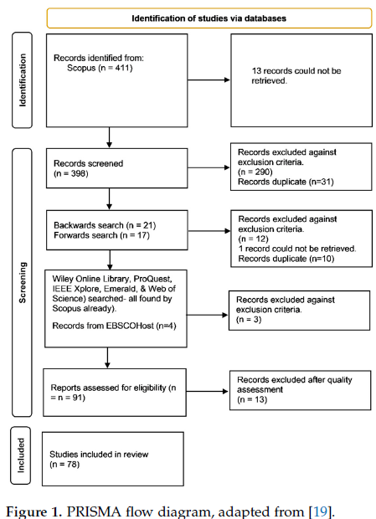
Methodology: Systematic Literature Review
Search Strategy
Selection Process
Webster and Watson's concept-centric approach was used to analyze challenges and solutions.
Rigorous filtering ensured quality and relevance of included studies.
Initial: 411 records identified
Screened: 398 records
Scopus primary database search
Assessed: 91 reports for eligibility
Final: 78 studies included
Extended to IEEE, Wiley, ProQuest, Emerald
Quality assessment using Dybå and Dingsøyr criteria
Backwards and forwards snowballing

Slide 6
11 Key Challenges Identified
01
02
Quality Requirements Neglected
Minimal Documentation
Focus remains on functional requirements while non-functional requirements are ignored in early sprints
Agile's less documentation-oriented approach leads to incomplete or non-existing records
03
04
Inappropriate Prioritization
Managing Change
Difficulty in objective measurement and maintaining priority lists with large requirement sets
Rapidly changing requirements cause instability and impact project cost and schedule
05
06
Poorly Written Requirements
Inaccurate Effort Estimation
Requirements are often ambiguous, incomplete, inconsistent, and unfeasible
Estimates change substantially due to requirement changes and lack of historical data

Slide 7
Additional Critical Challenges
1
2
3
Customer Unavailability
Customer Knowledge Gaps
Inappropriate Architecture
Low customer involvement and interactions with development teams, particularly in offshore development scenarios
Customers lacking knowledge about agile approaches or insufficient domain expertise
Early architecture decisions become redundant when new requirements arise
4
5
Communication Methods
Maintaining Specifications
Difficulty communicating efficiently with stakeholders using appropriate tools
Overloaded teams struggle to maintain software requirements specifications

Slide 8
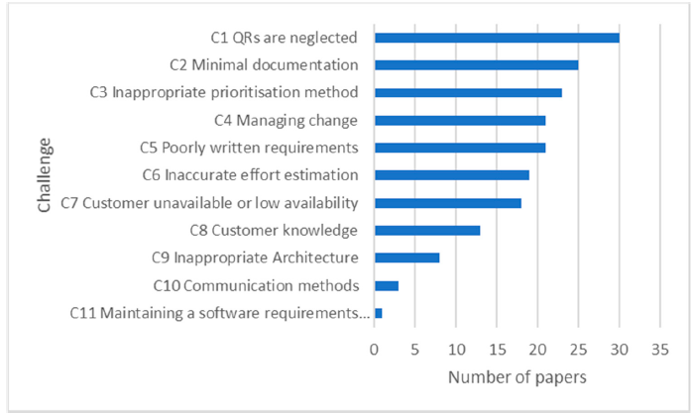
Challenge Prevalence Analysis
The most prevalent challenges show that quality requirements and documentation issues dominate agile requirements engineering concerns, appearing in 30 and 25 papers respectively.

Slide 9






Nine Solution Categories
Provide Requirement Information
Manage Quality Requirements
Test cases, user stories, acceptance criteria, and domain expert involvement
Separate QR backlogs, specialist teams, and lightweight tools like NORMATIC
Share Knowledge
Manage Product Backlog
Face-to-face interactions, communications hubs, and surrogate customers
Multiple backlogs covering different viewpoints and continuous reprioritization
Improve Estimation
Maintain Traceability
Elicit rationales, regular estimation time, and data-driven techniques
Models to trace requirements and tools like JIRA for management

Slide 10
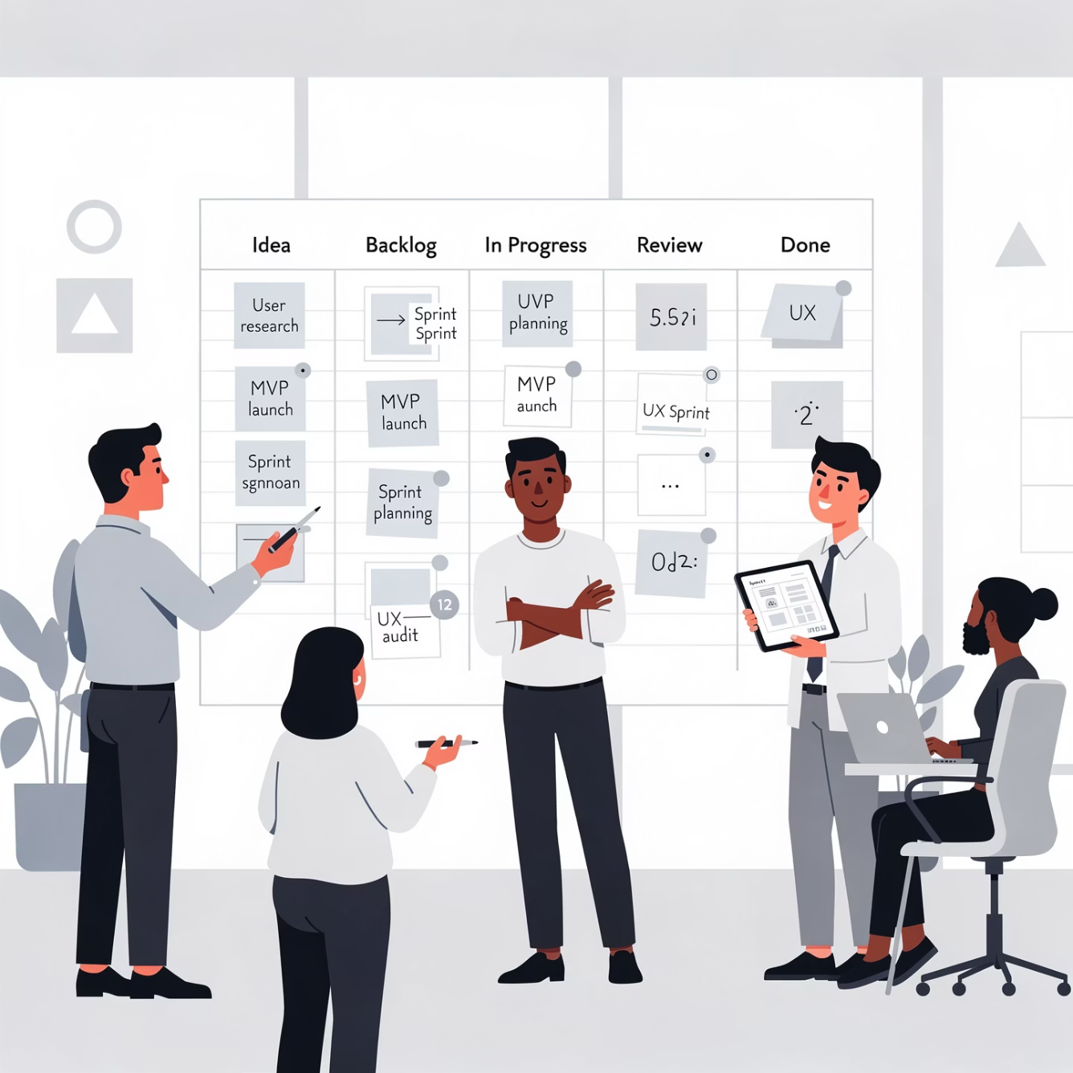
Additional Solution Strategies
Minimal Documentation
Product Vision
Consolidated software requirements specifications instead of various artifacts. Document architectural features and rationale.
Maintain common product vision between customers and development teams to reduce change requests.
Requirements Prioritization
Consider stakeholder satisfaction, implementation risk, and available resources in prioritization decisions.

Slide 11
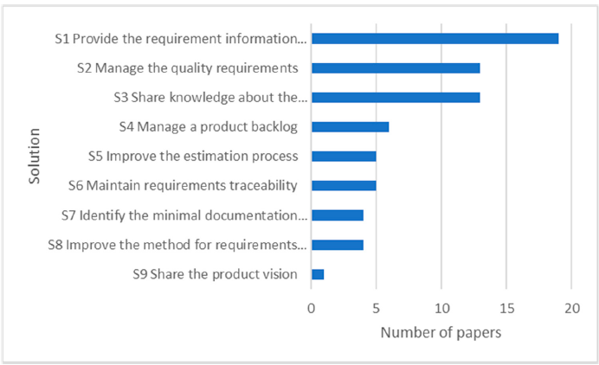
Solution Prevalence Analysis

Slide 12
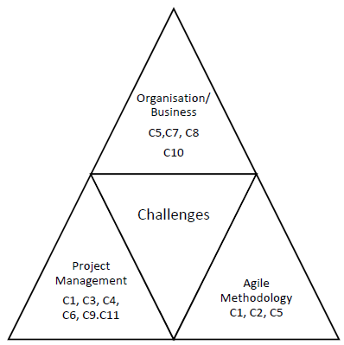

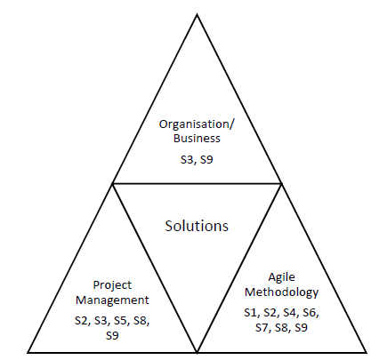


Three-Dimensional Framework
Challenges and solutions are classified into three interconnected dimensions that reveal the root causes and appropriate intervention strategies.
Organizational/Business Context
Large organizational settings, dynamic business changes, motivation, communication, and coordination challenges
Project Management
Execution, scheduling, cost estimation, team development, and quality management processes
Agile Methodology
Documentation practices, requirement specification techniques, and agile-specific processes

Slide 13

Challenge-Solution Mapping
Key Finding
7
5
Analysis reveals a significant mismatch between where challenges originate and where solutions are focused.
Agile Methodology Solutions
Project Management Solutions
Most challenges are rooted in organizational and project management dimensions, yet the majority of solutions target agile methodology improvements.
Largest portion of solutions
Moderate coverage
Critical Gap: Organizational and business context challenges receive insufficient attention in solution development despite being major sources of problems.
2
Organizational Solutions
Minimal attention

Slide 14
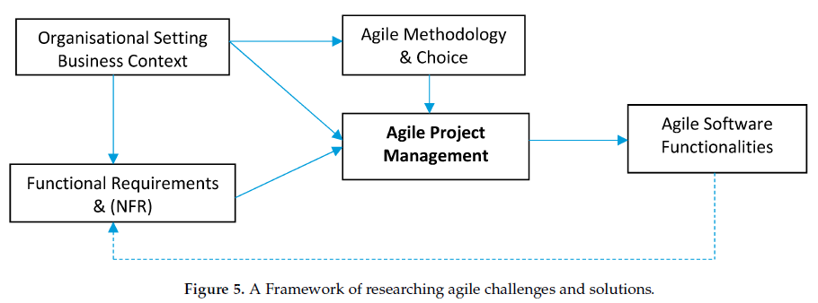
Conceptual Framework for Agile Success
The framework illustrates that agile software functionality depends on four interconnected factors: organizational context, requirements engineering, agile methodology choice, and project management orchestration. Success requires coordinated attention to all dimensions.

Slide 15
Key Insights & Implications
Research Saturation
1
Overwhelming focus on identifying challenges with disproportionately little exploration of solutions. Recent studies find no new challenges, suggesting saturation.
2
Solution Mismatch
Most solutions target agile methodology improvements while neglecting organizational and business context challenges that are root causes.
Orchestrated Approach Needed
3
Improving agile methods alone cannot solve all problems. Success requires coordinated consideration of organizational setting and project management.
4
Context Matters
Organizational complexity and business dynamics must be assessed for agile suitability before adoption. Fit between context and methodology is critical.

Slide 16
Practical Recommendations
1. Agile Eligibility Evaluation
Assess organizational preconditions including multiple objectives, dispersed teams, decision-making structures, and customer resource availability before adopting agile approaches.
2. Vision Articulation
Leadership must clearly communicate vision and goals to all stakeholders, ensuring consistency in understanding requirements and managing dynamic changes.
3. Competent Project Teams
Establish teams with adequate resources, control power, and engaged customers who have sufficient knowledge, time, and positive attitudes.
4. NFR Specification Strategy
Initiate non-functional requirements in demonstrable fashion early, engaging users for verification and improvements throughout development.
5. Methodology Improvements
Continue advancing agile practices in documentation, traceability, testing, prioritization, and handling implicit requirements and constant changes.

Slide 17

Conclusions & Future Directions
Key Contributions
Future Research Avenues
Three-dimensional classification of challenges and solutions
Shift focus from studying challenges to examining influential elements and their relationships. Investigate effectiveness and efficiency of agile practices in different contexts.
Identification of challenge-solution mismatch
Conceptual framework for orchestrated approach
Shift from challenge identification to relationship exploration
"Agile requirement engineering challenges are not all rooted in methodology deficiencies. Success requires supporting organizational settings coupled with appropriate project management."
Study Limitations
Limited scope to requirements engineering
Subjective classification analysis
Framework requires empirical validation

Slide 18
THANK YOU
References
https://pure.port.ac.uk/ws/portalfiles/portal/75915474/Agile_Software_Requirements_Engineering_Challenges_Solutions.pdf
Any Questions?

