Slide 1
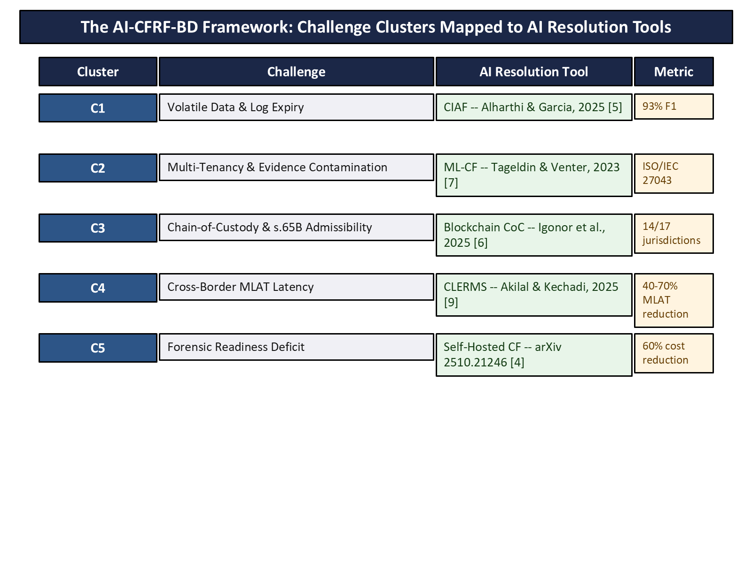
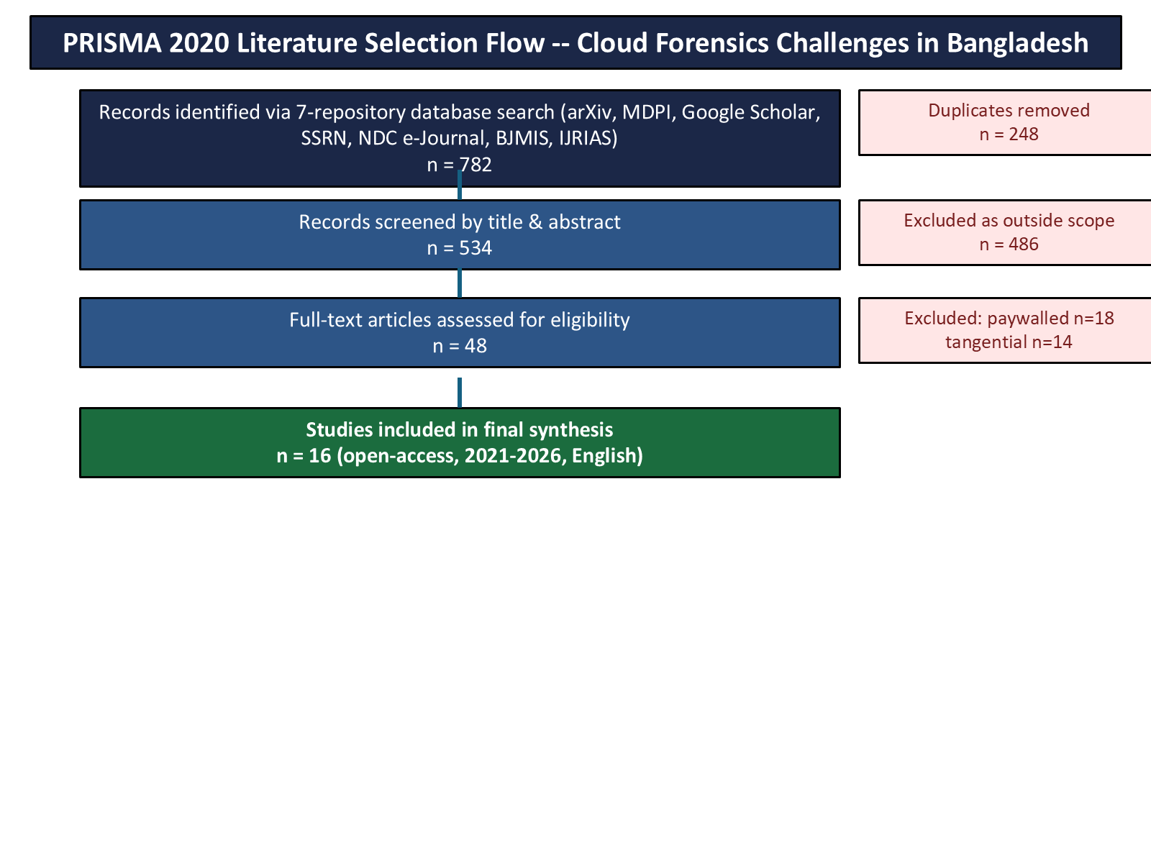
Cloud Forensics Challenges in Bangladesh: A PRISMA Systematic Review with AI-Enhanced Resolution Strategies
Md. Ahsan Kabir | Dept. of CSE, United International University, Dhaka | mkabir2520016@mscse.uiu.ac.bd
LATEST REGULATORY UPDATE (2026)
The Cyber Security Ordinance 2025 REPEALED the Cyber Security Act 2023 outright -- the same cloud-evidence gap persists under the new law. NEW: the Personal Data Protection (Amendment) Ordinance 2026 (signed 5 Feb 2026) now requires a real-time in-country cloud copy for "restricted" data or Critical Information Infrastructure (CII) -- an incidental opening for future forensic-audit-access legislation that this review's framework is positioned to use.
1. Introduction & Motivation
5. Results: AI-CFRF-BD Framework
Bangladesh: 100M+ internet-enabled devices; USD 1.2B+ public-sector cloud procurement since 2020. Investigative laws (ICT Act 2006, Cyber Security Ordinance 2025) were drafted for physical devices and are silent on cloud-hosted evidence. Result: a disproportionately high acquittal rate on cloud-evidence cases -- driven by chain-of-custody failures and Section 65B admissibility gaps, not disputed facts.
Five challenge clusters (C1-C5), each mapped to a validated AI/automation tool with quantitative evidence.
2. Research Gap & Questions
No prior PRISMA-based study maps cloud forensics challenges to Bangladesh's legal context.
RQ1: Technical cloud-forensics challenges in Bangladesh?
RQ2: Legal barriers to cloud-evidence admissibility?
RQ3: How can AI tools address RQ1/RQ2?
RQ4: What implementable framework improves Bangladesh's readiness?
3. Methodology (PRISMA 2020)
782 records identified -> 534 screened -> 48 full-text reviewed -> 16 studies included (2021-2026, open-access). 7 repositories, 6 query strings, single-reviewer thematic coding.
Phase 1 (no legislative change): CIAF log hash-stamping (C1, 93% F1); ML-CF artefact isolation (C2); Self-Hosted CF pre-incident capture (C5).
Phase 2 (Ministry of Law practice note): Blockchain chain-of-custody (C3, compatible in 14/17 jurisdictions).
Phase 3 (inter-ministerial): CLERMS MLAT pre-validation (C4, 40-70% latency reduction).
6. Limitations & Future Work
Single-reviewer coding; English/open-access sources only. Framework is synthesis-level -- not yet piloted on Bangladeshi data. Next steps: NTMC pilot of a Phase-1 tool; a narrow forensic-audit-access amendment leveraging the new CII residency rule; practitioner consultation with CID Digital Forensics & BGD e-GOV CIRT.
References (selected)
[1] Alshabibi et al. 2024 · [8] Karagiannis & Vergidis 2021 · [11] Uzzal 2025 · [15] Sharmin & Rahman 2025 · [20] Cyber Security Ordinance 2025 · [21] PDPO (Amendment) Ordinance 2026
Full 22-reference list in the accompanying paper.
4. Discussion & Contribution
First Bangladesh-specific PRISMA synthesis linking cloud forensics gaps to validated AI tools. Reframes the problem: the tools already exist -- the real gap is legal recognition and adoption, not missing technology. "Power of Disposal" (Karagiannis & Vergidis, 2021): only the cloud provider, not the Bangladeshi state, can currently grant access to cloud-hosted data.
CSE 6093 - Research Methodologies and Technical Writing | Final Presentation | United International University

