Slide 1


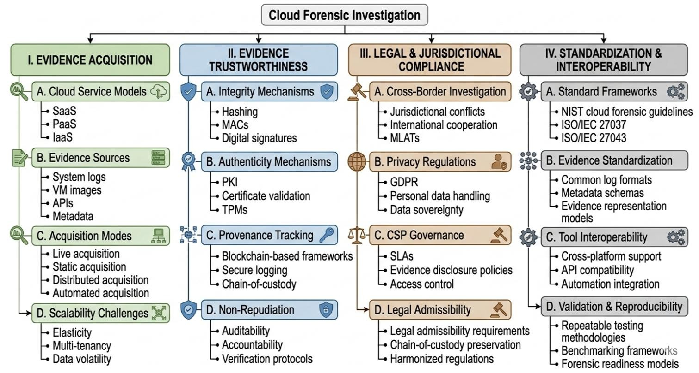





RMTW · FINAL PRESENTATION POSTER
Modern Cloud Forensics
A PRISMA-Guided Systematic Survey of Evidence Acquisition, Integrity, Jurisdictional Challenges, and Standardization Issues
MD. Ahsan Kabir (ID 0122520016) | Dept. of CSE, United International University | CSE 6093 RMTW
Four-Dimensional Taxonomy of Cloud Forensic Approaches
PRISMA-guided review: Identification → Screening → Eligibility → Inclusion, applied across four dimensions above.
Findings by Research Question
Research Gaps
RQ1
Limited real-world validation — most studies stop at simulation
Finding: IaaS dominates forensic acquisition research
Challenge: Limited SaaS/PaaS visibility
SaaS/PaaS forensics remain underexplored versus IaaS
Solution: Security Lake, automated acquisition
RQ2
Finding: Blockchain improves evidence integrity
No international consensus on forensic standards
Challenge: Provenance scalability and trust
Solution: Consortium ledgers, immutable logging
AI's "black box" nature limits legal admissibility
RQ3
Finding: GDPR and MLAT processes delay investigations
Challenge: Cross-border admissibility
Conflicting cyber laws slow international cooperation
Solution: Legal readiness frameworks
RQ4
Containers, serverless, and edge computing are underexplored
Finding: Poor interoperability across CSPs
Challenge: Log inconsistency and schema mismatch
Solution: OCSF, standardized APIs
Key Contributions
Future Directions
1
PRISMA-guided, transparent and reproducible survey
Explainable AI for court-admissible forensics
2
Four-dimensional taxonomy of cloud forensic approaches
Lightweight blockchain provenance ledgers
Vendor-neutral, standardized multi-cloud frameworks
3
Comparative analysis across methodology & contribution
Forensic readiness built into cloud services by design
4
Clear map of current limitations across the field
Real-time evidencing for containers & serverless
Privacy-preserving evidence collection
Conclusion
Cloud forensics is shifting from traditional to intelligent approaches — but real progress depends on CSP cooperation, explainable AI, blockchain-based evidence handling, standardized formats, and privacy-preserving collection working together.
Selected References
[15] Manral et al. 2019 — A Systematic Survey on Cloud Forensics. ACM Computing Surveys.
[28] Herman et al. 2020 — NISTIR 8006: NIST Cloud Computing Forensic Science Challenges.
[37] Herman et al. 2024 — NIST SP 800-201: Cloud Computing Forensic Reference Architecture.
[39] Dhital et al. 2026 — Forensic Blind Spots in Ephemeral Cloud VMs. APIT 2026.
[42] Ekwempu 2026 — Legal Complexities of Cloud Forensic Investigations Cross-Border. IJRIAS.
[46] Mukti & Hanif 2025 — AI in Cloud Forensics: Automating Evidence Acquisition. Forensics & Security J.
[47] Vucha & Kamarapu 2025 — AI-Driven Cloud Forensics: A Novel Framework. IRJET.
[48] Chourasiya et al. 2025 — Advanced System Log Analyzer Using LSTM and Transformer. J. Cloud Computing.
Full list of all 48 references in the complete survey paper. · mkabir2520016@mscse.uiu.ac.bd

