Slide 1
Docker
Introduction

Slide 2
Docker
Docker is a set of platform as a service products that use OS-level virtualization to deliver software in packages called containers. The service has both free and premium tiers. The software that hosts the containers is called Docker Engine.
Docker can package an application and its dependencies in a virtual container that can run on any Linux, Windows, or macOS computer. This enables the application to run in a variety of locations, such as on-premises, in public (see decentralized computing, distributed computing, and cloud computing) or private cloud.^{[10]} When running on Linux,
Docker uses the resource isolation features of the Linux kernel (such as cgroups and kernel namespaces) and a union-capable file system (such as OverlayFS)^{[11]} to allow containers to run within a single Linux instance, avoiding the overhead of starting and maintaining virtual machines.^{[12]} Docker on macOS uses a Linux virtual machine to run the containers.

Slide 3
What is a Container
Simply put, a container is a sandboxed process on your machine that is isolated from all other processes on the host machine. That isolation leverages kernel namespaces and cgroups, features that have been in Linux for a long time. Docker has worked to make these capabilities approachable and easy to use. To summarize, a container:
is a runnable instance of an image. You can create, start, stop, move, or delete a container using the DockerAPI or CLI.
can be run on local machines, virtual machines or deployed to the cloud.
is portable (can be run on any OS).
is isolated from other containers and runs its own software, binaries, and configurations.

Slide 4
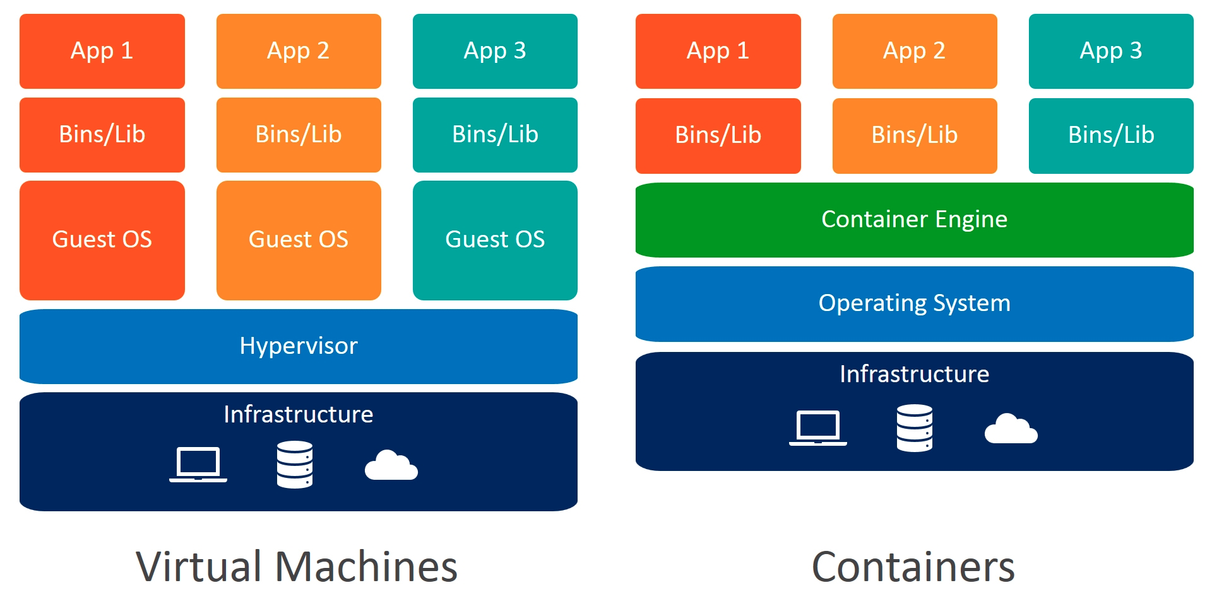
Container vs VMs

Slide 5
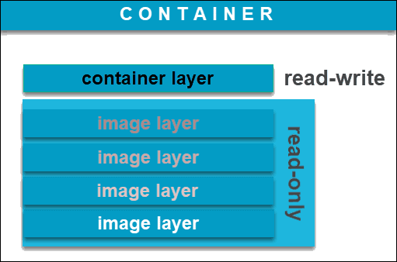
Docker Image
Images can exist without containers, whereas a container needs to run an image to exist. Therefore, containers are dependent on images and use them to construct a run-time environment and run an application. A container is a running Image
A Docker image is an immutable (unchangeable) file that contains the source code, libraries, dependencies, tools, and other files needed for an application to run.
You can create an unlimited number of Docker images from one image base. Each time you change the initial state of an image and save the existing state, you create a new template with an additional layer on top of it.

Slide 6
Dockerfile
A Dockerfile is a script that contains instructions for building a customized docker image. Each instruction in a Dockerfile creates a new layer in the image, and the final image is composed of all the layers stacked on top of each other.
It includes instructions for installing dependencies, copying files, setting environment variables, and configuring the container.
Dockerfile uses a simple, easy-to-read syntax that can be created and edited with any text editor. Once a Dockerfile has been created, it can be used to build an image using the docker build command.

Slide 7
Install Docker on Ubuntu
sudo apt-get update
sudo apt-get install ca-certificates curl gnupg lsb-release
sudo mkdir -p /etc/apt/keyrings
curl -fsSL https://download.docker.com/linux/ubuntu/gpg | sudo gpg --dearmor -o /etc/apt/keyrings/docker.gpg
echo \ "deb [arch=$(dpkg --print-architecture) signed-by=/etc/apt/keyrings/docker.gpg] https://download.docker.com/linux/ubuntu $(lsb_release -cs) stable" | sudo tee /etc/apt/sources.list.d/docker.list > /dev/null
sudo apt-get update
sudo chmod a+r /etc/apt/keyrings/docker.gpg
sudo apt-get update

Slide 8
Install Docker on Ubuntu
sudo apt-get install docker-ce docker-ce-cli containerd.io docker-buildx-plugin docker-compose-plugin
sudo docker run hello-world

Slide 9
Docker Commands
Docker build
Docker run
Docker ps
Docker create
Docker kill
Docker push
Docker pull
Docker rm

Slide 10
Docker Pull
Most of your images will be created on top of a base image from the Docker Hub registry.
Docker Hub contains many pre-built images that you can pull and try without needing to define and configure your own.
To download a particular image, or set of images (i.e., a repository), use docker pull.
$ sudo docker pull hello-world

Slide 11
Docker Build
Command | Explanation
docker build | Builds an image from a Dockerfile in the current directory
docker build https://github.com/docker/ rootfs.git#container:docker | Builds an image from a remote GIT repository
docker build -t imagename/tag | Builds and tags an image for easier tracking
docker build https://yourserver/file.tar.gz | Builds an image from a remote tar archive
docker build -t image:1.0 -<<EOFFROM busyboxRUN echo “hello world”EOF | Builds an image via a Dockerfile that is passed through STDIN

Slide 12
Docker run
The docker run command runs a command in a new container, pulling the image if needed and starting the container.
You can restart a stopped container with all its previous changes intact using docker start. Use docker ps -a to view a list of all containers, including those that are stopped.
$ docker run --name test -it debian
$ docker run --name hello hello-world
-i option keeps the STDIN interactive and -t option open a pseudo terminal for the container.

Slide 13
Docker ps
The 'docker ps' is a Docker command to list the running containers by default; however, we can use different flags to get the list of others.
$ docker ps
--all , -a |  | Show all containers (default shows just running)
--filter , -f |  | Filter output based on conditions provided
--format |  | Format output using a custom template: ‘table’: Print output in table format with column headers (default) ‘table TEMPLATE’: Print output in table format using the given Go template ‘json’: Print in JSON format ‘TEMPLATE’: Print output using the given Go template. Refer to https://docs.docker.com/go/formatting/ for more information about formatting output with templates
--last , -n | -1 | Show n last created containers (includes all states)
--latest , -l |  | Show the latest created container (includes all states)
--no-trunc |  | Don’t truncate output
--quiet , -q |  | Only display container IDs
--size , -s |  | Display total file sizes

Slide 14
Run an Existing Container Image
Docker run command is used to run a container
docker run --name mynginx1 -p 80:80 -d nginx
The above command starts an nginx container which can be verified using
docker ps
Docker ps command lists the running containers on the docker engine

Slide 15
Docker Hub
Docker Hub is a hosted repository service provided by Docker for finding and sharing container images with your team. Key features include:
Private Repositories: Push and pull container images
Automated Builds: Automatically build container images from GitHub and Bitbucket and push them to Docker Hub
Teams & Organizations: Manage access to private repositories
Official Images: Pull and use high-quality container images provided by Docker
Publisher Images: Pull and use high-quality container images provided by external vendors. Certified images also include support and guarantee compatibility with Docker Enterprise
Webhooks: Trigger actions after a successful push to a repository to integrate Docker Hub with other services

Slide 16
Create a Docker Image from App
Class Hello
{
public static void main(String[] args)
{
System.out.println("Hello World");
}
}
Step 1. Mkdir java-app
Step 2: Create a .java file
Step 3: Create a .java file save it as Hello.java
Step 4: Create a dockerfile
$touch dockerfile
Step 4: build the dockerfile inside java-app folder
sudo docker build -t java-app .
Step 4: run the docker image
sudo docker run java-app
FROM openjdk:17
COPY . /tmp
WORKDIR /tmp
RUN javac Hello.java
CMD ["java", "Hello"]

Slide 17
Upload Your Custom Image to the Hub
Upload the image created in the previous slide and add it to docker hub. Create another instance and pull and run the image in the new instance.

Slide 18
Assignments
Pull and run the hello-world image
Pull and run the nginx image, check if the webpage is actively hosted.
Pull and run mysql container from hub. Can you log into the tty provided using -it option.
Pull the nginx image from docker hub, rename the image to mynginx and upload it to docker hub.

Slide 19
Containerize an Application
https://docs.docker.com/get-started/02_our_app/

Slide 20
Assignment
Create a Ec2 instance and then install docker in it. Run the getting started app and create a container out of. Upload your container image to docker hub. Can you run the container created by you in any other system that runs docker engine.

