Slide 1

AUTOMATED GENERATION OF ABSA MODELS FOR MEDICAL DEVICES USING SYNTHETIC DATA
Lecturer: Dr. Aparcin Alexander
Students: Shoham Rachel Amira & Adi Malka

Slide 2
What is Aspect Based Sentiment Analysis?
Aspect Based Sentiment Analysis identifies the sentiment expressed toward specific aspects of a product, instead of predicting only the overall review sentiment.
What we did:
We used an ABSA-inspired multi-output approach: the model receives one review and predicts a score for every extracted aspect.
Review → Aspect Score Vector
Score meaning:
positive mention = 1
negative mention = -1
aspect not mentioned = 0

Slide 3
Motivation & Project Definition
motivation
Medical device reviews contain valuable information, but building labeled datasets for sentiment analysis requires a lot of manual work. In addition, each medical device has different characteristics, making it difficult to reuse existing datasets and models.
Goal
The goal of this project is to develop a generic pipeline that automatically extracts product specific aspects from a medical device PDF, generates labeled synthetic reviews, validates data quality, and trains a sentiment prediction model.

Slide 4
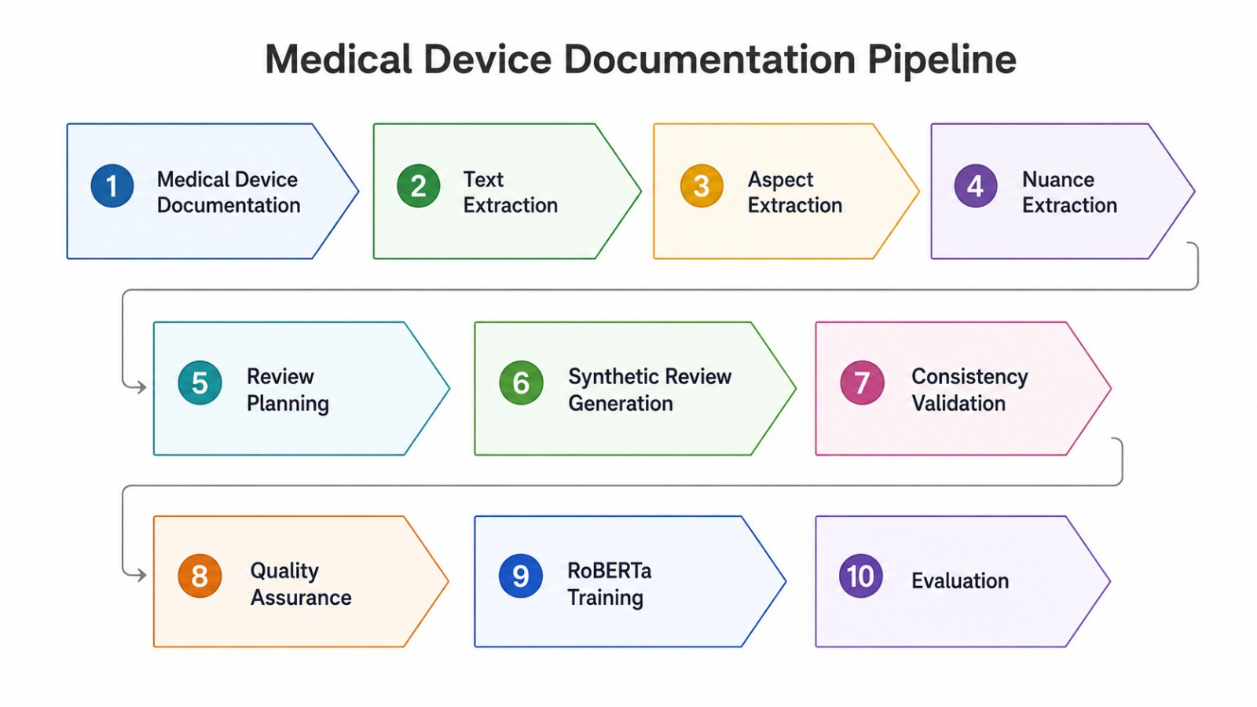
Project Overview

Slide 5
PDF Processing
Input
Medical Device Documentation
Processing Steps
Text Extraction, Text Cleaning, Text Chunking (splitting large documents into smaller sections for LLM processing)
Output
Structured text chunks ready for LLM processing

Slide 6
Automatic Aspect Extraction
An aspect is a product feature that users can express an opinion about.
Extracted automatically from each medical device documentation using an LLM.
The prompt requires for 5-8 document-grounded, product-specific, non-overlapping aspects.
Each product receives its own aspect list, based on its documentation.
The extracted aspects are saved as a JSON schema with an aspect_name and a short description.
This JSON schema is later used for synthetic review generation and model training.

Slide 7
Example Of Aspects
Uroject12
Medtronic 53401
Ease of Use
Durability & Build Quality
Cleaning & Maintenance
Compatibility with Syringes
Storage & Handling
Performance in Fluid Delivery
Battery Life
Pacing Modes
Device Portability
Output Adjustability
Sensitivity & Detection
Safety Features
Rate Range

Slide 8
Nuance Attribute Extraction
A nuance is a background factor that shapes how a synthetic review is written.
Motivation: make generated reviews more diverse, natural, and realistic.
A prompt is sent to the LLM to extract 6 nuance dimensions from the medical device documentation, with 3-6 possible values per dimension.
Extracted nuances are saved as JSON: dimension_name, description, possible_values.
Used later during review generation to guide the review’s context, tone, and level of detail.

Slide 9
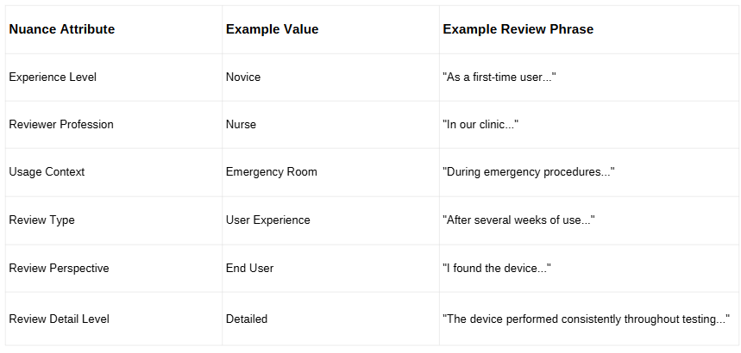
Example Of Nuance Attribute

Slide 10
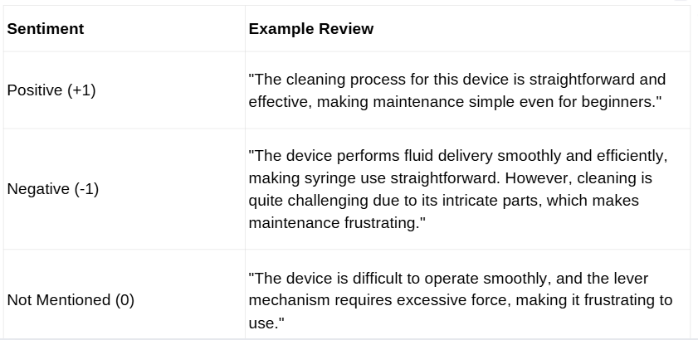
Review Generation Controls
Example Aspect: cleaning and maintenance

Slide 11
Model Architecture RoBERTa
\
Why RoBERTa-base?
Training Process
Fine-Tuning Strategy
Start from the validated synthetic review dataset
Split into Train / Validation / Test
Fine-tune RoBERTa
Input: review text
Output: continuous aspect-score
vector
Task: multi-output regression
Evaluate model performance
Pretrained transformer model for NLP tasks
Strong performance in sentiment analysis
Fine tuned on the generated medical review dataset
Loss Function: Mean Squared Error (MSE)
Learning Rate: 1e-5
Batch Size: 8
Epochs: 3
Weight Decay: 0.05
Maximum Sequence Length: 256
Hidden Dropout: 0.2
Attention Dropout: 0.2
Classifier Dropout: 0.2
Dynamic Padding (DataCollatorWithPadding)
Early Stopping (Patience = 1)
Best Model Selection using Validation Loss

Slide 12
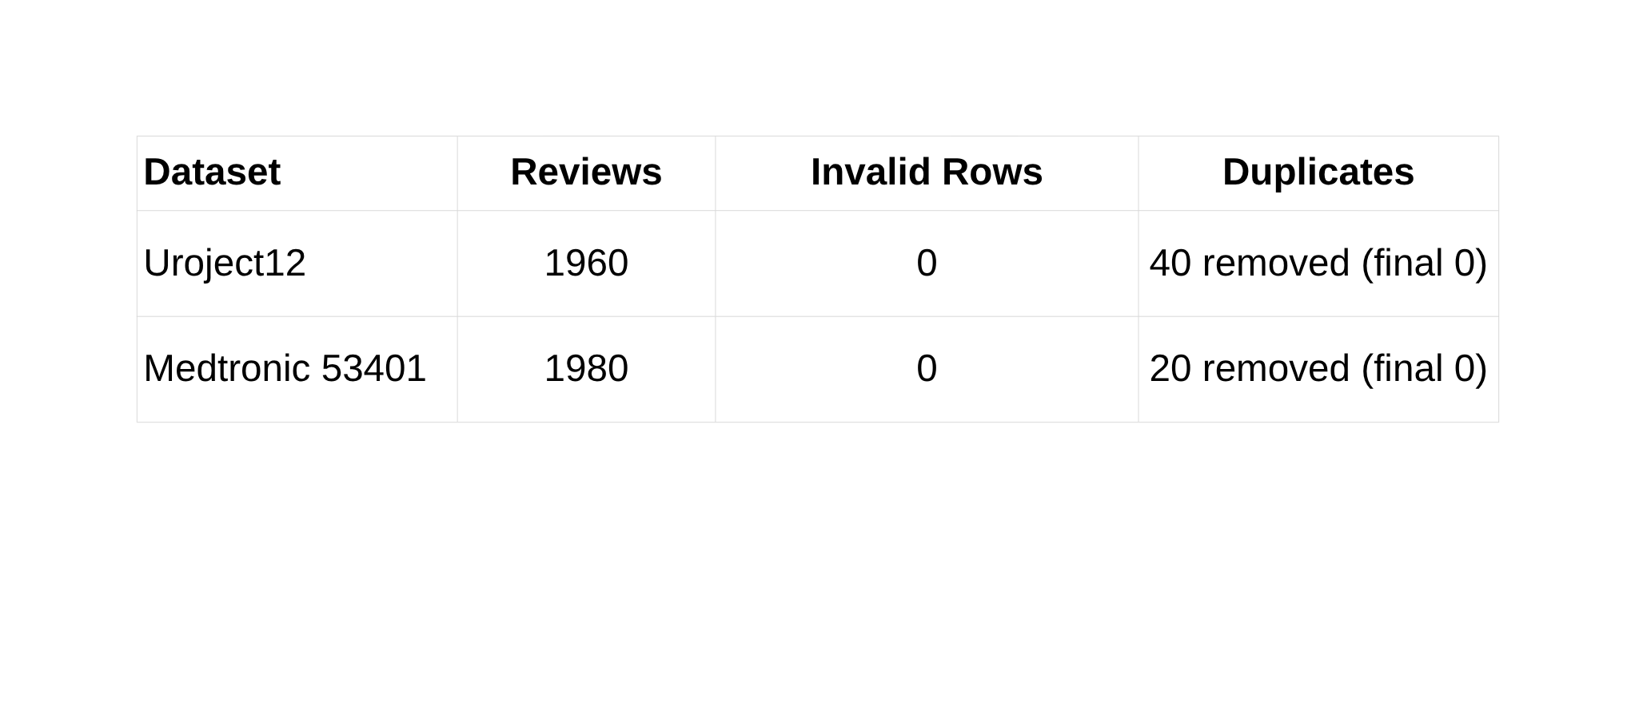
Validation
JSON validation: used Python json library to parse each JSONL row and check required fields
Duplicate detection: used Python Counter to detect repeated review texts and remove duplicates
Label consistency checks: custom Python rules: validated -1 / 0 / 1 scores and selected/unselected aspects

Slide 13
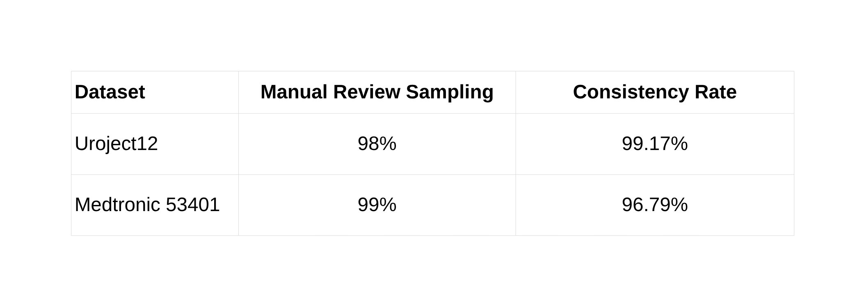
Validation
Aspect Distribution Analysis: used Python Counter to count aspect frequency and sentiment distribution.
Manual Review Sampling: used pandas to export a random sample of 100 reviews to CSV for human inspection.
LLM Consistency Audit: used an LLM verifier through the OpenAI API to check whether review text matches the assigned aspect labels.

Slide 14
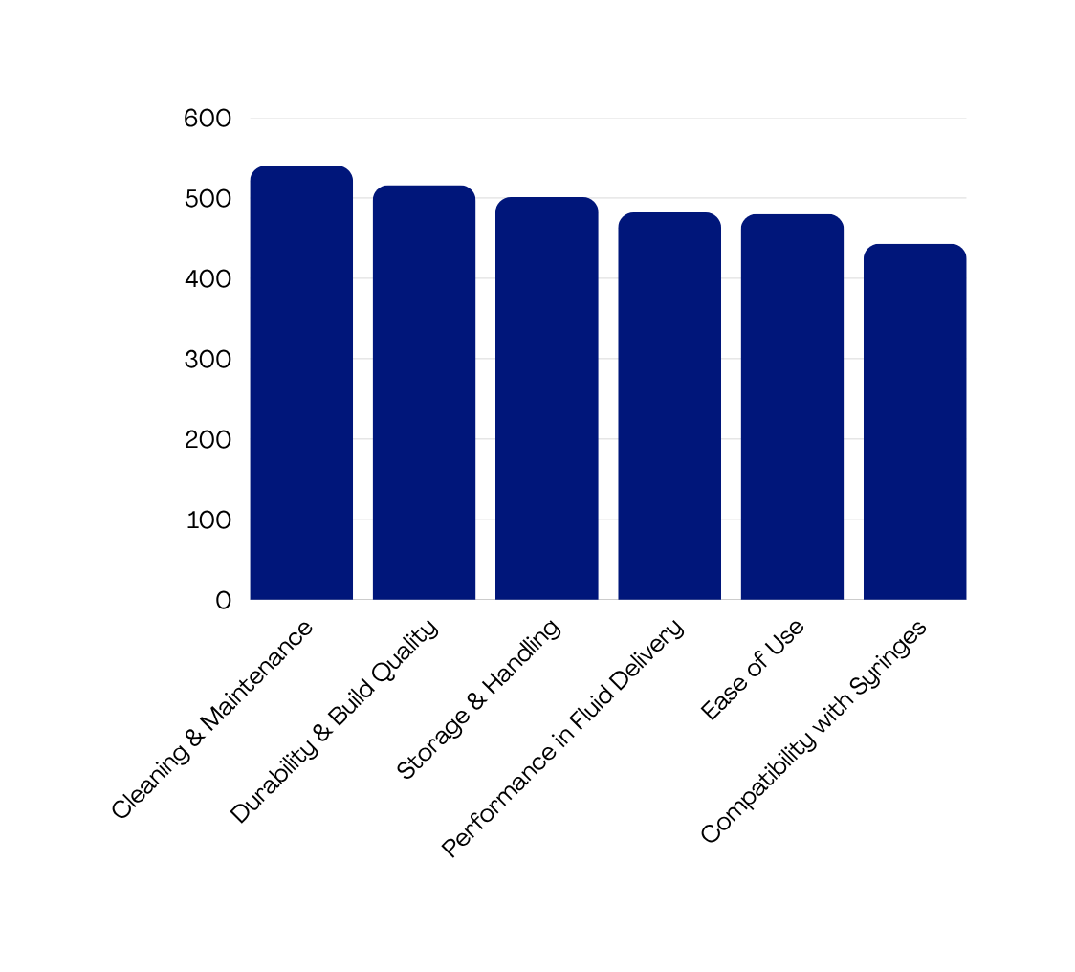
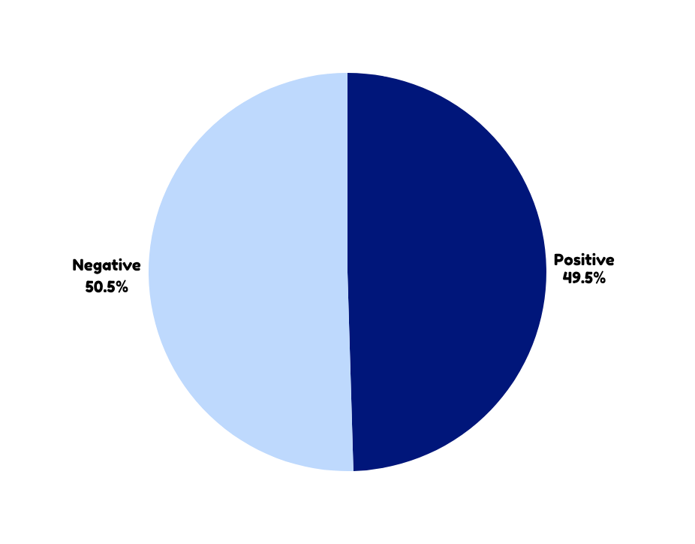
Uroject12
Aspect Distribution
Overall Sentiment Distribution
540
516
501
482
480
443

Slide 15
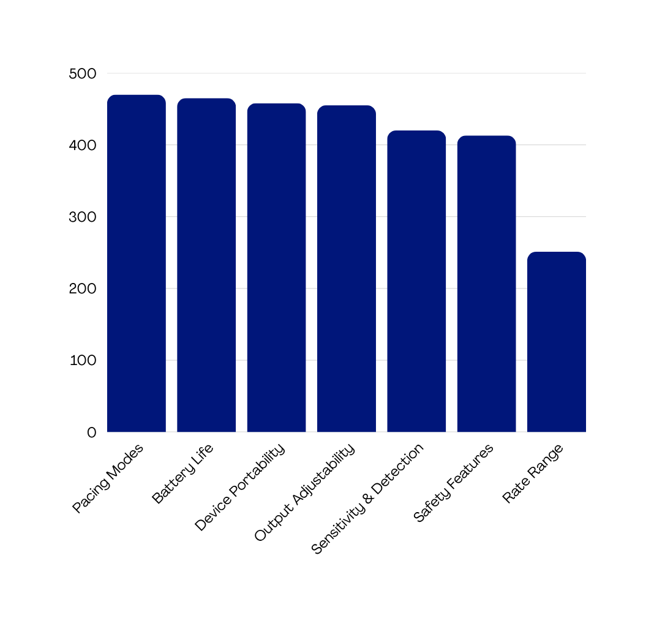
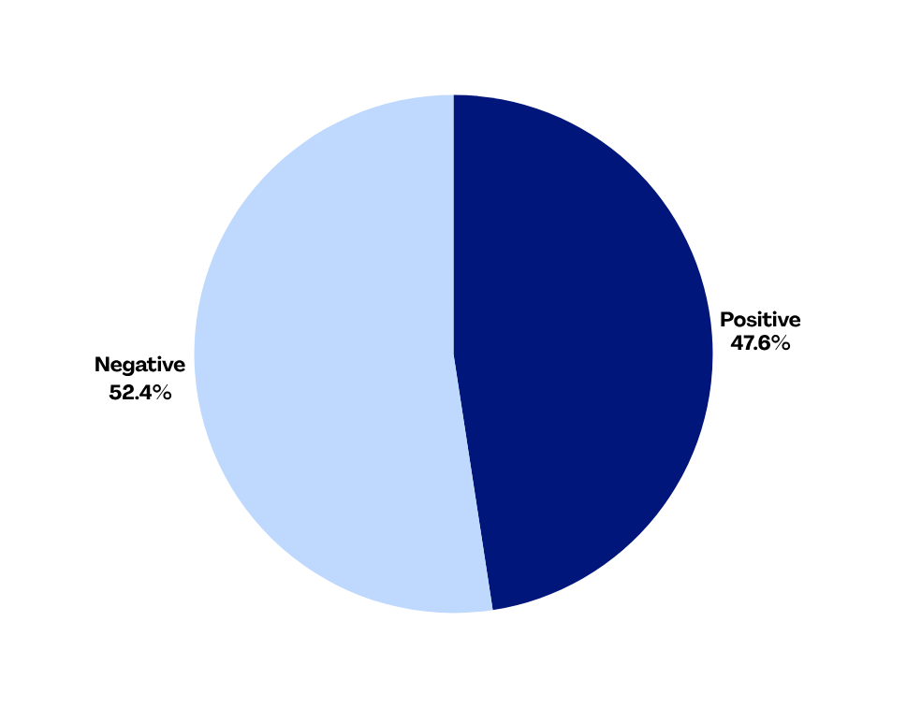
Medtronic 53401
Aspect Distribution
Overall Sentiment Distribution
470
465
458
455
420
413
251

Slide 16
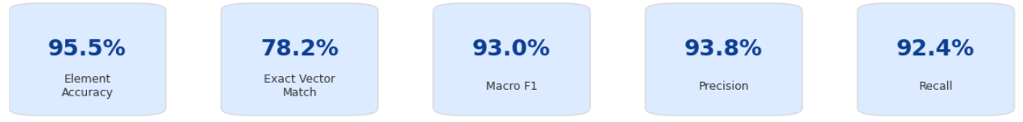
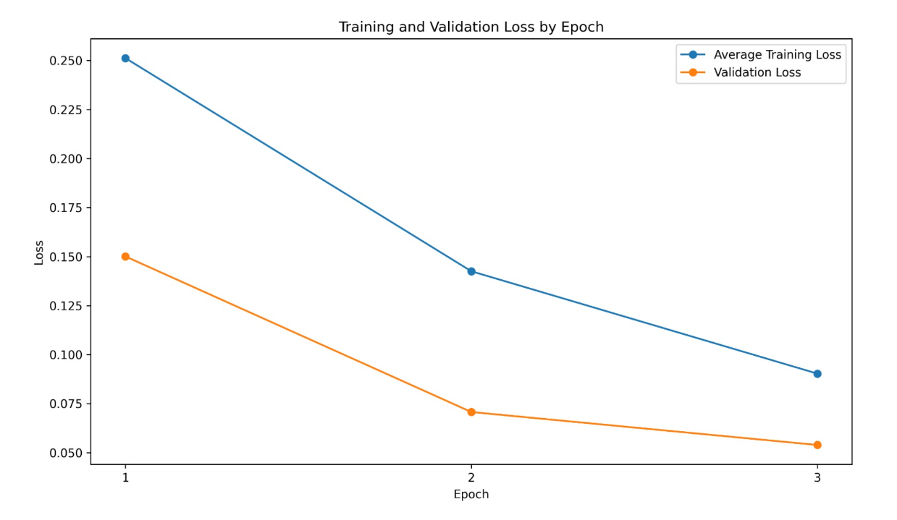
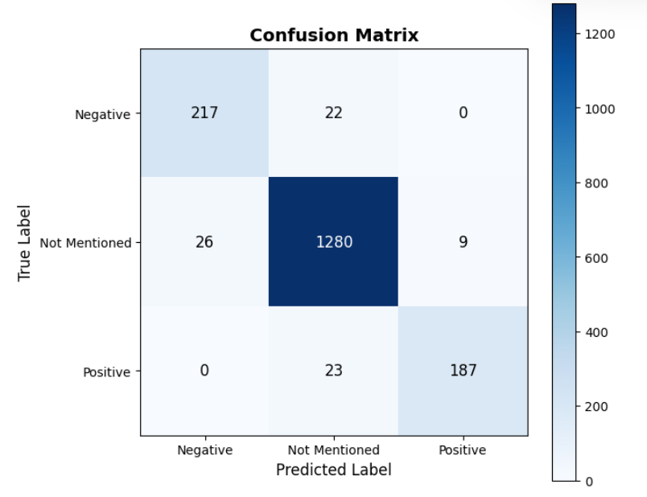
Results 1 : Uroject12
Overall Performance

Slide 17
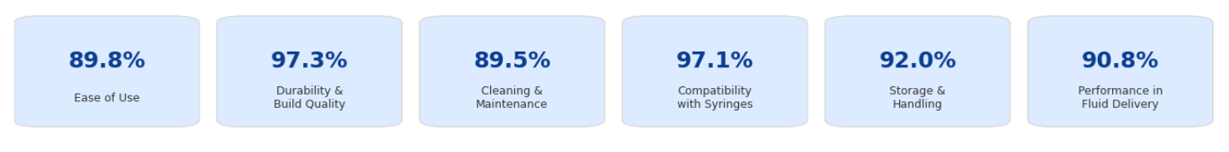
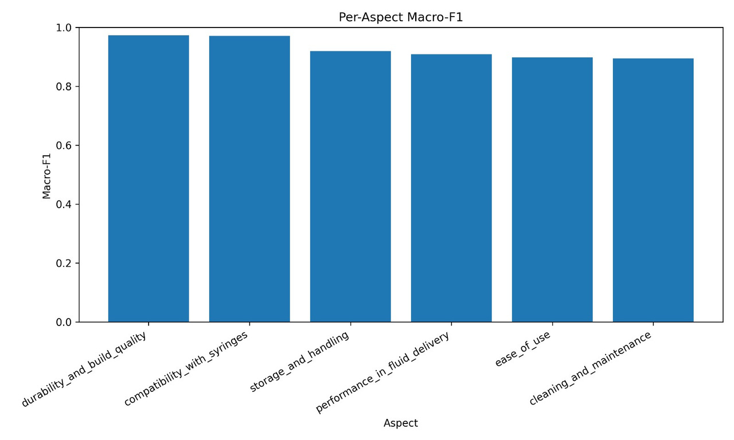
Results 1 : Uroject12
Per-Aspect Macro F1

Slide 18
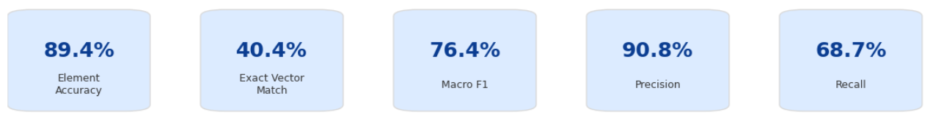
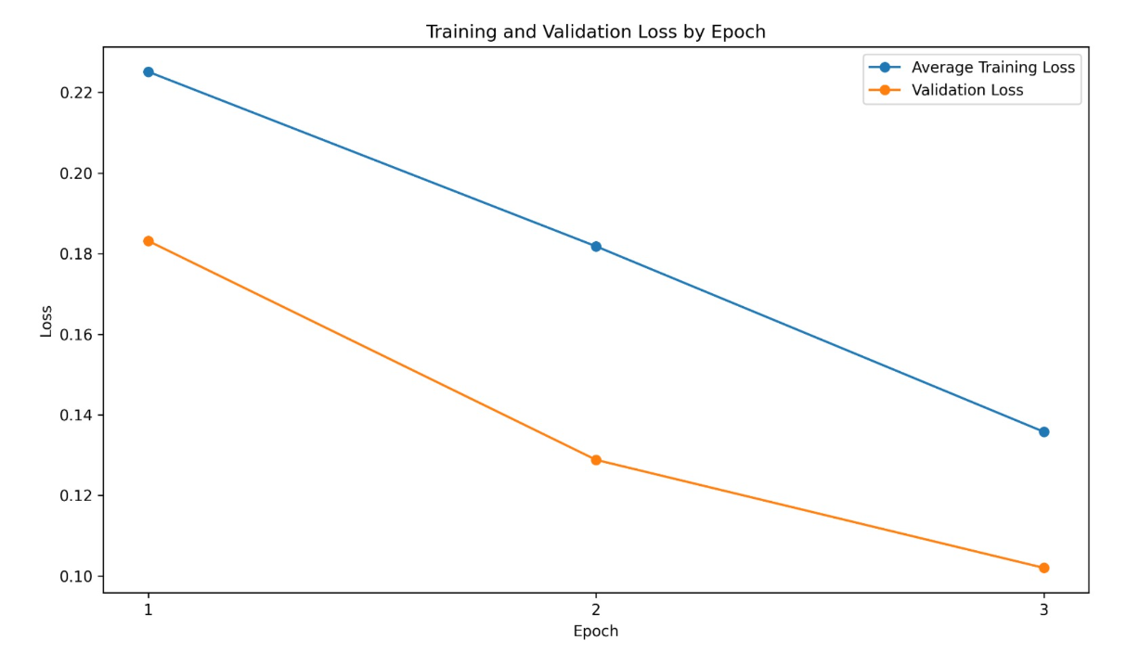
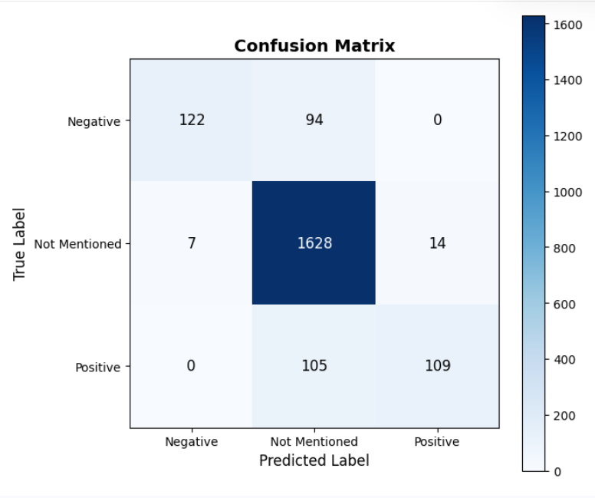
Results 1 : Medtronic 53401
Overall Performance

Slide 19
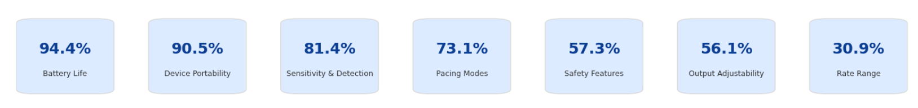
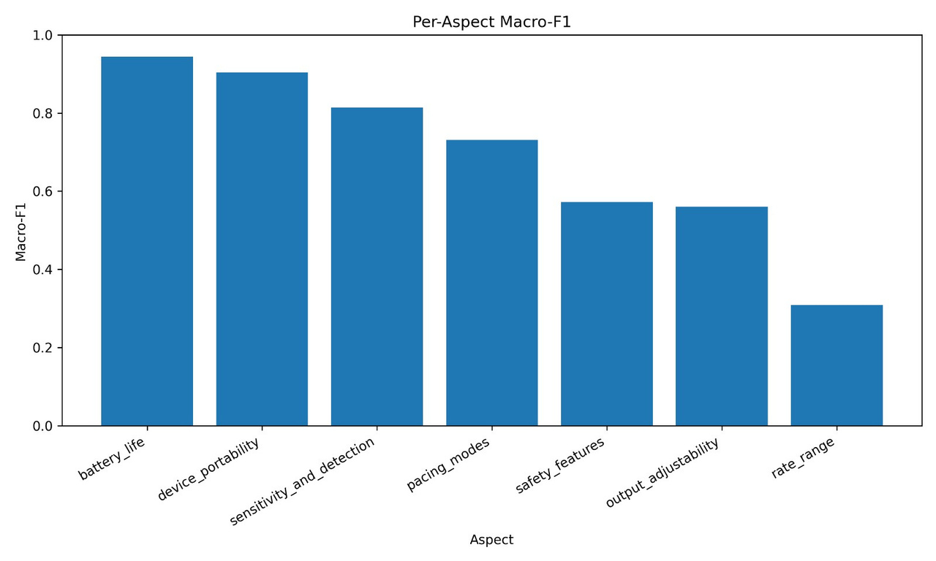
Results 1 : Medtronic 53401
Per-Aspect Macro F1

Slide 20
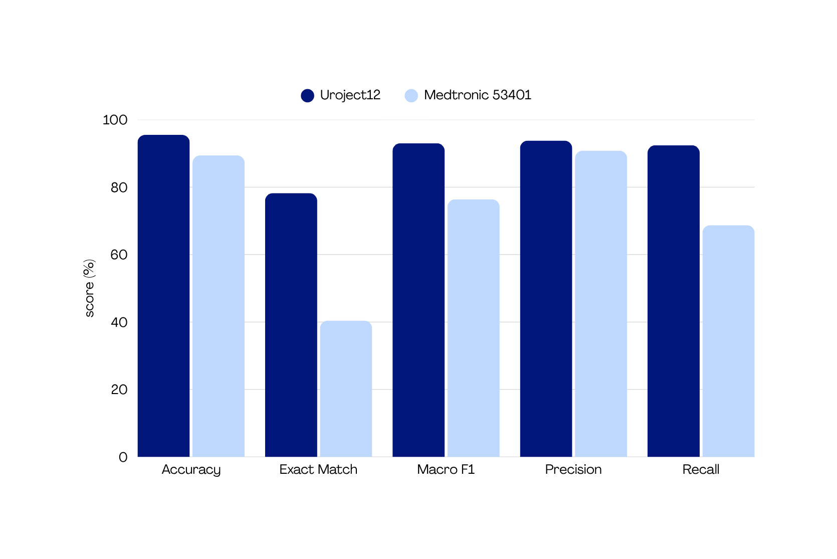
Comparison Between Devices
95.5
93.0
93.8
92.4
89.4
90.8
78.2
76.4
68.7
40.4

Slide 21
Model Architecture DeBERTa
Why DeBERTa-v3-small?
\
Training Process
Fine-Tuning Strategy
Advanced transformer architecture with disentangled attention.
Improved contextual understanding compared to RoBERTa.
Efficient performance with fewer parameters.
Well suited for aspect-based sentiment analysis in medical reviews.
Start from the validated synthetic review dataset
Split into Train / Validation / Test
Fine-tune RoBERTa
Input: review text
Output: continuous aspect-score
vector
Task: multi-output regression
Evaluate model performance
Loss Function: Mean Squared Error (MSE)
Learning Rate: 1e-5
Batch Size: 8
Epochs: 3
Weight Decay: 0.01
Maximum Sequence Length: 256
Hidden Dropout: 0.1
Attention Dropout: 0.1
Classifier Dropout: 0.1
Dynamic Padding (DataCollatorWithPadding)
Early Stopping (Patience = 1)
Best Model Selection using Validation Loss

Slide 22
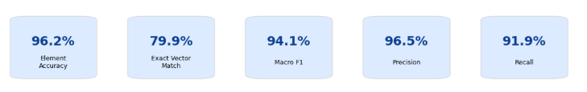
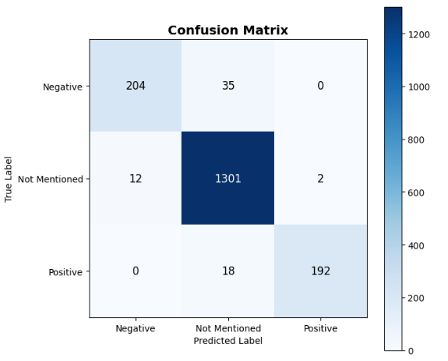
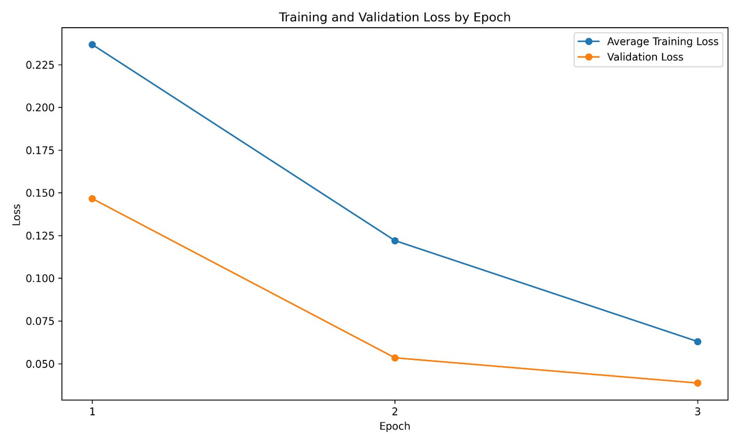
Results 2 : Uroject12
Overall Performance

Slide 23
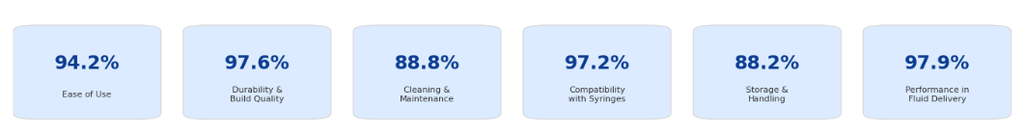
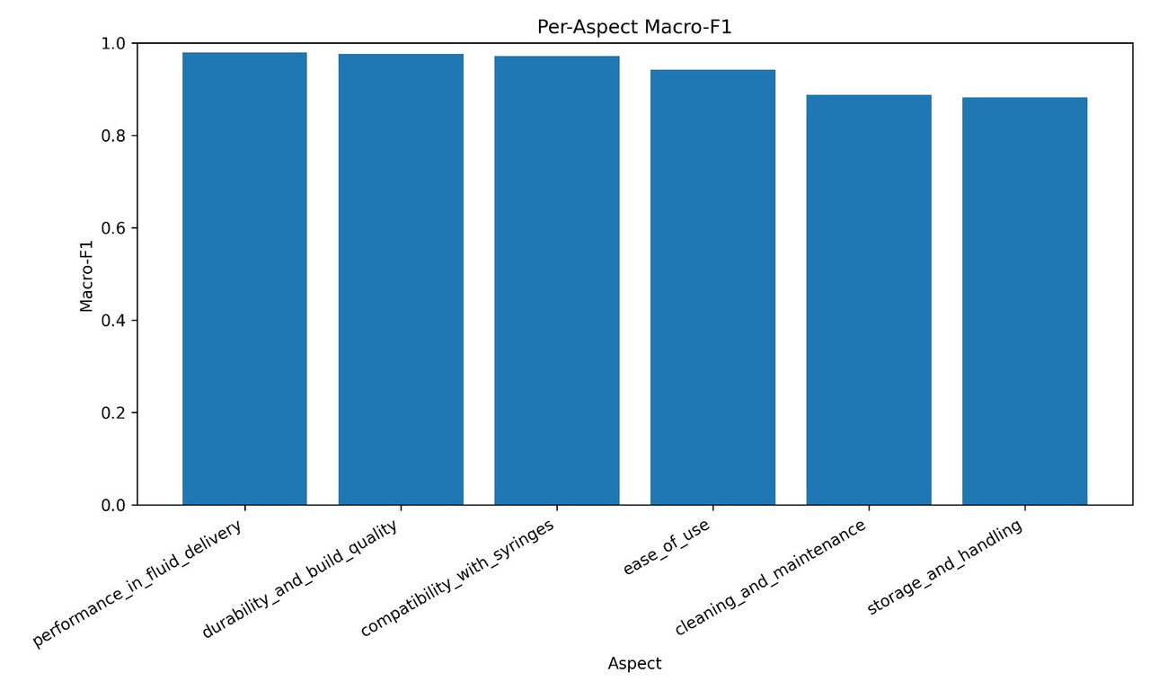
Results 2 : Uroject12
Per-Aspect Macro F1

Slide 24
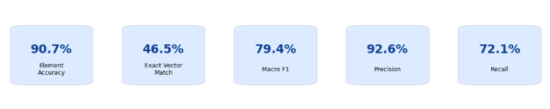
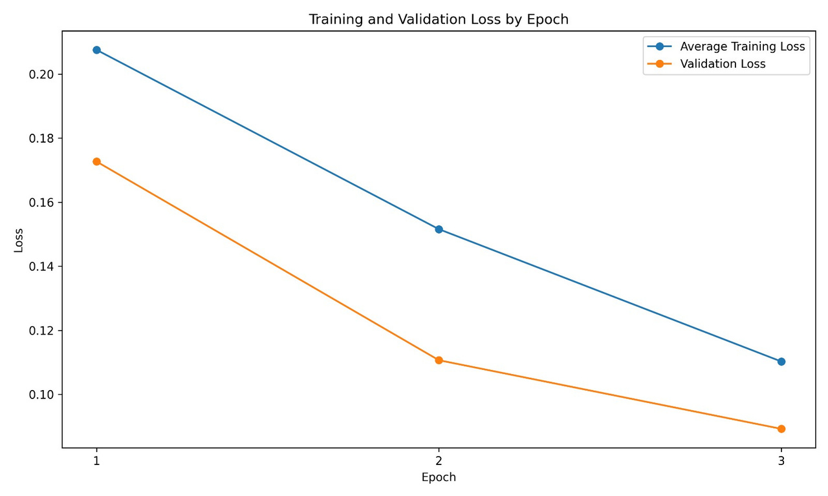
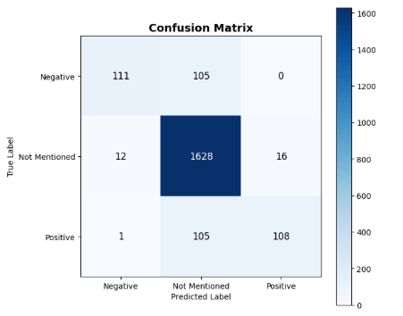
Results 2 : Medtronic 53401
Overall Performance

Slide 25
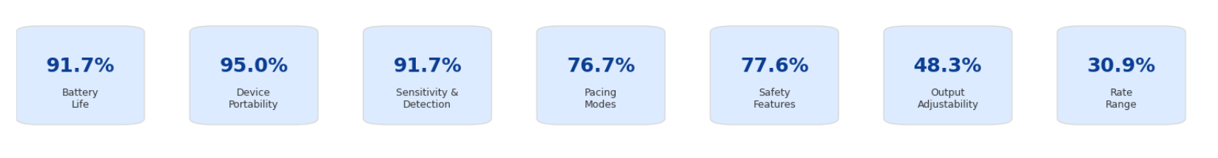
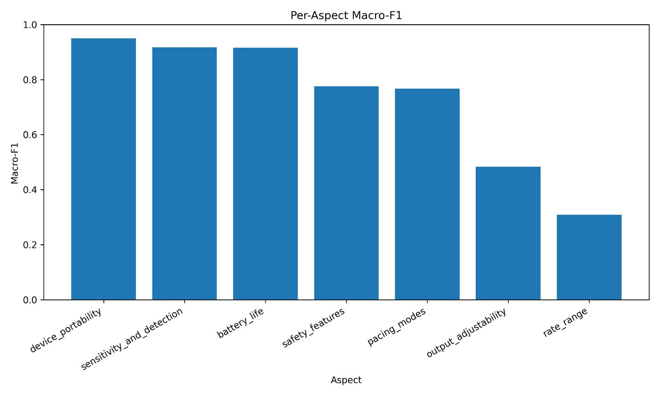
Results 2 : Medtronic 53401
Per-Aspect Macro F1

Slide 26
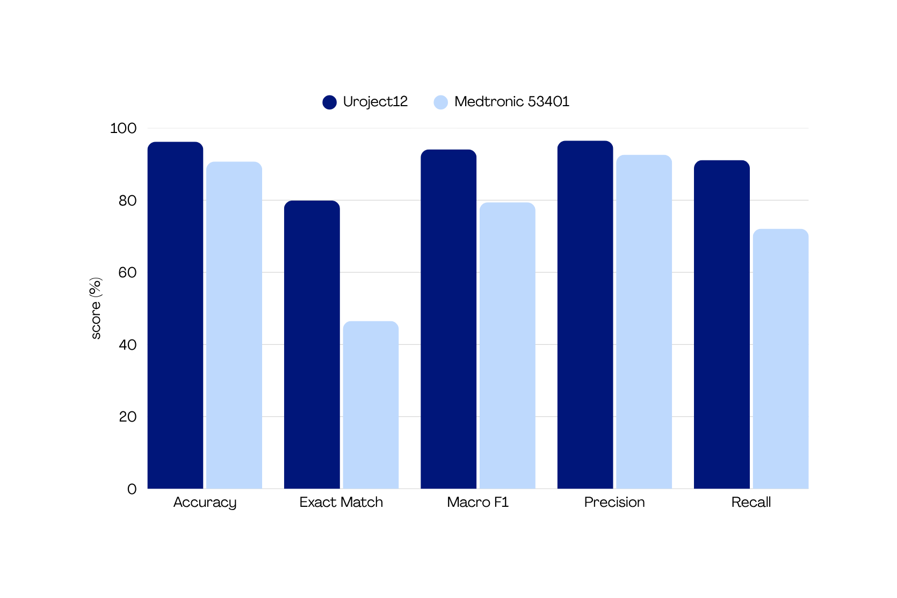
Comparison Between Devices
96.2
96.5
90.7
94.1
92.6
91.9
79.9
79.4
72.1
46.5

Slide 27
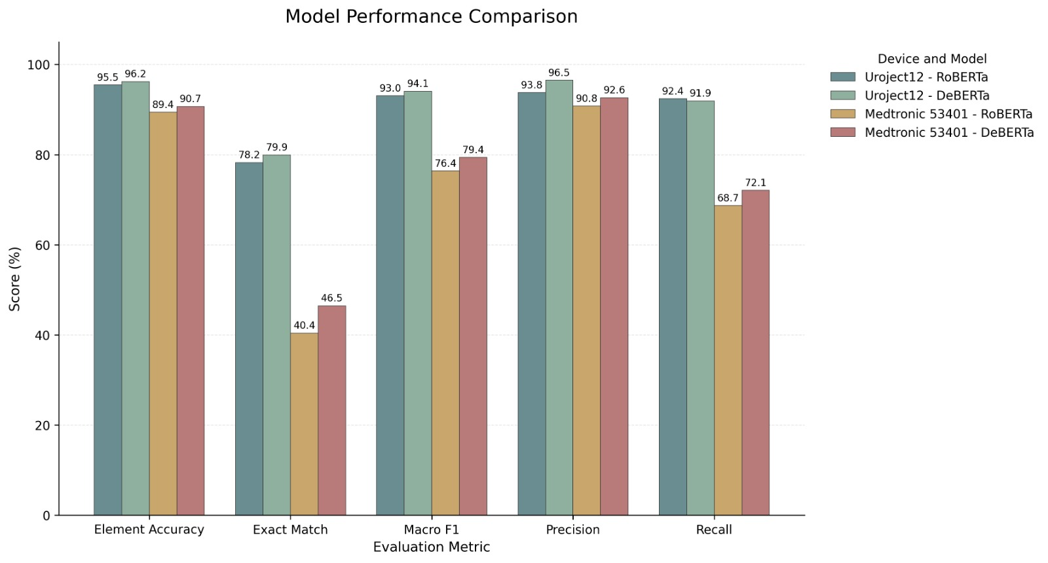
Comparison Between Models

Slide 28
Project Achievements & Novelty
Project Achievements
Built an automated PDF to ABSA pipeline.
Generated and validated high quality synthetic review datasets.
Trained RoBERTa and DeBERTa models for aspect level sentiment prediction.
Demonstrated the approach on two different medical devices.
Novelty
Automatic aspect extraction from medical device PDFs.
Synthetic review generation with sentiment and nuance control.
Automated consistency validation.
End to end PDF to aspect-scoring pipeline.
Comparative evaluation of transformer architectures.

Slide 29
Conclusions
RoBERTa learned the connection between review text and aspect scores.
DeBERTa achieved stronger overall performance than RoBERTa across most evaluation metrics.
Main errors were between mentioned and not mentioned, not positive vs. negative.
Clear aspects were easier to learn than broad or technical aspects.
The second device showed the pipeline is generic, but performance depends on aspect quality.
The proposed pipeline generalized successfully across two different medical device domains.
Real world generalization still requires testing on real reviews.

Slide 30
Future Work & Lessons Learned
Future Work
Evaluate the model on real-world reviews.
Improve aspect extraction to create clearer and less overlapping aspects.
Lessons Learned
Synthetic data is useful only when supported by strong quality checks.
Task formulation matters: Multi-Output Aspect Scoring fit our dataset better than classical ABSA.
Clear, distinct aspects are easier to learn than overlapping or highly technical aspects.

Slide 31
Thank You

