Slide 1

Multi-Cluster Network Policy Red Hat
Aviad Hadad & Shoham Danino

Slide 2
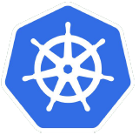
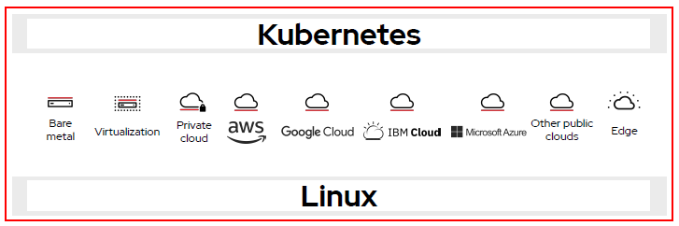
Background
Kubernetes is an open-source platform designed to easily deploy, scale and manage containerized applications in the cloud.
It allows developers to focus on the business logic
and workflows without worrying about the
underlying infrastructure.
Notes:
Kubernetes Network Policy allows cluster administrators to configure granular isolation rules using Network Policy objects. A network policy is a specification of how groups of pods (using labels) are allowed to communicate with each other and other network endpoints.
The purpose of this project is to provide a mechanism for Network Policies across multiple clusters so that policy enforcement from a single cluster will seamlessly expand and work across clusters.

Slide 3

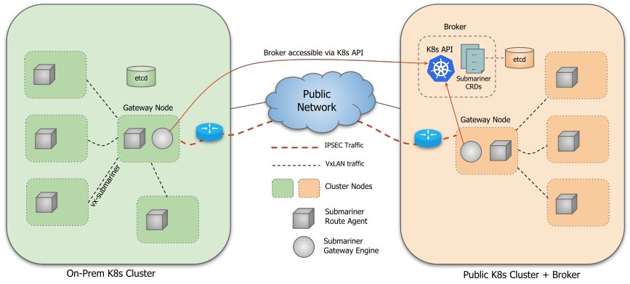
Submariner
Submariner enables direct networking between Pods and Services in different Kubernetes clusters, either on-premises or in the cloud.
Notes:
Kubernetes Network Policy allows cluster administrators to configure granular isolation rules using Network Policy objects. A network policy is a specification of how groups of pods (using labels) are allowed to communicate with each other and other network endpoints.
The purpose of this project is to provide a mechanism for Network Policies across multiple clusters so that policy enforcement from a single cluster will seamlessly expand and work across clusters.

Slide 4
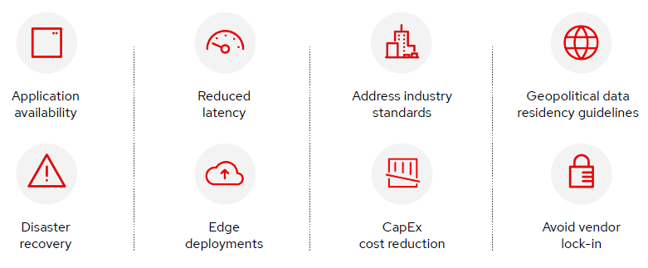
Motivation
Reasons for deploying multiple clusters
Notes:
The submariner project’s goal is to provide connectivity and service discovery between 2 (or more) kubernetes clusters. We will expand on common submariner use cases and describe the benefit from having network policy in each scenario.
Motivation A: Hybrid cloud
Many times, the Private cloud runs workflows that are sensitive from a security standpoint, and as such we don’t want services on the public cloud to be able to access them. Being able to allow only some services to connect from the public cloud to the private is crucial.
Motivation B: Distributed Data
In case of clusters in multiple regions, with replicas of the same service running in each cluster. The cloud-native Disaster Recovery will improve service availability while providing fault tolerance.
Motivation C: Disaster Recovery
In case we have clusters deployed across active/passive sites, application is deployed in the passive site, but not receiving traffic, volume is replicated asynchronously. we need that when a disaster hits the active site, the application can be restored to the passive site.
For both scenarios B&C - having the ability to limit connectivity from the second site is needed, in case the second site is compromised.

Slide 5
Multi-Cluster Network policy
Kubernetes has a built-in mechanism to control network connectivity between pods inside a cluster. For example, services from namespace A can’t access services from namespace B.
Our task was to provide a similar mechanism to control network connectivity across clusters.
Notes:
back to regular k8n - has network policy mechanism

Slide 6
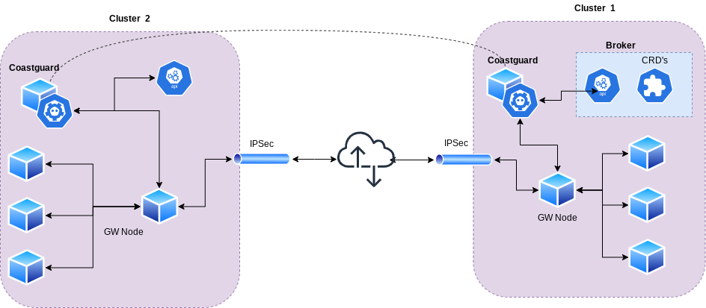
High Level Architecture
Notes:
coastguard - each cluster has one
coastguard implement multi -cluster by creating dynamically “regular” network policy objects
how? coastguard tracks deployments and changes across all clusters, and updates network policy how? each coastguard has an embedded etcd server. etcd is a distributed database which replicates across instances.

Slide 7
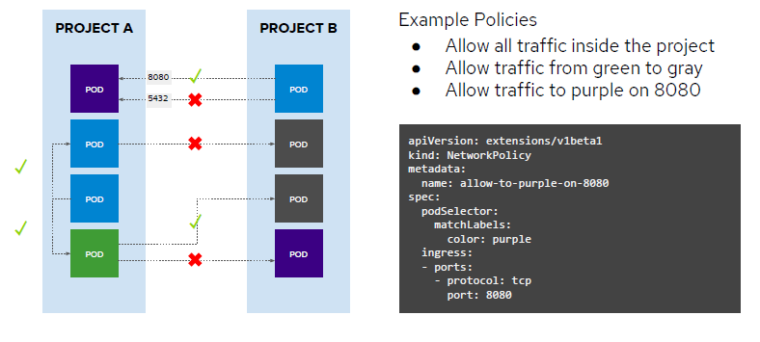
Demo
Notes:
declarative

Slide 8
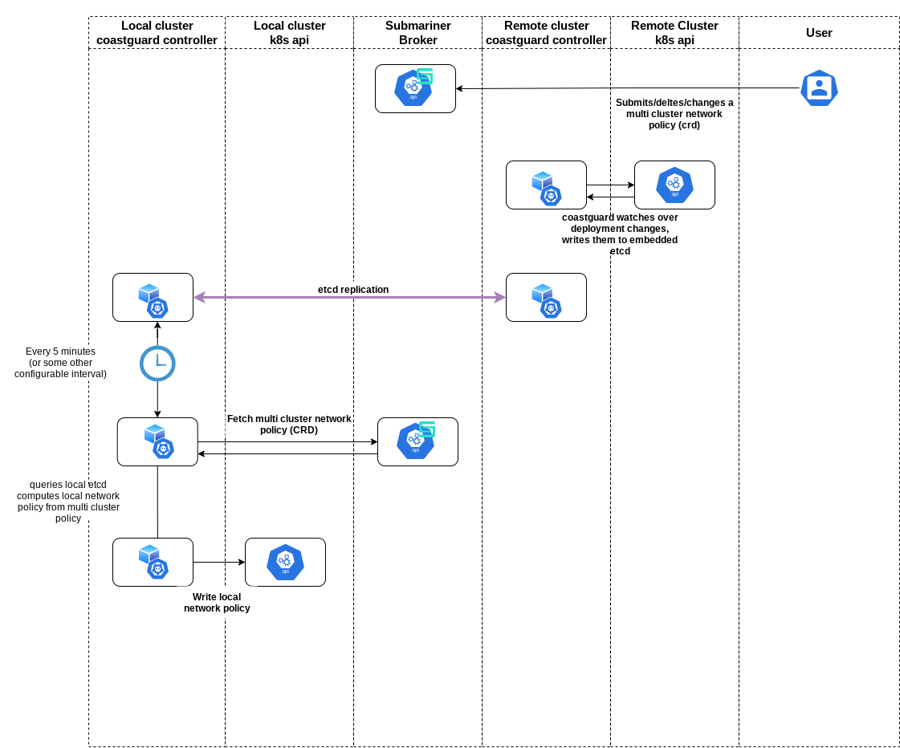
Key Lessons
Open Source projects
Scalability & Performance
Security
How to write a design

Slide 9
Thank you

