Slide 1
Project Supervisor
Md. Saiful Ambia Chowdhury
Lecturer
Coach, Programming Contest Teams
Dept. of Computer Science & Engineering

Slide 2

The ultimate solutions of medications.

Slide 3
What Is Doctorola ?
Doctorola is a revolutionary online healthcare platform in Bangladesh.
Dedicated to extend the horizons of healthcare facilities and services beyond regional limitations and make it accessible to all. We aim at taking healthcare in Bangladesh to the next level for today’s tech savvy population

Slide 4
Doctorola Features
Explore Doctors Near you.
Consult Nearest Hospital.
Blood Banks nearby.
Ambulance Online Appointment.
Health Tips.
Lateast Medication News.
24 / 7 Help Service.

Slide 5
Explore Doctors Near you.
Doctorola brings the most relevant and updated list of doctors from various specialties at one place so that users can search for them easily, get information about their availability, fees, chamber / hospital and all of information.

Slide 6
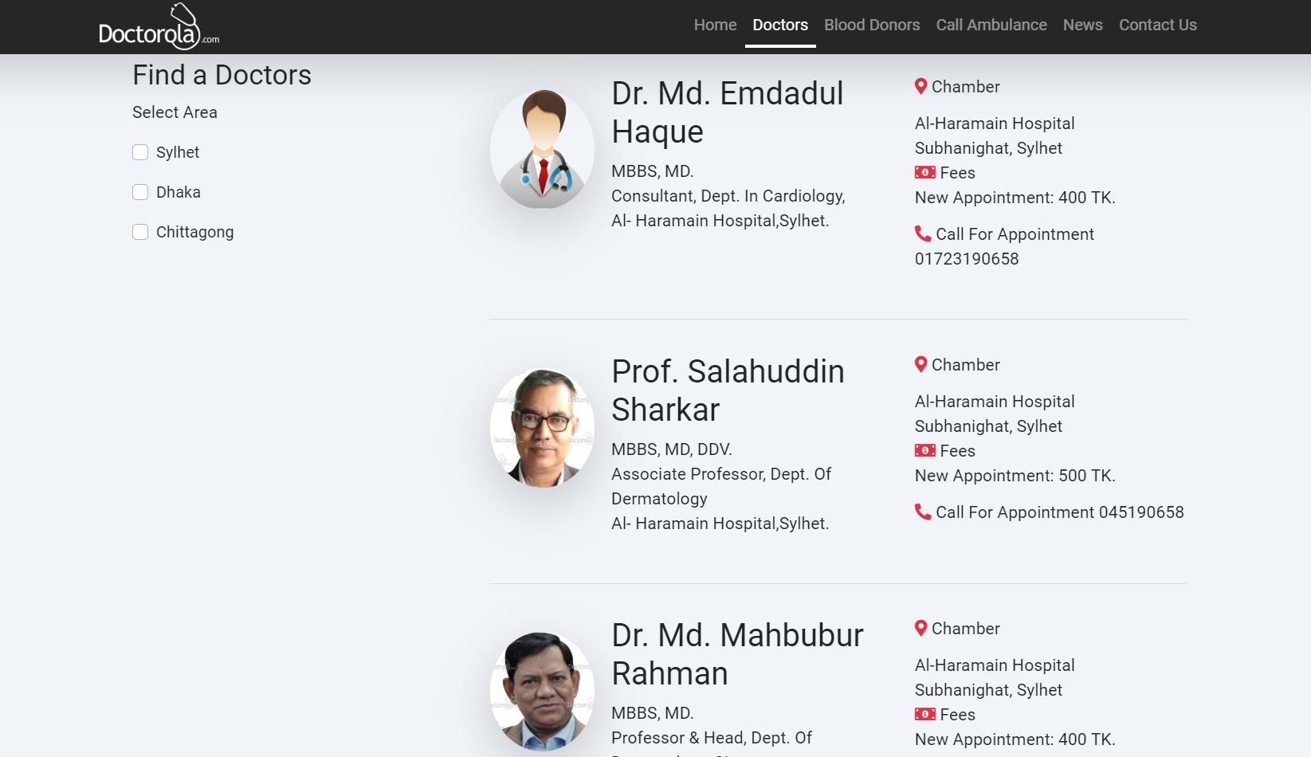
Screenshots of doctors page:

Slide 7
Need ambulance ?
For The First Time In Bangladesh Now You Can Book Ambulance At Your Finger Tip.

Slide 8
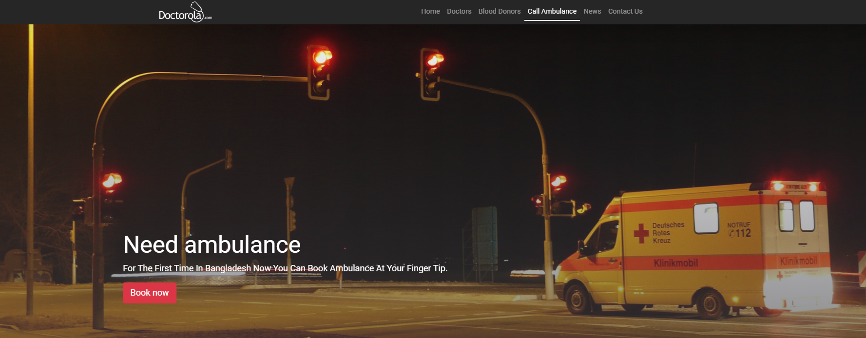
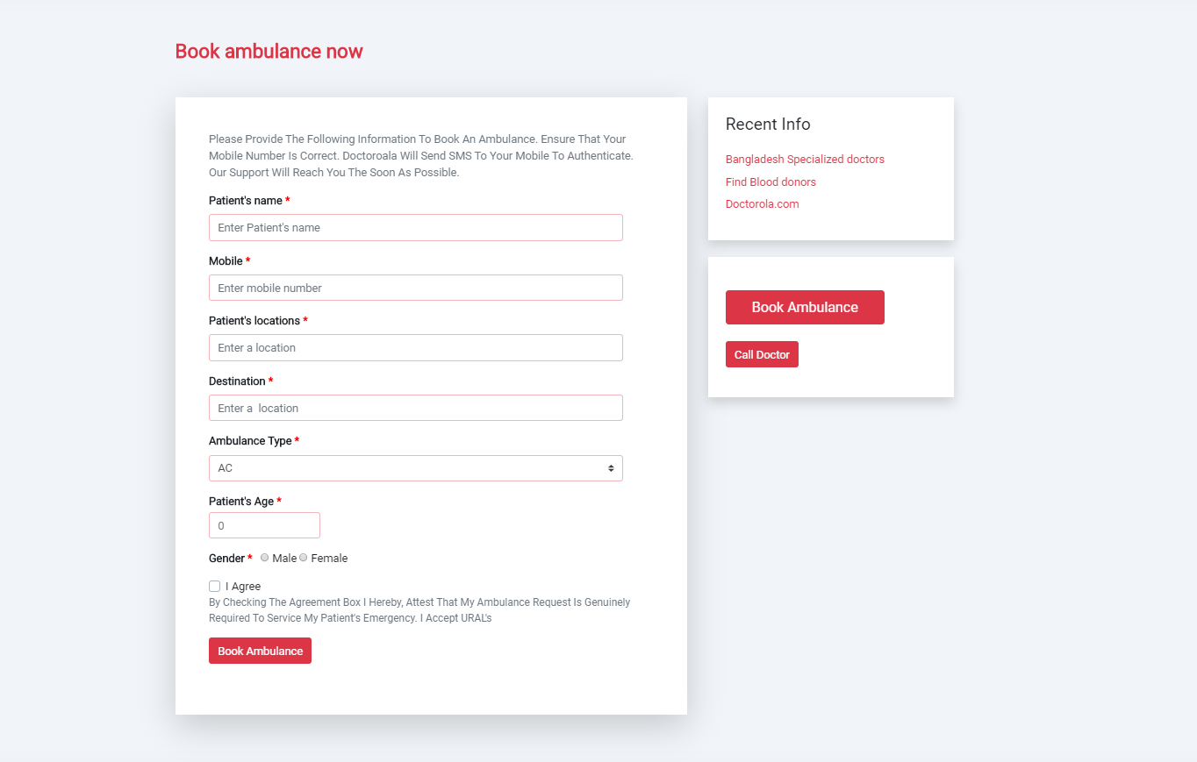
Screenshots of call ambulance page:

Slide 9
Blood Donors Club
Get information about the trusted blood donors near you with their contact no, Address.

Slide 10
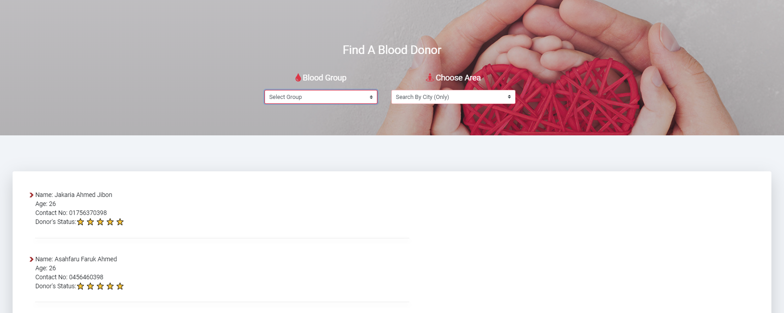
Screenshots of blood donors page:

Slide 11
Medication News
Doctorola informed you the latest medication news

Slide 12
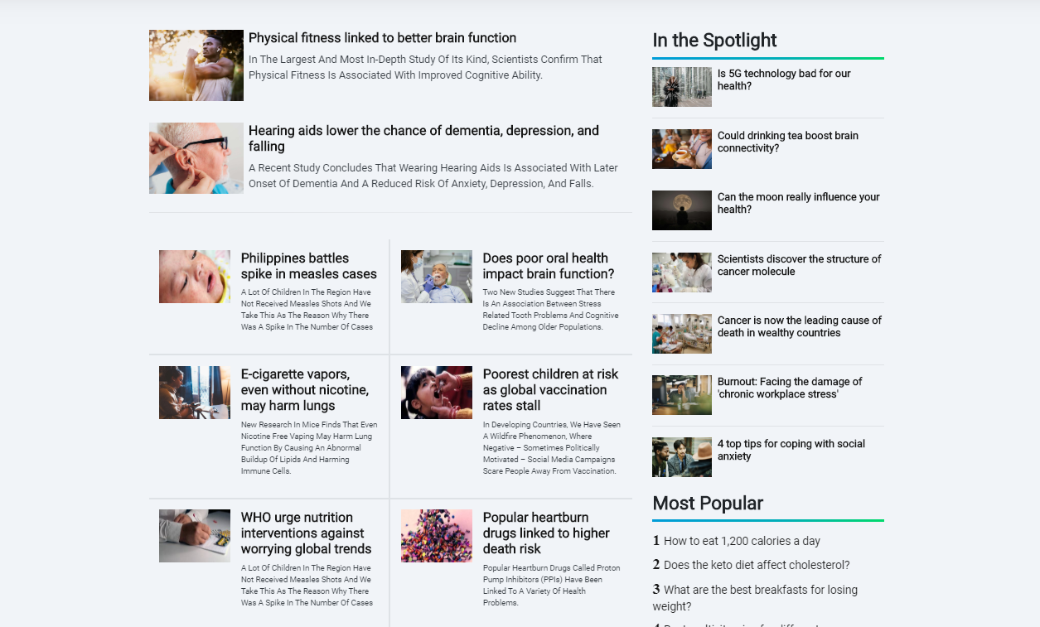
Screenshots of news page:

Slide 13
Let us be connected !
You can notify us your opinions.

Slide 14
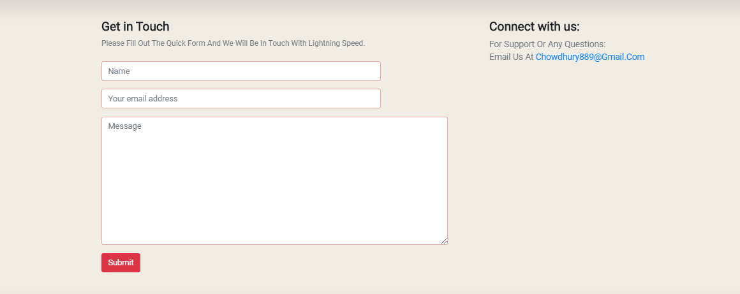
Screenshots of contact us page:

Slide 15
Conclusion
We hope our work will be more useful and beneficial in the years to come as we have developed a website which has many useful features like find doctors from various specialties, ambulance services which will be very useful for a patient.

Slide 16
Thank You

