Slide 1
Project Name: RentRead
Pre-K

Slide 2
What is RentRead?
A subscription-based service that allows users to rent PDF versions of books.
Provides affordable access to a wide variety of books.
Users can read books for a specific period (e.g., 7 days, 14 days).

Slide 3
How RentRead Works?
Subscription Model
Users subscribe to read books for a fixed period.
After the subscription period ends, the book is automatically
removed from the user’s account.
Payment Process
Payments are processed via popular payment gateways like bKash.
Affordable subscription plans that fit various budgets.

Slide 4
Technical Architecture Frontend: Built using HTML, CSS, and JavaScript (Bootstrap/Tailwind). Backend: Developed with Node.js, handling user authentication, book rentals, and subscriptions. Database: Xampp File Storage: Books stored securely on Google Drive or cloud services. Payment Integration: bKash payment gateway for secure transactions.

Slide 5
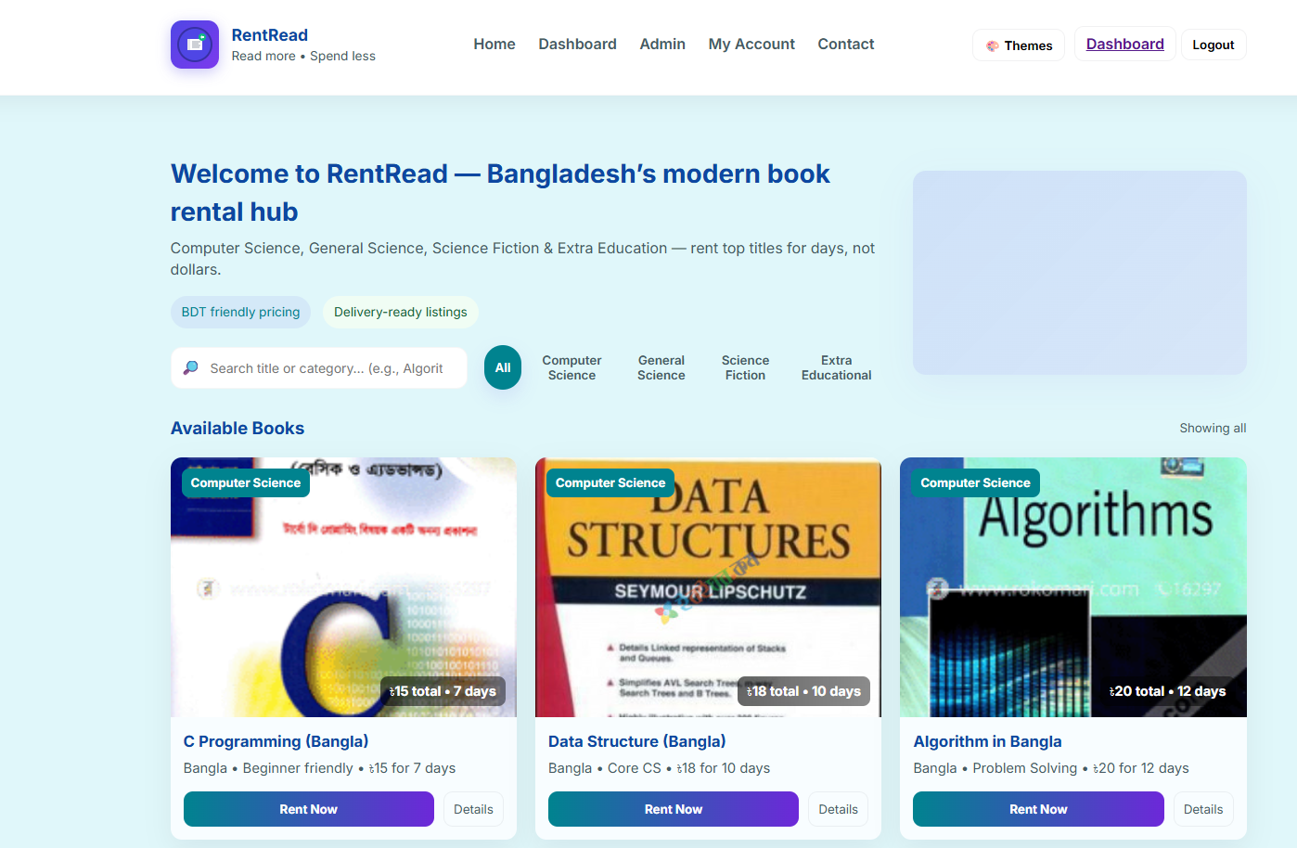
Project Update Complete dashboard work
Welcome Message
The platform welcomes users with the tagline: "Bangladesh’s modern book rental hub."
RentRead offers a variety of categories, including Computer Science, General Science, Science Fiction, and Extra Educational books.
Categories & Search
Search Function: Users can search for specific book titles or categories (e.g., “Algorithm”) using the search bar.
Category Selection: Users can filter books by different categories like Computer Science, Science Fiction, etc.
Available Books
The page displays available books along with some key details:
Book Title
Category (e.g., Computer Science)
Pricing Information: Includes the rental price in BDT and the duration (e.g., 7 days, 10 days, etc.)
Rent Now: A button to rent the book immediately.
Details: A button to view further details about the book.

Slide 6
Navigation Options
Home: Links to the homepage of RentRead.
Dashboard: User's main dashboard with a summary of their account and activities.
Admin: Admin access to manage the platform's content (likely visible to admins).
My Account: The section you are currently in, where users can manage their profile.
Contact: A contact page for customer support or inquiries.
Themes: A button to change or adjust the visual theme of the platform.

Slide 7
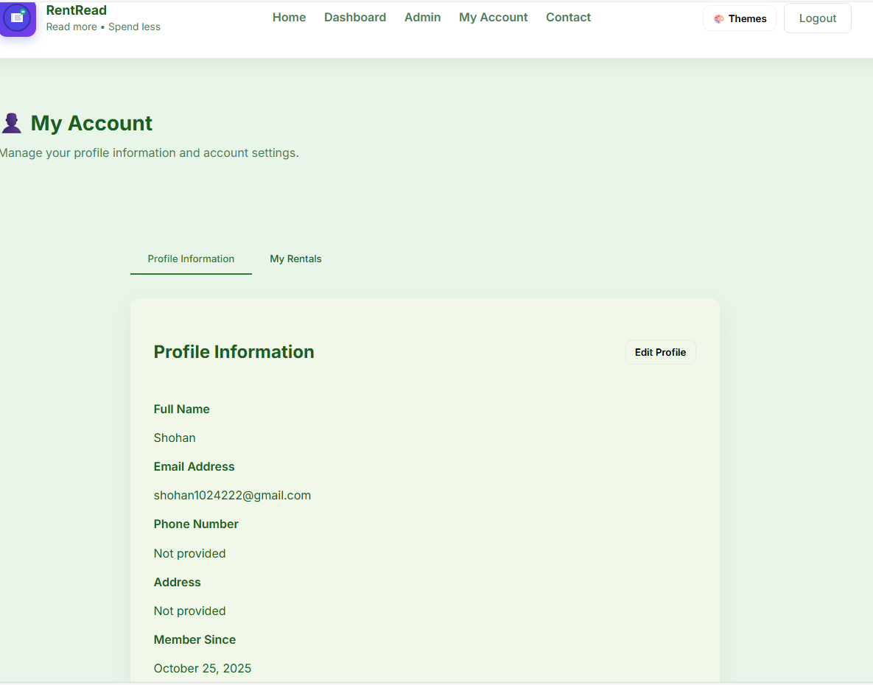
Create user account page
Profile Information
This section allows users to manage their personal details.
Details Displayed:
Full Name: The user's name is displayed.
Email Address: The registered email address is shown.
Phone Number: If provided, it will be listed here (currently not provided in this case).
Address: The user's address can be added here, although it is not provided yet.
Member Since: Displays the date the user joined the platform.

Slide 8
The My Rentals section in the RentRead platform allows users to track their rented books and view important rental details. Here's a breakdown of what is displayed:
Rental Summary
Total Rentals: Shows the total number of books the user has rented so far (e.g., 11).
Active Rentals: Indicates how many books are currently active rentals (e.g., 1 active rental).
Total Spent: Displays the total amount the user has spent on rentals (e.g., ৳64).

Slide 9
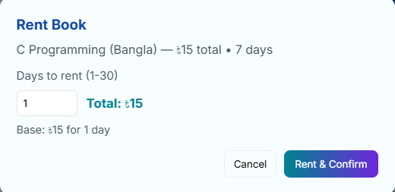
Rent Book modal, which allows users to rent a book for a specified period.
If I increase days,TK will be automatically increase.

Slide 10
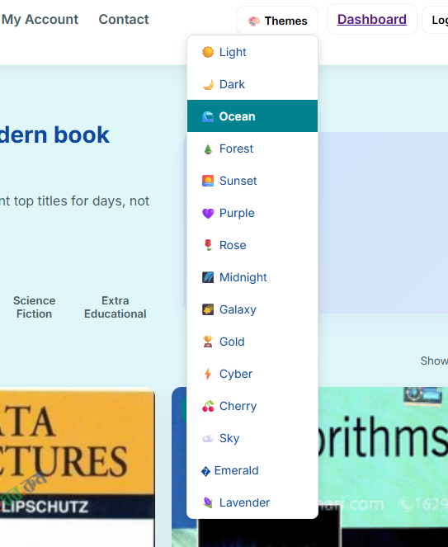
added some beautiful themes to the RentRead platform to enhance the user experience and make the website more visually appealing. The themes available in the dropdown menu allow users to choose their preferred design style. Here's a description in English of what you've done:

Slide 11
Future Workplans
Admin Panel Creation
Dynamic admin panel where administrators can easily update, delete, and manage books in the system. The admin panel will allow for seamless management of the entire platform's content.
Bkash Payment Integration
You will ensure bKash payment integration, allowing users to make secure payments for renting books. This will provide a convenient and local payment method, ensuring a smooth transaction process for users.
PDF Book Upload and Storage
Books in PDF format will be uploaded and securely stored in a storage system. This will enable users to rent books in digital form and access them conveniently for reading.

Slide 12
Thanks!

