Slide 1
CSE3107: Computer Networks
Lecture 3

Slide 2
Network layer: our goals
understand principles behind network layer services, focusing on data plane:
network layer service models
forwarding versus routing
how a router works
addressing
generalized forwarding
Internet architecture

Slide 3
















Network-layer services and protocols
transport segment from sending to receiving host
sender: encapsulates segments into datagrams, passes to link layer
receiver: delivers segments to transport layer protocol
network layer protocols in every Internet device: hosts, routers
routers:
examines header fields in all IP datagrams passing through it
moves datagrams from input ports to output ports to transfer datagrams along end-end path
mobile network
national or global ISP
application
transport
network
link
physical
network
link
physical
network
link
physical
network
link
physical
network
link
physical
network
link
physical
datacenter
network
application
transport
network
link
physical
enterprise
network

Slide 4
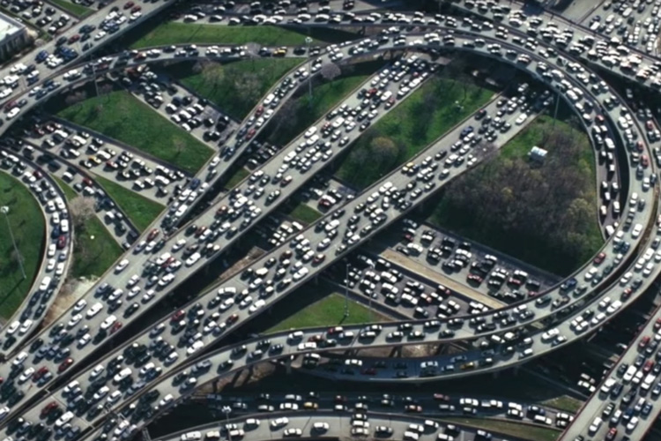
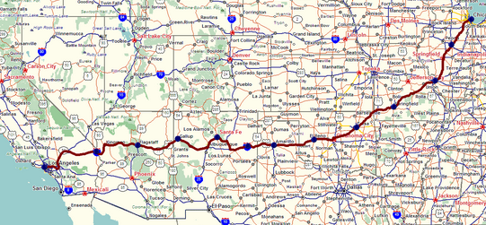
Two key network-layer functions
network-layer functions:
forwarding: move packets from a router’s input link to appropriate router output link
analogy: taking a trip
forwarding: process of getting through single interchange
routing: process of planning trip from source to destination
routing: determine route taken by packets from source to destination
routing algorithms
forwarding
routing

Slide 5
Network layer: data plane, control plane
Data plane:
local, per-router function
determines how datagram arriving on router input port is forwarded to router output port
Control plane
network-wide logic
determines how datagram is routed among routers along end-end path from source host to destination host
values in arriving
packet header
two control-plane approaches:
traditional routing algorithms: implemented in routers
software-defined networking (SDN): implemented in (remote) servers
0111
1
3
2

Slide 6

Per-router control plane
Individual routing algorithm components in each and every router interact in the control plane
Routing
Algorithm
control
plane
data
plane
values in arriving
packet header
0111
1
3
2

Slide 7
Network service model
Q: What service model for “channel” transporting datagrams from sender to receiver?
example services for individual datagrams:
guaranteed delivery
guaranteed delivery with less than 40 msec delay
example services for a flow of datagrams:
in-order datagram delivery
guaranteed minimum bandwidth to flow
restrictions on changes in inter-packet spacing

Slide 8
Network-layer service model
Quality of Service (QoS) Guarantees ?
Network
Architecture
Internet
ATM
ATM
Internet
Internet
Service
Model
best effort
Constant Bit Rate
Available Bit Rate
Intserv Guaranteed
(RFC 1633)
Diffserv (RFC 2475)
Bandwidth
none
Constant rate
Guaranteed min
yes
possible
Loss
no
yes
no
yes
possibly
Order
no
yes
yes
yes
possibly
Timing
no
yes
no
yes
no
Internet “best effort” service model
No guarantees on:
successful datagram delivery to destination
timing or order of delivery
bandwidth available to end-end flow

Slide 9
Network-layer service model
Quality of Service (QoS) Guarantees ?
Network
Architecture
Internet
ATM
ATM
Internet
Internet
Service
Model
best effort
Constant Bit Rate
Available Bit Rate
Intserv Guaranteed
(RFC 1633)
Diffserv (RFC 2475)
Bandwidth
none
Constant rate
Guaranteed min
yes
possible
Loss
no
yes
no
yes
possibly
Order
no
yes
yes
yes
possibly
Timing
no
yes
no
yes
no

Slide 10
Reflections on best-effort service:
simplicity of mechanism has allowed Internet to be widely deployed adopted
sufficient provisioning of bandwidth allows performance of real-time applications (e.g., interactive voice, video) to be “good enough” for “most of the time”
replicated, application-layer distributed services (datacenters, content distribution networks) connecting close to clients’ networks, allow services to be provided from multiple locations
congestion control of “elastic” services helps
It’s hard to argue with success of best-effort service model

Slide 11

Network layer: “data plane” roadmap
Network layer: overview
data plane
control plane
What’s inside a router
input ports, switching, output ports
buffer management, scheduling
IP: the Internet Protocol
datagram format
addressing
network address translation
IPv6
Generalized Forwarding, SDN
match+action
OpenFlow: match+action in action
Middleboxes

Slide 12
Network Layer: Internet
host, router network layer functions:
transport layer: TCP, UDP
IP protocol
datagram format
addressing
packet handling conventions
Path-selection algorithms: implemented in
routing protocols (OSPF, BGP)
SDN controller
network
layer
forwarding
table
ICMP protocol
error reporting
router “signaling”
link layer
physical layer

Slide 13
IP Datagram format
32 bits
IP protocol version number
head.
len
type of
service
total datagram
length (bytes)
ver
length
header length(bytes)
“type” of service:
diffserv (0:5)
ECN (6:7)
flgs
fragment
offset
fragmentation/
reassembly
16-bit identifier
time to
live
upper
layer
header
checksum
header checksum
TTL: remaining max hops
(decremented at each router)
source IP address
32-bit source IP address
destination IP address
Maximum length: 64K bytes
Typically: 1500 bytes or less
upper layer protocol (e.g., TCP or UDP)
32-bit destination IP address
overhead
options (if any)
e.g., timestamp, record route taken
20 bytes of TCP
20 bytes of IP
= 40 bytes + app layer overhead for TCP+IP
payload data
(variable length,
typically a TCP
or UDP segment)

Slide 14

IP addressing: introduction
223.1.1.1
IP address: 32-bit identifier associated with each host or router interface
interface: connection between host/router and physical link
router’s typically have multiple interfaces
host typically has one or two interfaces (e.g., wired Ethernet, wireless 802.11)
223.1.2.1
223.1.1.2
223.1.1.4
223.1.2.9
223.1.1.3
223.1.3.27
223.1.2.2
223.1.3.1
223.1.3.2
dotted-decimal IP address notation:
223.1.1.1 = 11011111 00000001 00000001 00000001
223
1
1
1

Slide 15
IP addressing: introduction
The identifier used in the IP layer of the TCP/IP protocol suite to identify each device connected to the Internet is called the Internet address or IP address.
An IP address is a 32-bit address that uniquely and universally defines the connection of a host or a router to the Internet.
IP addresses are unique.
They are unique in the sense that each address defines one, and only one, connection to the Internet.
Two devices on the Internet can never have the same address.

Slide 16
Note:
An IP address is a 32-bit address.

Slide 17
Note:
The IP addresses are unique.

Slide 18
Note:
The address space of IPv4 is 2³² or 4,294,967,296.

Slide 19
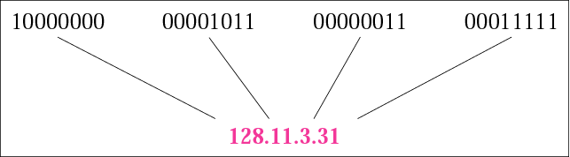
Figure 4.1 Dotted-decimal notation

Slide 20
Example 1
Change the following IP addresses from binary notation to dotted-decimal notation.
a. 10000001 00001011 00001011 11101111 b. 11000001 10000011 00011011 11111111 c. 11100111 11011011 10001011 01101111 d. 11111001 10011011 11111011 00001111
Solution We replace each group of 8 bits with its equivalent decimal number and add dots for separation:
a. 129.11.11.239 b. 193.131.27.255 c. 231.219.139.111 d. 249.155.251.15

Slide 21
Example 2
Change the following IP addresses from dotted-decimal notation to binary notation.
a. 111.56.45.78 b. 221.34.7.82 c. 241.8.56.12 d. 75.45.34.78
Solution
We replace each decimal number with its binary equivalent:
a. 01101111 00111000 00101101 01001110 b. 11011101 00100010 00000111 01010010 c. 11110001 00001000 00111000 00001100 d. 01001011 00101101 00100010 01001110

Slide 22
Example 3
Find the error, if any, in the following IP addresses:
a. 111.56.045.78 b. 221.34.7.8.20
c. 75.45.301.14 d. 11100010.23.14.67
Solution
a. There are no leading zeroes in dotted-decimal notation (045).
b. We may not have more than four numbers in an IP address.
c. In dotted-decimal notation, each number is less than or equal to 255; 301 is outside this range.
d. A mixture of binary notation and dotted-decimal notation is not allowed.

Slide 23
Example 4
Change the following IP addresses from binary notation to hexadecimal notation.
a. 10000001 00001011 00001011 11101111
b. 11000001 10000011 00011011 11111111
Solution We replace each group of 4 bits with its hexadecimal equivalent. Note that hexadecimal notation normally has no added spaces or dots; however, 0X (or 0x) is added at the beginning or the subscript 16 at the end to show that the number is in hexadecimal.
a. 0X810B0BEF or 810B0BEF₁₆ b. 0XC1831BFF or C1831BFF₁₆

Slide 24
4.2 CLASSFUL ADDRESSING
IP addresses, when started a few decades ago, used the concept of classes. This architecture is called classful addressing. In the mid-1990s, a new architecture, called classless addressing, was introduced and will eventually supersede the original architecture. However, part of the Internet is still using classful addressing, but the migration is very fast.
The topics discussed in this section include:
Recognizing Classes
Netid and Hostid
Classes and Blocks
Network Addresses
Sufficient Information
Mask
CIDR Notation
Address Depletion

Slide 25
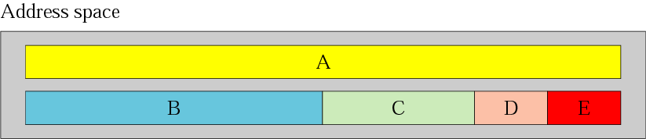
Figure 4.2 Occupation of the address space

Slide 26
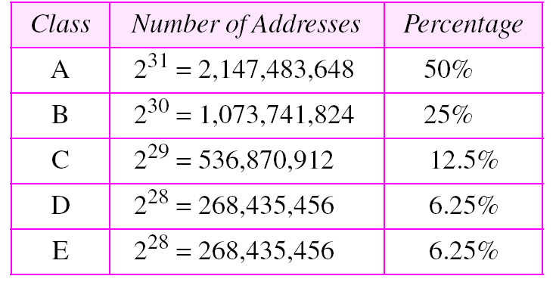
Table 4.1 Addresses per class

Slide 27
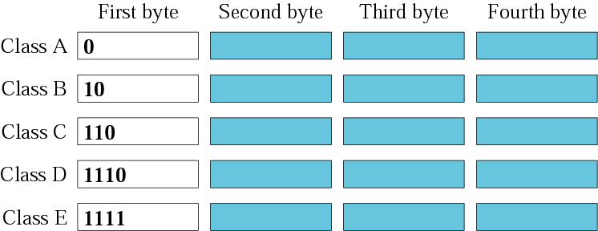
Figure 4.3 Finding the class in binary notation

Slide 28
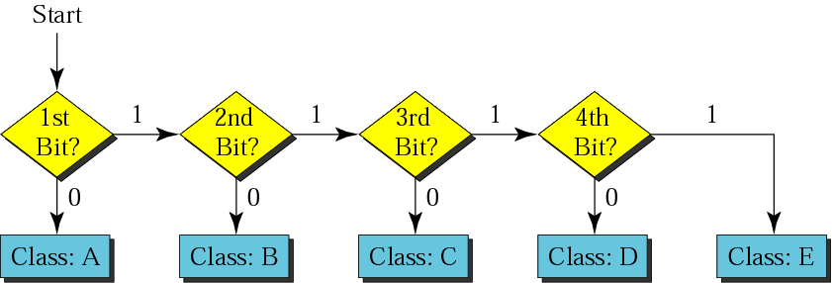
Figure 4.4 Finding the address class

Slide 29
Example 5
How can we prove that we have 2,147,483,648 addresses in class A?
Solution In class A, only 1 bit defines the class. The remaining 31 bits are available for the address. With 31 bits, we can have 2³¹ or 2,147,483,648 addresses.

Slide 30
Example 6
Find the class of each address:
a. 00000001 00001011 00001011 11101111 b. 11000001 10000011 00011011 11111111 c. 10100111 11011011 10001011 01101111 d. 11110011 10011011 11111011 00001111
Solution See the procedure in Figure 4.4. a. The first bit is 0. This is a class A address. b. The first 2 bits are 1; the third bit is 0. This is a class C address. c. The first bit is 0; the second bit is 1. This is a class B address. d. The first 4 bits are 1s. This is a class E address..

Slide 31
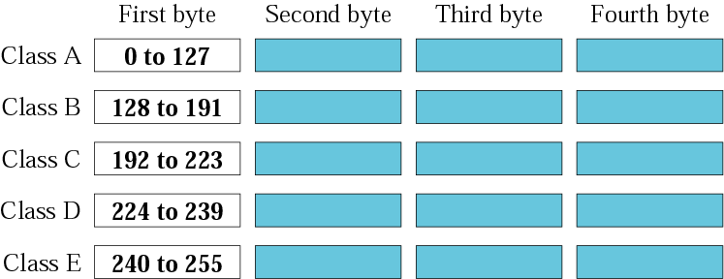
Figure 4.5 Finding the class in decimal notation

Slide 32
Example 7
Find the class of each address:
a. 227.12.14.87 b.193.14.56.22 c.14.23.120.8 d. 252.5.15.111 e.134.11.78.56
Solution a. The first byte is 227 (between 224 and 239); the class is D. b. The first byte is 193 (between 192 and 223); the class is C. c. The first byte is 14 (between 0 and 127); the class is A. d. The first byte is 252 (between 240 and 255); the class is E. e. The first byte is 134 (between 128 and 191); the class is B.

Slide 33
Example 8
In Example 5 we showed that class A has 2³¹ (2,147,483,648) addresses. How can we prove this same fact using dotted-decimal notation?
Solution The addresses in class A range from 0.0.0.0 to 127.255.255.255. We need to show that the difference between these two numbers is 2,147,483,648. This is a good exercise because it shows us how to define the range of addresses between two addresses. We notice that we are dealing with base 256 numbers here. Each byte in the notation has a weight. The weights are as follows:
See Next Slide

Slide 34
Example 8 (continued)
256³, 256², 256¹, 256⁰
Now to find the integer value of each number, we multiply each byte by its weight:
Last address: 127 × 256³ + 255 × 256² + 255 × 256¹ + 255 × 256⁰ = 2,147,483,647
First address: = 0
If we subtract the first from the last and add 1 to the result (remember we always add 1 to get the range), we get 2,147,483,648 or 2³¹.

Slide 35
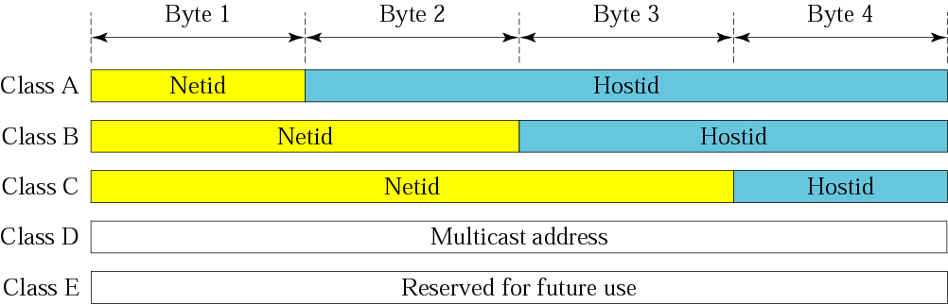
Figure 4.6 Netid and hostid

Slide 36
Note:
Millions of class A addresses are wasted.

Slide 37
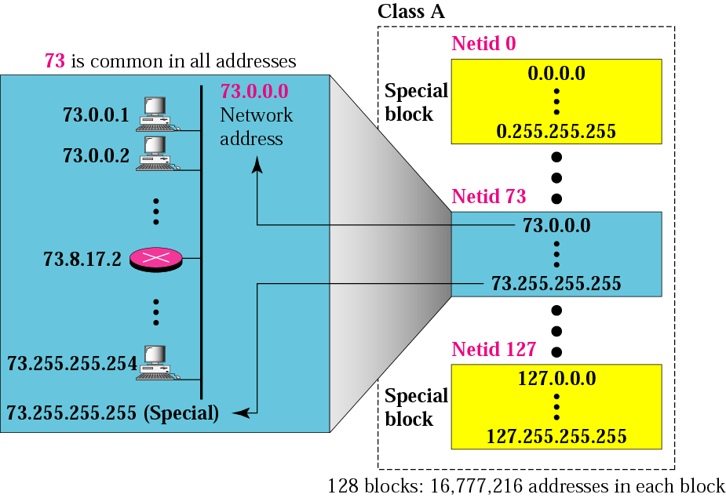
Figure 4.7 Blocks in class A

Slide 38
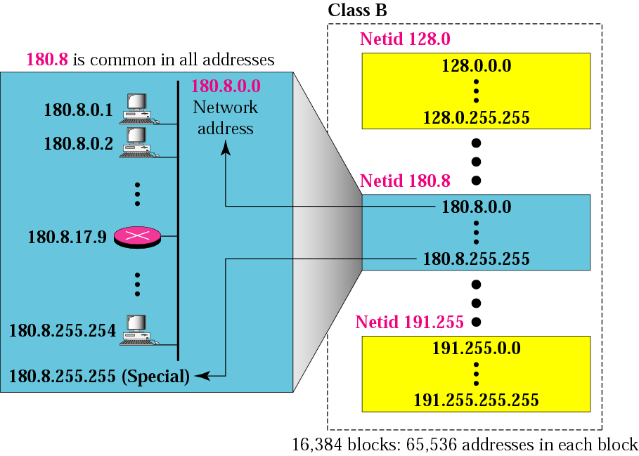
Figure 4.8 Blocks in class B

Slide 39
Note:
Many class B addresses are wasted.

Slide 40

Figure 4.9 Blocks in class C

Slide 41
Note:
The number of addresses in class C is smaller than the needs of most organizations.

Slide 42
Note:
Class D addresses are used for multicasting; there is only one block in this class.

Slide 43
Note:
Class E addresses are reserved for future purposes; most of the block is wasted.

Slide 44
Note:
In classful addressing, the network address (the first address in the block) is the one that is assigned to the organization. The range of addresses can automatically be inferred from the network address.

Slide 45
Example 9
Given the network address 17.0.0.0, find the class, the block, and the range of the addresses.
Solution The class is A because the first byte is between 0 and 127. The block has a netid of 17. The addresses range from 17.0.0.0 to 17.255.255.255.

Slide 46
Example 10
Given the network address 132.21.0.0, find the class, the block, and the range of the addresses.
Solution The class is B because the first byte is between 128 and 191. The block has a netid of 132.21. The addresses range from 132.21.0.0 to 132.21.255.255.

Slide 47
Example 11
Given the network address 220.34.76.0, find the class, the block, and the range of the addresses.
Solution The class is C because the first byte is between 192 and 223. The block has a netid of 220.34.76. The addresses range from 220.34.76.0 to 220.34.76.255.

Slide 48
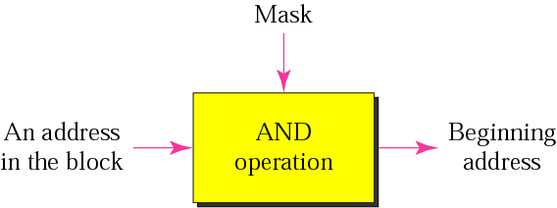
Figure 4.10 Masking concept

Slide 49
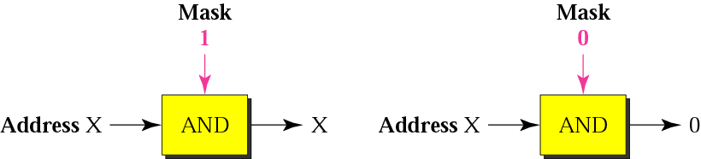
Figure 4.11 AND operation

Slide 50
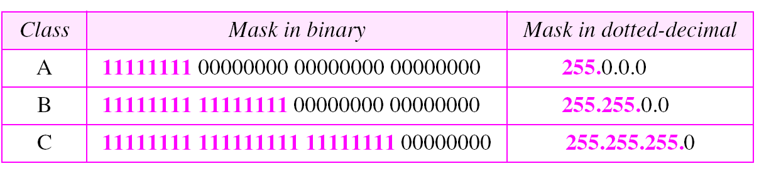
Table 4.2 Default masks

Slide 51
Note:
The network address is the beginning address of each block. It can be found by applying the default mask to any of the addresses in the block (including itself). It retains the netid of the block and sets the hostid to zero.

Slide 52
Example 12
Given the address 23.56.7.91, find the beginning address (network address).
Solution The default mask is 255.0.0.0, which means that only the first byte is preserved and the other 3 bytes are set to 0s. The network address is 23.0.0.0.

Slide 53
Example 13
Given the address 132.6.17.85, find the beginning address (network address).
Solution The default mask is 255.255.0.0, which means that the first 2 bytes are preserved and the other 2 bytes are set to 0s. The network address is 132.6.0.0.

Slide 54
Example 14
Given the address 201.180.56.5, find the beginning address (network address).
Solution The default mask is 255.255.255.0, which means that the first 3 bytes are preserved and the last byte is set to 0. The network address is 201.180.56.0.

Slide 55
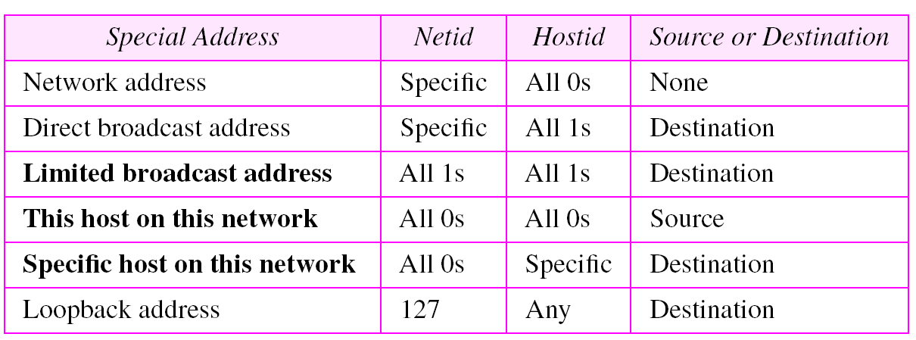
Table 4.3 Special addresses

Slide 56
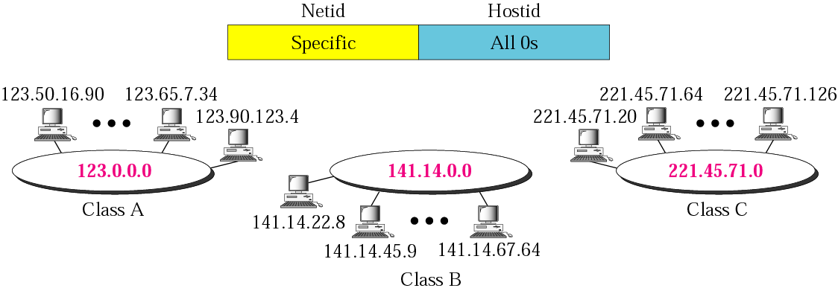
Figure 4.13 Network address

Slide 57
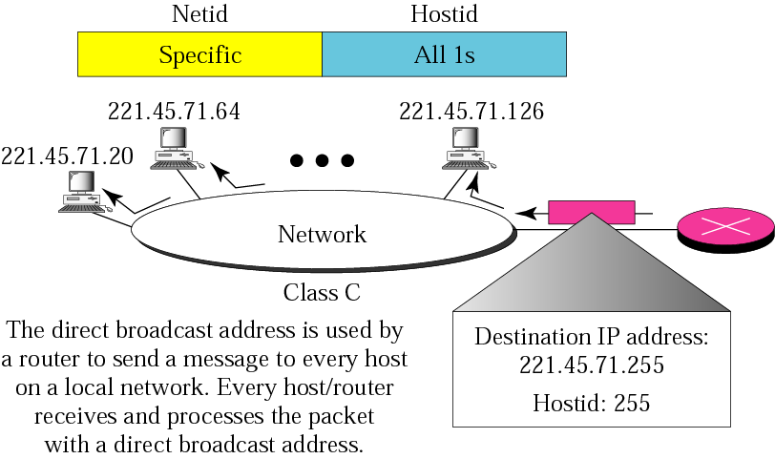
Figure 4.14 Example of direct broadcast address

Slide 58
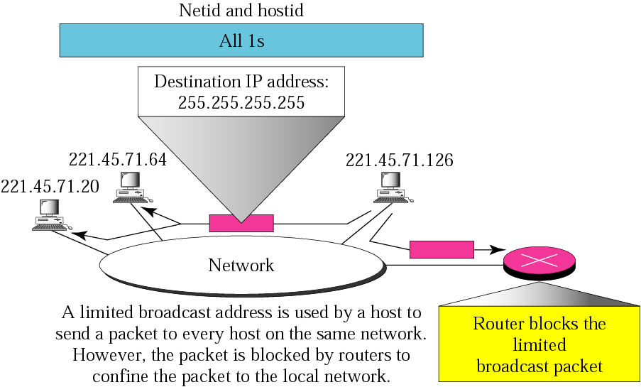
Figure 4.15 Example of limited broadcast address

Slide 59
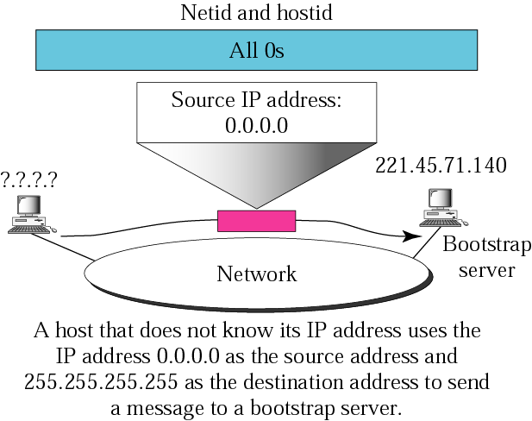
Figure 4.16 Examples of “this host on this network”

Slide 60
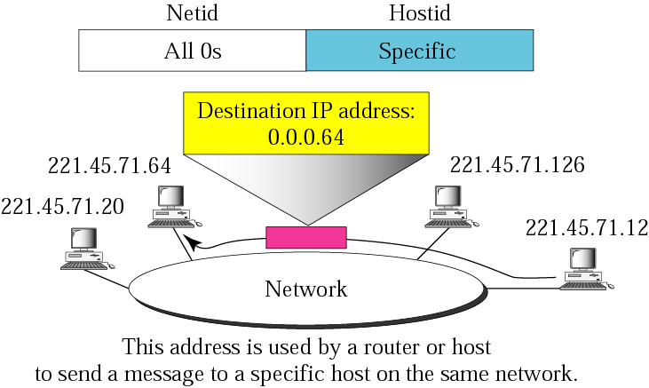
Figure 4.17 Example of “specific host on this network”

Slide 61
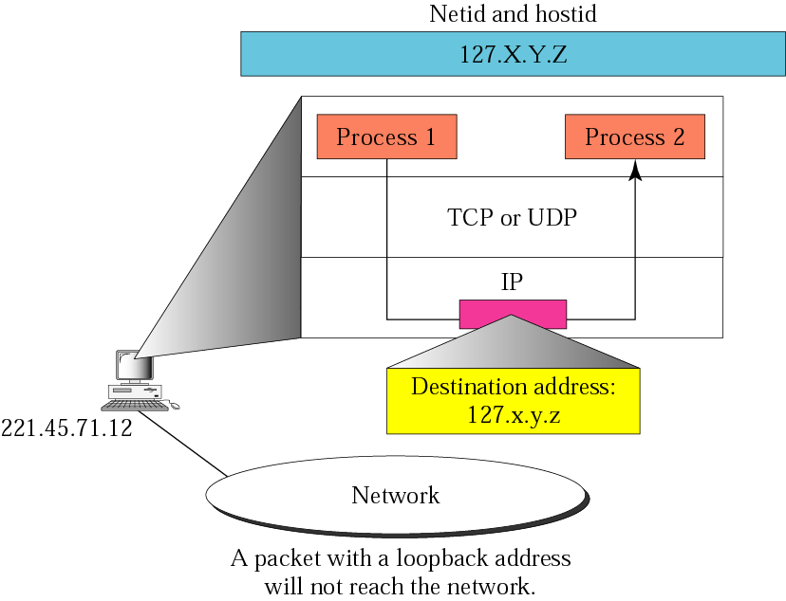
Figure 4.18 Example of loopback address

Slide 62
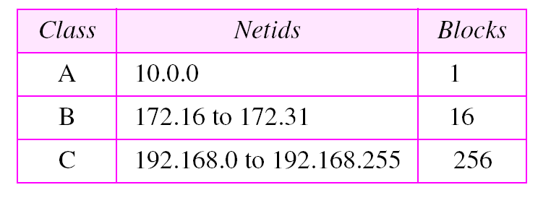
Table 4.5 Addresses for private networks

